Slide 1
How GPT-style AI Could Transform Preventive Medicine
NLP News of the Week
Chloe Barker

Slide 2
The Problem
Patients develop multiple interacting conditions, over time
Most clinical risk tools predict one disease at a time
They often ignore order and timing of diagnoses
Risk is usually detected after damage begins
Key Gap: No unified way to model long-term health trajectories for various conditions

Slide 3
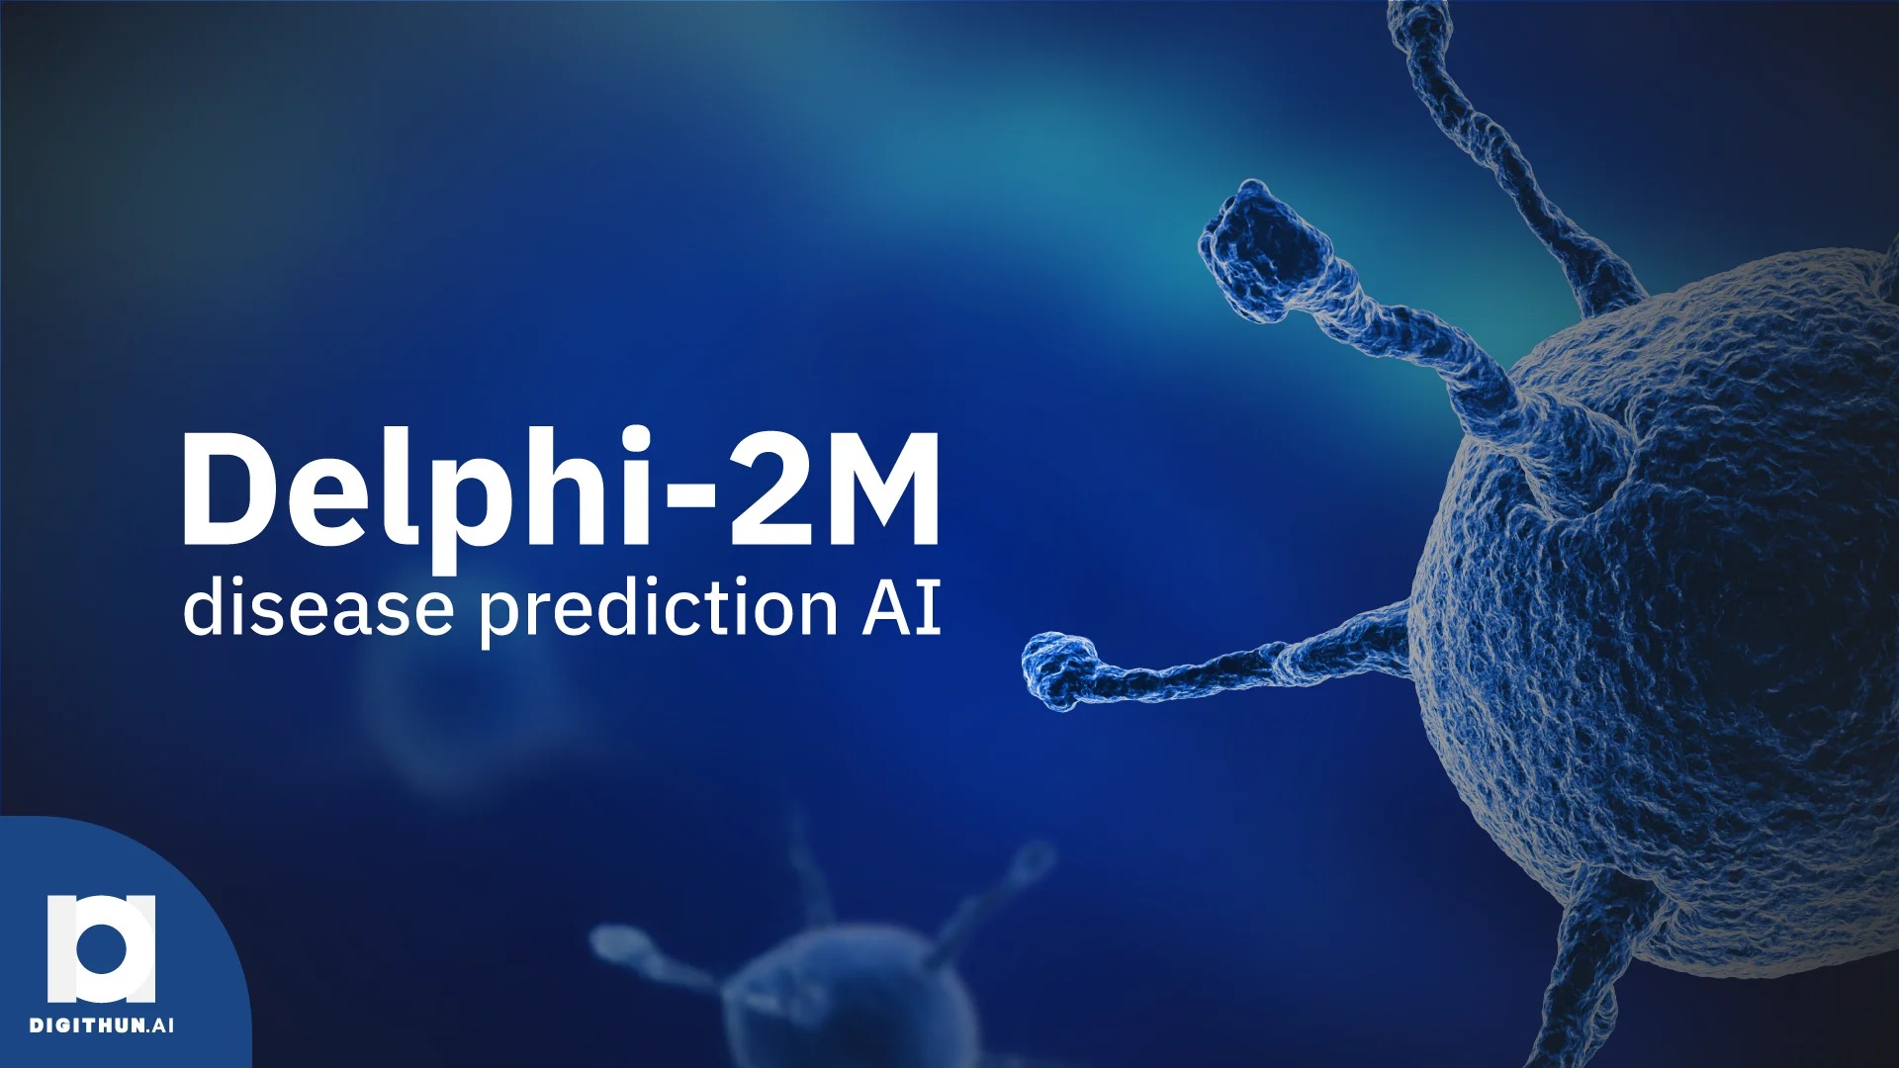
Meet Delphi-2M
Predicts risk for 1,000+ diseases simultaneously
Forecasts disease probability and timing of events, up to 20 years ahead
Built on a modified GPT-style transformer
Treats health history as a sequence

Slide 4
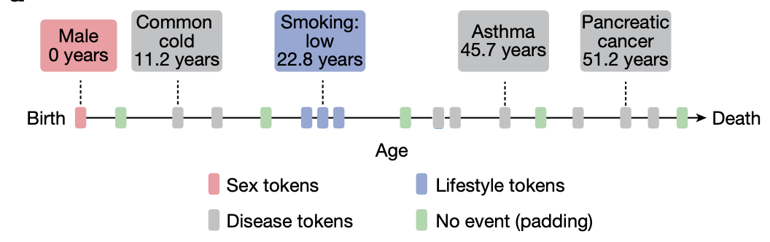
How Delphi-2M Works
Health as Tokens Over Time
Each diagnosis = a token (ICD-10 code)
Tokens are ordered sequentially, by age
Tokens Included:
Sex
Disease
Lifestyle (BMI, smoking, alcohol, etc.)
No event (padding)
Model learns the grammar of disease progression
Sample Figure: Schematic of health trajectories based on ICD-10 diagnoses, lifestyle and healthy padding tokens, each recorded at a distinct age.
Credibility: Training, validation and testing data derived from:
400K UK Biobank participants
1.9M Danish disease registries

Slide 5
Limitations & Ethical Considerations
Limitations:
Ethical Considerations:
Not ready for clinical deployment
Predictions reflect probability, not certainty
Performance varies by disease type
Training data may introduce demographic bias
Raises ethical questions about potential future risk
Privacy and governance of sensitive health data

Slide 6
Why This Matters for Prevention
Enables earlier identification of high-risk individuals
Supports preventive screening before symptoms
Allows population-level forecasting
Shifts medicine from reactive → preventive
Shows how NLP models can predict health trajectories
Delphi-2M reframes healthcare as a sequence modeling problem
Transformers can learn the structure of disease over time
A major step toward AI-driven preventive medicine
Delphi-2M predicts not just WHAT is coming, but also WHEN

Slide 7
Thanks!
Do you have any questions?
chloebarker@smu.edu

Slide 8
References
Shmatko, A., Jung, A.W., Gaurav, K. et al. Learning the natural history of human disease with generative transformers. Nature 647, 248–256 (2025). https://doi-org.proxy.libraries.smu.edu/10.1038/s41586-025-09529-3

