Slide 1




MetaSky: Bringing the Sky into the Metaverse
A Radical Transformation of Meta’s Physical Product Ecosystem
By Chloe Barker

Slide 2





Imagine Seeing Beyond Your Vision
01
02
03
04
Imagine you're in a natural disaster.
Your Meta Ray-Bans stream your POV to a drone, which transmits coordinates to emergency crews in real time.
Imagine you're a homebuilder.
A drone gives you a 360° AR view of a pool in your future backyard before construction begins.
Imagine you're a farmer.
A Meta drone tracks destructive animals and monitors crop health from above.
Imagine you're a content creator or influencer.
Your followers see both your POV and a cinematic drone shot - perfectly synced in real time.

Slide 3

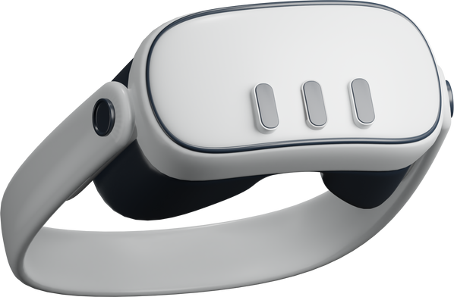




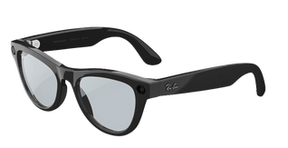
MetaQuest
Introducing MetaSky
Smart, Seamless, Aerial - Meet MetaSky
MetaSky
Syncs with Ray-Ban Stories and MetaQuest for real-time AR and POV integration.
01
Reality Labs
02
Posts instantly to Instagram, Facebook, and WhatsApp - no delay, no transfer.
03
Controlled intuitively through your phone, by voice, with hand gestures, or directly through MetaQuest.
Meta Ray-Bans
04
Snap, Stream, Scout - from above.

Slide 4






Why Meta is Uniquely Positioned
Feature | Google | Apple | DJI | Meta
Social Media Integration
AR/VR Hardware
AI + GenAI Power
Drone Tech Experience
Ray-Ban Stories and MetaQuest
POV Streaming, AR overlays + drone footage in games
Past VR/AR Success and Investment into the future
Vast Social Media Presence
Seamless uploading and posting
Object detection, tracking, 3D mapping
AI Engine and high tech capabilities

Slide 5
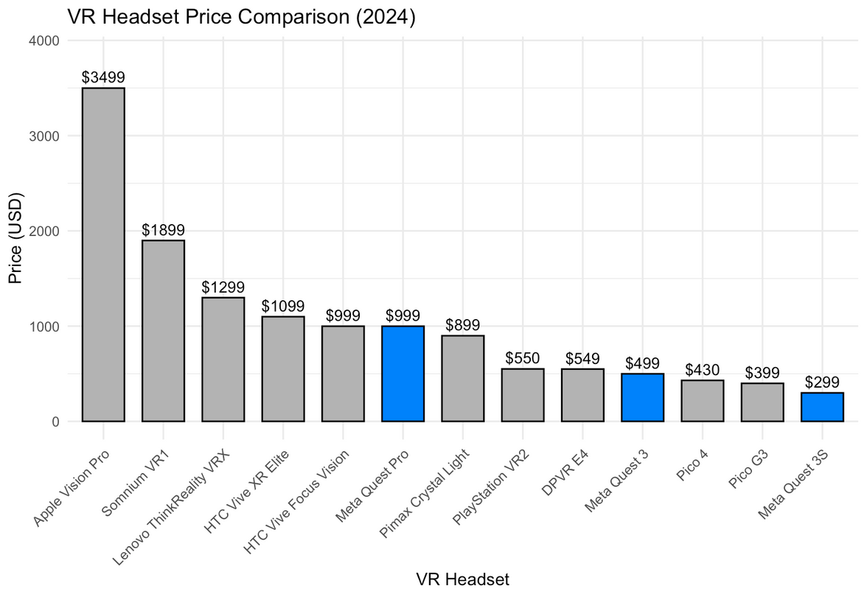
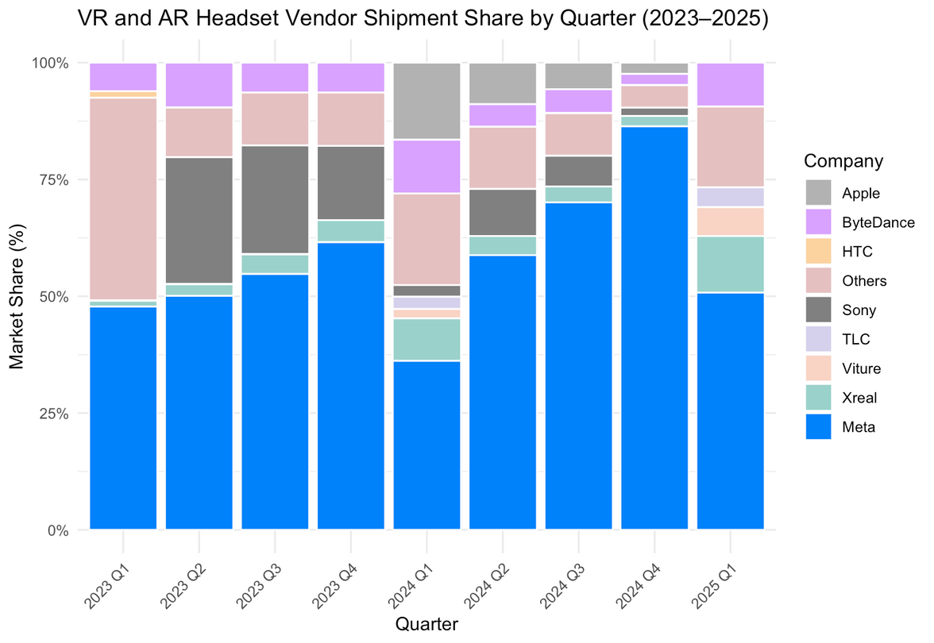
Meta’s Dominance in AR/VR
MetaQuest offers the most affordable mainstream VR headset - broad adoption at low cost.
Meta maintains dominant market share and shipment volume in immersive tech.
Virtual Reality (VR)
Augmented Reality (AR)
Fully immersive digital environments via headsets.
Fully immersive digital environments via headsets.

Slide 6



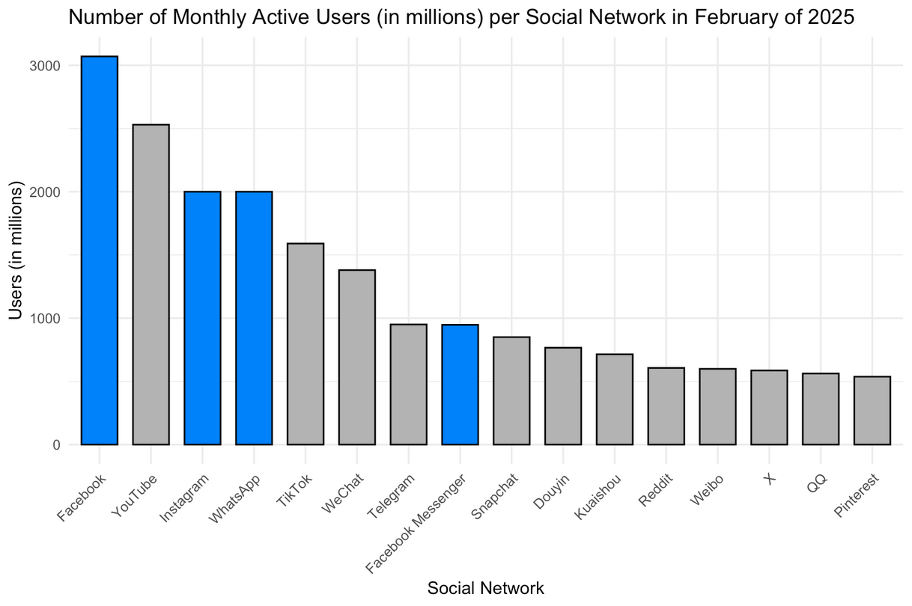



The Advantage of being a Social Superpower
Current Drone Market Landscape
DJI Drone | Retail Price
DJI Inspire 3 | 16,499
DJI Mavic 3 Pro | 2,199
DJI Mavic 3 Classic | 1,279
DJI Air 3 | 1,099
DJI Avata 2 | 999
DJI Mini 4 Pro | 759
Facebook leads globally, and Meta owns 3 of the top 5 platforms.
Meta’s social dominance + drone innovation = new revenue streams from content creators and beyond.

Slide 7
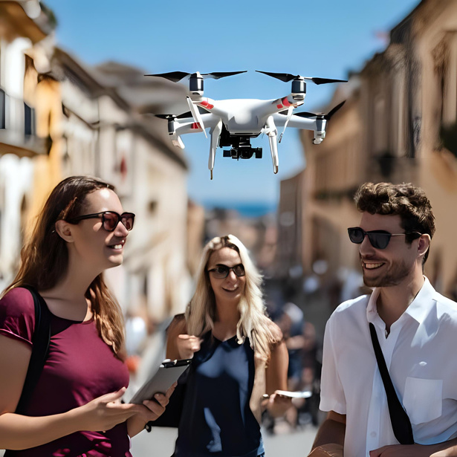


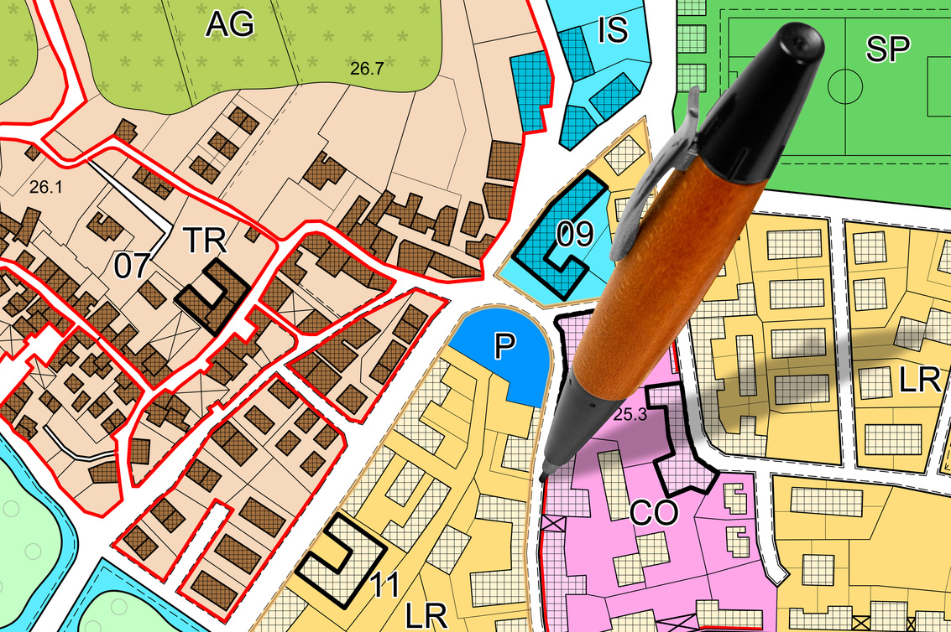

MetaSky in Action: Who Benefits
Existing Meta Users
Seamless integration into Meta’s immersive ecosystem
New Target User Segments & Impact
Influencers, Creators, & Leisure
Search & Rescue Teams
Farmers & Environmentalists
Urban Planners & Developers
Tourists, Educators, & AR Explorers
Syncs drone footage with POV content
Instant uploads to social platforms
New formats for vlogs, travel, and events
Higher engagement with multi-angle streaming
Thermal imaging and live aerial views
Real-time object tagging and tracking
Crop monitoring
Animal tracking
Irrigation analysis
Wildfire detection
3D mapping
Construction tracking
AR simulations of future builds
Drone-guided tours with AR overlays
Live-streamed lessons and immersive learning
MetaSky expands Meta’s impact - from creators to communities, entertainment to emergency response.

Slide 8



Launch Plan and Roadmap
01
Fund MetaSky Research & Development
02
Test creator & emergency pilot programs
Leverage Reality Labs to fast-track development od drone-AI integration.
Partner with influencers and crisis teams to test real-world applications.
03
Launch with
Ray-Ban Stories 3 + MetaQuest 4
04
Security and Safety
Transparent AI decisions
Fair and unbiased algorithms
Data security and privacy by design
Protection from misuse and unintended consequences
Maximize synergy with new hardware rollouts.
A responsible rollout ensures trust, safety, and long-term value.

Slide 9








The future isn’t just immersive - it’s elevated.
Lets Put Meta into
the Sky!
THANK
YOU
QUESTIONS?
LinkedIn
@chloedbarker
Email Address
chloebarker@smu.edu

Slide 10
References
IDC. (June 18, 2025). Augmented reality (AR) and virtual reality (VR) headset companies shipment share worldwide from 2023 to 2025, by quarter [Graph]. In Statista. Retrieved July 24, 2025, from https://www-statista-com.proxy.libraries.smu.edu/statistics/1407105/ar-vr-headset-companies-shipment-share/
We Are Social, & DataReportal, & Meltwater. (February 5, 2025). Most popular social networks worldwide as of February 2025, by number of monthly active users (in millions) [Table]. In Statista. Retrieved July 24, 2025, from https://www-statista-com.proxy.libraries.smu.edu/statistics/272014/global-social-networks-ranked-by-number-of-users/
VRcompare. (October 23, 2024). Comparison of virtual reality (VR) headsets worldwide in 2024, by price (in U.S. dollars) [Graph]. In Statista. Retrieved July 24, 2025, from https://www-statista-com.proxy.libraries.smu.edu/statistics/1337123/vr-headset-comparison-by-price/

