Slide 1
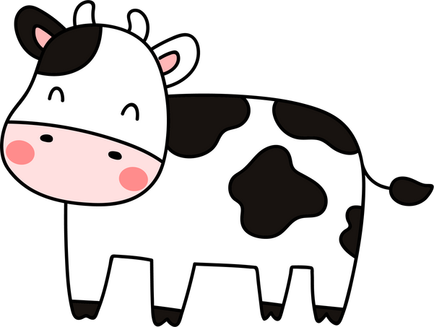
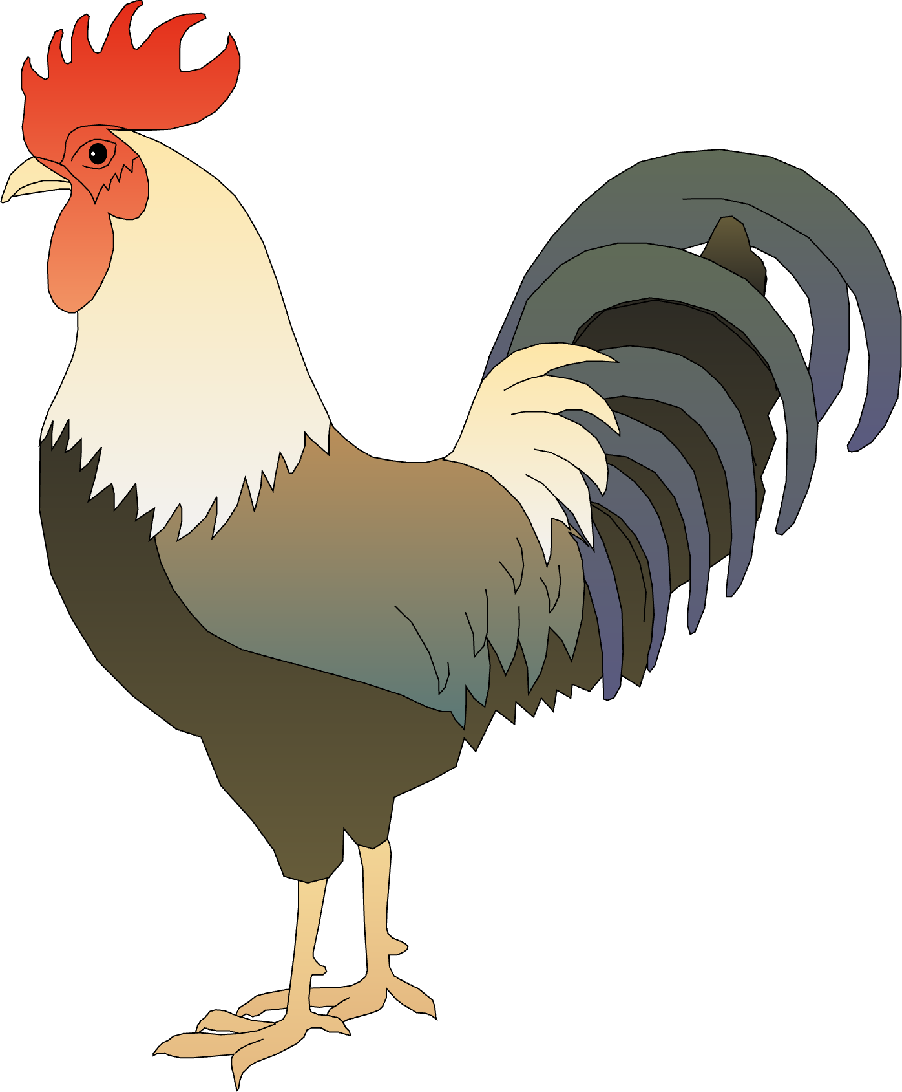
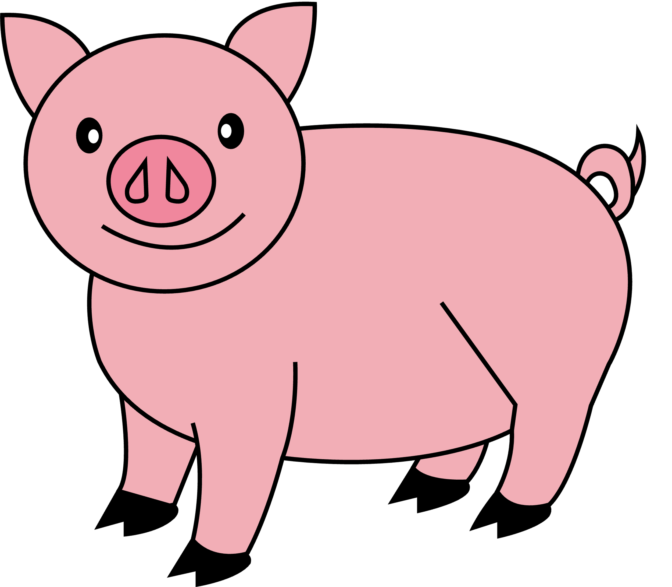
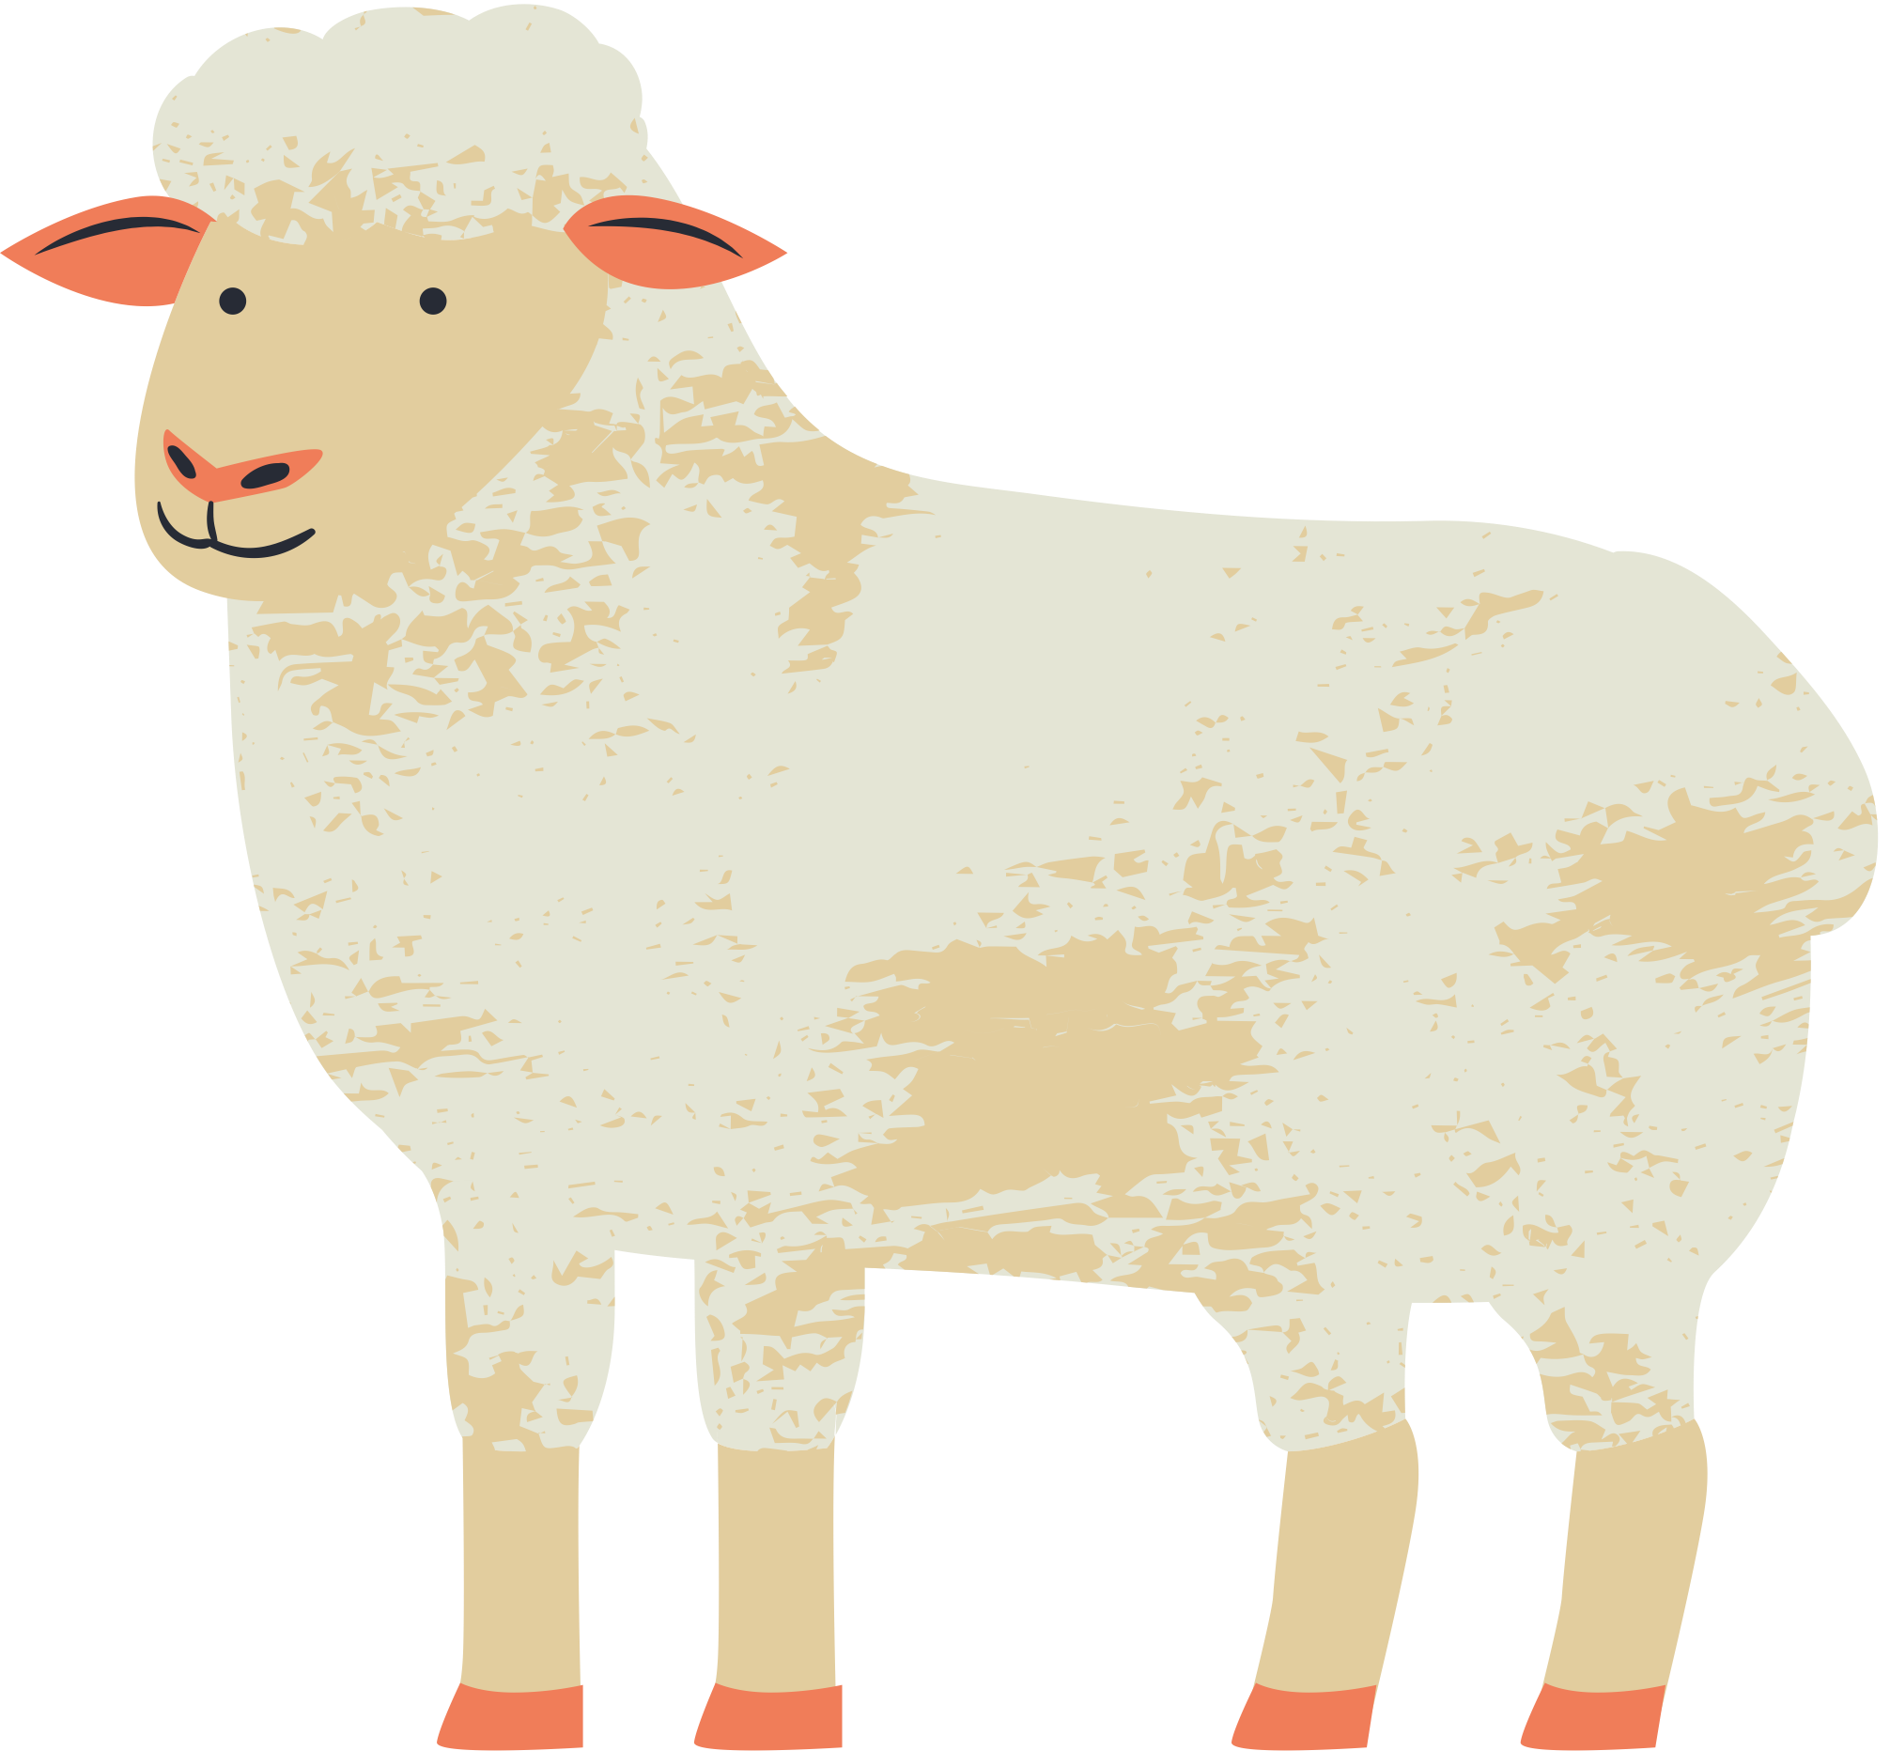
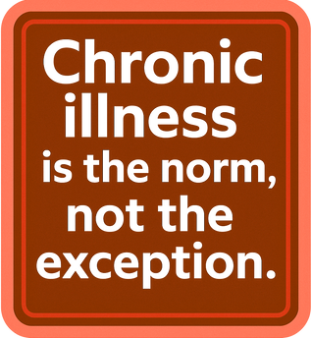




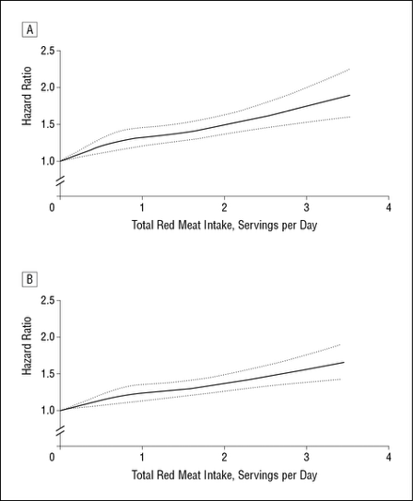
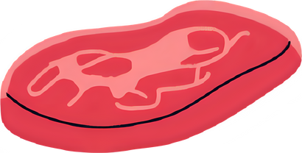
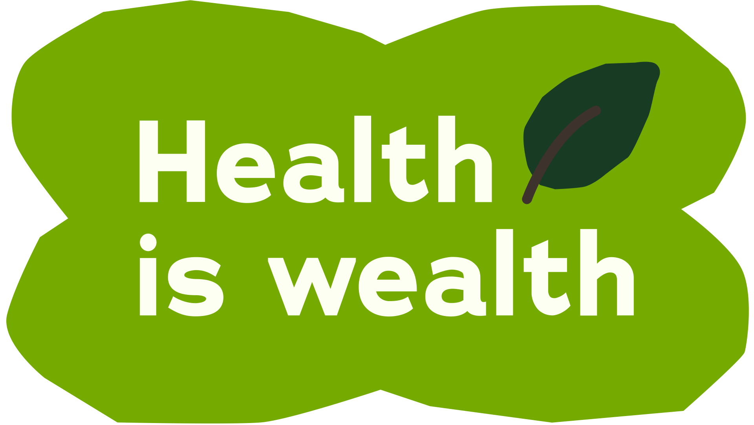





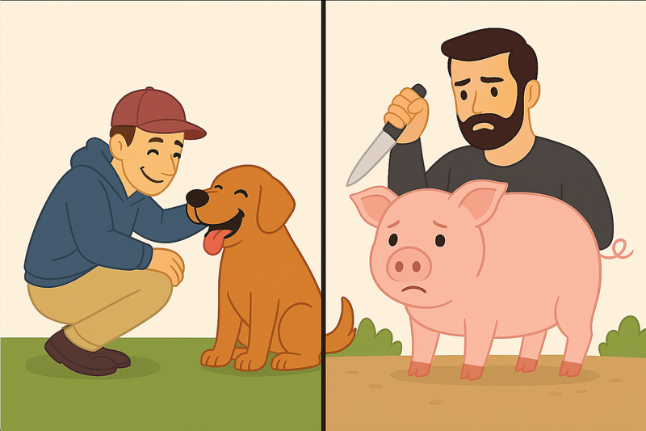


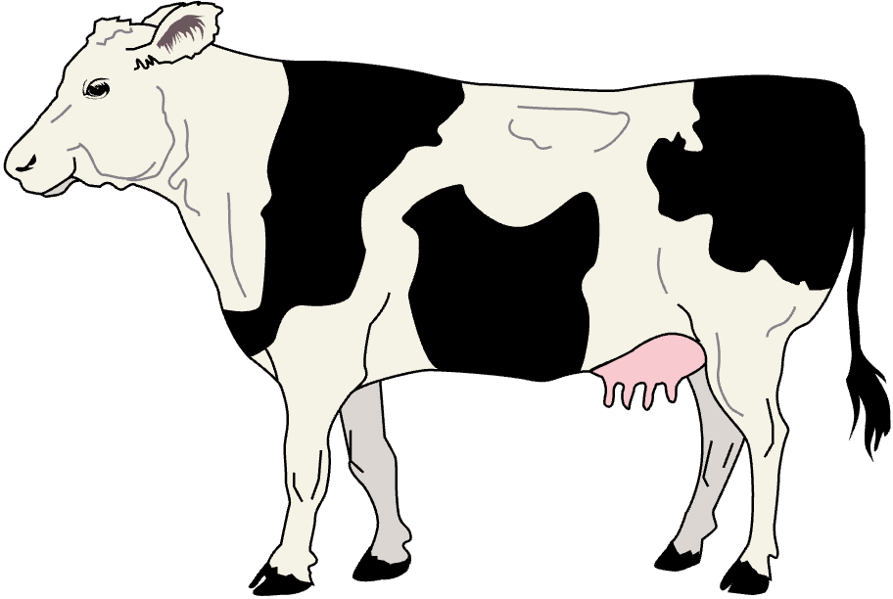


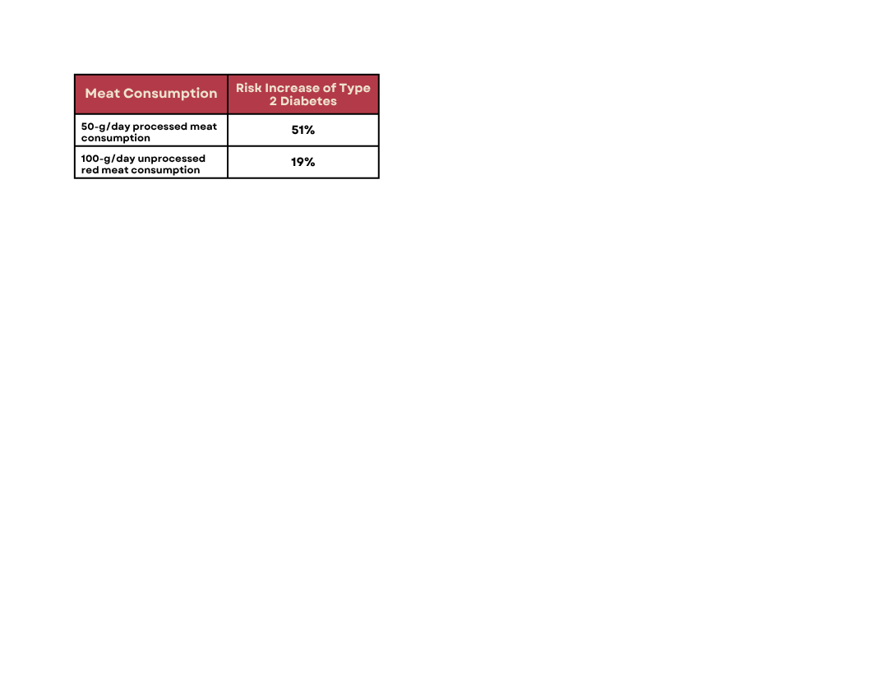
Compassion Heals
How Plant-Based Diets Can Prevent Disease and Protect Animals
Chloe Barker
Chronic Disease in America
6 in 10 young adults (59.5%)
8 in 10 midlife adults (78.4%)
9 in 10 older adults (93.0%)
The top three leading causes of death in the U.S include:
heart disease
diabetes
cancer
Reported having at least one chronic condition (CDC, 2023)
Meat and Mortality
More red meat = Higher mortality risk
NURSES' HEALTH STUDY
(1976-2008, N = 83,644 WOMEN AGED 30-55 YEARS)
HEALTH PROFESSIONALS FOLLOW-UP STUDY
(1986-2008, N = 37,698 MEN AGED 40-75 YEARS)
Red meat is linked to:
Increased mortality rate
Higher risk of cancer and cardiovascular disease
Plants Can Prevent It
What is a plant-based diet?
A plant-based diet focuses on whole foods from plants - vegetables, fruits, legumes, grains, nuts, and seeds - and minimizes consumption of animal products.
Supported by the American Dietetic Association as nutritionally adequate for all life stages.
Plant-based diets can reduce risk of:
↓ Cardiovascular Disease by 30% (Huang et al., 2012)
↓ Type 2 Diabetes by 25% (Satija et al., 2016)
↓ Colorectal Cancer by 20%
↓ Hypertension, Kidney Disease, Acne (Hou et al., 2022; Fusano, 2023)
↓ Inflammation and Obesity (Menzel et al., 2020)
↓ Harmful compounds like TMAO (Constantino-Jonapa et al., 2023)
Vegetarian & vegan diets are associated with decreased mortality rates and reduced risk for chronic diseases.
Beyond Your Plate
I love life!
83 billion animals are slaughtered for meat production globally per year (FAOUN)
Over 1 million animals are eaten per hour in the U.S. (USDA)
Ethical concern: Why do we love some animals and eat others?
I want to
love life too.
ANIMAL AGRICULTURE: THE HIDDEN COST OF OUR PLATES.
Takeaway & Action
Why It Matters
What You Can Do Today
You can improve your health.
You can save animal lives.
You can lower your footprint.
Compassion is contagious & feeling good is forever.
Start small: Try Meatless Mondays
Explore swaps like lentils, tofu, or chickpea pasta to meet nutritional needs.
Focus on progress, not perfection.
Share this info.
References
CDC, Constantino-Jonapa et al., 2023, Food and Agriculture Organization of the United Nations, Fusano, 2023, Hou et al., 2022, Huang et al., 2012, Menzel et al., 2020, Pan et al., 2012, Satija et al., 2016, USDA
Contact Information:
chloebarker@smu.edu
www.linkedin.com/in/chloedbarker

