Slide 1
Preventing Readmissions
Diabetes Transitional Care Resource Allocation System
Chloe Barker
Notes:
Hi, I am Chloe Barker. My project is a diabetes transitional-care resource allocation system.
The one-sentence version is this: this is not just a model that predicts readmission. It is a decision-support tool that helps a hospital decide who gets help first when it does not have the staff or budget to help everyone intensively.

Slide 2
Today’s Agenda and Outcomes
From predicting readmission to deciding how to use limited care-management capacity
PROJECT AT A GLANCE
Problem
Decision
Solution
Recommendation
Hospitals cannot provide intensive post-discharge support to every diabetes patient.
Which diabetes patients should receive enhanced support first?
Rank patients by readmission risk and test capacity/cost scenarios.
Pilot as decision support with human review, not automated clinical decision-making.
Notes:
Here is the whole project in one slide. Hospitals cannot give intensive post-discharge support to every diabetes patient, so the real decision is which patients should receive support first.
My solution ranks patients by 30-day readmission risk and lets a care team test capacity and cost scenarios. There are three pieces to follow: the model answers who to prioritize, the RAG guidance tool helps answer what actions to consider, and the cost model helps answer whether the plan is worth it.
My recommendation, which I will come back to at the end, is to pilot this as decision support with a person always making the final call.

Slide 3
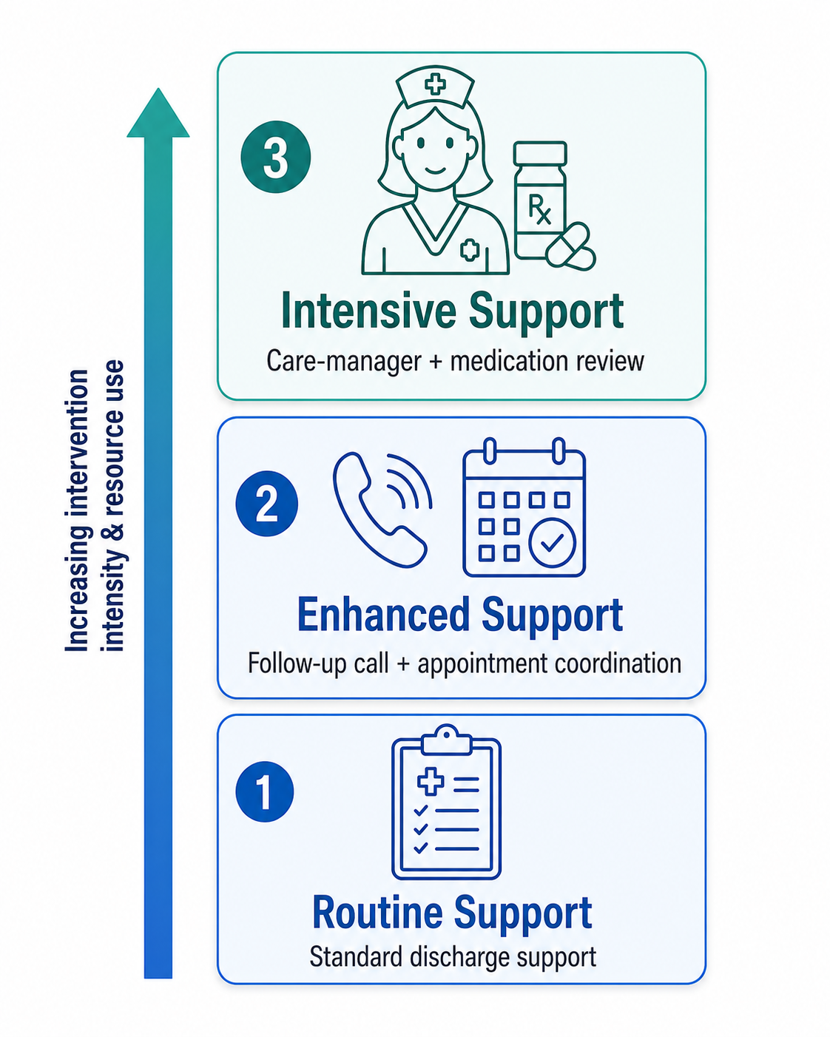
Business Problem & Stakeholder
Primary stakeholder:
Director of Care Management / Transitional Care Manager
Core constraint:
Limited staff, intervention slots, and budget
Decision:
Prioritize eligible diabetes discharges for the appropriate level of transitional-care support
KPI:
Recall@Capacity: How many actual readmissions are captured within the number of patients the team can serve?
Secondary Metrics:
Precision@Capacity · Lift · Expected Net Value
Notes:
This is built for a Director of Care Management or a Transitional Care Manager. Their real constraint is not just information. It is capacity: limited staff, limited intervention slots, and limited budget.
So the question is not only, “Will this patient be readmitted?” The better business question is, “Who should get our limited available support first?”
That is why my primary KPI is recall at capacity. In plain terms, out of all patients who actually get readmitted, how many did we capture inside the number of patients the team can realistically serve? I also track precision, lift, and expected net value to make the model useful for an operational decision.

Slide 4
FACE Framework
Start from the discharge-support decision, not the dataset, then analyze, communicate, and execute against it.
F
A
Frame
Analyze
Prioritize limited transitional-care resources for patients at highest readmission risk.
Clean and engineer data, compare models, evaluate ranking, build RAG, and estimate value.
C
E
Communicate
Execute
Ranked worklist, risk tiers, capacity metrics, cost scenarios, and cited guidance.
Pilot with care managers, validate locally, and monitor performance, fairness, and outcomes.
Notes:
I used Davenport’s FACE framework to keep this business-first rather than model-first.
Frame means starting with the care-management decision: how to prioritize limited transitional-care resources.
Analyze means cleaning the UCI diabetes data, engineering features, comparing models, evaluating ranking performance, building the RAG guidance component, and estimating cost and value.
Communicate means turning the analysis into a ranked patient list, risk tiers, scenario outputs, and cited guidance a stakeholder can actually understand.
Execute means this should be piloted carefully with care managers, validated on local data, and monitored for performance, fairness, calibration, and outcomes.

Slide 5
DELTA Framework
DELTA Plus Readiness: Useful Prototype, Not Production-Ready Yet
DELTA Plus: 7-Element Framework
D
Data | Large but historical (1999 to 2008), with missing values and no intervention outcomes.
E
Enterprise | Fits existing discharge-planning and care-management workflows.
L
Leadership | Requires care management, nursing, pharmacy, IT, compliance, and finance support.
T
Targets | Readmissions captured within capacity, targeting efficiency, and expected net value.
T
Technologies | Python, scikit-learn, Gradio/Hugging Face, embeddings, and vector search.
A
Analysts | Data science + clinical + care-management + finance expertise.
A
Analytical Techniques | Classification, calibration, capacity metrics, RAG, and break-even analysis.
Notes:
The DELTA Plus assessment is basically the readiness reality check. My conclusion is that this is a useful prototype, but not production-ready yet.
The data is large, but it is historical, from 1999 to 2008, and it does not include actual transitional-care intervention outcomes. That is the biggest limitation.
Real use would require support from care management, nursing, pharmacy, IT, compliance, and finance. It would also require a reliable technology stack for the model, the dashboard, RAG retrieval, monitoring, and governance.

Slide 6
Data and Methodology
Dataset: UCI Diabetes 130-US Hospitals dataset
101,766 encounters
Diabetes inpatient encounters from 130 U.S. hospitals
Cleaned decision population:
99,340 eligible encounters
After excluding hospice and expired discharge dispositions
Target:
Readmitted within 30 days = 1
Otherwise = 0
11.4% readmission rate
Imbalanced dataset
Feature engineering:
Prior utilization, medication activity, length of stay, discharge/admission groups, A1C, ICD-9 chapters.
Notes:
The main dataset is the UCI Diabetes 130-US Hospitals dataset. It starts with 101,766 inpatient encounters across 130 hospitals.
I cleaned it down to 99,340 eligible encounters after removing hospice and expired discharge dispositions, because those encounters do not match the preventable readmission decision.
The target is binary: readmitted within 30 days equals 1, and otherwise equals 0. Only about 11.4 percent of the cleaned encounters were readmitted within 30 days, so this is an imbalanced problem.
The features focus on practical readmission-risk signals: prior inpatient, emergency, and outpatient visits; medication activity; length of stay; admission and discharge context; A1C result; and diagnosis categories.

Slide 7
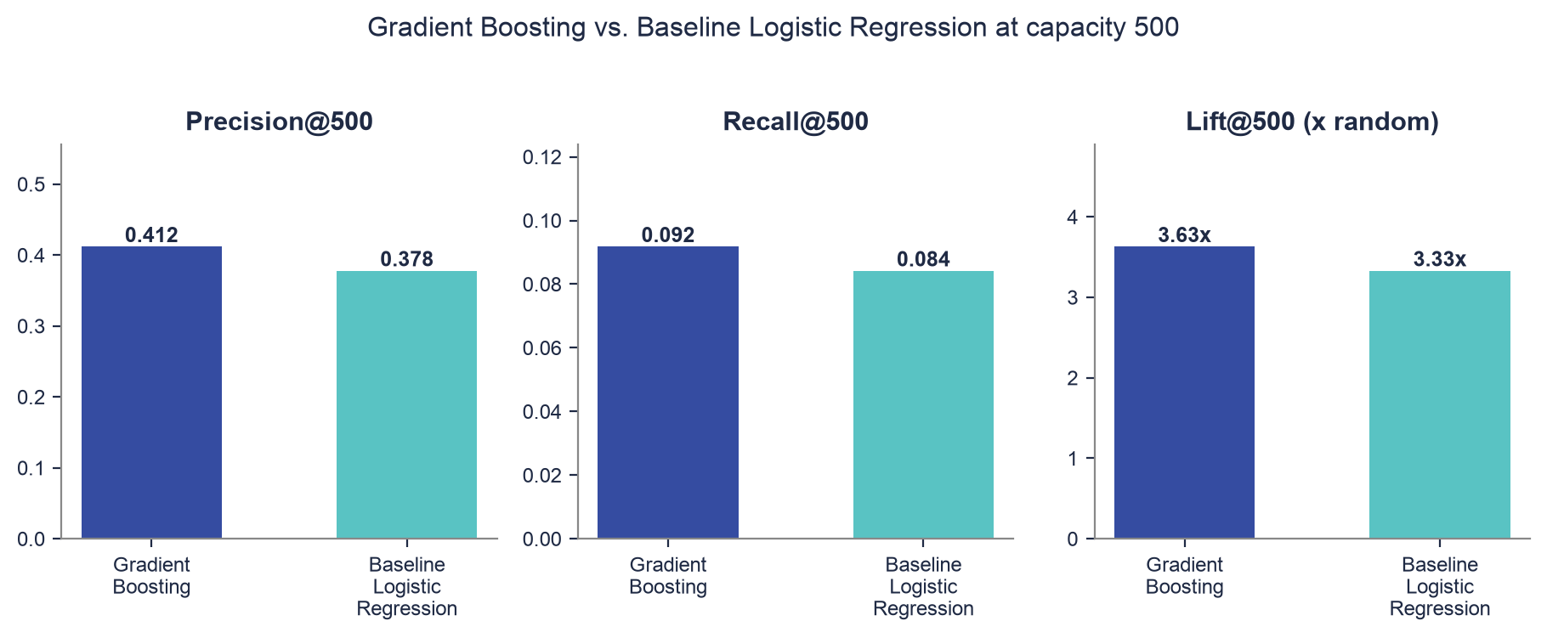
Model Selection: Gradient Boosting
Best fits the 500-patient capacity decision
At 500 intervention slots:
40.8% Precision: about 2 in 5 selected patients were readmitted
9.1% Recall: captured about 1 in 11 of all readmissions
3.6× Lift: identified readmissions 3.6× better than random selection
204 to 210 Readmissions Captured
Why Gradient Boosting?
Captured the most readmissions within the available 500 slots
Best aligned with the goal of using limited care-management resources efficiently
Notes:
Because only about 1 in 9 patients are readmitted, accuracy is not enough. A model could look accurate by mostly predicting “not readmitted,” but that would not help care management decide who to serve.
So I evaluated the model at capacity, because the care-management team can only handle a limited number of patients.
At 500 intervention slots, the current calibrated Gradient Boosting model has about 40.8 percent precision. That means about 2 in 5 selected patients were actually readmitted.
Recall at 500 is about 9.1 percent. That may sound low at first, but remember this is the top 500 patients out of a much larger test population. The model is capturing a focused high-risk slice.
Lift is about 3.6 times, meaning the selected worklist is about three-and-a-half times richer in readmissions than picking patients at random. Gradient Boosting won because it best matched the fixed-capacity triage decision.

Slide 8
Risk Tiers Turn Scores Into Care Workflows
Low Risk 6.5% observed readmission rate n = 9,887 Routine support
Medium Risk 11.4% observed readmission rate n = 5,934 Enhanced follow-up
High Risk 23.3% observed readmission rate n = 3,952 Prioritized review for intensive support
High-risk patients readmitted at 3.6× the rate of low-risk patients.
Risk tier defines priority; available capacity determines how many patients are actually served.
Risk Tier | Number of Patients | Observed 30-Day Readmission Rate
Low | 9,887 | 6.50%
Medium | 5,934 | 11.40%
High | 3,952 | 23.30%
Notes:
Risk tiers translate model scores into a workflow a care manager can use.
The low-risk group has an observed readmission rate around 6.5 percent and would generally receive routine support. The medium-risk group is around 11.4 percent and may receive enhanced follow-up. The high-risk group is around 23.3 percent, nearly 1 in 4, so those patients are prioritized for intensive review.
The important point is that the tier creates priority, but capacity determines how many patients are actually served. The model supports the decision. It does not replace clinical judgment.

Slide 9
RAG Connects Risk Scores to Care Guidance
Sources: CMS HRRP + AHRQ Project RED/discharge resources
Retrieval: MiniLM embeddings + FAISS vector search
Fallback: TF-IDF retrieval if embeddings are unavailable
Topics: medication reconciliation, follow-up, education, coordination
Ask: Care manager asks a discharge or care-transition question
Retrieve: Find relevant passages from approved CMS/AHRQ documents
Generate: Produce a concise answer with source and page citations
Apply: Care manager considers the guidance when planning follow-up
Model = who to prioritize RAG = what evidence-based actions to consider
Notes:
The model tells the care manager who to prioritize. The RAG component helps answer what evidence-based actions to consider.
RAG stands for retrieval-augmented generation. I would explain it as a search-and-answer tool that only uses approved documents, rather than a general chatbot.
In this project, the sources are CMS HRRP materials and AHRQ Project RED or discharge-planning resources. A care manager asks a question, the system retrieves relevant passages, and then it produces a short answer with the source title, page, and snippet.
That source grounding matters because this is healthcare decision support. The answer needs to be traceable, not just fluent.

Slide 10
Fine-Tuning Pipeline: Business Evaluation
2,000 labeled prompts
Structured encounters were converted into text-based readmission examples.
Binary Target
Readmitted within 30 days vs. not readmitted within 30 days
Leakage Control
Evaluation remained patient-grouped.
Common Scorecard
Compare models using PR-AUC, Recall@500, calibration, and expected net value.
Goal
Determine whether a text-based classifier improves the actual care-management decision.
Structured Encounter → Text Prompt → Readmission Classifier → Business Metrics
Notes:
The project also required a fine-tuned readmission classifier. To do that, I converted structured patient encounters into short text-style prompts.
I trained on 2,000 labeled examples and evaluated on a held-out patient-grouped test set. The patient grouping matters because the same patient should not appear in both training and testing.
I evaluated the prompt classifier with the same business scorecard as the tabular model: PR-AUC, recall at 500, calibration, and expected net value.
The point was not just to satisfy a course requirement. The real question was whether a text-based classifier actually improves the care-management decision.

Slide 11
Fine-Tuned Readmission Classifier: Model Comparison
Metrics | Gradient Boosting | Prompt Text Model
PR-AUC | 0.241 | 0.147
Recall@500 | 9.10% | 5.10%
Readmissions Captured | 204 | 115
Expected Net Value | +$113.7K | −$14.3K
Gradient Boosting remained the better model for the resource-allocation decision.
Notes:
The honest result is that the fine-tuned prompt classifier was completed, saved, and compared, but it did not beat the tabular model.
Gradient Boosting had a PR-AUC of about 0.241, compared with 0.147 for the prompt text model. Recall at 500 was about 9.1 percent for Gradient Boosting versus 5.1 percent for the prompt classifier.
In actual readmissions captured, that is 204 for Gradient Boosting compared with 115 for the prompt classifier.
The financial comparison makes the recommendation even clearer. Under the default assumptions, Gradient Boosting creates about $113,700 in expected net value, while the prompt classifier is negative, around negative $14,300.
So Gradient Boosting stays the triage engine. The fine-tuned model is still valuable as a required comparison, but it is not the better operational choice for this structured-data problem.

Slide 12
Cost & Value: Scenario Assumptions
Turning cost and effectiveness assumptions into a net-value estimate
Assumptions
$15,000 Assumed cost per readmission
What the Assumptions Produce
Expected Net Value
Avoided readmission cost − intervention cost
$300 Assumed intervention cost per patient
10% Assumed intervention effectiveness
Break-Even Question
How effective must the intervention be, or how targeted must the worklist be, for expected savings to exceed cost?
500 Available intervention slots
These are adjustable scenario assumptions, not measured financial outcomes.
Notes:
Every number on the next slide comes from four adjustable assumptions.
The defaults are $15,000 per readmission, $300 per intervention, 10 percent intervention effectiveness, and 500 available intervention slots.
Net value is avoided readmission cost minus intervention cost.
The break-even question is: how effective does the intervention need to be for savings to exceed cost?
These are scenario assumptions, not measured financial outcomes. A real hospital would adjust them using its own costs, staffing model, and intervention evidence.

Slide 13
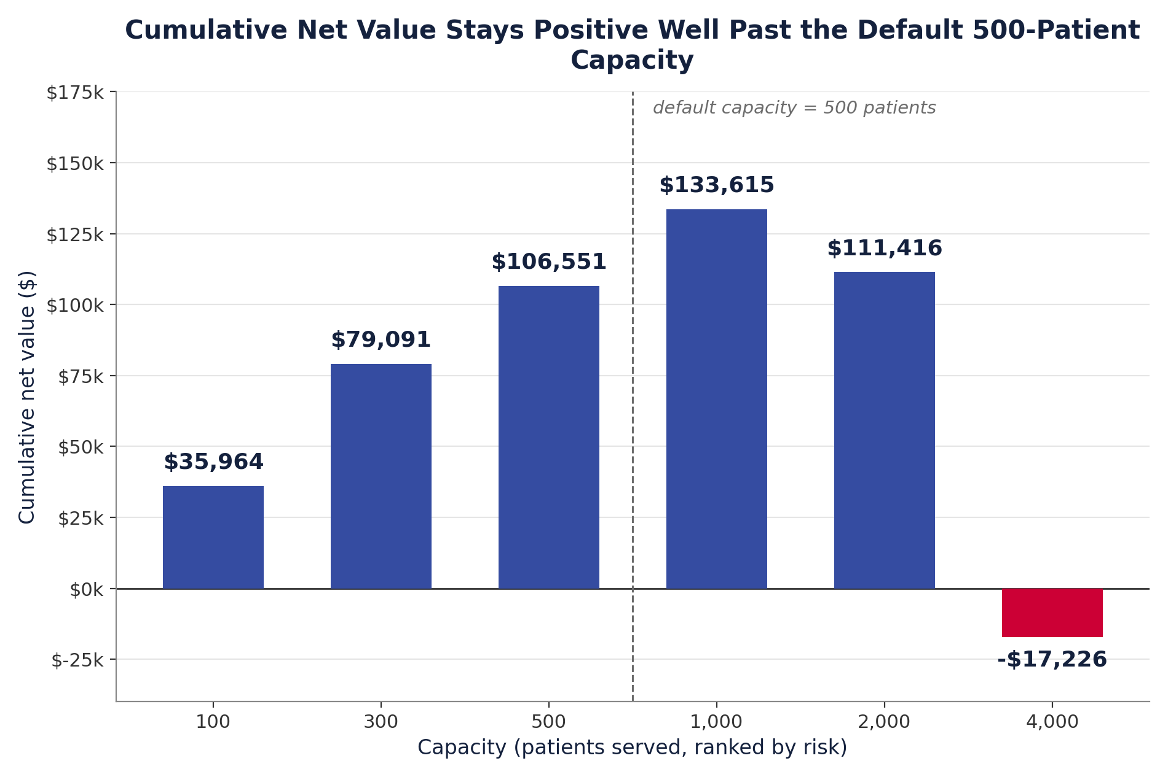
Cost & Value: Results at 500 Patients
500 Patients Targeted:
Expected Impact
175.8 expected readmissions without intervention
17.6 expected readmissions avoided
Financial Impact
$263.7K gross avoided readmission costs
– $150K intervention cost
+ $113.7K estimated net value
Break-Even Point
5.7% intervention effectiveness
Takeaways:
At these assumptions, targeting the top 500 patients creates positive expected value.
Marginal value turns negative near 1,300 patients, showing why capacity should be optimized rather than maximized.
Notes:
At 500 selected patients, the current calibrated model estimates about 175.8 expected readmissions without intervention.
At 10 percent assumed effectiveness, that means about 17.6 readmissions avoided.
At $15,000 per readmission, that is about $263,700 in gross avoided readmission cost. The interventions cost $150,000 total, so the estimated net value is about $113,700.
The intervention only needs to be about 5.7 percent effective to break even, which gives some cushion below the 10 percent assumption.
The marginal value turns negative around 1,300 patients under these assumptions. That is the point of the project: the best plan is not always serving the maximum number of patients. It is choosing the right number within capacity and expected value.

Slide 14
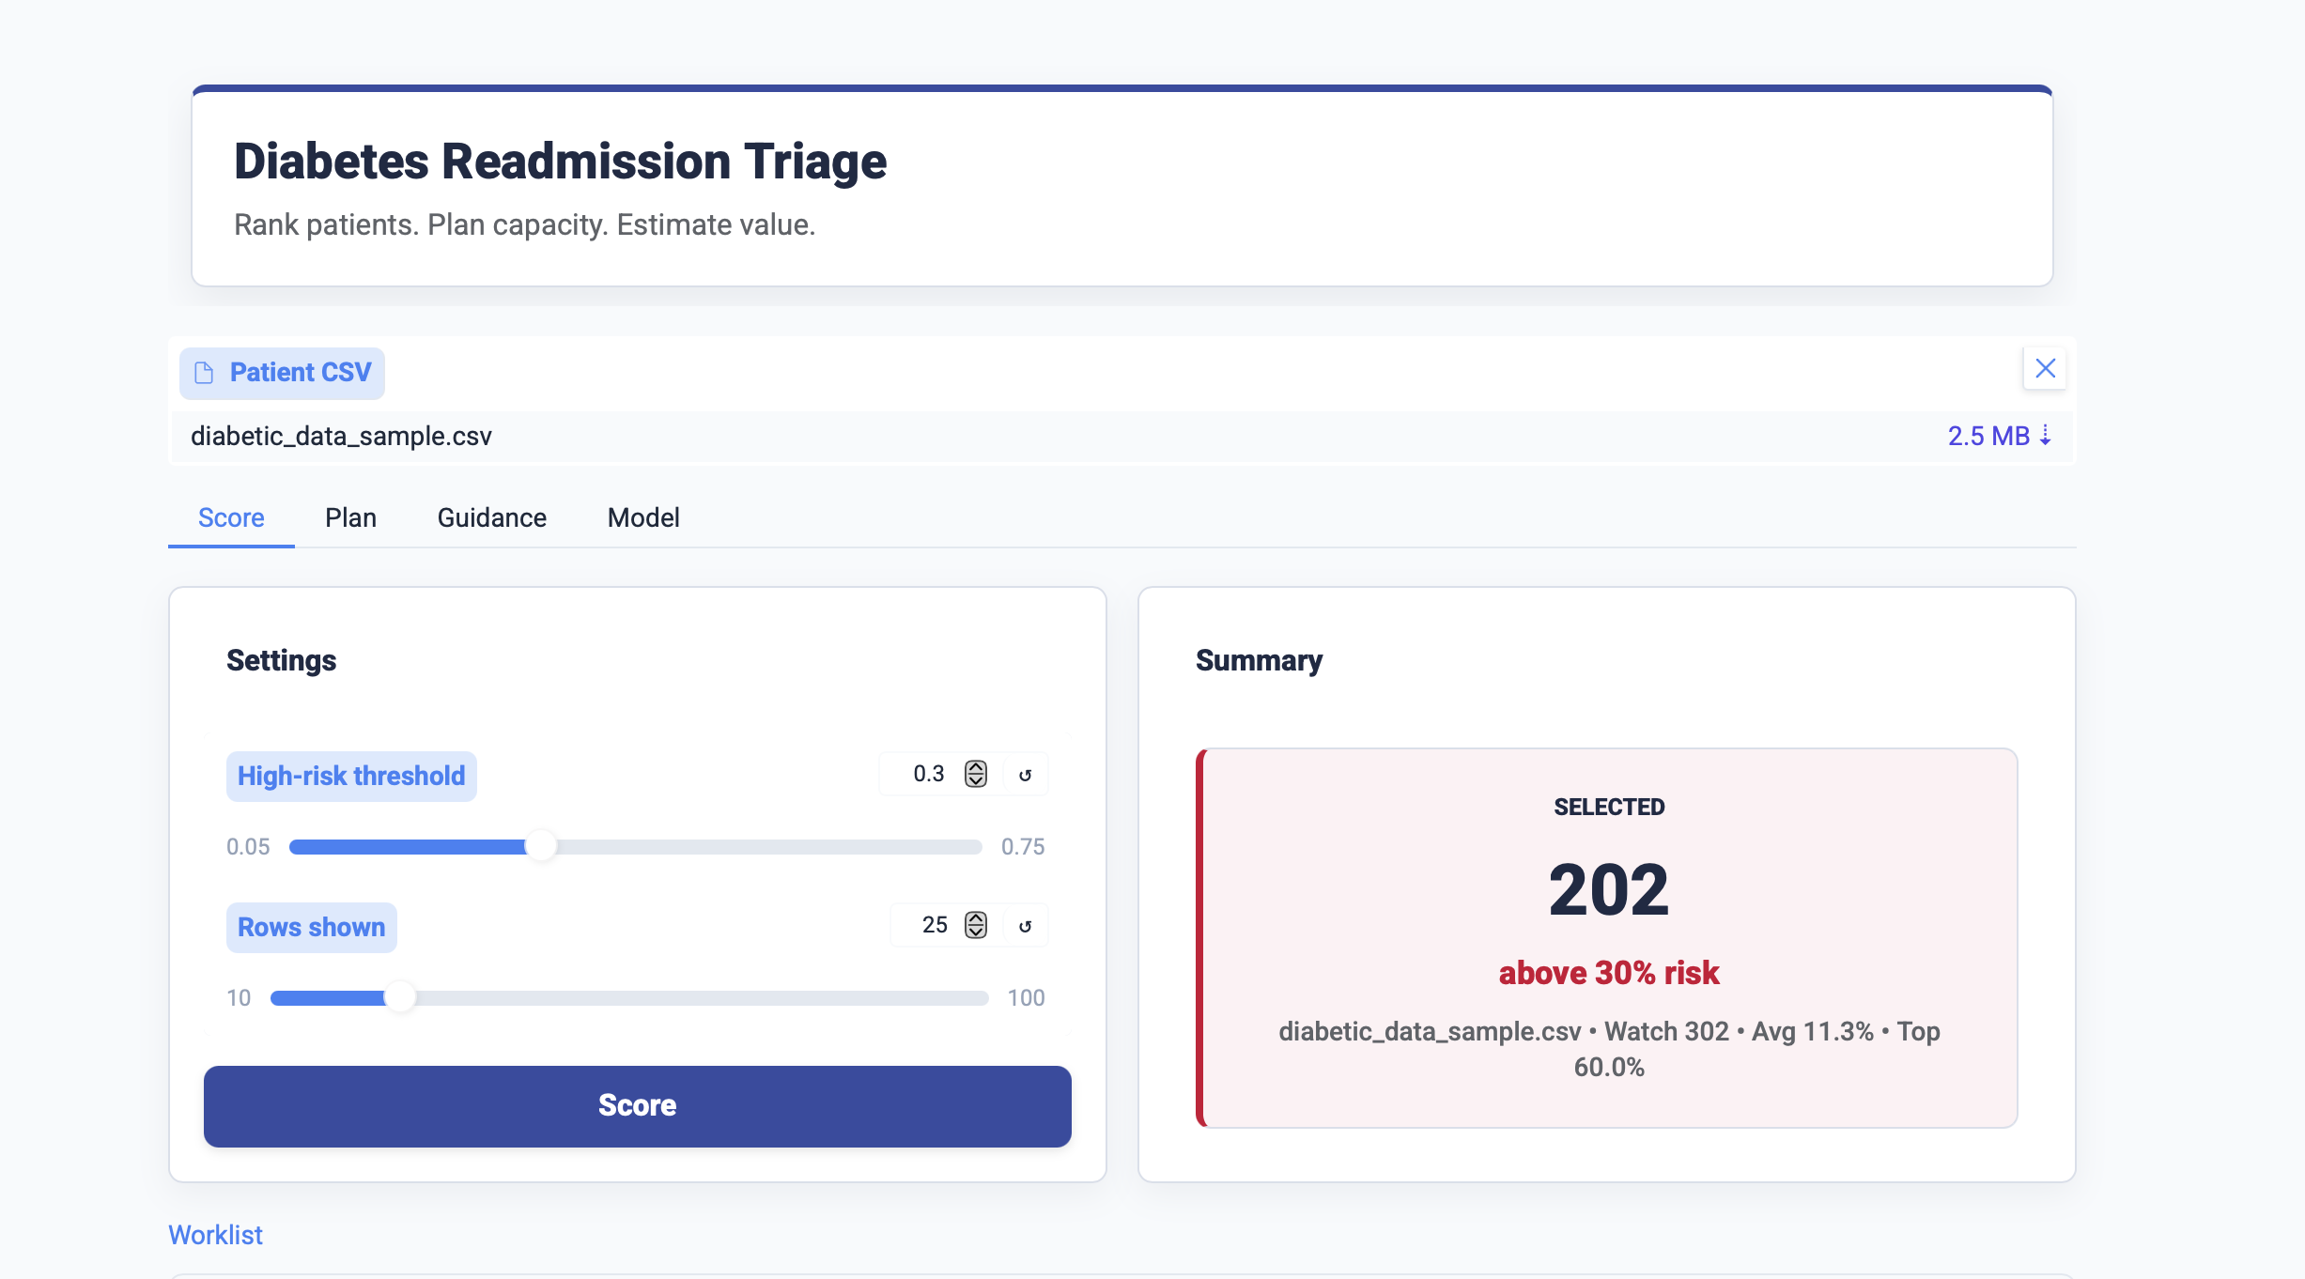
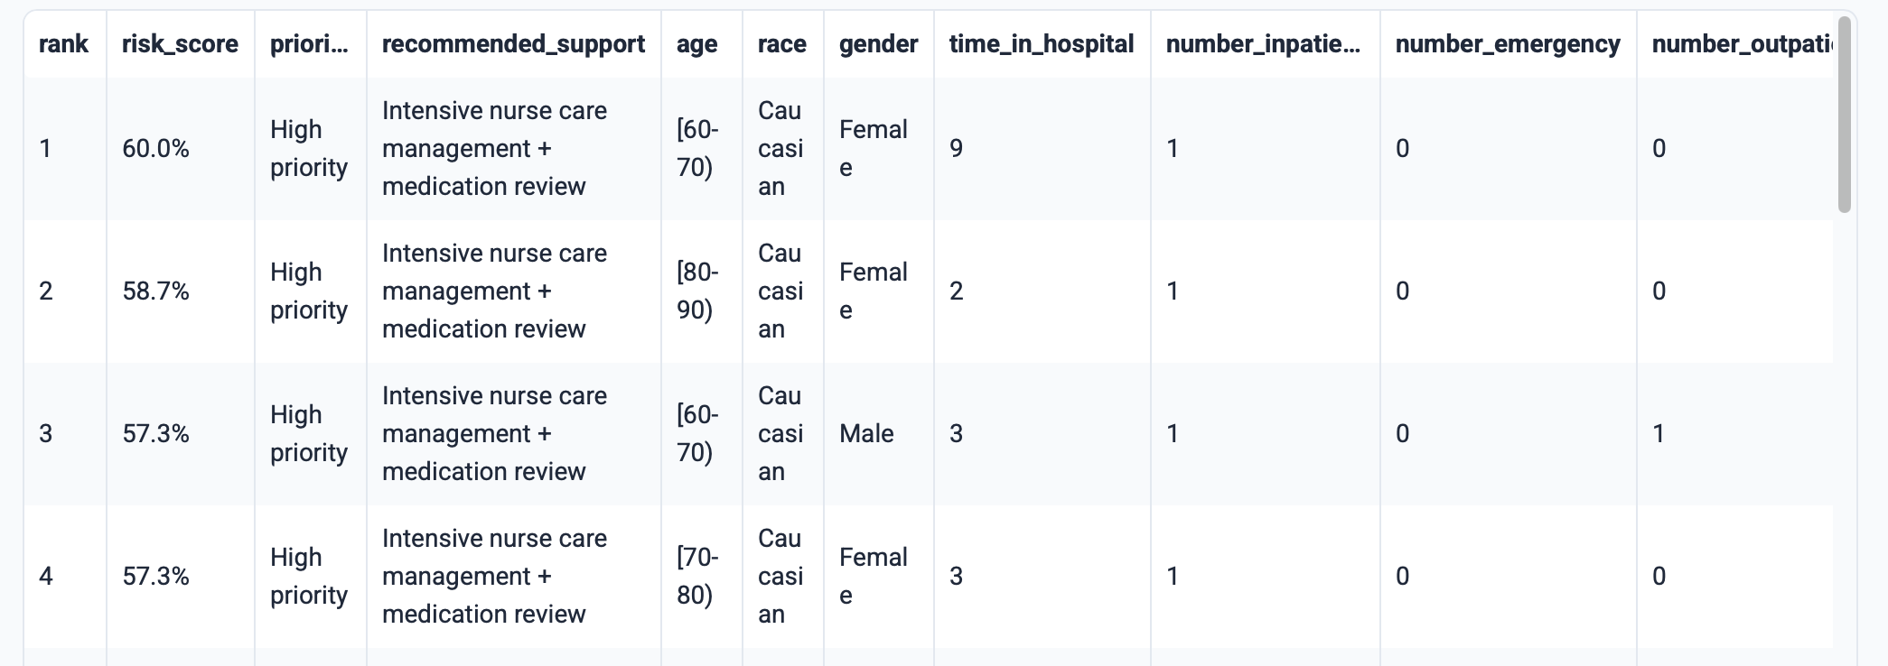
Product Demo
Link to App
Score
Rank patients by 30-day readmission risk
Plan
Adjust capacity, threshold, cost, and effectiveness
Guidance
Ask questions grounded in CMS/AHRQ documents
Model
Review performance, limitations, and governance
Care-Manager Workflow
Upload or use a patient list
Set available capacity
Review prioritized patients and expected value
Use guidance and governance information before action
Notes:
The project is built into a Gradio app with four main sections.
Score ranks patients by 30-day readmission risk and shows a prioritized worklist.
Plan is the scenario planner. The user can adjust capacity, threshold, readmission cost, intervention cost, and intervention effectiveness, and the value estimate updates.
Guidance is the RAG tab. It lets the user ask discharge-planning or care-transition questions grounded in CMS and AHRQ documents.
Model shows performance, the fine-tuned classifier comparison, limitations, and governance language.
Presenter note: the Space link is https://huggingface.co/spaces/chloebarker/diabetes-care-management-decision-support. Open it before presenting because free-tier Spaces may be building, sleeping, or waking up. If it loads in time, demo Score, Plan, and Guidance live. If not, use screenshots and explain that the same app is also verified locally.

Slide 15
Recommendation: Pilot as Decision Support
Use risk ranking + capacity + net value to set the operating point.
Use RAG for source-grounded care-transition guidance.
Keep the final intervention decision with care managers.
Retrospective
Validation: Test performance on current local EHR data
Shadow-mode
workflow test: Compare recommendations with existing care-management decisions
Limited pilot: Use with care-manager review in a defined patient population
Monitored
Deployment: Track performance, fairness, calibration, outcomes, and value
The value is better prioritization under scarcity, not automated clinical decision-making.
Notes:
My recommendation is to pilot this as human-in-the-loop decision support.
Use risk ranking, capacity, and expected net value together to set the operating point. Use the guidance tab to connect high-risk patients to source-grounded care-transition actions. But keep the final decision with care managers.
I would roll this out in stages: first retrospective validation on local hospital data, then a shadow-mode workflow test beside existing care-management decisions, then a limited pilot with real review, and only after that a monitored deployment.

Slide 16
Limitations, Risks & Next Steps
Limitations
Next Steps
Historical UCI data from 1999 to 2008
No observed transitional-care intervention outcomes
Local validity has not been established
Fairness and calibration require further validation
RAG answer quality has not undergone formal evaluation
Predictions show associations, not causal effects
Validate on current local EHR data
Monitor the fine-tuned prompt classifier against Gradient Boosting on future/local data.
Build a formal RAG answer-quality test set
Test the workflow with care managers
Monitor ranking performance, fairness, calibration, and financial assumptions
Complete privacy, governance, and EHR-integration review
Notes:
The biggest limitation is that the model is trained on historical data from 1999 to 2008, not a current hospital’s live EHR data.
The dataset also does not include actual transitional-care intervention outcomes, so the cost and effectiveness estimates are assumptions, not measured causal results.
Fairness, calibration, and RAG answer quality would all need local validation before real use. The model shows predictive associations, not proof of what causes readmission.
The next steps are to validate on current local data, test the workflow with actual care managers, monitor the fine-tuned prompt classifier against Gradient Boosting on future data, build a formal RAG answer-quality test set, and complete privacy, governance, and EHR-integration review.

Slide 17

Thank you!
Chloe Barker
Role: SMU Data Science Graduate Student
Please reach out if you have any questions
Contact Information
LinkedIn: www.linkedin.com/in/chloedbarker/
Portfolio: chloedbarker.github.io
Phone: 214-733-7514
Email: chloedbarkerr@icloud.com
Notes:
Thank you.
If there is one thing to take away, it is that analytics becomes more useful when it is tied to a real decision.
The value here is not just a clever model. It is better prioritization under scarcity, with a person always making the final call.
I am happy to answer questions.

Slide 18
Appendix

Slide 19
Appendix: Full Model Comparison Table
Metric | Gradient Boosting | Baseline Logistic Reg. | Balanced Random Forest | Balanced Logistic Reg.
Accuracy | 0.8871 | 0.8876 | 0.6875 | 0.6632
Precision | 0.6897 | 0.6400 | 0.1893 | 0.1815
Recall | 0.0089 | 0.0214 | 0.5343 | 0.5606
F1 | 0.0176 | 0.0414 | 0.2796 | 0.2742
ROC-AUC | 0.6756 | 0.6686 | 0.6706 | 0.6688
PR-AUC (avg precision) | 0.2423 | 0.2239 | 0.2214 | 0.2233
Brier score | 0.0951 | 0.0960 | 0.2086 | 0.2250
Precision@500 | 0.412 | 0.378 | n/a | n/a
Recall@500 | 0.0918 | 0.0842 | n/a | n/a
Lift@500 (x random) | 3.6303 | 3.3307 | n/a | n/a
Gradient Boosting was selected: best precision/lift at fixed capacity. Raw accuracy (~0.89) is misleading since only ~11% of patients readmit: always predicting "no" would already score ~89%, so ranking metrics (PR-AUC, precision/recall/lift at capacity) drove model selection instead.

Slide 20
Appendix: Confusion Matrix and Threshold Table
Default threshold (n=19,773) | Predicted not <30 | Predicted <30
Actual not <30 | 17,524 | 5
Actual <30 | 2,235 | 9
Threshold | Flagged | Flagged % | Precision | Recall | F1 | Readmit. captured
0.05 | 17,649 | 89.26% | 0.1231 | 0.9684 | 0.2185 | 2,173
0.10 | 10,098 | 51.07% | 0.1606 | 0.7228 | 0.2628 | 1,622
0.15 | 3,557 | 17.99% | 0.2407 | 0.3815 | 0.2951 | 856
0.20 | 1,133 | 5.73% | 0.3345 | 0.1689 | 0.2245 | 379
0.25 | 626 | 3.17% | 0.3882 | 0.1083 | 0.1693 | 243
0.30 | 359 | 1.82% | 0.4596 | 0.0735 | 0.1268 | ~165
0.35 | 178 | 0.90% | 0.5506 | 0.0437 | 0.0809 | ~98
0.40 | 80 | 0.40% | 0.6500 | 0.0232 | 0.0448 | ~52
0.45 | 33 | 0.17% | 0.6970 | 0.0102 | 0.0202 | ~23
0.50 | 14 | 0.07% | 0.6429 | 0.0040 | 0.0080 | ~9
Class | Precision | Recall | F1 | Support
Not <30 | 0.89 | 1.00 | 0.94 | 17,529
<30 | 0.64 | 0.00 | 0.01 | 2,244
Overall accuracy at default threshold: 0.89.
Near-zero default-threshold recall is expected for a ranking model with a rare positive class.

Slide 21
Appendix: Capacity Table by Patient Volume
Capacity | Precision@capacity | Recall@capacity | Lift over random | Readmissions captured
100 | 0.6400 | 0.0285 | 5.64x | 64
250 | 0.5040 | 0.0561 | 4.44x | 126
500 | 0.4200 | 0.0936 | 3.70x | 210
1,000 | 0.3520 | 0.1569 | 3.10x | 352
2,000 | 0.2835 | 0.2527 | 2.50x | 567
As capacity grows, precision falls and recall rises: this tradeoff shapes staffing decisions. model_summary.json reports recall@500 as 0.0918 with 204 captured (a very slightly different run than the notebook figures above); the deployed app uses the notebook capacity table.

Slide 22
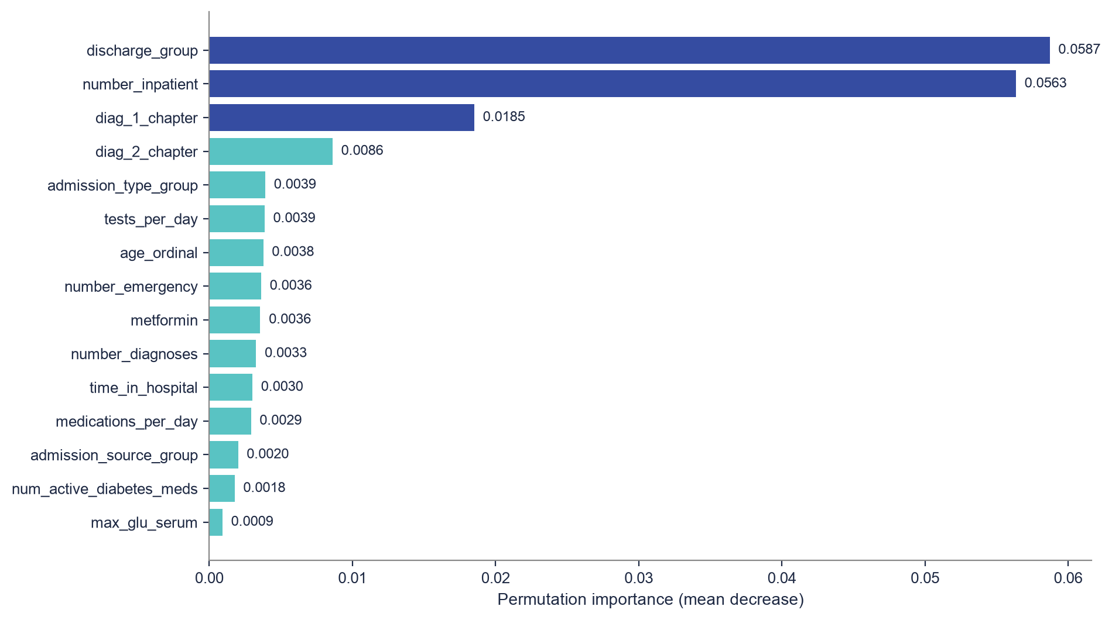
Appendix: Feature Importance (Top 15)

Slide 23
Appendix: Fairness by Race, Gender, and Age
Race | n | Actual rate | Avg risk | Recall
Caucasian | 14,813 | 11.72% | 11.22% | 0.52%
African American | 3,697 | 10.79% | 10.94% | 0.00%
Unknown | 447 | 7.16% | 9.62% | 0.00%
Hispanic | 398 | 9.05% | 10.27% | 0.00%
Other | 302 | 10.26% | 9.87% | 0.00%
Asian | 116 | 8.62% | 9.50% | 0.00%
Age group | n | Actual rate
[10-20) | 137 | 5.84%
[20-30) | 369 | 16.26%
[30-40) | 757 | 11.49%
[40-50) | 1,909 | 9.59%
[50-60) | 3,467 | 10.87%
[60-70) | 4,356 | 11.57%
[70-80) | 4,921 | 11.30%
[80-90) | 3,284 | 12.15%
[90-100) | 547 | 12.43%
Gender | n | Actual rate | Avg risk | Recall
Female | 10,726 | 11.45% | 11.28% | 0.65%
Male | 9,047 | 11.23% | 10.84% | 0.10%
Key takeaway
Predicted risk scores track closely with actual observed rates across race, gender, and age; no group is wildly over- or under-scored. But recall at the default 0.5 classifier threshold is near zero for every group, because this is a ranking model, not a threshold classifier. Fairness should be evaluated on the ranked list / top-K, not on default-threshold recall. The [20-30) group has the highest actual rate but a small sample size (n=369).

Slide 24
Appendix: Cost / Value Formulas
Quantity | Formula
Expected readmissions without intervention | capacity x baseline_readmission_rate_among_selected
Expected readmissions avoided | expected_readmissions_without_intervention x intervention_effectiveness
Gross avoided readmission cost | expected_readmissions_avoided x readmission_cost
Total intervention cost | capacity x intervention_cost
Net value | gross_avoided_readmission_cost - total_intervention_cost
Break-even effectiveness | total_intervention_cost / (expected_readmissions_without_intervention x readmission_cost)
Default assumptions: readmission cost $15,000; intervention cost $1,200; intervention effectiveness 10%; capacity 500; threshold 0.0. These are scenario inputs the app lets a care-management leader adjust; they are not measured financial outcomes.

Slide 25
Appendix: RAG Corpus and Example Questions
Corpus (pdfs/): HRRP_Formula.pdf (CMS HRRP payment reduction formula) | A Reengineered Hospital Discharge Program to Decrease Rehospitalization.pdf (AHRQ Project RED trial) | dischargeprep.pdf (RED discharge preparation workbook) | goinghomeguide.pdf (AHRQ going-home guide)
Requirement | Status | Notebook / app connection
Document collection | Done: 4 approved CMS HRRP / AHRQ RED PDFs in pdfs/ | Guidance tab corpus
Document loading & preprocessing | Done: pypdf text extraction, cleaned and paginated | RAG preprocessing script
Chunking strategy | Done: ~950-character chunks, 160-character overlap, sentence-aware breaks | Retriever quality
Embeddings | Done: sentence-transformers/all-MiniLM-L6-v2 dense embeddings | Retriever index
Vector search / retrieval | Done: FAISS vector search plus topic keyword boosting (TF-IDF fallback if embeddings unavailable) | Question-answer workflow
Prompt design | Done: system prompt scopes the assistant to grounded, cited, non-clinical guidance | Business-facing answer behavior
Generated response | Done (optional): OpenAI gpt-4o-mini answer when a user key is supplied, otherwise an extractive summary | Stakeholder output
Source grounding | Done: source title, page, and snippet shown with every answer | Trust and auditability
Evaluation & failure modes | Partial: manual test questions only, documented fallback behavior, no formal answer-quality rubric yet | Limitations and governance
Example care-transition questions:
What should a care manager confirm before a high-risk diabetes patient is discharged home?
What does the AHRQ Re-Engineered Discharge (RED) approach recommend for medication reconciliation?
How does CMS calculate the HRRP readmission payment penalty?
What follow-up appointment timing does the AHRQ discharge guidance recommend for high-risk patients?

Slide 26
Appendix: Fine-Tuning Example Record
2,000 fine-tuning examples in artifacts/fine_tuning_readmission_examples.jsonl. Real example record:
text: “Classify whether this diabetes inpatient encounter is readmitted within 30 days. Age: [60-70); race: Caucasian; gender: Male; time in hospital: 4; prior inpatient visits: 0; prior emergency visits: 0; prior outpatient visits: 0; number of medications: 13; number of diagnoses: 7; A1C result: >8; insulin: 0; discharge group: Home; admission source: Emergency room.”
label: “not_readmitted_within_30_days”
Reusable technical pattern:
Base model: Qwen 2.5 1.5B
Efficient fine-tuning: Unsloth LoRA adapters
Forced-choice label scoring (constrain generation to the label set instead of free text)
Save and reload the fine-tuned model via the Hugging Face Hub
Serve inference through a Gradio interface

