Slide 1
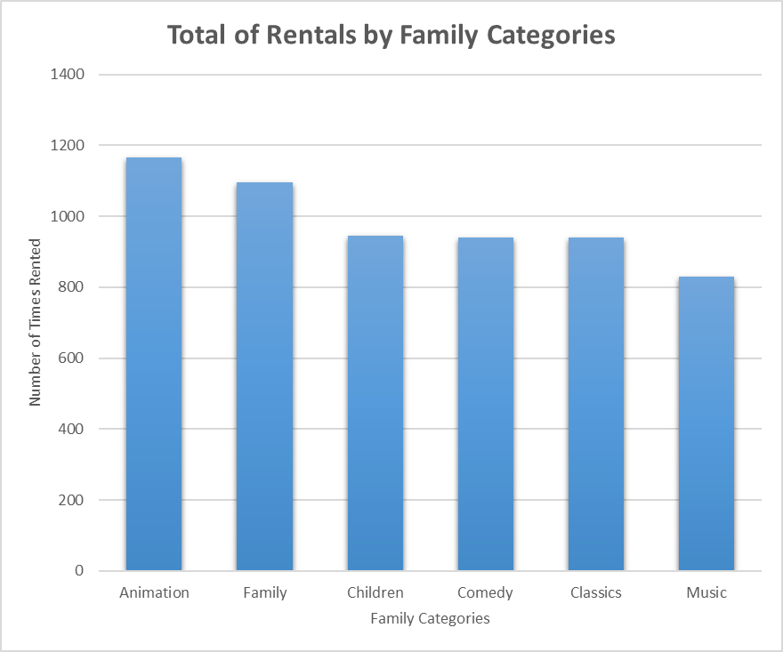
What are the most successful categories among the family movies ?
Among the family movies, the Animation category is the most successful as it has been rented close to 1200 times. The least successful is the Music category which has been rented approximately 800 times.

Slide 2
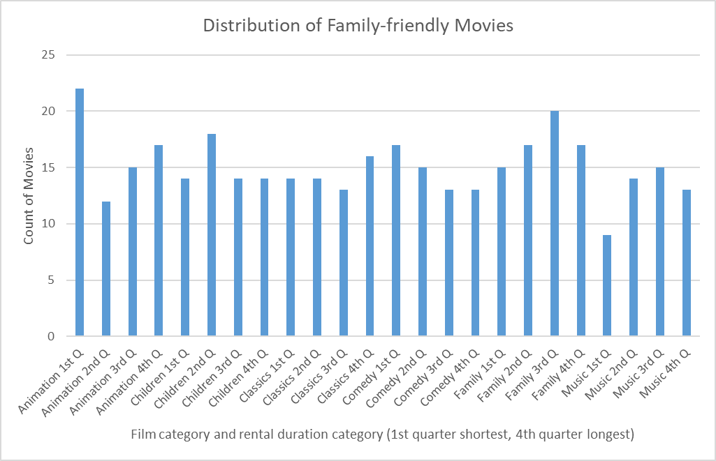
What is the distribution of family-friendly movies among the film categories and rental duration categories ?
<visualization>
A significant number of Animation movies (22) are rented for a short period of time (first quarter). However, only a small portion of Music movies (9) are rented for such a short period.

Slide 3
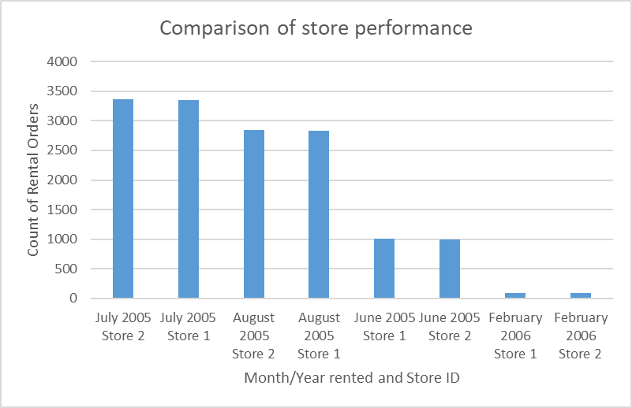
How does the two stores compare in their count of rental orders ?
<visualization>
We observe that for every month we have data for, the performance of the two stores is roughly the same. This is the case for months with high number of rental orders like July 2005 (3350 orders) and for months with low number of rental orders like February 2006 (90 orders).

Slide 4
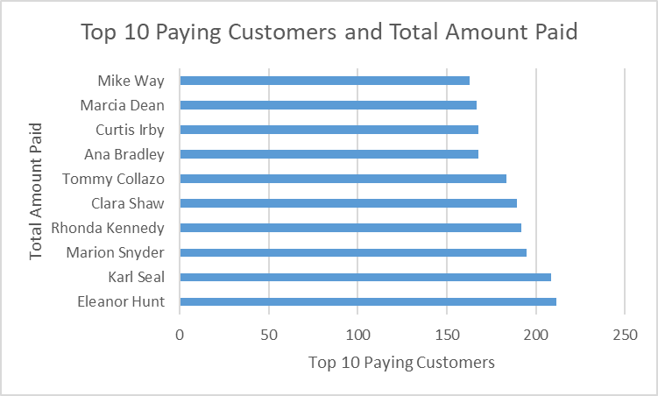
Who are the top 10 paying customers ? How many did each paid in total ?
<visualization>
The number 1 customer is Eleanor Hunt and she paid roughly 210 dollars in total. The number 10 customer is Mike Way and he paid approximately 160 dollars.

