Slide 1


AN APP TO HELP PLAN YOUR NEXT DATE

Slide 2

PROJECT CONCEPT & MOTIVATION
Planning a date can be nerve-wracking with so many choices to pick from in your area. With DateMate™, we give you the tools to create a plan for your date.
How we created it: Using the Google Map API, a location is set using either the user’s location or input from the user.
The establishment’s information is called using Zomato’s API. Only establishments with a certain rating are displayed to the user and even then it is only the top five establishments in your area.
As you confirm the establishment(s) for your date, the info is saved onto Firebase as a list.

Slide 3
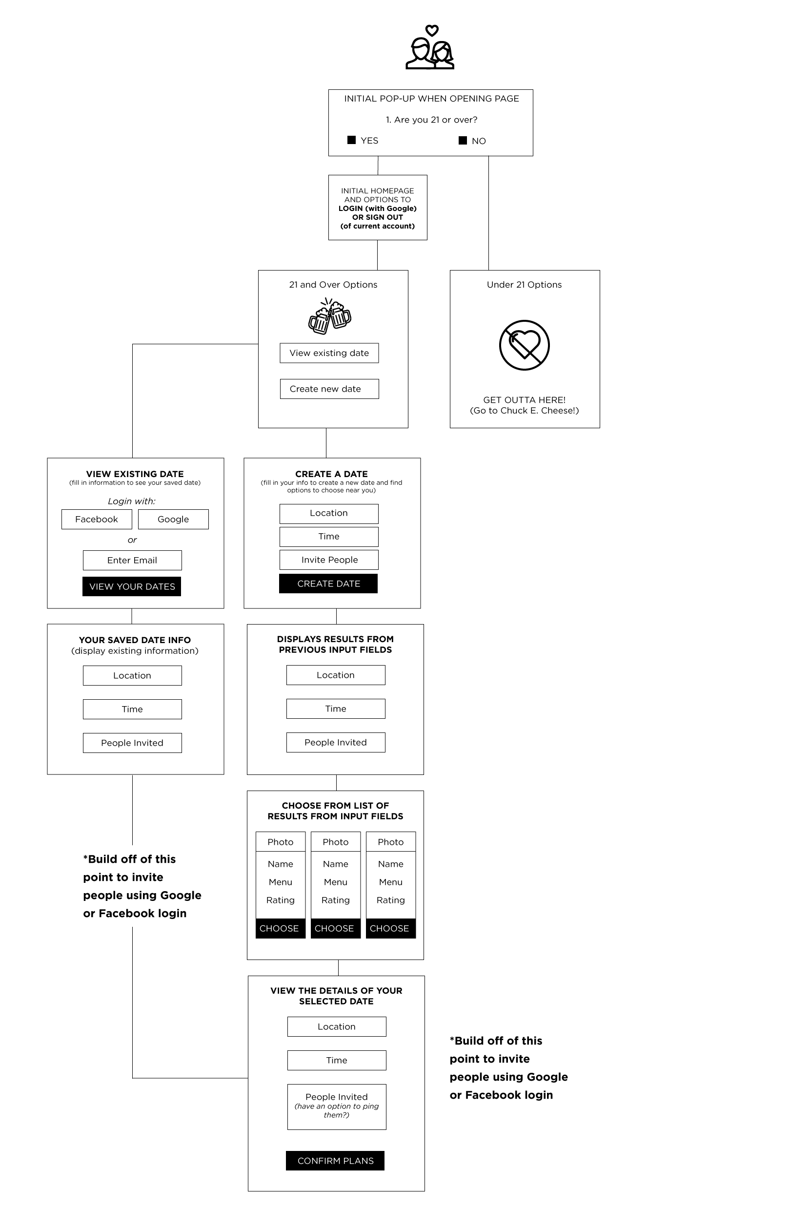
DESIGN & PLANNING
Discussed intention of app and created a wireframe to layout basic functionality and flow
Created a design for the look and feel (edited along the way)
Created tasks, issues, and tracked progress within sprints using Github
Collaborated using branches and merging pull requests
Planned for future app expansion

Slide 4
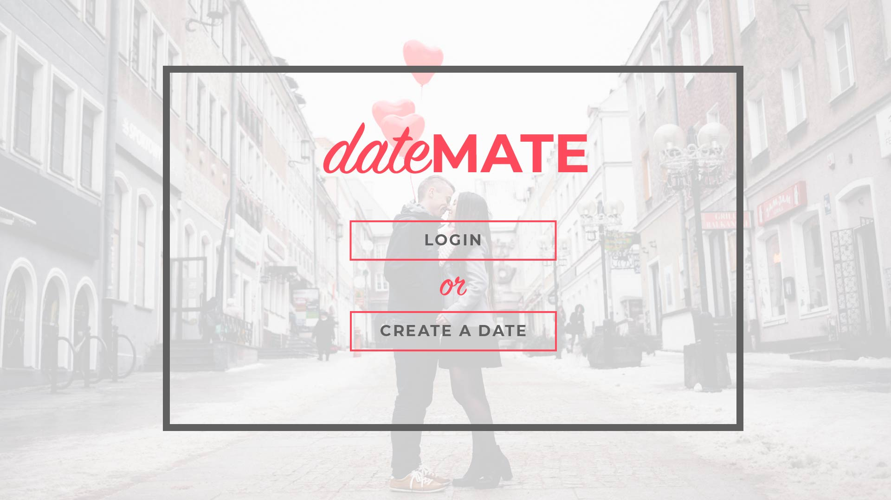
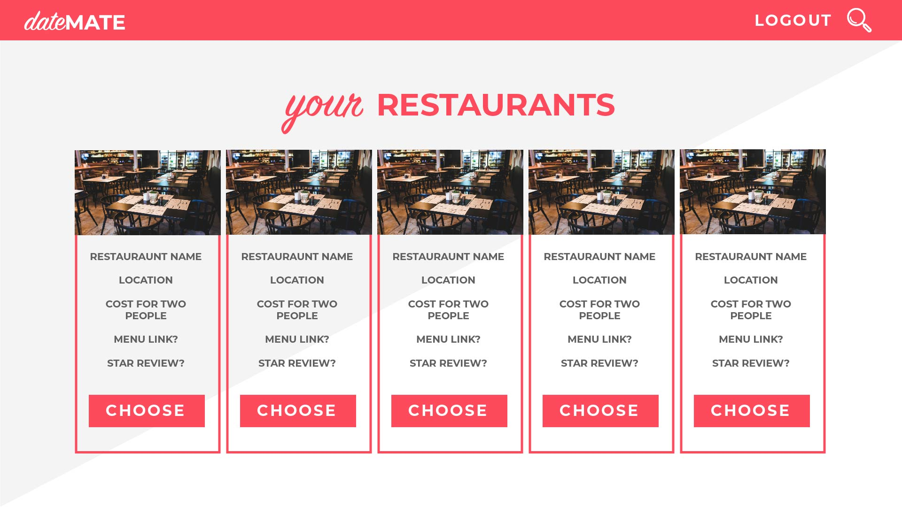
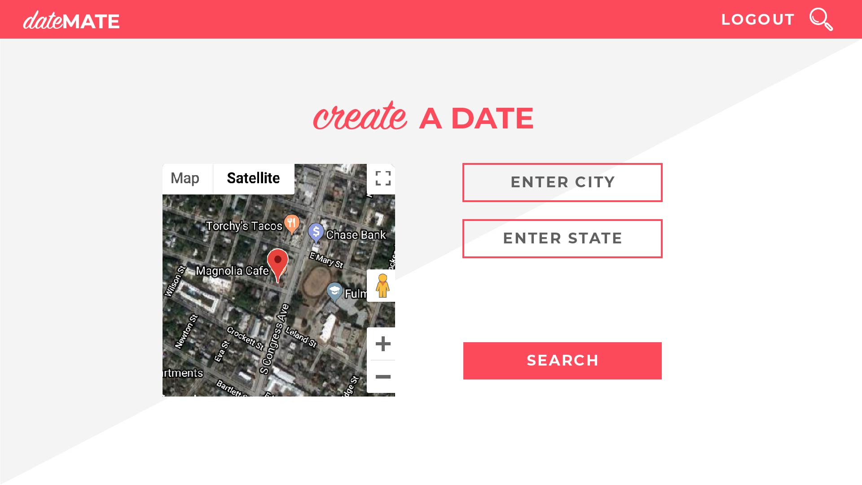
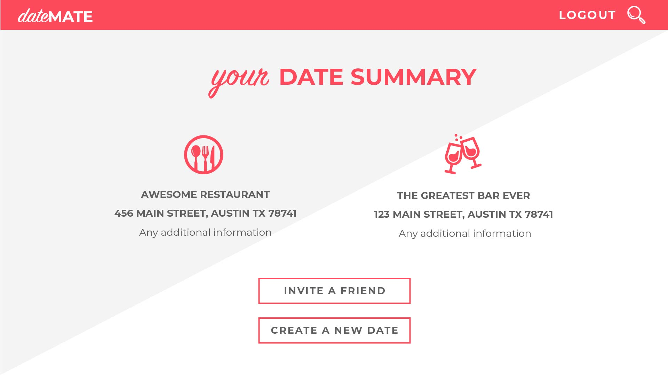

Slide 5
TECHNOLOGIES USED
HTML/CSS
Designed based off of mockup, incorporated .sass/.scss for styling
Roadblocks with corrupted image files – issue was resolved
API’s – Google & Zomato
Incorporating map information
Things we learned, roadblocks experienced – troubleshooting with API’s
Node
Experience with Node.js
Firebase
What we wanted to have: Google, FB, etc.
What we almost had working: Google authentication

Slide 6
DIRECTION FOR FUTURE DEVELOPMENT
We would like to get authentication working (FB, Google, etc) for date sharing
If two users’ dates match, create a DateMate “Most Popular Date” feature.
Ask the date creator questions and use the inputs create a personalized experience by making recommendations
example: if we ask the user “do both of you like basketball?”, user says “yes”, then recommend the next available game as a date option.

Slide 7
CHECK IT OUT!
https://thegroupthatworkz.github.io/DateMate/

