Slide 1
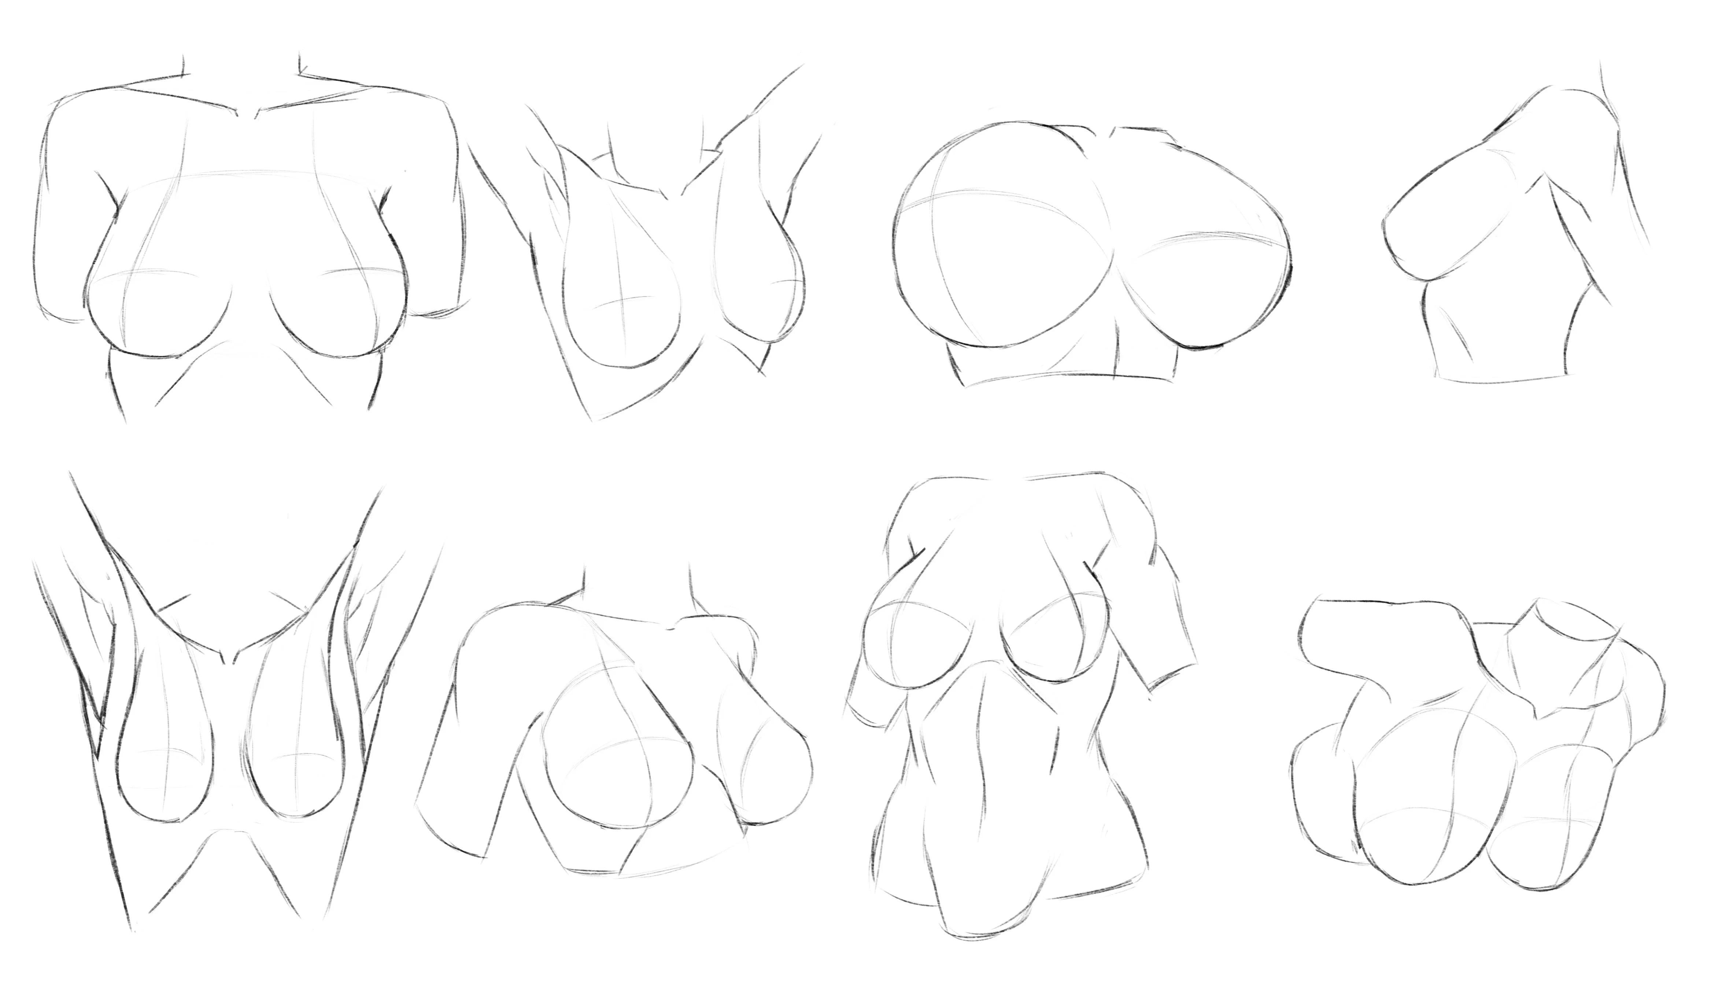
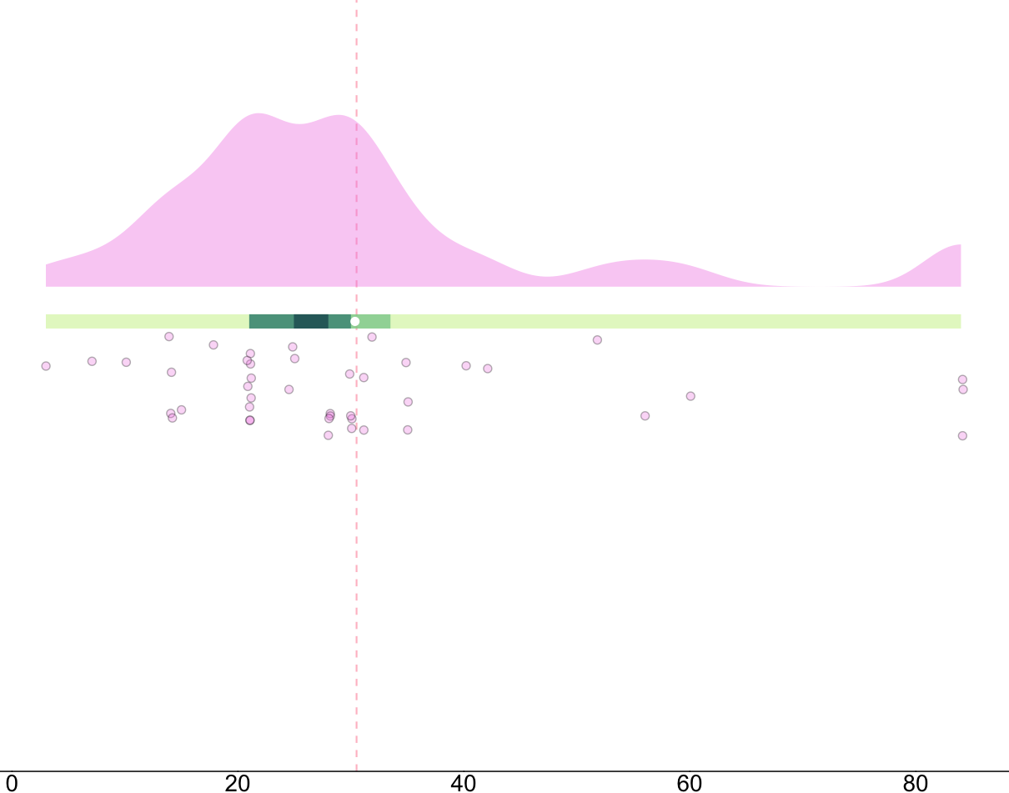
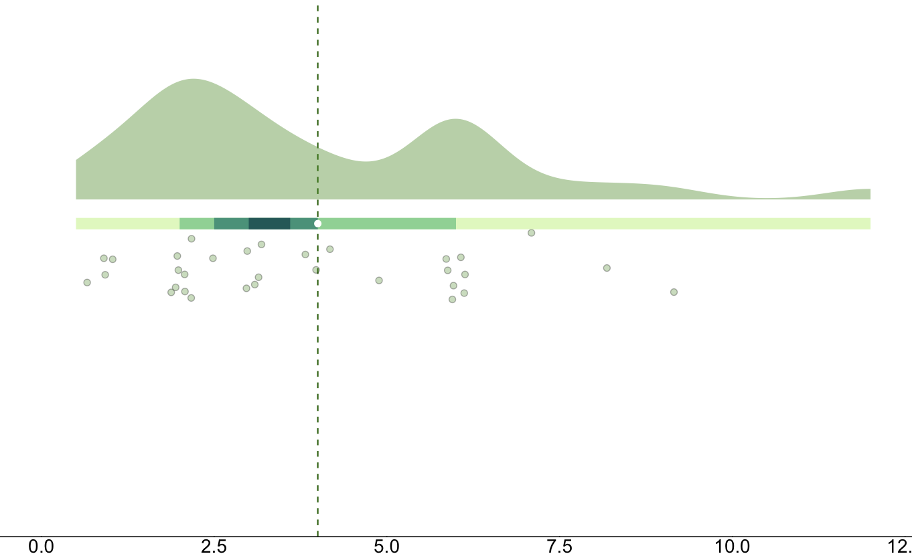
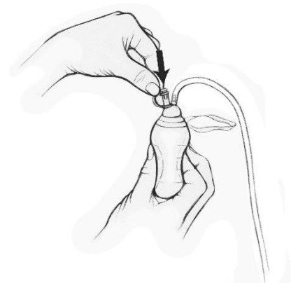

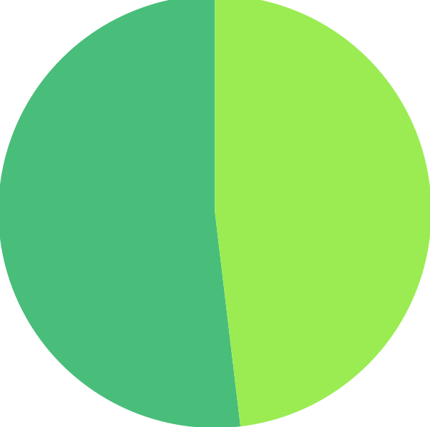
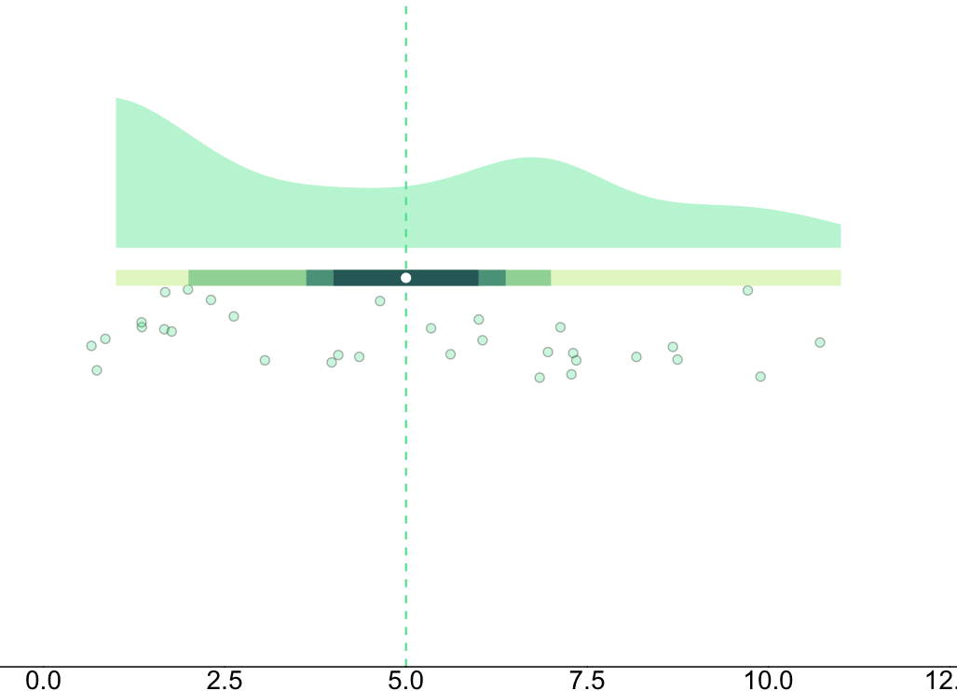

Based on Reddit-user reports, it appears mean swelling peaks at 30 days.
Perhaps this is related to an increase in activity after the operation?
Sketches from Reddit User : LA_ZBoi00
1 MONTH
Peak swelling (days)
DAYS
Based on Reddit-user reports, it appears that final sizes post reduction are around 4MPO.
However, be mindful of the spread of data here; we see important peak around the 6-month mark
4 MONTHS
Time to final size (months)
MONTHS
Breast reduction data pulled across multiple years of r/Reduction threads
Drain illustration from FraserHealth
DRAINS
NO
n = 55
YES
n = 51
From the subset of data with drains, average duration is 5 days.
Drain usage seems independent of initial size, total reduction volume (grams), or patient demographics.
From these data it seems truly based on surgeon decision.
Time with drains in (days)
Code, data, and links on
github/chloefouilloux
Read about the motivation + graphs chloefouilloux.com

Slide 2
Based on Reddit-user reports, it appears mean swelling peaks at 30 days (1MPO).
Perhaps this is related to an increase in activity after the operation?
Peak swelling (days)

Slide 3
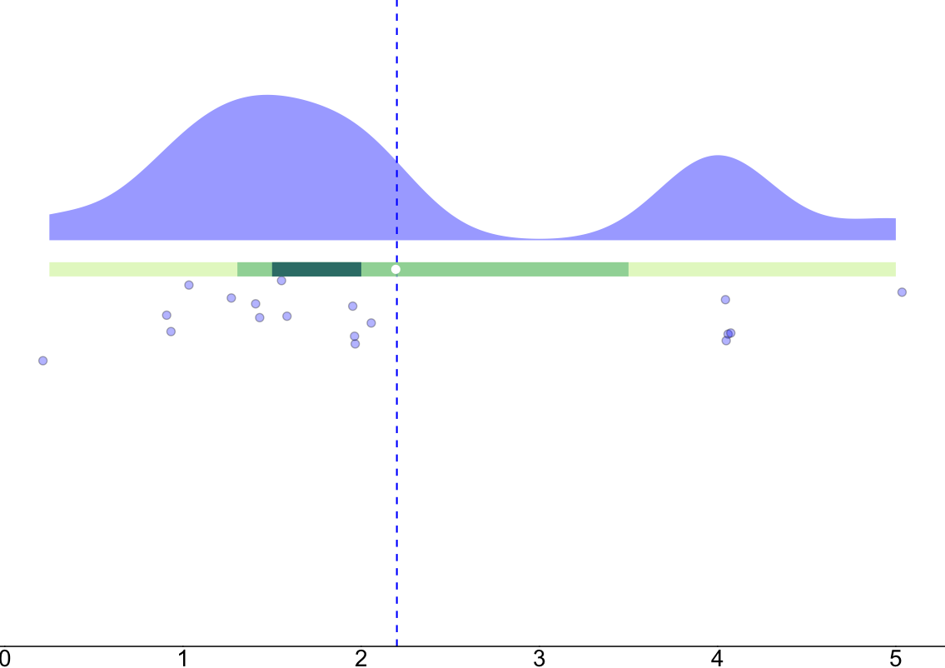
Based on Reddit-user reports, it appears most users report little problems flying longer distances after 2 weeks.
Time to fly (weeks)

Slide 4
Based on Reddit-user reports, it appears that final sizes post reduction are around 4MPO.
However, be mindful of the spread of data here; we see important peak around the 6-month mark
Time to final size (months)

Slide 5
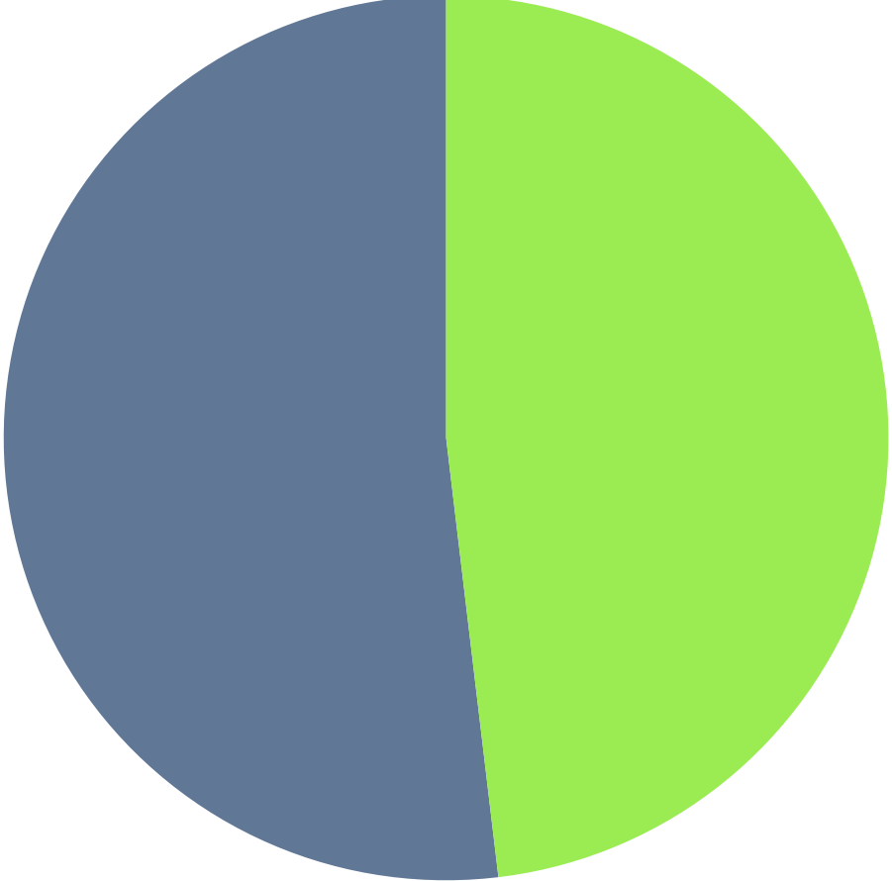
From the subset of data that had drains, average duration with drains in 5 days.
NO
n = 55
YES
n = 51
Drain usage seems independent of initial size, total reduction volume (grams), or patient demographics.
From these data it seems truly based on surgeon decision.
Time with drains in (days)

