Slide 1
What does the 2d Motion Equation mean?
So, if we have
- Iᵼᴾ¹ = u ∙ Iₓᴾ¹ + v ∙ Iᵧᴾ¹
- Iᵼᴾ² = u ∙ Iₓᴾ² + v ∙ Iᵧᴾ²
then, when can we solve this?
We can solve for u and v, exactly when ( Iₓᴾ¹ , Iᵧᴾ¹ ) is different from
(Iₓᴾ² , Iᵧᴾ² ). Each pair is the image gradient at the respective point. So,
if the gradient vectors are different, we can solve. Not being different,
means that we have only one edge direction even though we have two
points. So, it is pretty clear: we can only solve if we have two
independent edge directions, from which the two observed points
come. So, getting both points on the same straight edge is a bad idea.

Slide 2
What does the 2d Motion Equation mean?
Now that we know what having two equations does for us,
we can ask “what information is contained in one equation?”
Let us examine a single equation closely and carefully.
- Iᵼ = u ∙ Iₓ + v ∙ Iᵧ
In the equation here, we notice that the right hand side is
simply a dot-product, also called scalar-product, (or in my
terminology) a one-step convolution. So, let us write it like
that:
- Iᵼ = [ ] ∙ [ ]
u
v
Iₓ
Iᵧ

Slide 3
What does the 2d Motion Equation mean?
So, writing the equation in the form
- Iᵼ = [ ] ∙ [ ]
shows us that the Right Hand Side simply is the dot product of two vectors, which are 1) the total 2d motion vector (u,v), and 2) the image gradient vector (Iₓ , Iᵧ ). Let these be denoted by ѵ̅ (2d motion vector having components u and v), and V̅͞ I (image gradient vector having components Iₓ and Iᵧ )
u
v
Iₓ
Iᵧ

Slide 4
What does the 2d Motion Equation mean?
So, we now have
- Iᵼ = ѵ̅ . V̅͞I
Now, what we have here is a Dot Product (scalar product) of two vectors. The single step convolution expansion was where this dot product came from. i.e., that single step convolution was one way to have expanded the dot product. However, there is another way to do this expansion, and that is by writing it as
- Iᵼ = ǁ ѵ̅ ǁ x ǁ V̅͞I ǁ x Cos (θ )

Slide 5
What does the 2d Motion Equation mean?
Our equation has become:
- Iᵼ = ǁ ѵ̅ ǁ x ǁ V̅͞I ǁ x Cos (θ )
Now, pulling all the knowns to the right, and all the unknowns to the left, this can be re-written as:
ǁ ѵ̅ ǁ x Cos (θ ) = - Iᵼ / ǁ V̅͞I ǁ
Note that we have done an interesting trick here. We have pulled all known quantities to the right. That means that what remains on the left can now be computed (from the right). So, we can ask, “what is this new thing we have become able to compute?”
i.e., this thing on the left, what exactly is it? (we know now how to compute it, but we want to know “what does it represent?”)

Slide 6
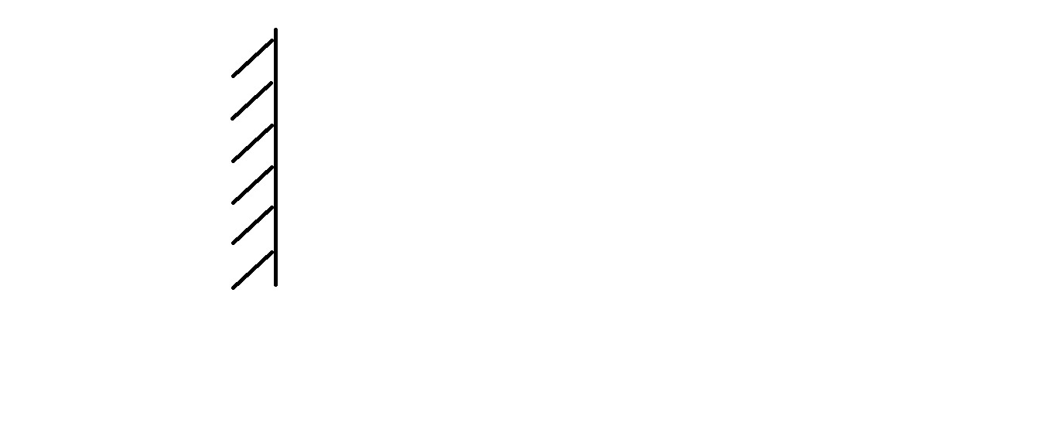
What does the 2d Motion Equation mean?
“what does the vCosθ term represent?”
We need to look at a figure: Consider an edge, that has the dark part on the left.

Slide 7
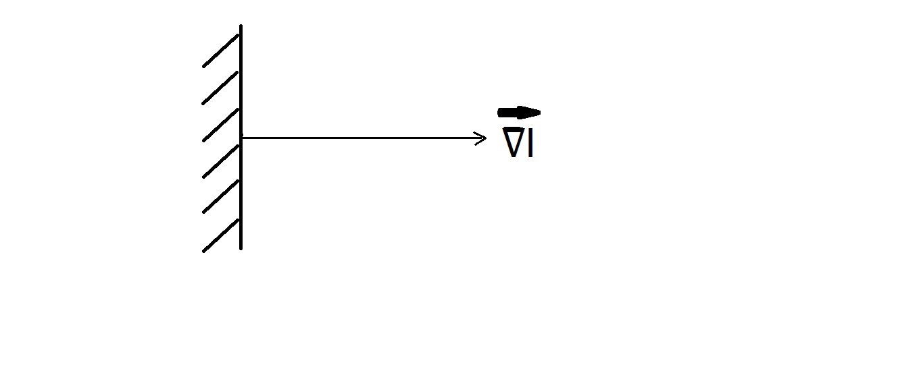
What does the 2d Motion Equation mean?
“what does the vCosθ term represent?
So, for this edge, we draw in the Gradient Vector.

Slide 8
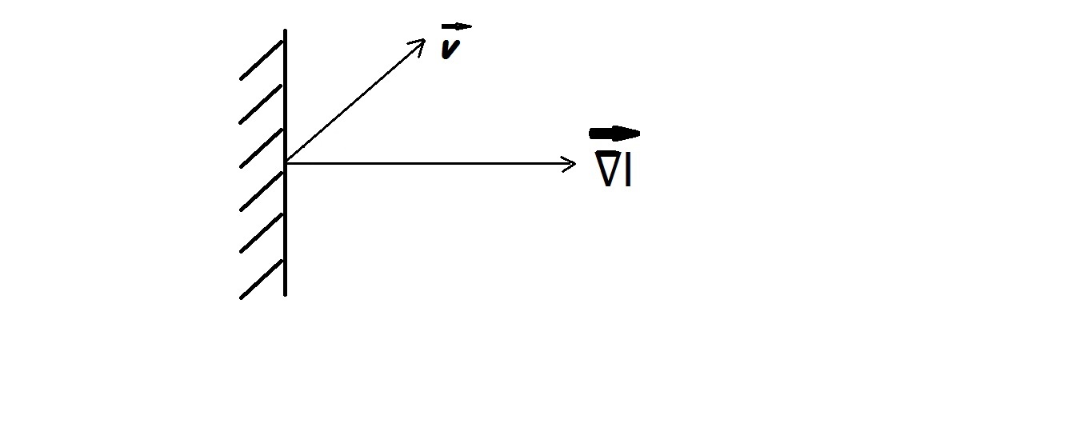
What does the 2d Motion Equation mean?
“what does the vCosθ term represent?”
We now suppose that a particular point on the edge is moving diagonally upwards with a motion vector, ѵ̄

Slide 9
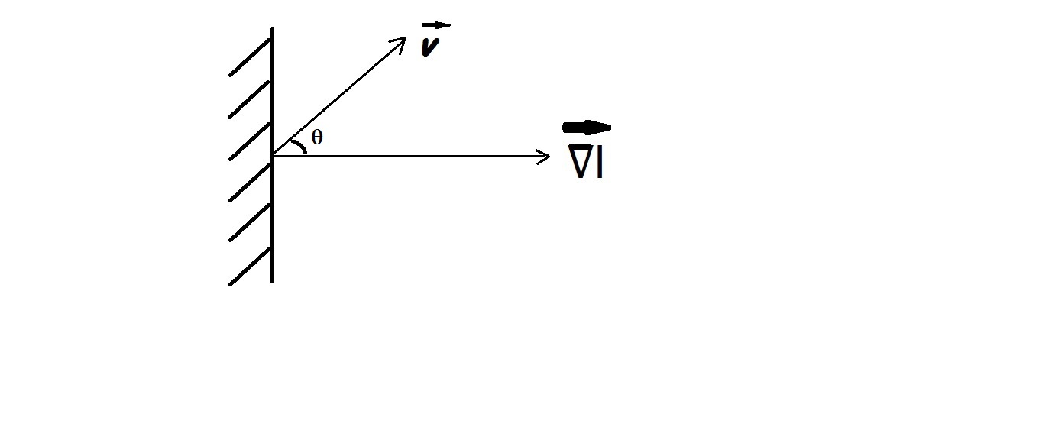
What does the 2d Motion Equation mean?
“what does the vCosθ term represent?”
We now note that the angle between the motion vector, ѵ̄ ,
and the gradient vector is θ, as shown in the figure

Slide 10
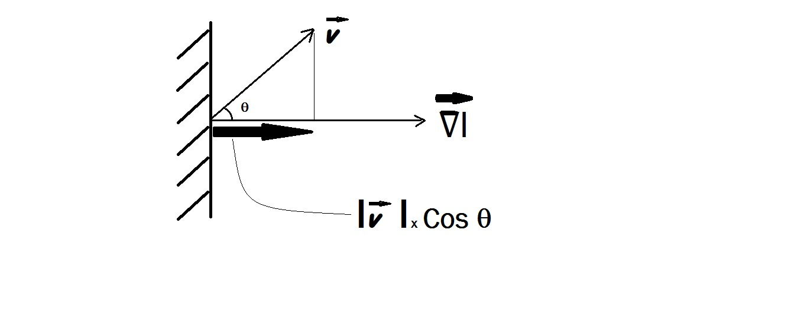
What does the 2d Motion Equation mean?
We now see that, the quantity of interest, namely, |v|Cosθ,
is merely the “perpendicular drop” from v onto the gradient
vector (sometimes also called the perpendicular projection,
or “shadow”) as shown by the thick arrow in the figure.

Slide 11
What does the 2d Motion Equation mean?
This is an important insight. It says that no matter how much there is of the component ALONG the EDGE, the only part of motion that is measureable is the component that is Normal (i.e., perpendicular) to the edge. This part is |v|Cosθ. The other part, the motion along the edge, is lost,
if one is able to view only one edge in one’s small window.
We now look at a simple demo of this concept.

Slide 12
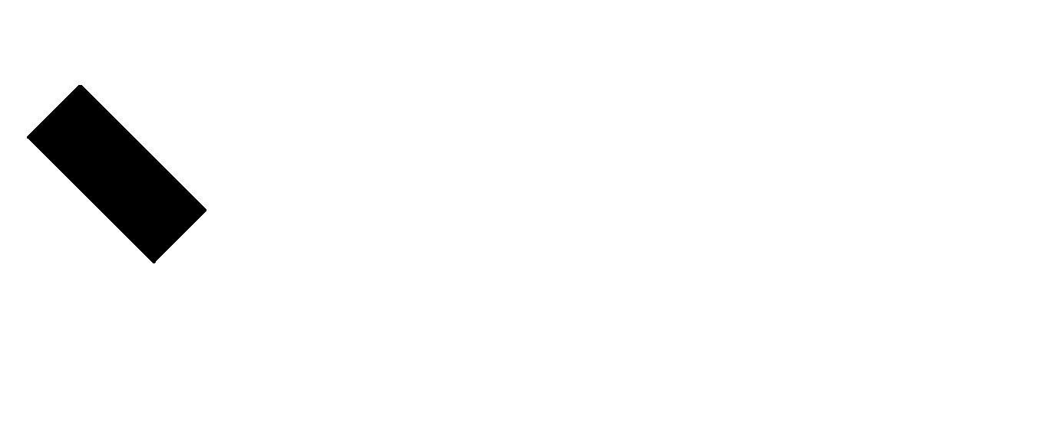
Black Stripe moves to the right

Slide 13
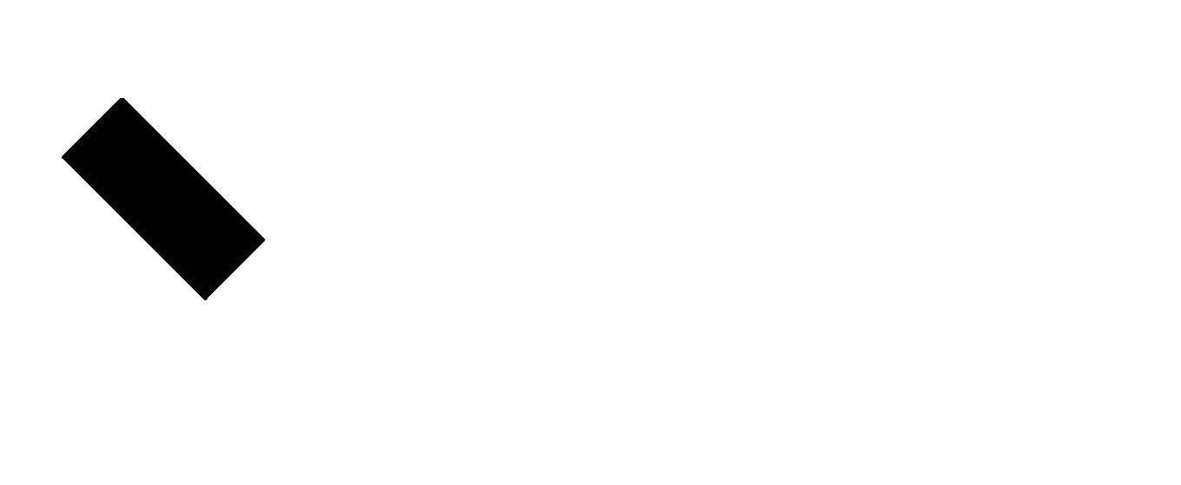
Black Stripe moves to the right

Slide 14

When covered, its perceived as moving Perpendicular to edge !!!

Slide 15

When covered, its perceived as moving Perpendicular to edge !!!

Slide 16
Aperture Problem demo is DONE
So, we understand that a single equation cannot solve for answers.
A single equation only provides the component of motion that is perpendicular to the edge. The component that is ALONG THE EDGE is lost. This makes sense; try sliding a black rectangular shape , along the direction of its longer side when viewed thru a small window , similar to the type of small RED covering we used; the motion will not be visible.
Had we tracked a corner viewed thru the RED covering’s aperture, the true direction of motion becomes readily perceptible. This is because the corner has two edge directions, so this is equivalent to providing a second (independent, because its gradient is different from the first equation’s) equation.
In practice, more than two equations are used to get 2d-motion.

Slide 17
Having 3 or more locations to measure
We must assume that the three (or more) locations are coming from different gradients, so that the equations are independent.
With exactly two equations, the solution technique is the straightforward one, just simply invert the 2x2 matrix, and obtain the solution for (u,v). However, for this to be reliable, the two gradients and two temporal derivative calculations would have had to have been perfect.
It is better to use many locations and then to use some form of averaging, or least squares solution.

Slide 18
Having 3 or more locations to measure
We must assume that the three (or more) locations are coming from different gradients, so that the equations are independent.
With exactly two equations, the solution technique is the straightforward one, just simply invert the 2x2 matrix, and obtain the solution for (u,v). However, for this to be reliable, the two gradients and two temporal derivative calculations would have had to have been perfect.
It is better to use many locations and then to use some form of averaging, or least squares solution.

Slide 19
Having 3 or more locations to measure
We must assume that the three (or more) locations are coming from different gradients, so that the equations are independent.
With exactly two equations, the solution technique is the straightforward one, just simply invert the 2x2 matrix, and obtain the solution for (u,v). However, for this to be reliable, the two gradients and two temporal derivative calculations would have had to have been perfect.
It is better to use many locations and then to use some form of averaging, or least squares solution.

