Slide 1
Introduction to Python and Keras
Part I

Slide 2
Outline
Python Basics
Data Structures: Lists, Tuples, Dictionaries
Functions
Classes
Debugging
Modules & Packages
File Handling
Numpy Fundamentals
Content credit: Dr. Niels Lobo, Kishan, Aisha, Stanford slides, and Kartik.

Slide 3
Python
What?
High-level, Object-Oriented programming language
Interactive, Interpreted language - evaluated at run-time one line at a time
Why?
Easy to learn - close to pseudocode or natural language
Useful for quick prototyping
Open source support from 10000s of contributors around the world
Becoming industry standards for many CS fields
Where?
Backend Web-applications
Numeric and Scientific Computing
Artificial Intelligence, Machine Learning, Deep Learning

Slide 4
How is it Different Than Java/C++?
Python3
pi = 3.14
y = pi + 7
name = “Robot”
5 > 10 # => False
True and False # => False
not False # => True
for i in range(10):
print(‘Index’, i)
Jave/C++
double pi = 3.14;
double y = pi + 7;
String name = “Robot”; // Java
string name(“Robot”); // C++
5 > 10 // => false
true && false // => false
!(false) // => true
for(int i = 0; i < 10; ++i){ // C++
cout << “Index” << i;
}
Variables are not statically typed, and indentation, rather than curly braces, defines blocks.

Slide 5
How to Run on My Computer?
Use Python 3.4+ (Preferably 3.6)
MacOSX & Linux: Pre-installed
Note: DO NOT uninstall the pre-installed version (2.X) of Python on your Mac
Windows: https://www.python.org/downloads/
Type python3 or python in terminal/console/cmd to enter Interactive Mode
The >>> means the interactive mode is waiting for your input
To exit the interactive mode, type exit()
Source code files have extension .py
Run files using python3 filename.py

Slide 6
How to Run on My Computer?
The information on the previous slide is meant to be informative only! We will be using Anaconda in the next lecture, which will handle the Python installation for you.
Best option for in-class: https://repl.it/languages/python3
Online editor that does not require any installations
Good for new users to experiment with Python syntax
Another useful tool is Jupyter Notebook
Interactive python environment
Installed automatically with Anaconda installation
All of the following code was executed in Jupyter Notebook & can be found at https://colab.research.google.com/drive/1FBusHR5hMPU7Qy1o8BgBK5LmGM0rup4Q

Slide 7
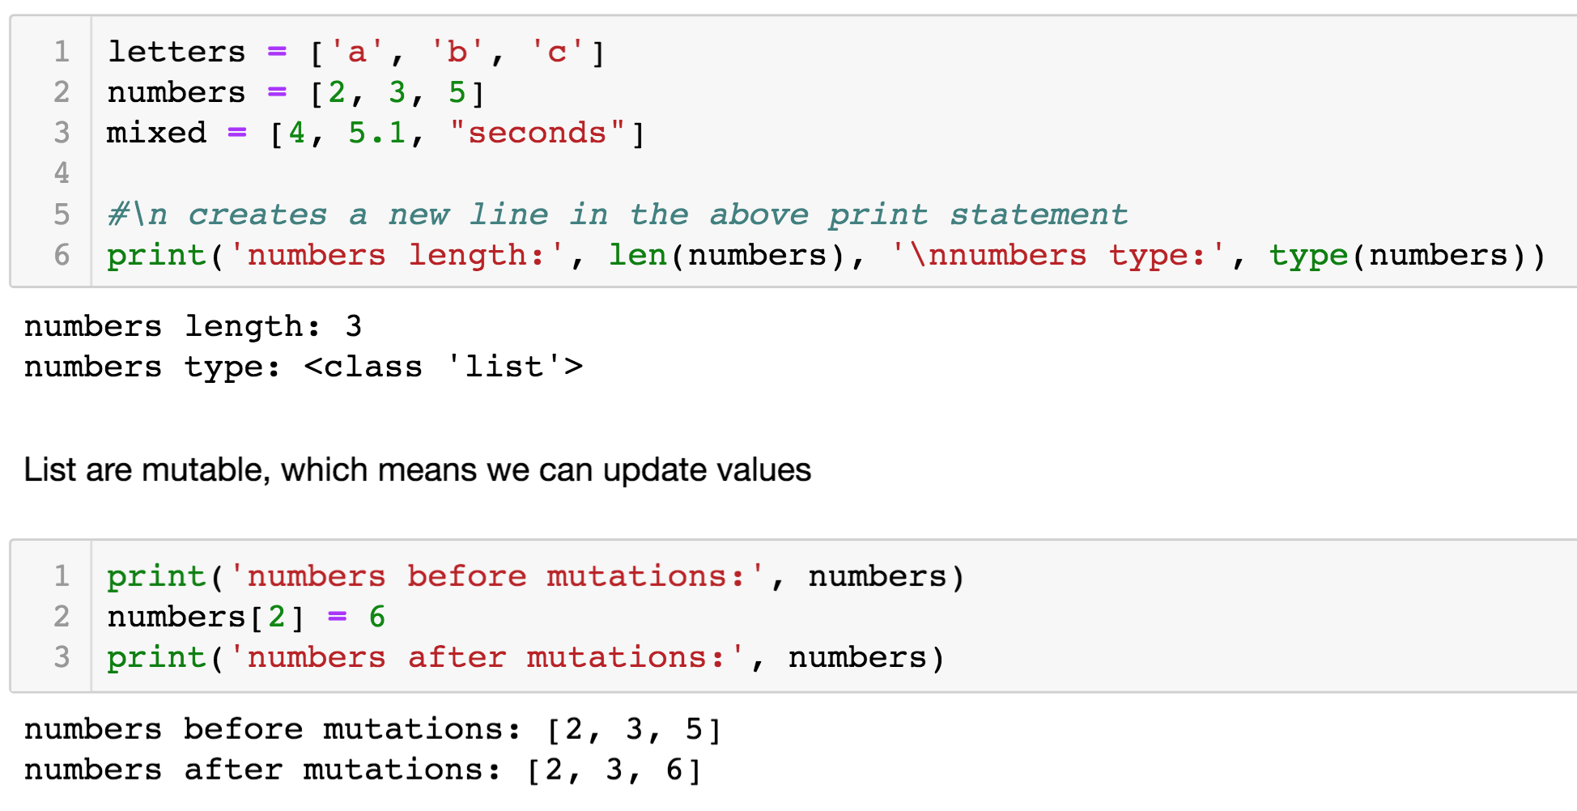
Data Structures – Lists

Slide 8
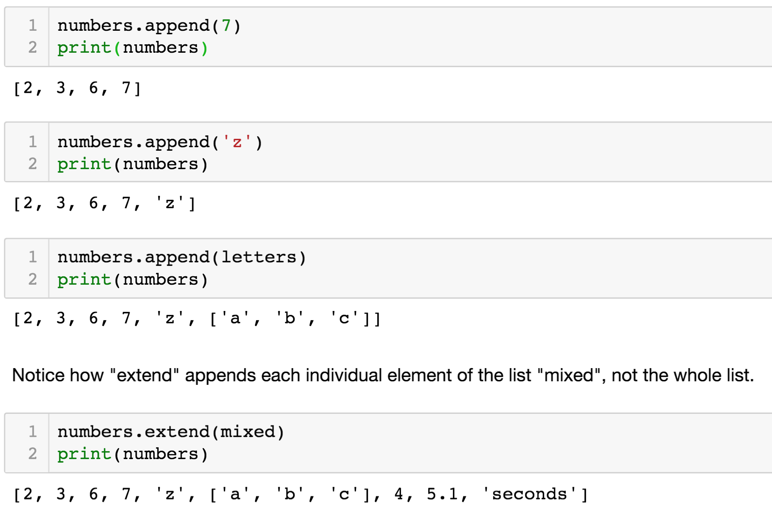
Data Structures – Lists: Append & Extend

Slide 9
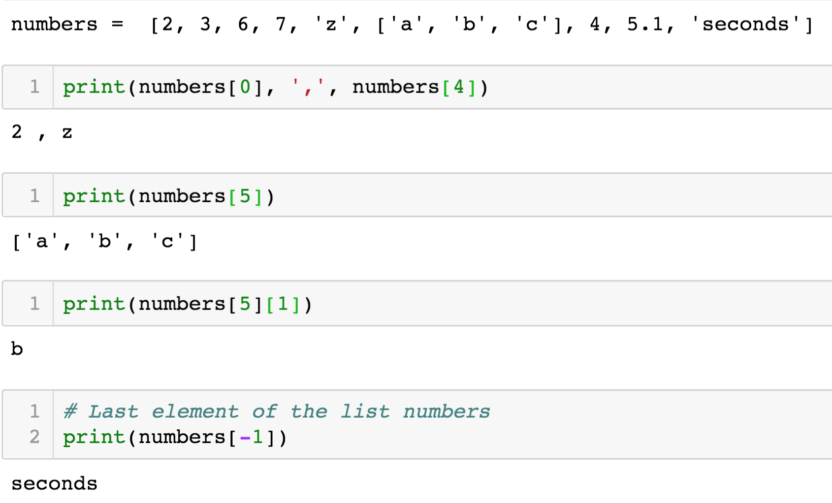
Data Structures – Lists: Indexing

Slide 10
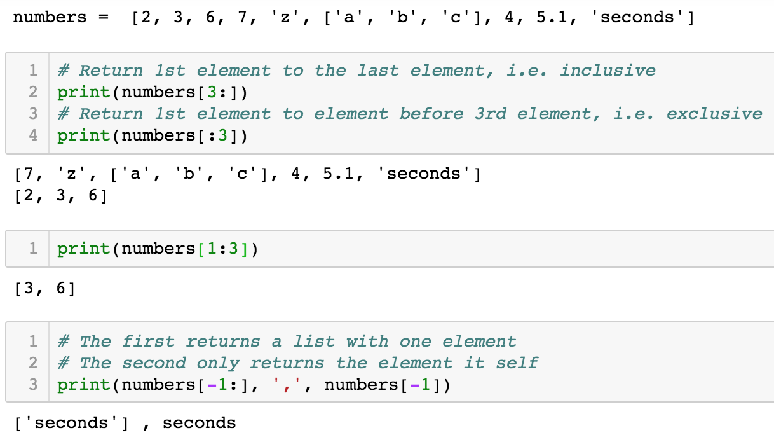
Data Structures – Lists: Slicing

Slide 11
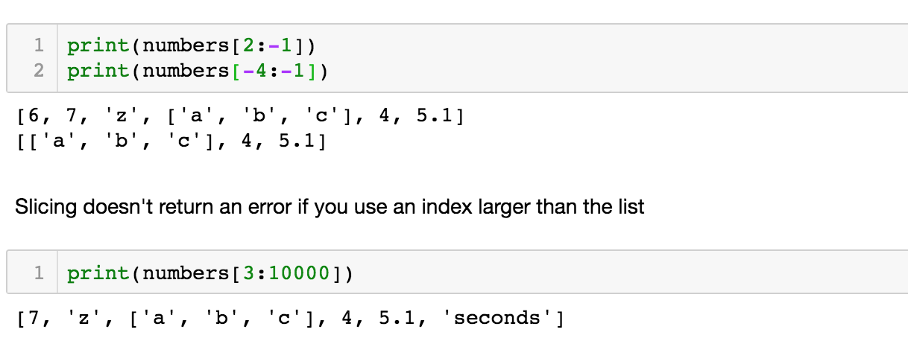
Data Structures – Lists: Slicing

Slide 12
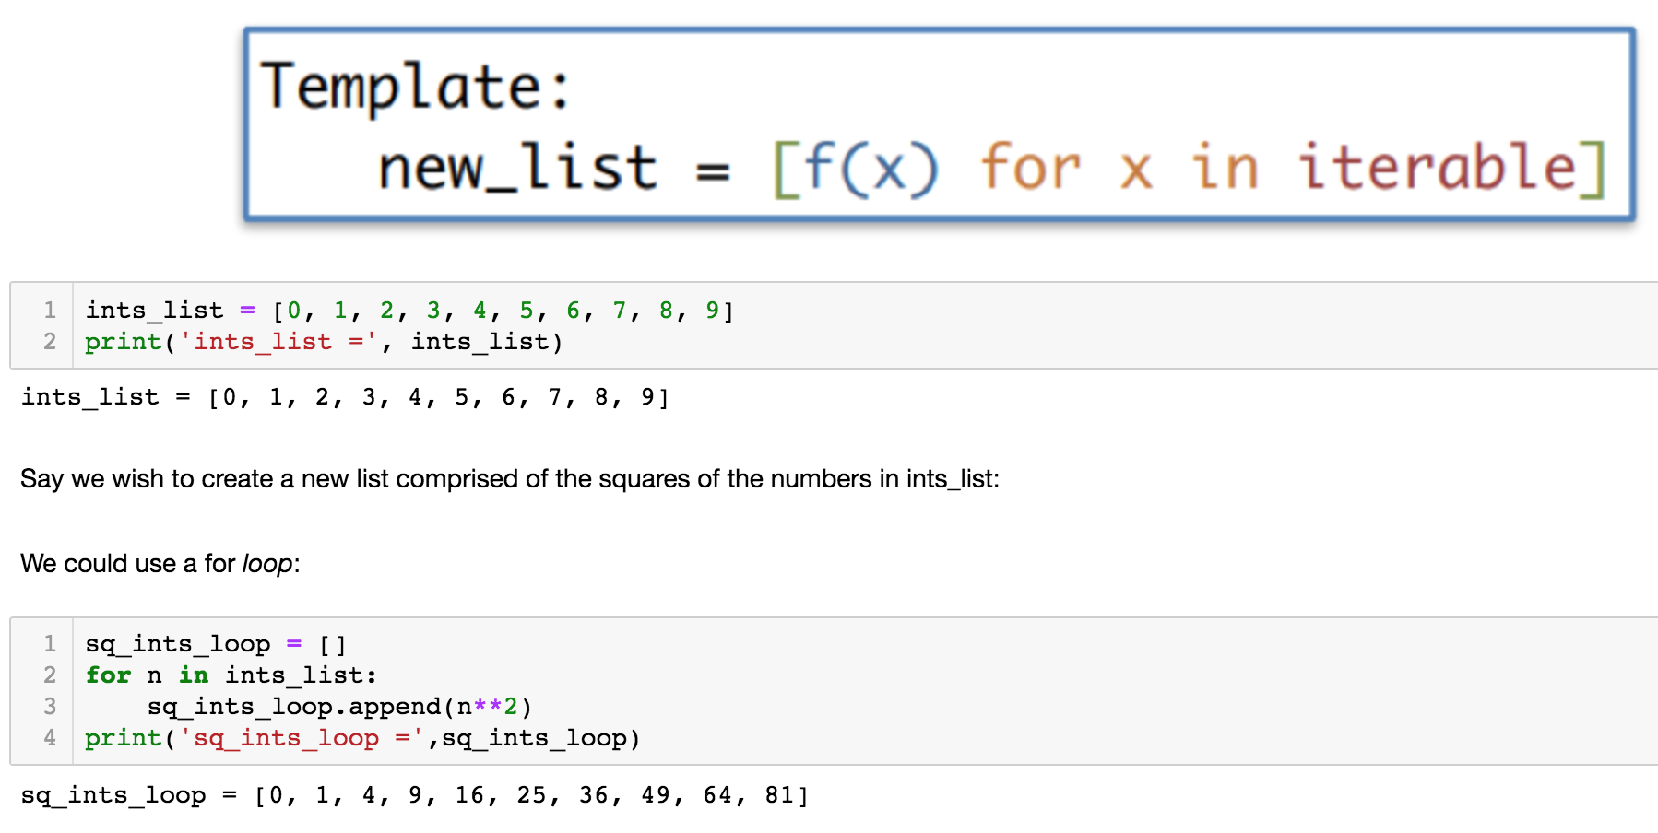
Data Structures – Lists: List Comprehension

Slide 13
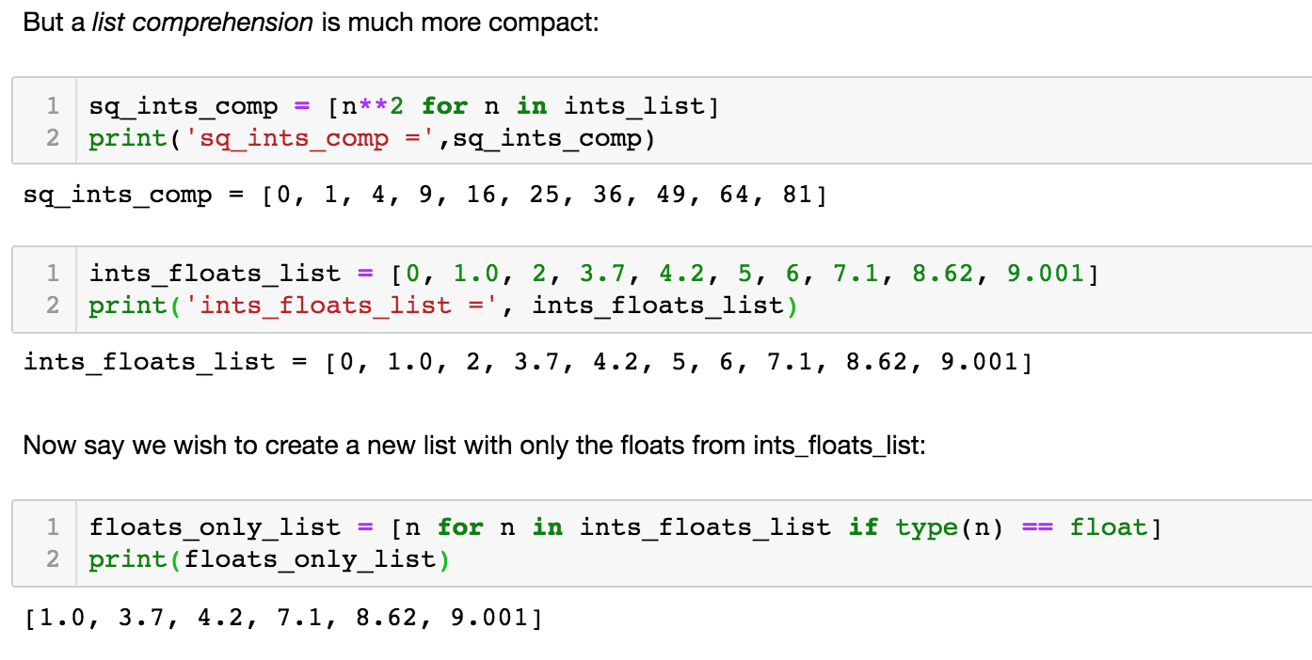
Data Structures – Lists: List Comprehension

Slide 14
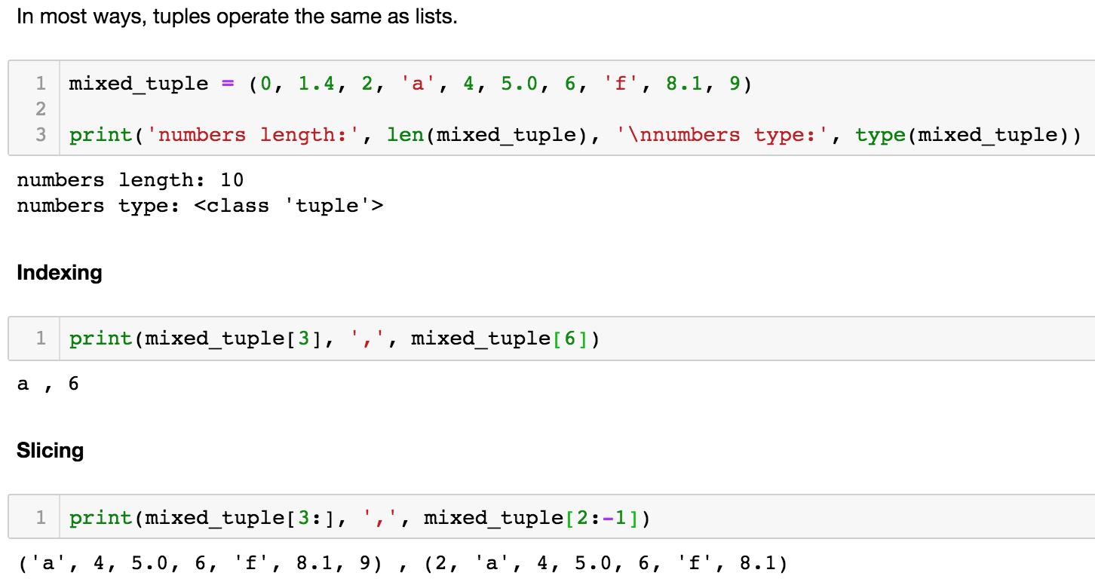
Data Structures - Tuples

Slide 15
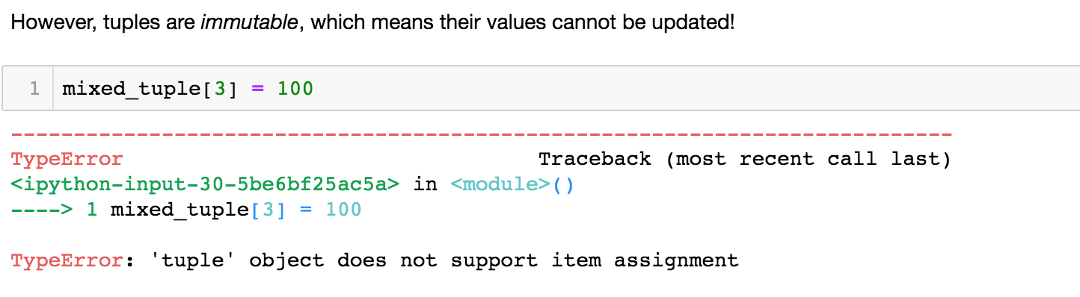
Data Structures - Tuples

Slide 16
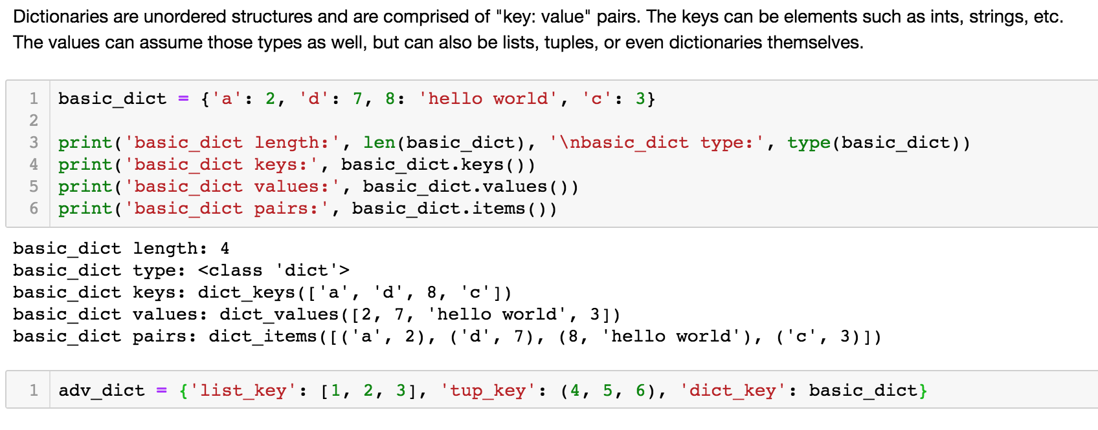
Data Structures - Dictionaries

Slide 17
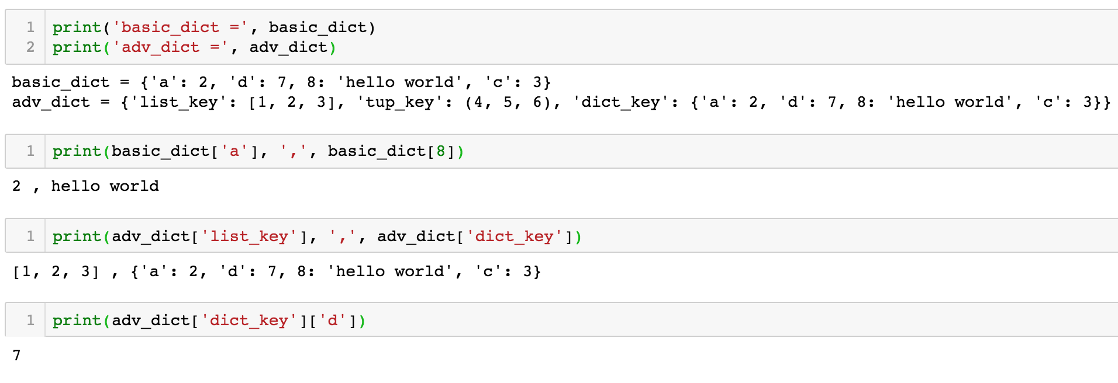
Data Structures – Dictionaries: “Indexing”

Slide 18
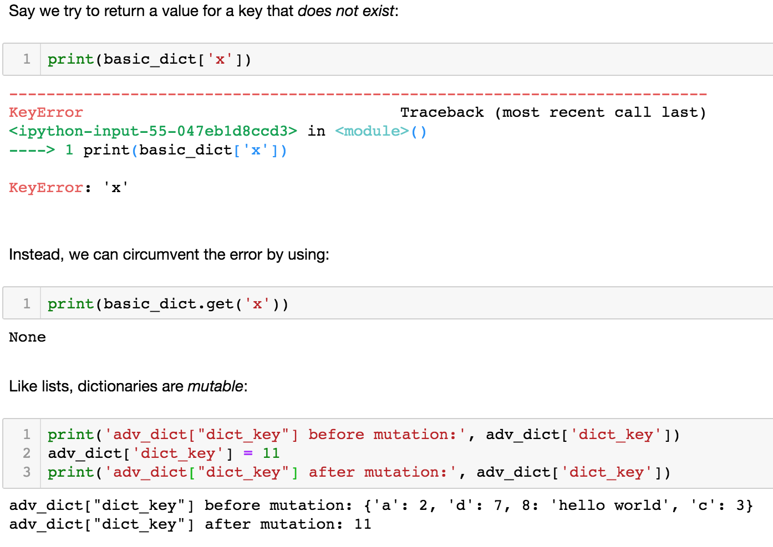
Data Structures – Dictionaries: “Indexing”

Slide 19
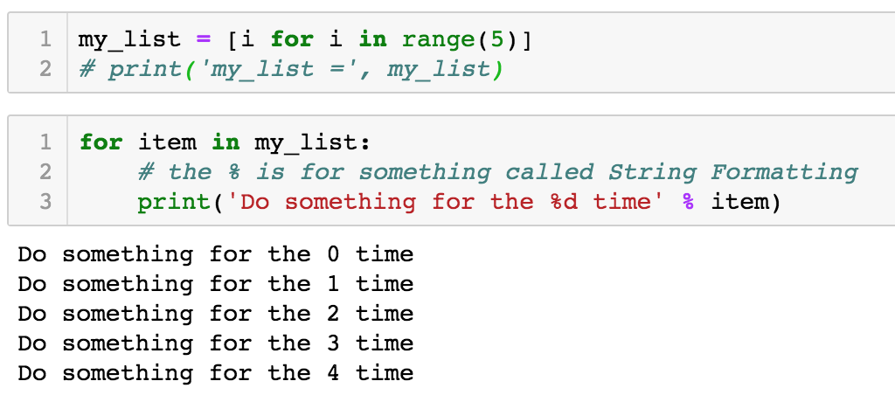
Data Structures – Iterating Over Lists

Slide 20
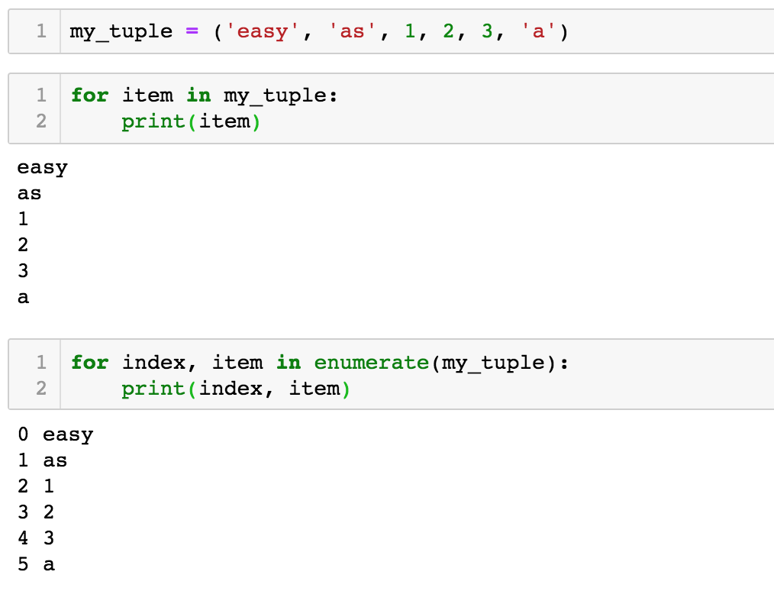
Data Structures – Iterating Over Tuples

Slide 21
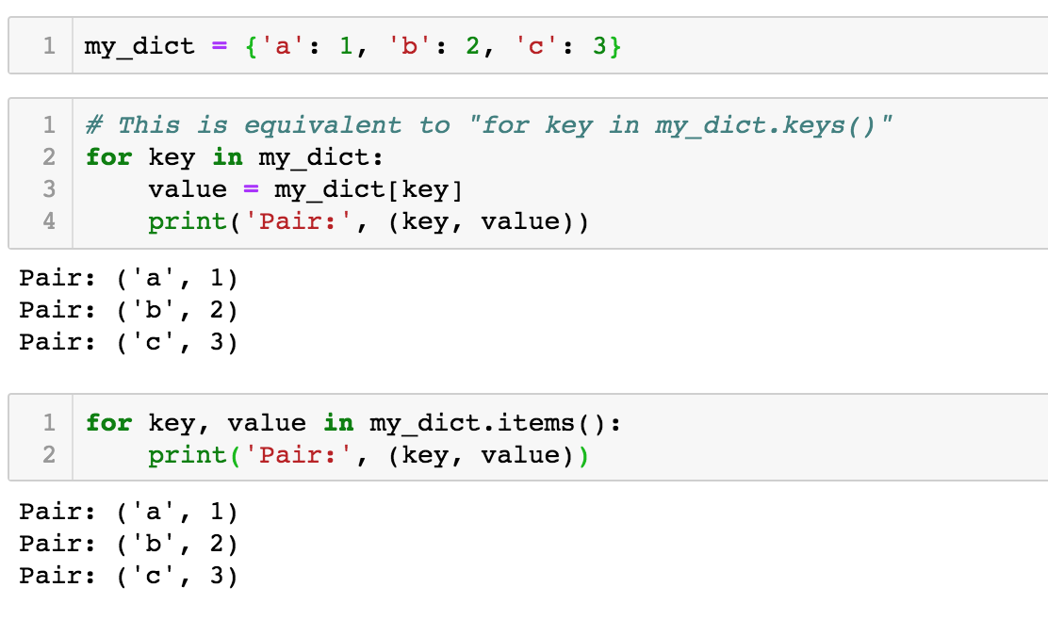
Data Structures – Iterating Over Dictionaries

Slide 22
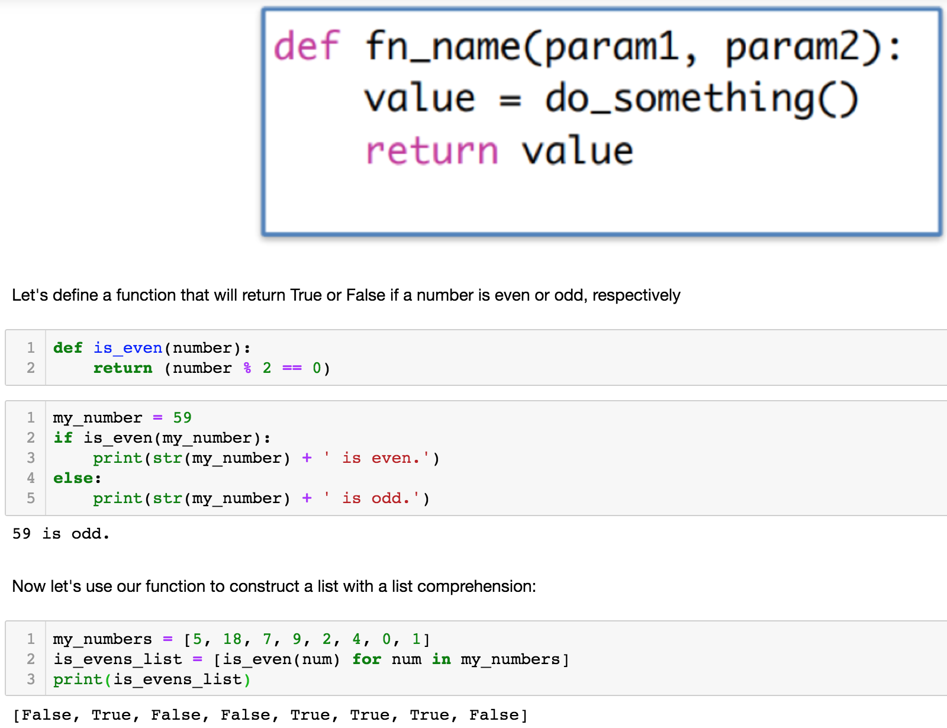
Functions

Slide 23
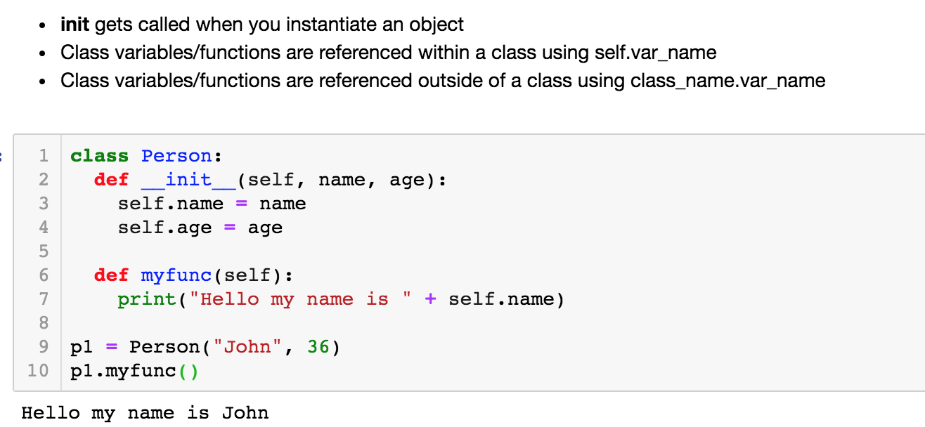
Classes

Slide 24
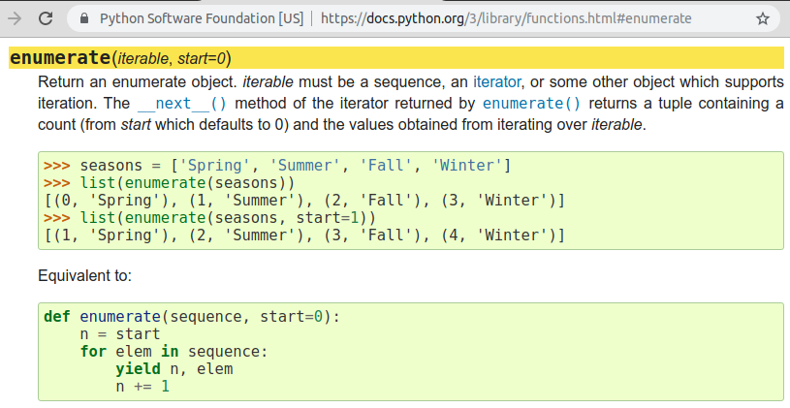
Aside - Referring to Python Documentation
If unsure, look for documentation. For example, https://docs.python.org/3/library/functions.html#enumerate.

Slide 25
Debugging
Print line debugging
Add print statements at various points in your code.
Print strings using format function for conciseness:
print(‘x, y, z are {}, {}, {}’.format(x, y, z))
Python debugger (pdb)
Import module pdb using import pdb (More on this later).
Set a breakpoint (where execution will stop for your action) using pdb.set_trace():
n to step to the next line in the current function.
s to step into a function.
c to continue to the next breakpoint.

Slide 26
Importing Modules/Libraries
Importing the entire module
Good practice to keep namespaces separate.
E.g. import math, import random, etc.
Access functions using math.exp(0.5), random.random(), etc.
Importing functions from modules
More concise code.
E.g. from math import exp, from random import random, etc.
Access functions directly using exp(0.5), random(), etc.
Do not reinvent the wheel - Use existing modules (e.g. os, math, sys, numpy, scikit, etc.) whenever you can as they provide access to many useful functions.

Slide 27
File Handling
Python can handle a number of file formats with relative ease including TXT, CSV, HTML, JSON, and Pickle.
The open() function returns a file object and is commonly used as follows:
open(filename, mode) where mode is one commonly one of the following:
‘r’ for reading.
‘w’ for writing.
‘x’ for creating and writing to a new file.
‘a’ for appending to a file.
‘r+’ for reading and writing to the same file.
‘rb’ and ‘wb’ respectively for reading and writing in binary mode.

Slide 28
File Handling
Reading the complete file in one go using read():
Reading a fixed size and returning as a string in text mode (or bytes in binary mode):
Reading a line at a time using readlines() is usually memory efficient, and fast.:
with open(‘workfile’) as f:
read_data = f.read()
print(f.closed) # True
f.read(size)
with open(‘workfile’) as f:
lines = f.readlines()
for line in lines:
print(line)

Slide 29
File Handling - JSON and Pickle
json module can convert data hierarchies to string called serializing.
Identical functions for pickle module.
Reconstructing the data from string representation is deserializing.
import json
data = [1, ‘simple’, ‘list’]
string_data = json.dumps(data) # Serializing to string ‘[1, “simple”, “list”]’
with open(filepath, ‘w’) as f:
json.dump(data, f) # Serialized data to a file
data = json.loads(string_data) # Deserializing from string
with open(filepath, ‘r’) as f:
data = json.load(f) # Deserialized string from a file

Slide 30
Numpy
Flexibility of Python data types lack computational speed.
Numpy contains operations and functions optimized for fast numerical calculations, especially on large multi-dimensional data.
Wildly popular among the Python scientific community.
Sister library for scientific computations: Scipy
Import using import numpy as np for further exercises:
Note - If a library is not found on your machine, install it using pip or conda (more on that later).

Slide 31
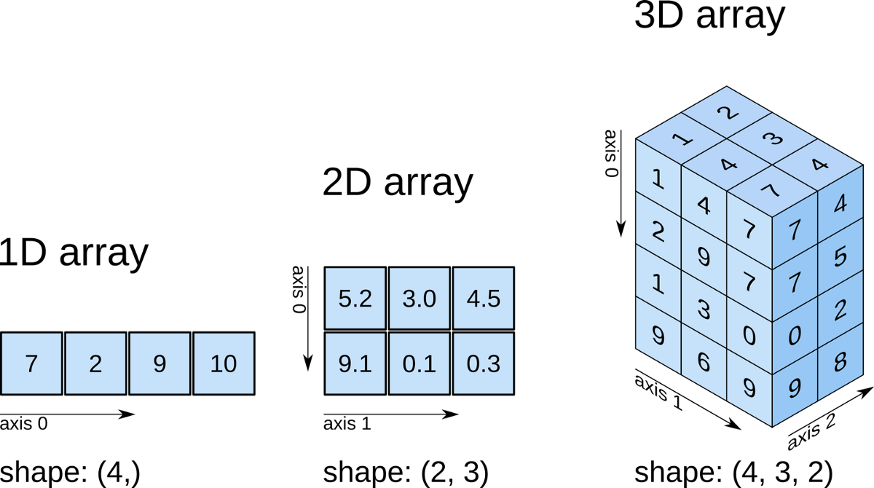
Numpy Terminologies
A Numpy array is a grid of values indexed by a tuple of non-negative integers.
ND-array:
1D-arrays have the shape (p, ).
2D-arrays have the shape (p, q) … and so on.
Axis refers to the dimensions:
Axis 0 - Along the rows.
Axis 1 - Along the columns.
Axis 2 - Along the third dimension

Slide 32
Numpy Examples
Functions to create matrices of specific values:
Multi-dimensional indexing using commas and printing shape:
Built-in linear algebra operations:
Supports broadcasting to carry out a single operation on all the matrix elements in a vectorized fashion (i.e. fast).
matrix = np.ones((3, 3))
matrix[1, 1] = 5
# [[1. 1. 1.]
# [1. 5. 1.]
# [1. 1. 1.]]
print(matrix.shape) # (3, 3)
vector = np.array([1, 2, 3])
product = np.dot(matrix, vector) # [6. 14. 6.]
result = vector + product # [7. 16. 9.]
np.all(np.abs(result) < 15) # False
# Since absolute value of all the elements in
# result is not less than 15

Slide 33
Numpy Examples
# ND-arrays of zeros or ones
Z = np.zeros((2, 2)) # 2x2 array
O = np.ones((1, 2, 3)) # 1x2x3 array
I = np.eye(3, 3) # Identity matrix of size 3
# Creates a 2D array of size 2x4 of random values drawn from a uniform distribution [0, 1).
X = np.random.rand(2, 4)
X = np.random.normal(mean, std, size) # Normal distribution with user defined mean and standard deviation
# Following math broadcasted operations for x and y of same size
A = np.add(x, y)
S = np.subtract(x, y)
M = np.multiply(x, y)
D = np.divide(x, y)

Slide 34
Numpy Array Handling
Assignment operator (=) assigns the reference to the array instead of making a copy of it.
Use np.copy(array) to make a copy and perform manipulations on the new array.
Data-type conversion using astype:
Y = X.astype(int) or any other of the valid data types.
Reshape array making sure the number of elements stay the same:
Y = np.reshape(X, (2,4)) # Here, X must have eight values or the operation will throw error.
Concatenating and stacking along an axis:
Z = np.concatenate((X, Y), axis = 0) # X and Y must have same shape everywhere except axis 0.
Z = np.vstack((X, Y)) # Stacks along rows.
Z = np.hstack((X, Y)) # Stacks along columns.

