Slide 1
Introduction to Python and Keras
Part II

Slide 2
Outline
Anaconda Installation
Create “conda” Environment
Install Necessary Packages
Pycharm Installation
Import and Run Code in Pycharm
Jupyter Notebooks
Keras
MNIST

Slide 3

Anaconda - Installation
Anaconda can help you install and manage all the libraries you are going to need for your machine learning/computer vision tasks.
The installation instructions for the following platforms are linked below:
Windows - https://docs.anaconda.com/anaconda/install/windows/
MacOS - https://docs.anaconda.com/anaconda/install/mac-os/
Linux - https://docs.anaconda.com/anaconda/install/linux/
The instructions are very clear and helpful. We recommend following them precisely.
At the end of these instructions, there will be a link to install Pycharm. Save this link. We’ll use it in a few slides.
(We recommend that you use Anaconda 3 with Python 3.6 on a Unix based system (a popular Linux distro like Ubuntu or Mac) so that we can help you with debugging errors at a later stage.)

Slide 4
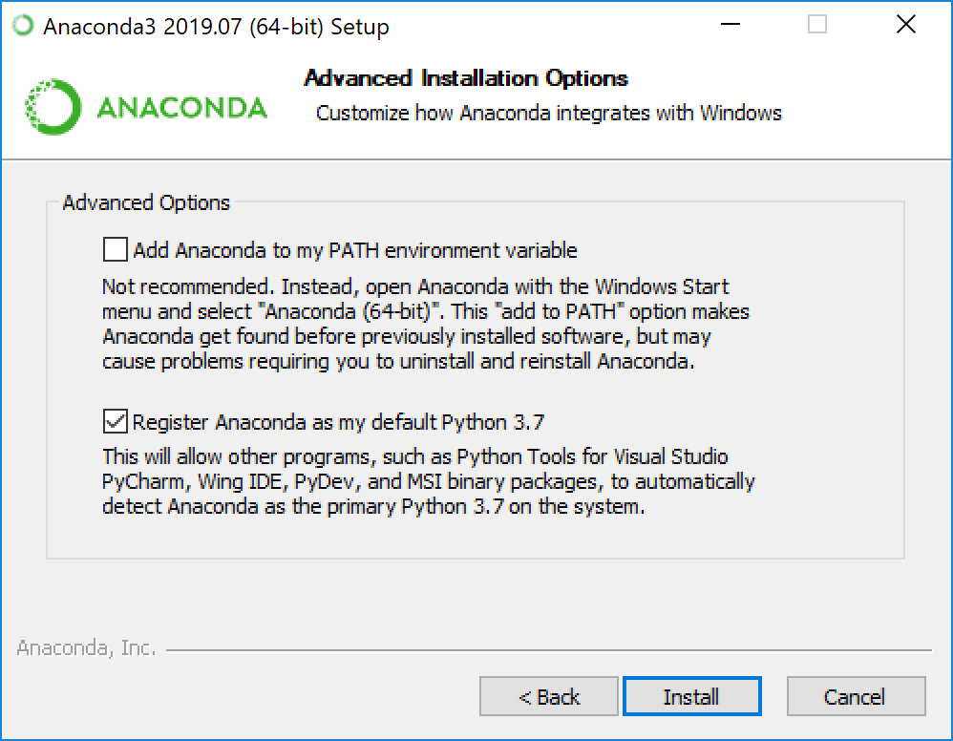
Anaconda – Advanced Users Only
Be Careful with Replacing Existing Stuff
If you have existing projects that strictly depend on a certain version of Python, unchecking options like the one shown may be needed. Same applies for command-line installation i.e. select no (type n).
NOTE: If you do not understand this page, simply follow the Anaconda instructions from the previous page.

Slide 5
Anaconda - Environments
Anaconda virtual environments are workspaces isolated from the rest of your machine. They keep dependencies required by different projects separate
Create an environment:
Mac/Linux (in terminal/shell):
Create: conda create -n yourenvname python=3.6 anaconda
Activate: source activate yourenvname or conda activate yourenvname
Deactivate: deactivate yourenvname
Windows (in Anaconda Prompt):
Create: conda create -n yourenvname python=3.6 anaconda
Activate: activate yourenvname
Deactivate: deactivate yourenvname

Slide 6
Anaconda - Environments
By including the command “anaconda” at the end when creating an environment, all standard packages will be installed.
Once your environment is activated:
List all installed packages with conda list:
This is very useful to check if certain packages are currently installed
Install new packages (specifically the ones we’ll need):
Tensorflow: conda install tensorflow (don’t have GPU) or conda install tensorflow-gpu (you have GPU)
Keras: conda install -c conda-forge keras
Note: Google ”conda install your_package” before installing anything
Problem? Visit the docs at:
https://docs.conda.io/projects/conda/en/latest/user-guide/tasks/manage-environments.html

Slide 7
pip vs. Anaconda
If any library such as numpy, scipy, matplotlib, etc. cannot be installed using conda install -n yourenvname [package], it can probably be found under the pip package. Install pip using the above command and then install the desired library using pip install [package].
Libraries A-X
CONDA
Libraries D-Z
PIP Library

Slide 8

PyCharm
PyCharm is a powerful Integrated Development Environment (IDE) for Python projects.
Use the PyCharm installation link obtained at the final stage of your Anaconda installation (it can be found at https://www.jetbrains.com/pycharm/promo/anaconda/).
Use university email to obtain the Professional Edition for free.
PyCharm can help with auto-completing functions. VERY useful for new users.
NOTE: You can create conda environments and install packages using Pycharm. However, we highly recommend using the methods showed in the previous slides, i.e. via Terminal/Shell/Anaconda Prompt.

Slide 9
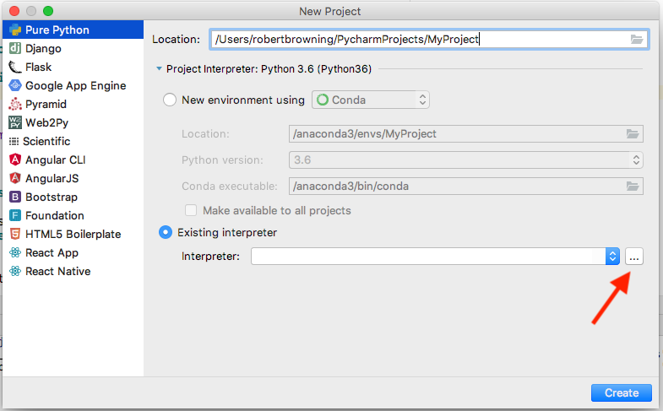
PyCharm – New Project Interpreter
Name your project
Click “Existing interpreter”
Select ”…” menu button

Slide 10
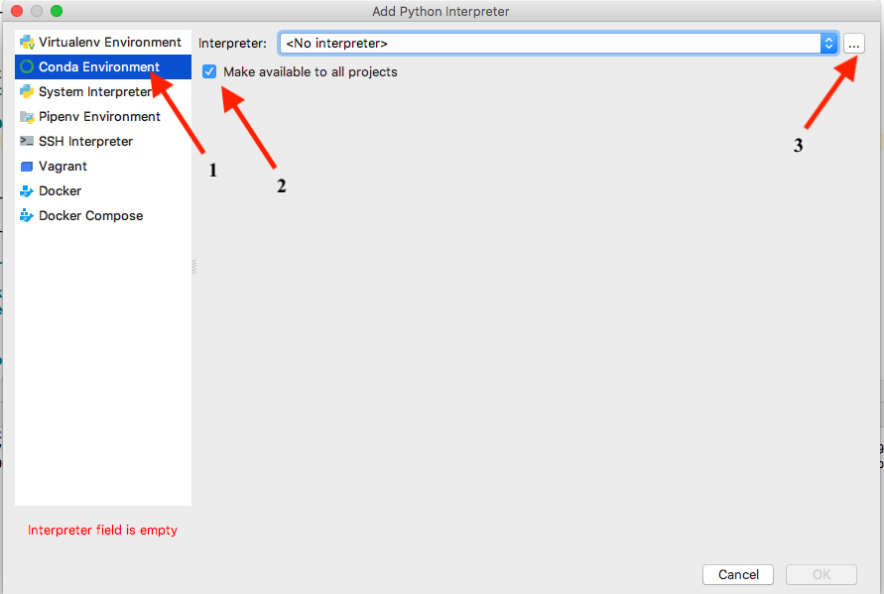
PyCharm – New Project Interpreter
Select “Conda Environment” from left hand menu bar
Click “Make available to all projects”
Select ”…” menu button

Slide 11
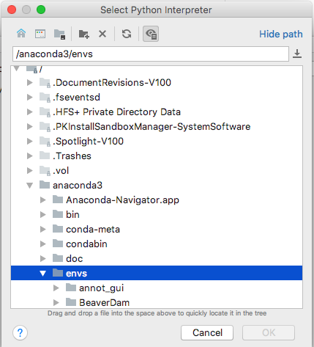
PyCharm – New Project Interpreter
Navigate to /anaconda3/envs/YourEnv/bin/python and select the ”python”, “python3”, ”python.exe”, or something similar
The above path may not be the exact same as on your machine. Navigate around until you find a similar directory, then look for the sub-directory listed in the above path
For additional help, the following tutorial is https://bit.ly/2X4wgFi very helpful

Slide 12
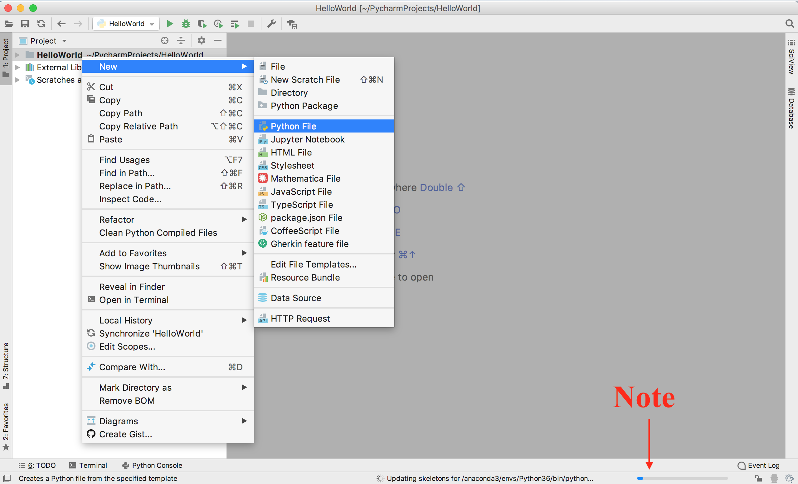
PyCharm – New Project
Right-click on project name in left hand menu bar
Select “New”
Select Python File
NOTE: Right after you open a new project, PyCharm might not run code for a short time. This is because it is updating system info.

Slide 13
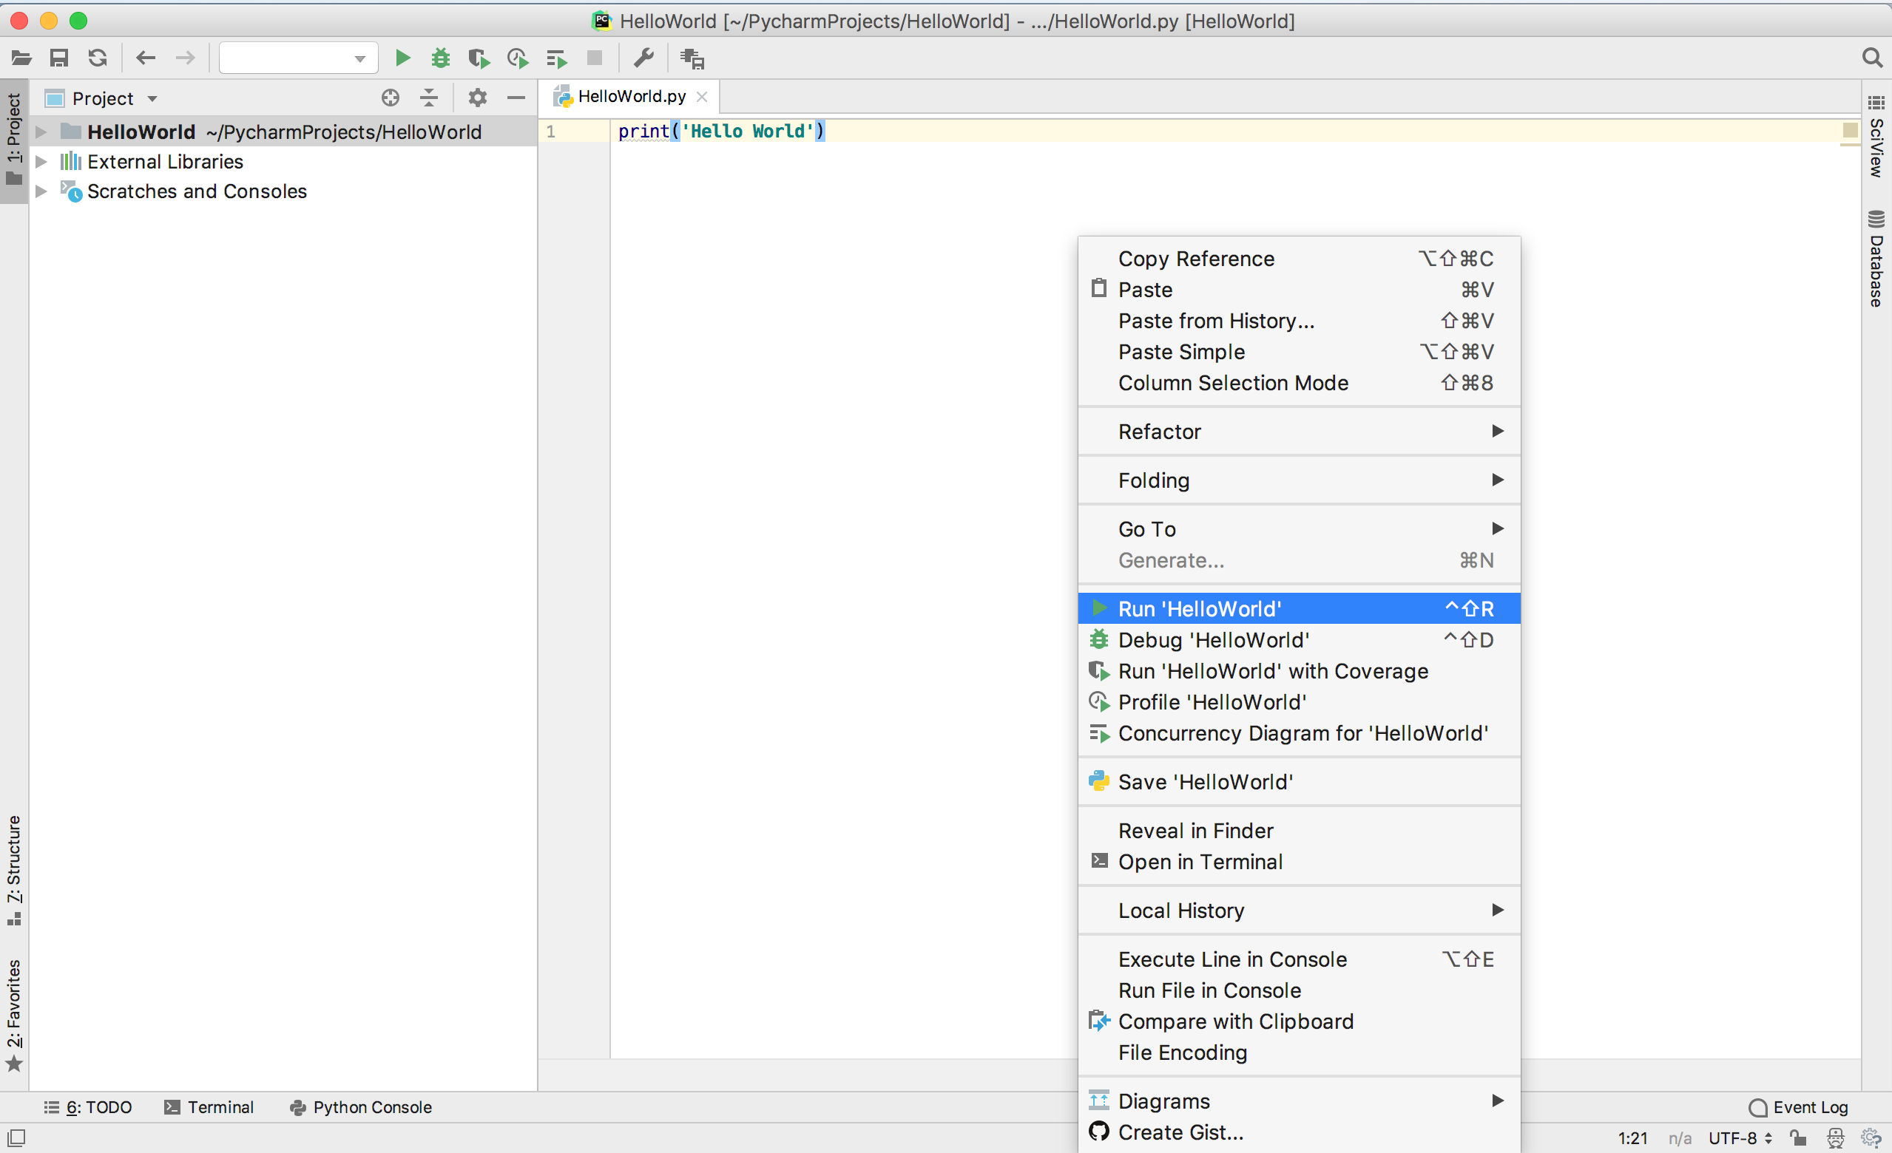
PyCharm – New Project
To run your code for the first time, right-click in the editor window and scroll down to “Run ‘MyCode’ “

Slide 14

Jupyter Notebooks
Allows you to edit and run your notebooks via a (local) web browser
Run one “cell” at a time. Helps to troubleshoot or experiment
Comes installed with Anaconda
To run a Jupyter Notebook, open Terminal/Shell/CMD and type
jupyter notebook

Slide 15
Keras
Among a bunch of deep learning frameworks, Keras is probably the easiest to begin with:
TensorFlow, Keras, PyTorch, Chainer, Caffe, Theano, etc.
Keras is:
A high-level neural network API with support for both CPU and GPU.
Modular - Building models can be as simple as stacking layers.
Useful for fast prototyping as we can ignore implementation details of backpropagation,
Open source - Large community support.
Comprehensive - Contains implementations of popular networks, datasets, etc.
Has luxury of using any backend from TensorFlow, Theano, or CNTK without change in code.

Slide 16
Pipeline to Implement an NN-based Model in Keras
Specify the input size and output size.
Design and define the NN architecture.
Select the optimizer that performs gradient descent.
Select the loss function and train the network for an objective.
Select appropriate evaluation metrics for the problem you’re working on.
Prepare input and specify size
(Images, videos, text, audio, etc.)
Define the NN model
(Sequential or Functional style)
(MLP, CNN, RNN, etc.)
Optimizers
(SGD, RMSprop, Adam, etc.)
Loss function
(MSE, Cross entropy, Hinge, etc.)
Train and evaluate the model

Slide 17
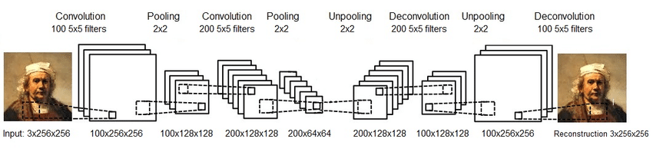
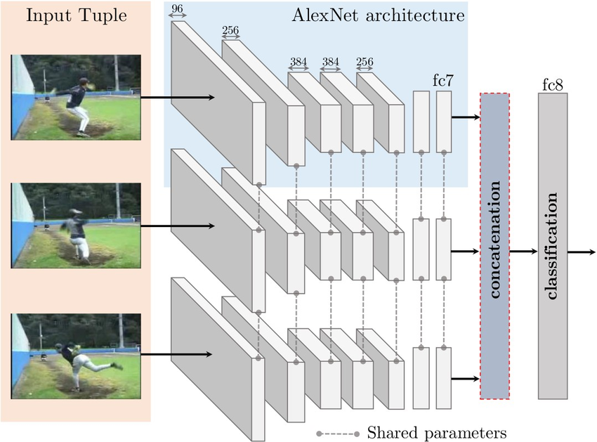
Keras Models
Sequential:
Linear stack of layers.
Useful for building:
Simple classification networks.
Encoder-Decoder networks.
Basically any single-flow network.
Under Keras as Sequential() class.
Functional:
Multi-input, multi-output models.
Supports, forking/branching of models.
Supports intermediate merging of models.
Under Keras as Model() class.

Slide 18
Sequential Model Code
Import Sequential class from keras.models.
Stack layers in a sequential object using .add() method.
Only the first layer needs to know the expected input dimensions as next layers can infer shape from the previous layers.
Configure the learning process i.e. loss functions, optimizers, etc. using the .compile() method.
Train the model using .fit() method on training set tensors (can be np arrays).
from keras.models import Sequential
from keras.layers import Dense, Activation
model = Sequential()
# Dense is Keras lingo for a fully connected layer
model.add(Dense(units=64, input_dim=100))
model.add(Activation(‘relu’))
model.add(Dense(units=10))
model.add(Activation(‘Softmax’))
model.compile(loss=’categorical_crossentropy’,
optimizer=’sgd’,
metrics=[‘accuracy’])
model.fit(X_train, Y_train, epochs=5, batch_size=32)

Slide 19
Functional Model Code
Import Model class from keras.models.
Each layer has to explicitly return a tensor.
Manually pass the returned tensor to any compatible layer.
Flexibility at the cost of a bit of code complexity.
Explicitly mention model inputs and outputs.
.compile() and .fit() same as a Sequential model.
from keras.models import Model
from keras.layers import Input, Dense
inputs = Input(shape=(784,))
x = Dense(64, activation=’relu’)(inputs)
x = Dense(64, activation=’relu’)(x)
predictions = Dense(10, activation=’softmax’)(x)
model = Model(inputs=inputs, outputs=predictions)
model.compile(loss=’categorical_crossentropy’,
optimizer=’rmsprop’,
metrics=[‘accuracy’])
model.fit(X_train, Y_train, epochs=5, batch_size=32)

Slide 20
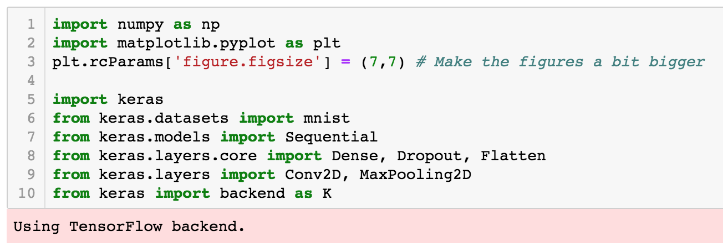
MNIST - Imports

Slide 21
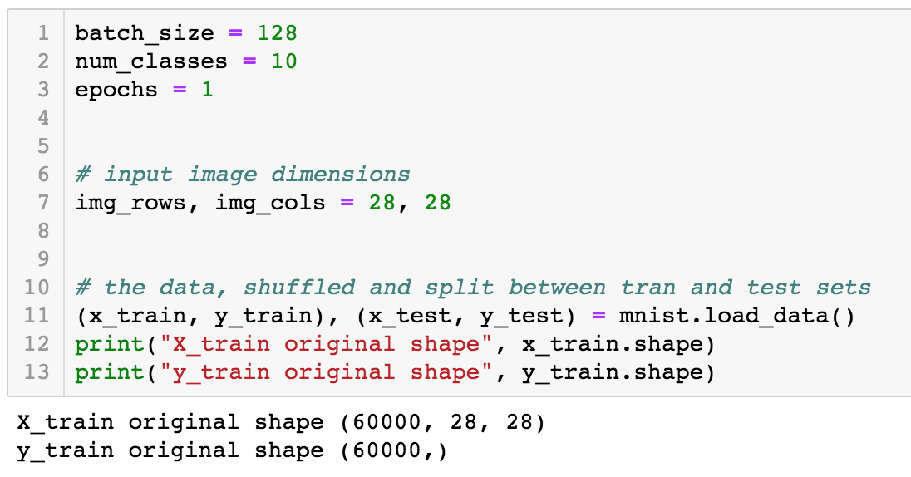
MNIST – Hyperparameters & Load Data

Slide 22
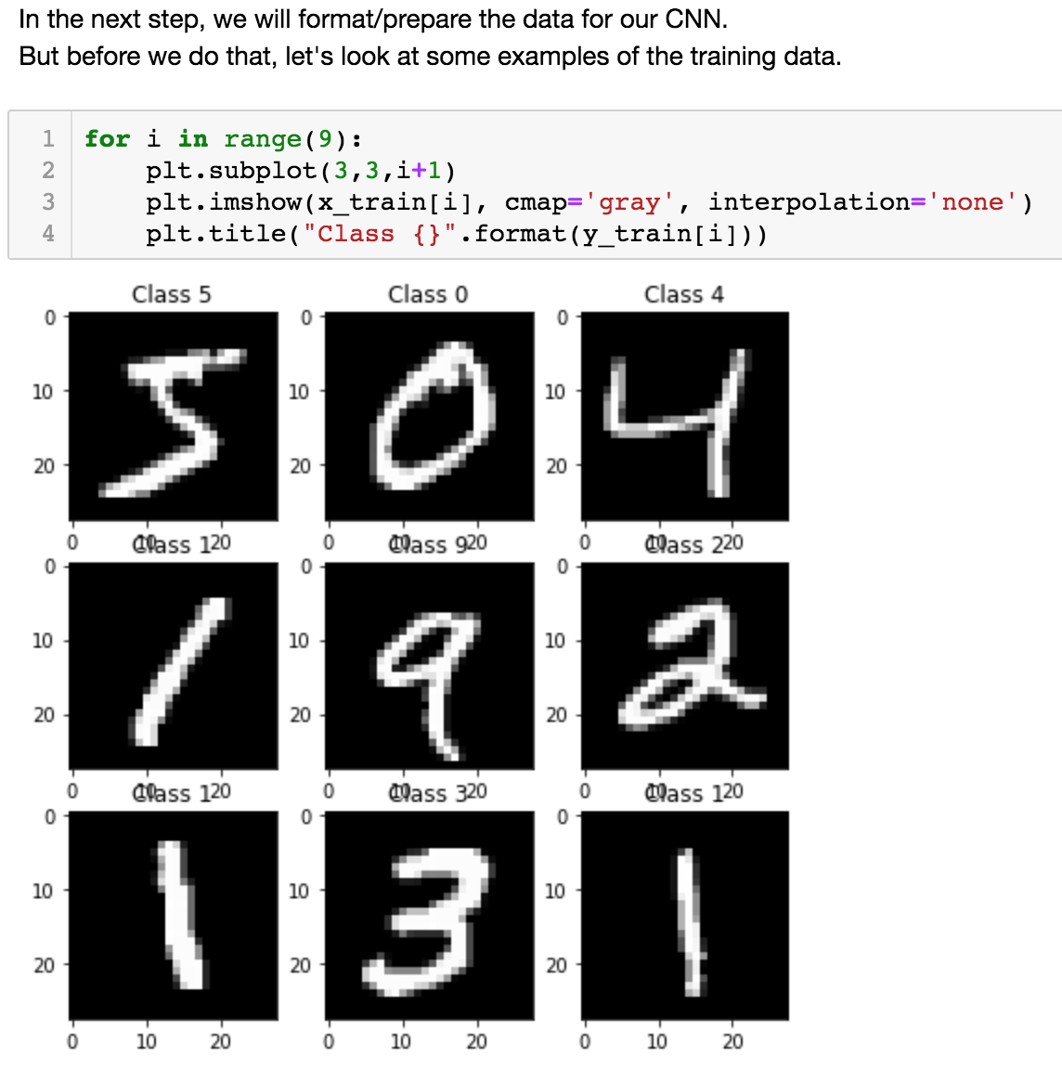
MNIST – Visualize Data

Slide 23
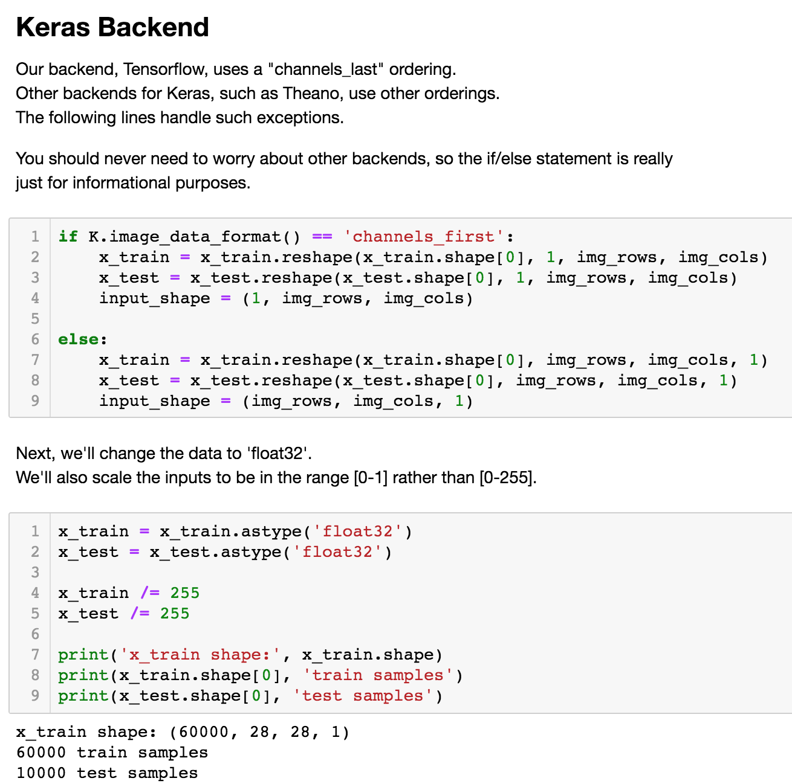
MNIST – Format Data

Slide 24
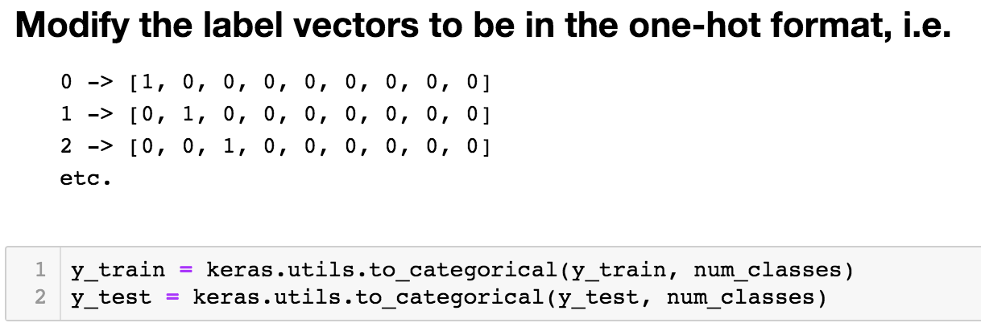
MNIST – Format Data

Slide 25
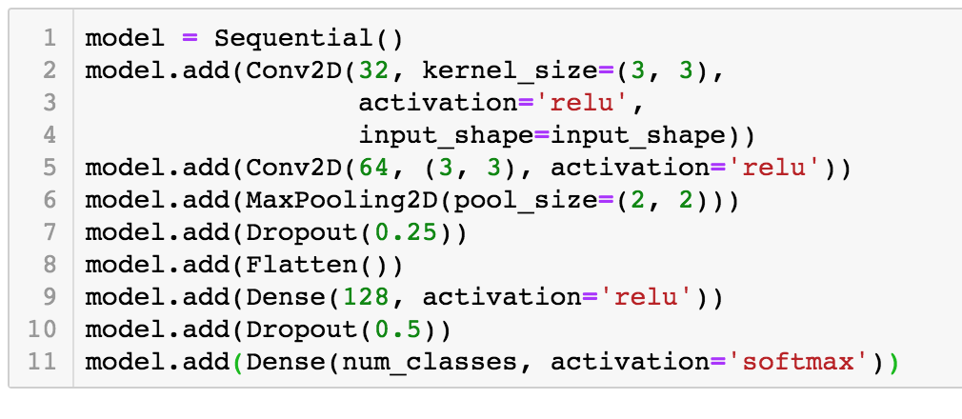
MNIST – Define Sequential Convolutional Model

Slide 26
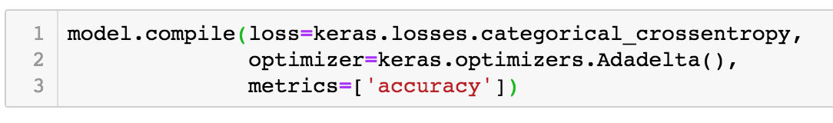
MNIST – Compile Model: Loss, Optimizer, Metrics

Slide 27
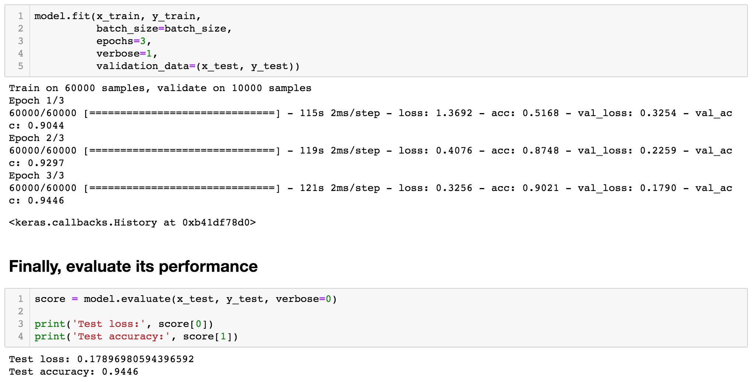
MNIST – Train & Test Model

Slide 28
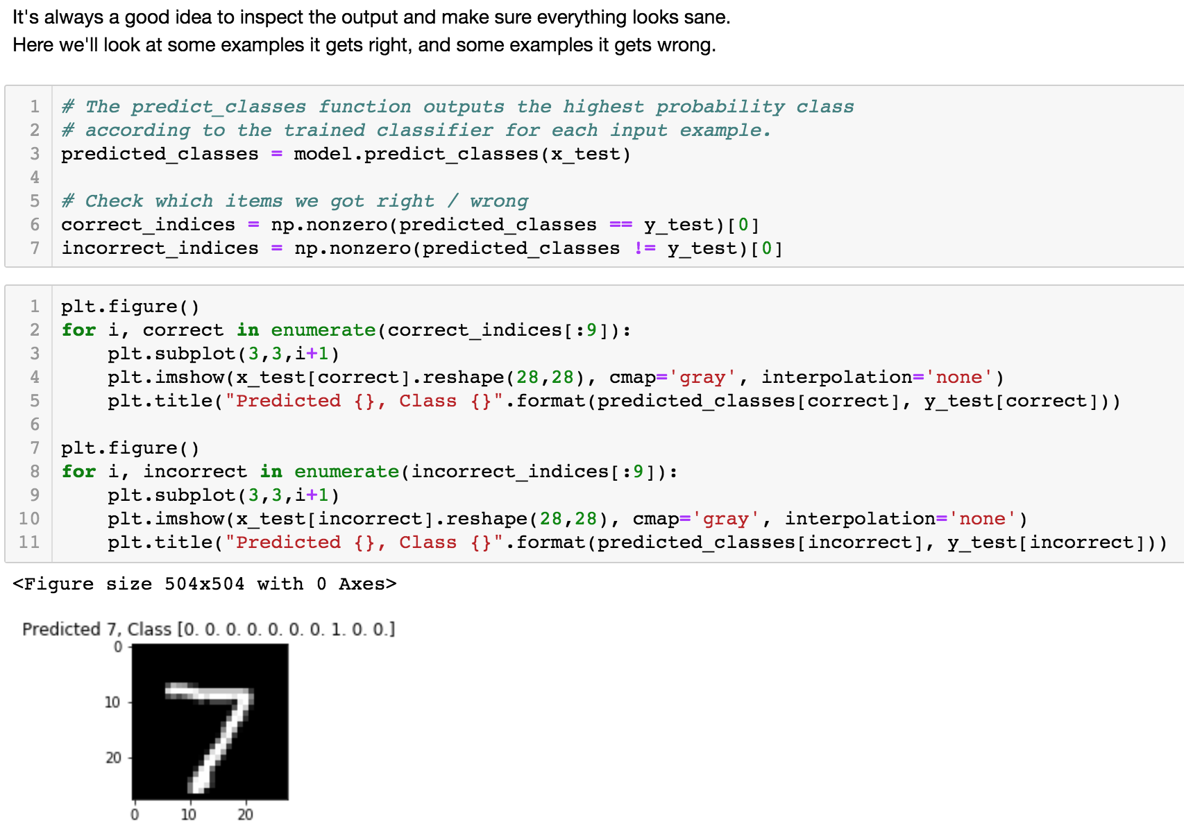
MNIST – Inspect Output

Slide 29
General Tips
Build a model step-by-step: move from simple to complicated models.
Train step-by-step: move from simple training (SGD) to using tricks.
Sanity check on noise, then overfit on a subset, then train on entire set.
Save and visualize all you can - models, predictions, data, tensor shapes, etc.
Refer documentation for default settings and whether they make sense for your problem (e.g. weight initialization, activation, learning rate, etc.).
Remember to deep-copy, and prefer functional over object-oriented approach if facing weird bugs (e.g. low = np.min(x) over low = x.min()).
Find more online (e.g. https://blog.slavv.com/37-reasons-why-your-neural-network-is-not-working-4020854bd607)

Slide 30
Afterword
The MNIST code above was implemented in a Jupyter Notebook and has been shared on Google CoLab at:
https://colab.research.google.com/drive/16PbFjJFwKyuOBSDQZzsy4qZKJVEsDCRe
For a complete (not in cells) version of the code, please visit:
https://keras.io/examples/mnist_cnn/
Once you have completed this example, we recommend that you try implementing the following, slightly more advanced experiment:
https://keras.io/examples/cifar10_cnn/

