Slide 1
Project 4
The Health Insurance Premium of Customers
ALY6000: Introduction to Analytics
Instructor: Ji-Young Yun
October 25, 2023
Notes:
We chose to study the dataset from Kaggle called “The Health Insurance Premium of Customers.” The dataset contains 76,855 records and 13 usable features.
For insurance companies, when a vast number of customers do not pay their premiums on time, the system cannot function smoothly. They cannot have a stable income stream to maintain their system. That is why investigating the impact of various factors on the healthcare premium system is crucial and analyzing the efficiency of the health insurance premiums can be used to develop better strategies for reducing healthcare costs and improving the operation of healthcare delivery.
Our goal is to find the distribution of the Health Insurance premium and target which factors can be considered to improve the premium payment efficiency.

Slide 2
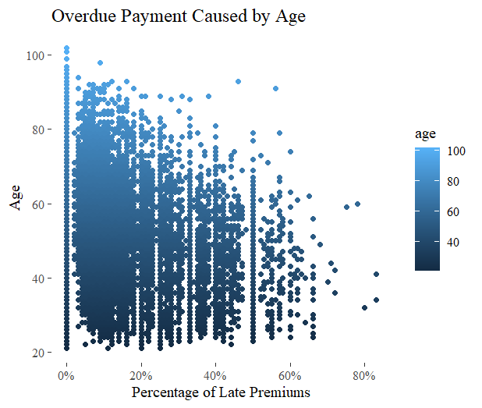
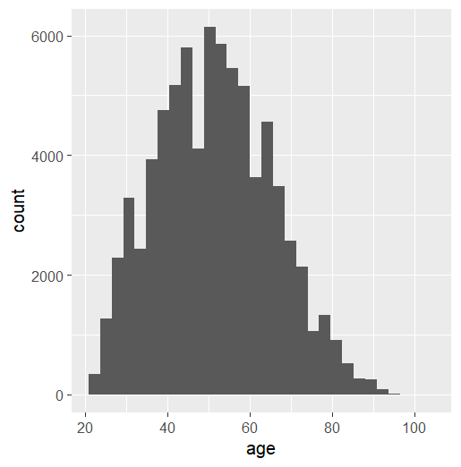
Q1: How does age affect the total times of overdue premiums?
The age range is between 21 to 102
Notes:
For the first question, a graph that is able to show me each case that falls into the age is needed, as well as the total number of late premiums, which makes the scatter plot the right fit.
The scatter plot shows that over 50% of the overdue premiums occur in the age group of 30-40. This age group has the highest proportion of people who are likely to forget to pay their premiums on time. This indicates that the age of the insured has a significant effect on the number of overdue premiums. Older insureds have more time to pay their premiums, while younger insureds are more likely to fall behind on their premiums. This suggests that insurance companies should consider the age as an important factor to consider when setting premiums. Companies should also consider providing extra assistance according to age to help them pay on time.

Slide 3
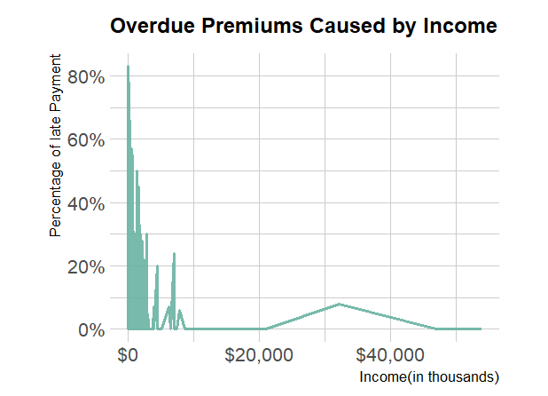
Q2: What income level is more likely to have an overdue premium?
Notes:
I use a line chart to present how the late premiums are affected by income.
It shows that the lower the income, the higher the number of late payments; the higher the income, almost 0% late payments.
It leads to the result that income is a factor that has a correlation.
This circumstance may be because the premium is not affordable for people who have lower income, or people have bad time management to pay the premium on time so this also affects their income. The people who have a high percentage of overdue payments have a relatively low salary, the accurate number of income will be demonstrated in the next two slides.

Slide 4
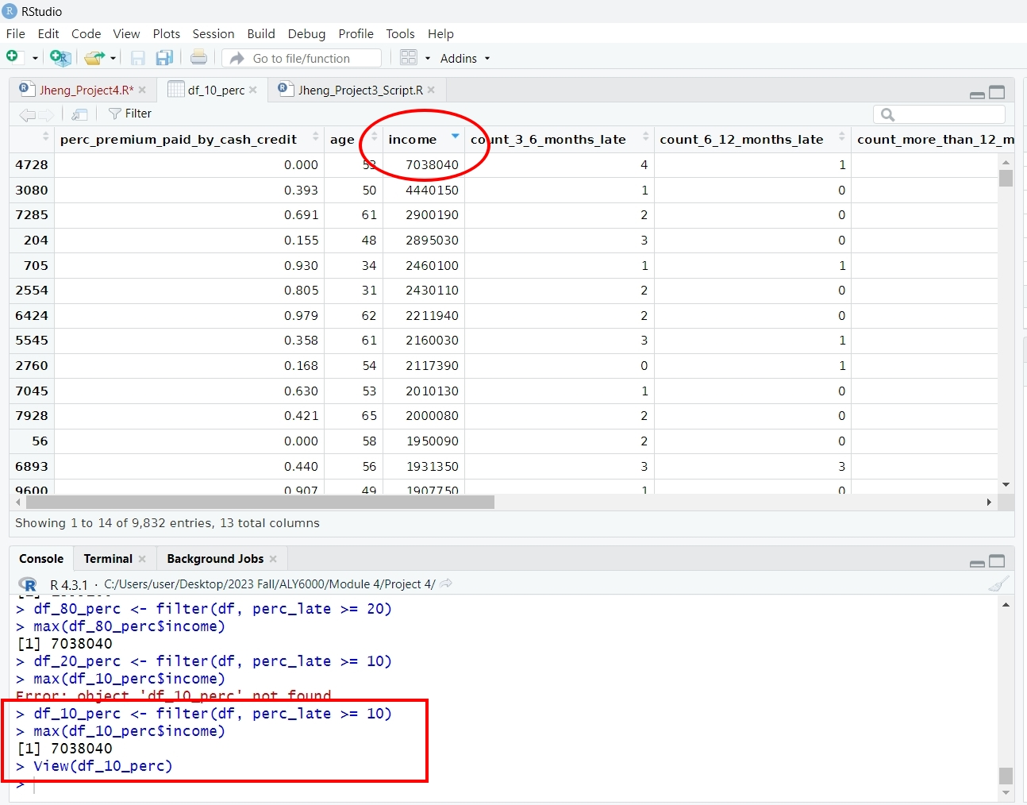
Notes:
df$total_late <- df$count_3_6_months_late + df$count_6_12_months_late + df$count_more_than_12_months_late
total_late is a new column from the sum of the “count_3_6_months_late”, “count_6_12_months_late”, and “count_more_than_12_months_late” columns.
#sum these three variables' integers I will get the total numbers of late pay premiums.
df$total_enrolled <- df$total_paid_premiums + df$total_late
#sum the total numbers of late pay premiums and the number of paid premiums I will get the total number of their enrolled premiums so that I can calculate the percentage of non-pay premiums below:
df$perc_late <- floor((df$total_late / df$total_enrolled)*100)
The perc_late column() is filtered to see what the income range of the percentage of late premiums bigger than 10%.
the highest income in the percentage of late premiums higher than 10% is $7,038,040. People whose income level is between $24K and $7,100K are more likely not to pay on time.

Slide 5
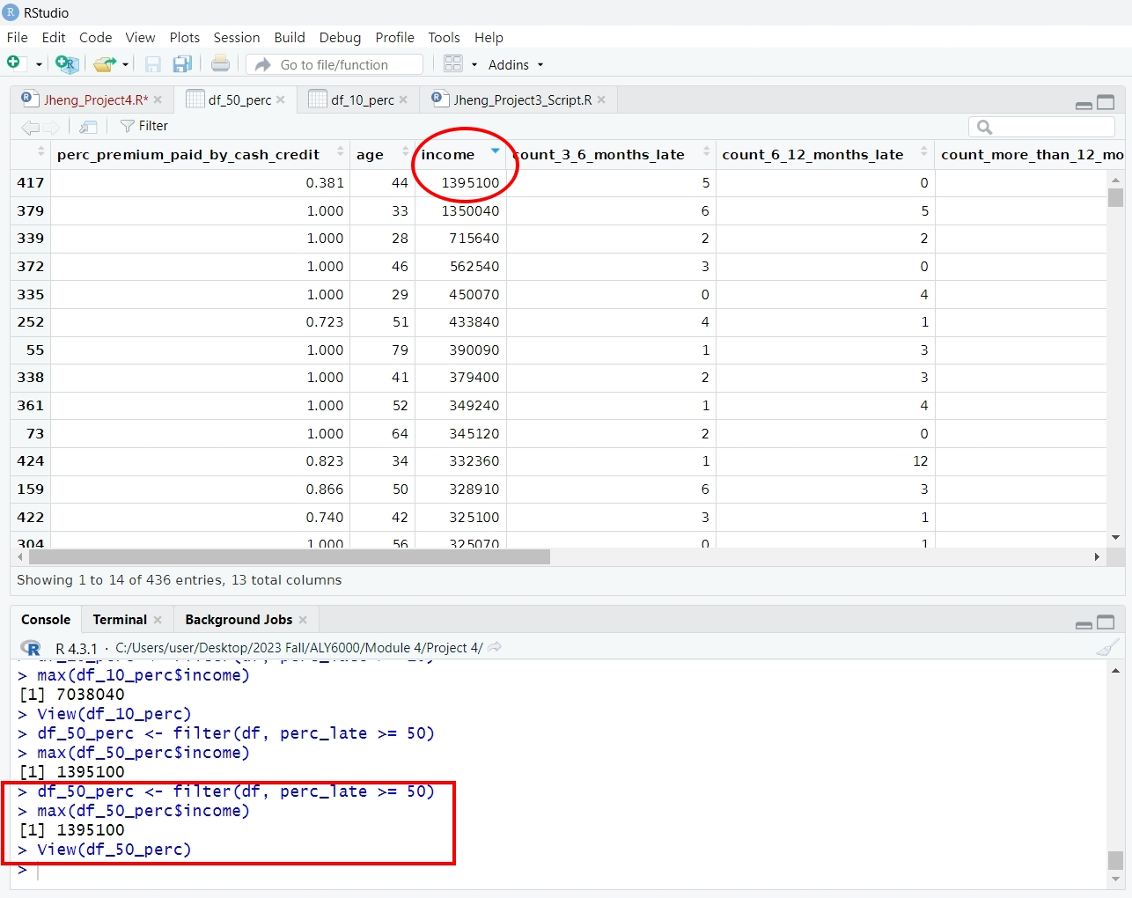
Notes:
The perc_late column() is filtered to see what the income range of the percentage of late premiums bigger than or equal to 50%.
The third picture indicates that the highest income in the percentage of late premiums higher than 50% is $1,395,100. People whose income level is between $24K and $1,400K have a 50% not paid on time history for their premiums purchased. Companies should provide extra assistance or reminders to people's income level is between $24K to 1,400K to push them to pay on time.

Slide 6
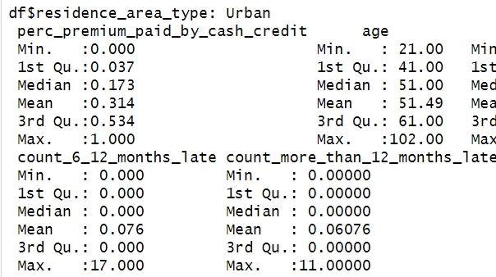
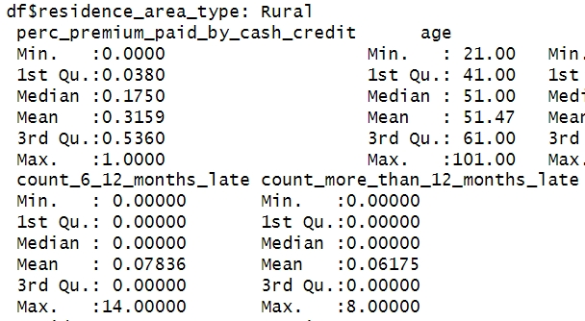
The late premium is affect by area
Notes:
before entering the third question, we can take a look at the raw dataset.
by(df, df$residence_area_type, summary) #print summary by group can help us to compare the overdue premiums in these two areas.
The red circle shows the 6-12 months late payment in these two areas. We can see that the times of late payment are higher in Urban areas.
It happened in the overdue premiums which are more than 12 months late too, the urban residents are more likely to have overdue premiums.

Slide 7
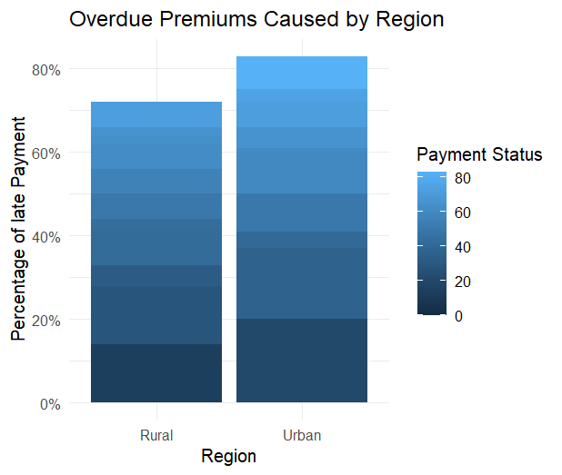
Q3: How significant is the region's impact on the premiums?
Notes:
So, when it comes to the percentage of total late premiums will it be different from the data of 6-12 months and more than 12 months late in the previous slide?
A bar chart has been created to compare the difference in the premiums paid status by the area where people live.
This bar chart shows the same information as the summary group by area in the 6-12 months and more than 12 months late premiums payment column that we mentioned.
The insurance company has residents living in the Urban area who had more late payments during their enrolled time. In addition, the more important message in this chart is that only the Urban areas’ residents have an 80% overdue payment during their enrolled premiums history; the Rural areas’ residents have around 73% overdue payment during their enrolled premiums history, but there are no residents have 80% overdue payment in their enrolled premium.

Slide 8
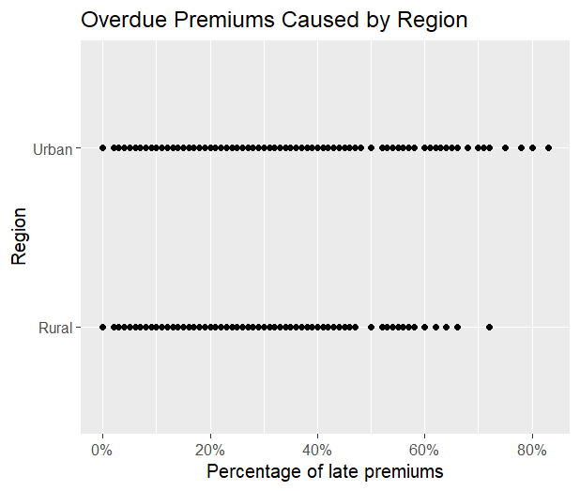
Notes:
Here is a scatter plot of income and region. To be honest, the two areas didn't have significant differences; however, the people who live in urban areas fell behind on their premiums which surprised me. It might be caused by two reasons:
1. Those who live in urban areas have more economic pressure than rural residents
2. The pace of life is faster and busier, which leads to forgetting to pay premiums.
The insurance company can make an effort for urban residents to make sure they do not forget to pay their insurance in their busy lives.

Slide 9
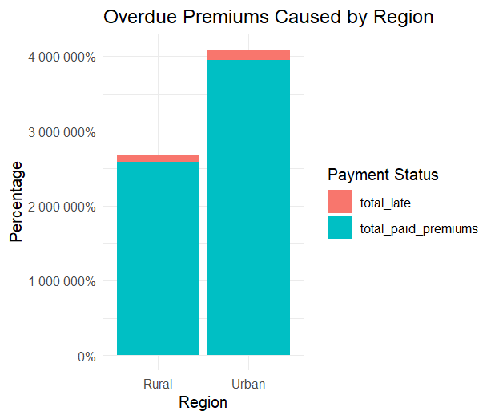
Notes:
I have tried to use a Stacked Bar Chart, but the X-axis appears percentage larger than 100.
If this chart’s information is correct, there are more urban residents enrolled in health insurance and they have more percentage to pay their premiums late during their premiums.
Therefore, that might be the reason why urban areas have more people overdue their payments; however, it will not change the fact that urban residents have an 80% overdue payment during their premiums, while rural residents don’t have.

Slide 10
Conclusion
Younger customers who have less income may have higher late payment possibility.
Higher late payment rates and urban housing are the main variables that increase premiums.
Company:
1. Consider these aspects when setting premium and schedule payment.
2. Customize policy to minimize the late payment.
3. Use data-driven decision-making to control risk.
Notes:
Conclusion
The young insured whose income level is between $24K to $1,400K are more likely to result in overdue premium payments.
It is like a vicious circle, the customers who live in urban areas have several reasons unable to pay on time so the premiums increase. The high late payment rates and urban housing prices will make the premiums price climb, so the customers can no longer afford it and the late payment rates keep going up.
Insurance company can consider the factors that we discussed about scheduling payment methods when setting premiums; for instance, flexible schedules or auto-deduction.
The company can adjust its policy and change its marketing campaign based on our research.
Consider these aspects when setting premiums and scheduling payments to create a customized policy will help to minimize past-due payments. By using data-driven decision-making to control risk, this strategy can improve client happiness while lowering risks for both policyholders and insurers.
The follow-up questions I have are:
How is age or income distributed to the premium type?
Did the highest premium price affect the late payment rate?

Slide 11
RESOURCES
Dataset
Chaudhari, S. (2020). Health Insurance Premium of Customers. [Data set]. Kaggle. https://www.kaggle.com/datasets/itssuru/health-insurance-premium-of-customers

Slide 12
THANK YOU

