Slide 1
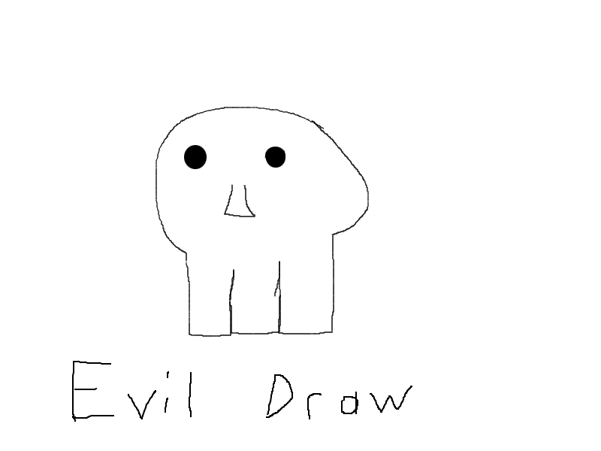
Evil Draw
Chloe Klein

Slide 2
Why make this?
Original reason was because I think drawing is fun and I wanted to spread that to any bored person
Later I realized that it can also be useful for making quick diagrams

Slide 3
What does my program offer
It offers many different colors
A rectangle, ellipse and pen tool
Adjustable pen size
A save feature
Quickly reset canvas

Slide 4
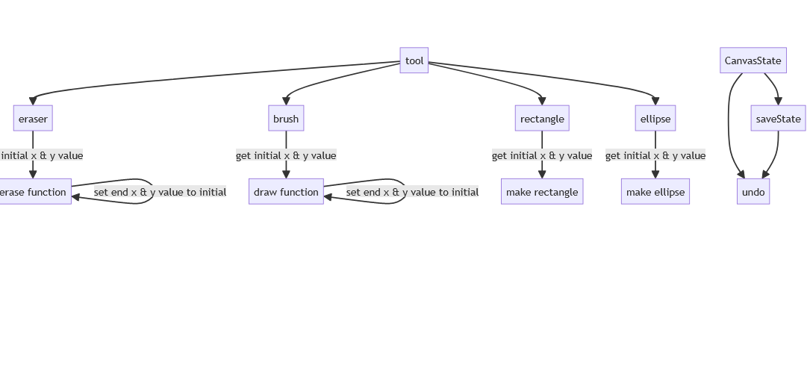

Slide 5
What I learned
I learned a lot about FavaFX specifically Canvas and GraphicsContext
How to implement IOException
Enum
Stacks

