Slide 1
Stage 2D: Architecture-Aware Copolymer Modeling
Does copolymer architecture affect property predictions? If so, does chemistry-conditioned architecture modeling help?
• Stage 2A (Frac): h_poly = f_A·h_A + f_B·h_B — architecture-blind
• Stage 2D0: h_poly = h_mix + α·e_arch — global architecture offset
• Stage 2D1: h_poly = h_mix + α·r_arch(h_A, h_B, ...) — chemistry-conditioned
• 7 model variants tested across 5-fold a_held_out cross-validation

Slide 2
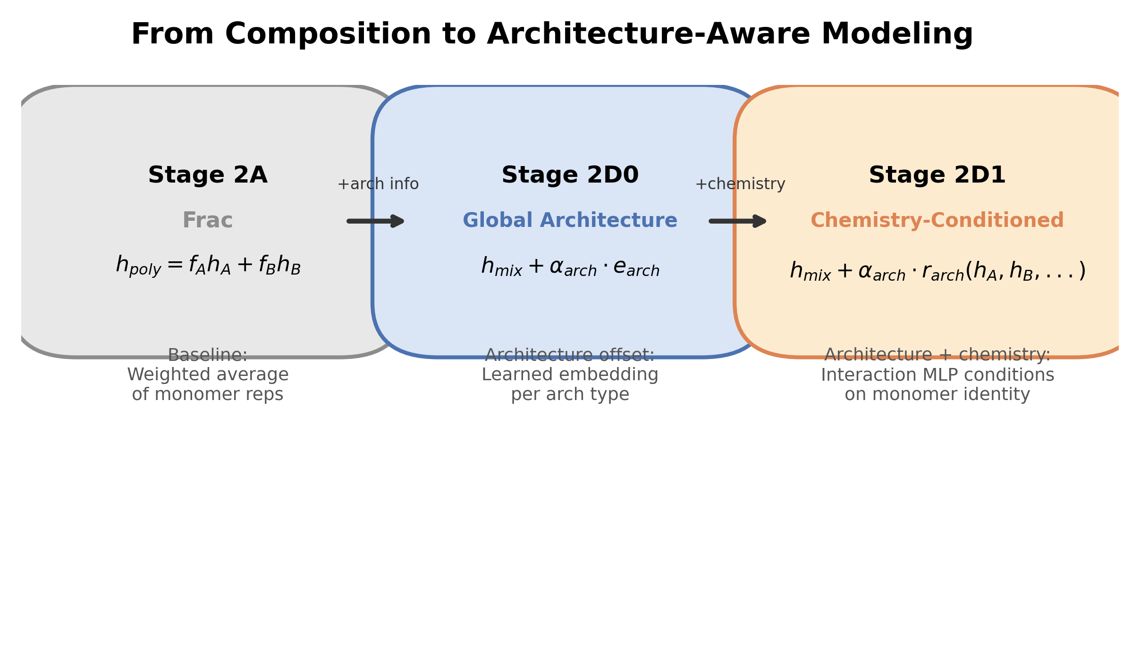
Model Progression: Frac → 2D0 → 2D1
Increasing architecture awareness

Slide 3
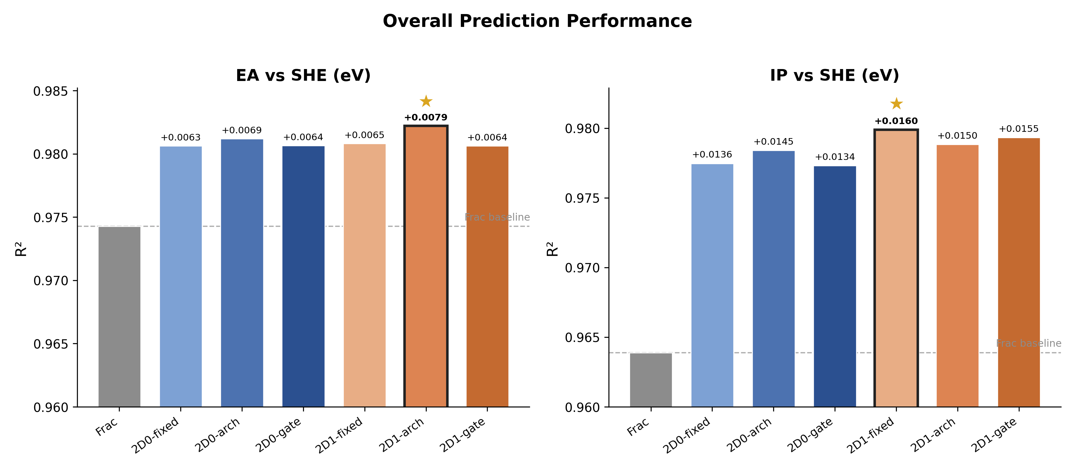
Overall Prediction Performance
All architecture-aware variants significantly improve over Frac (p < 0.05)

Slide 4
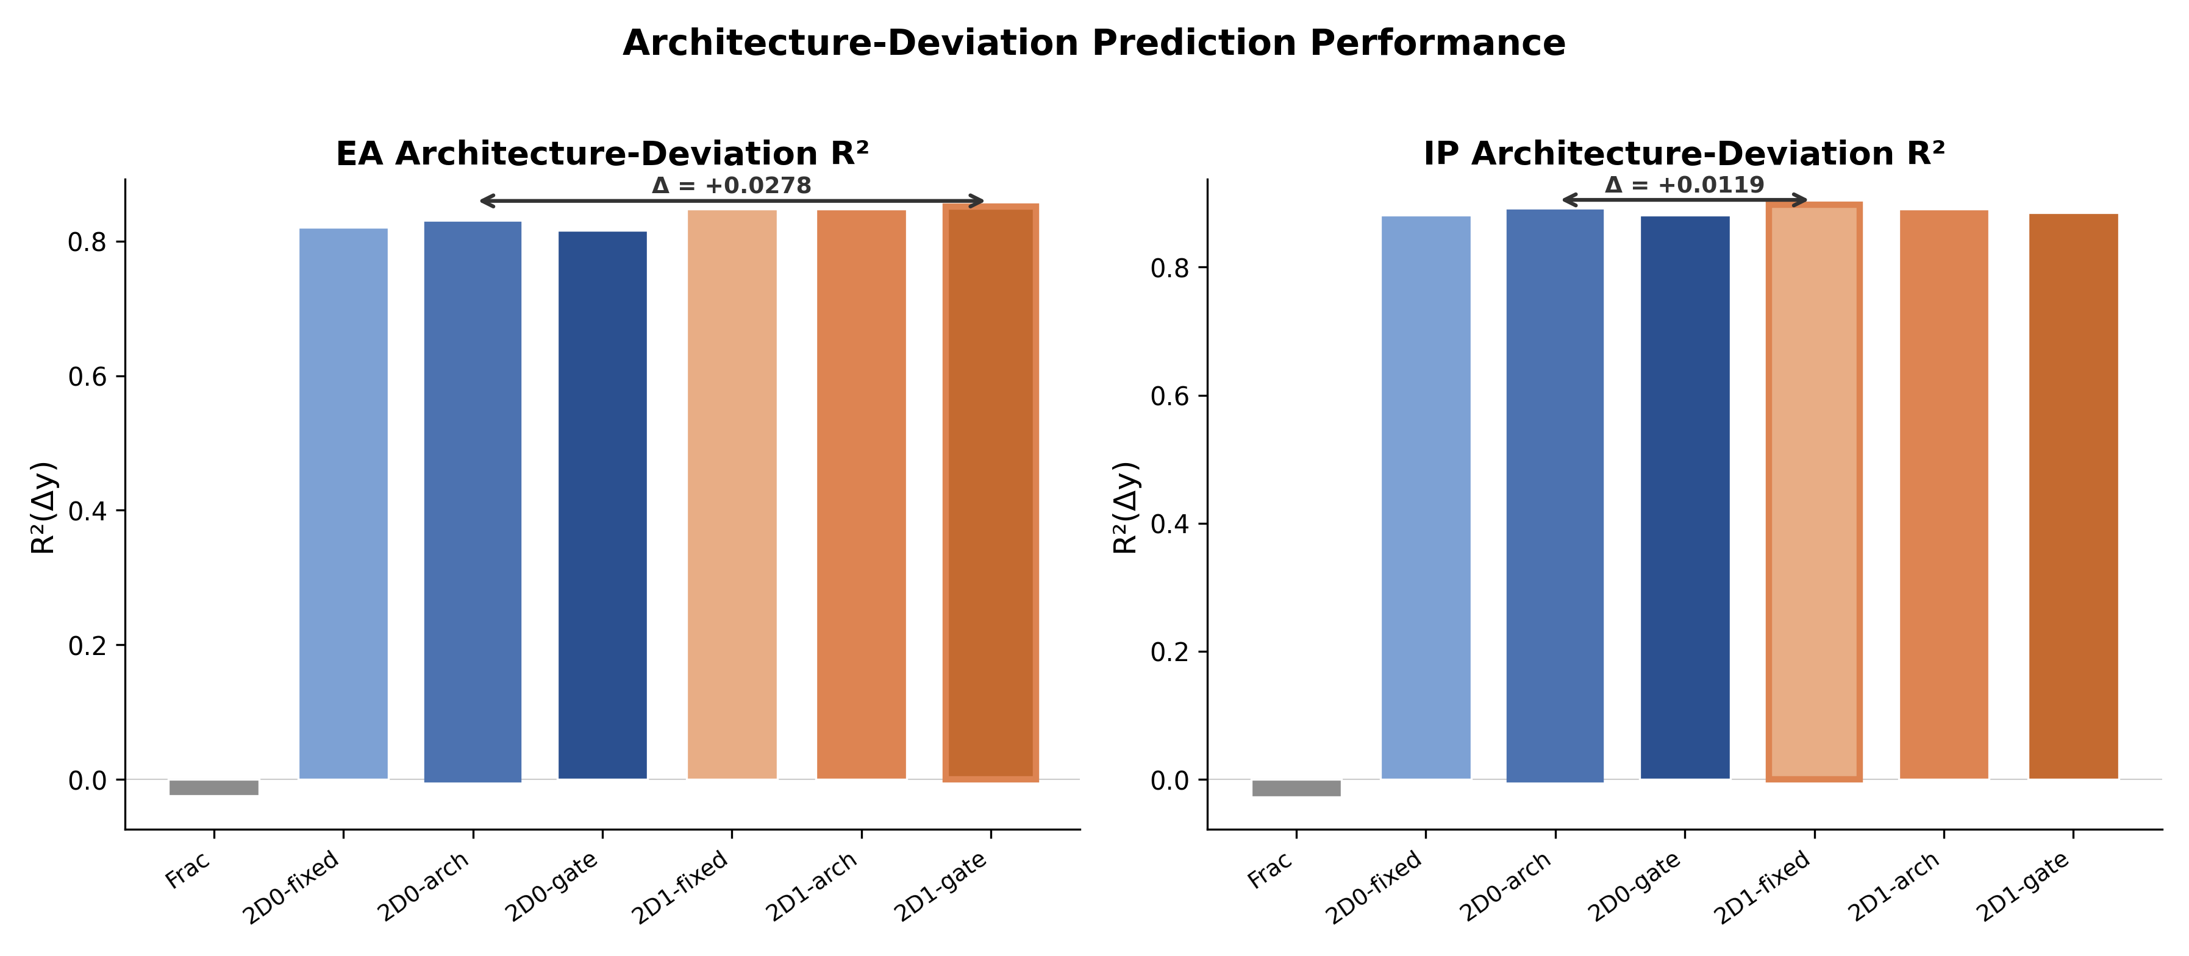
Architecture-Deviation Prediction
2D1 variants better capture architecture-specific property differences

Slide 5
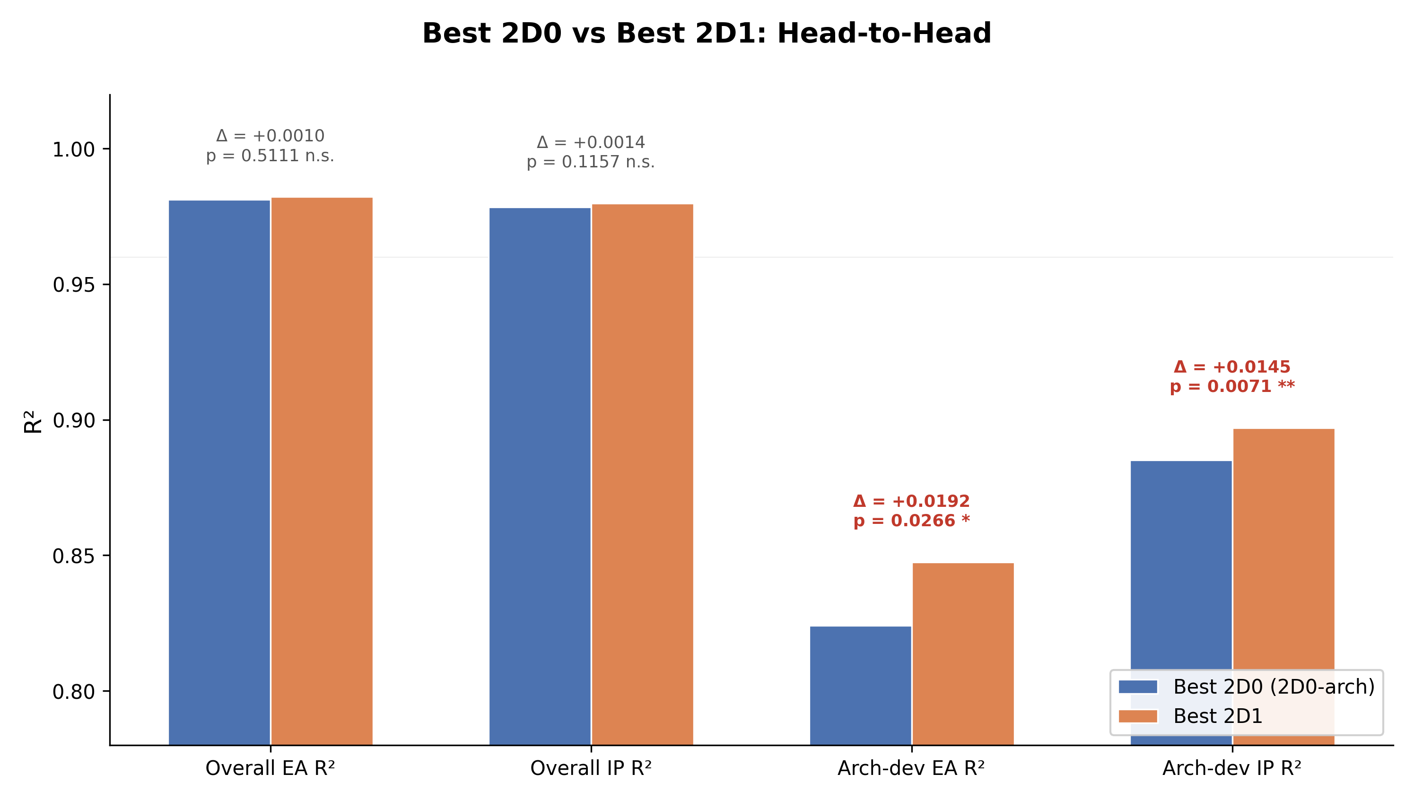
Best 2D0 vs Best 2D1
Overall R² gains are small (n.s.); architecture-deviation gains are significant

Slide 6
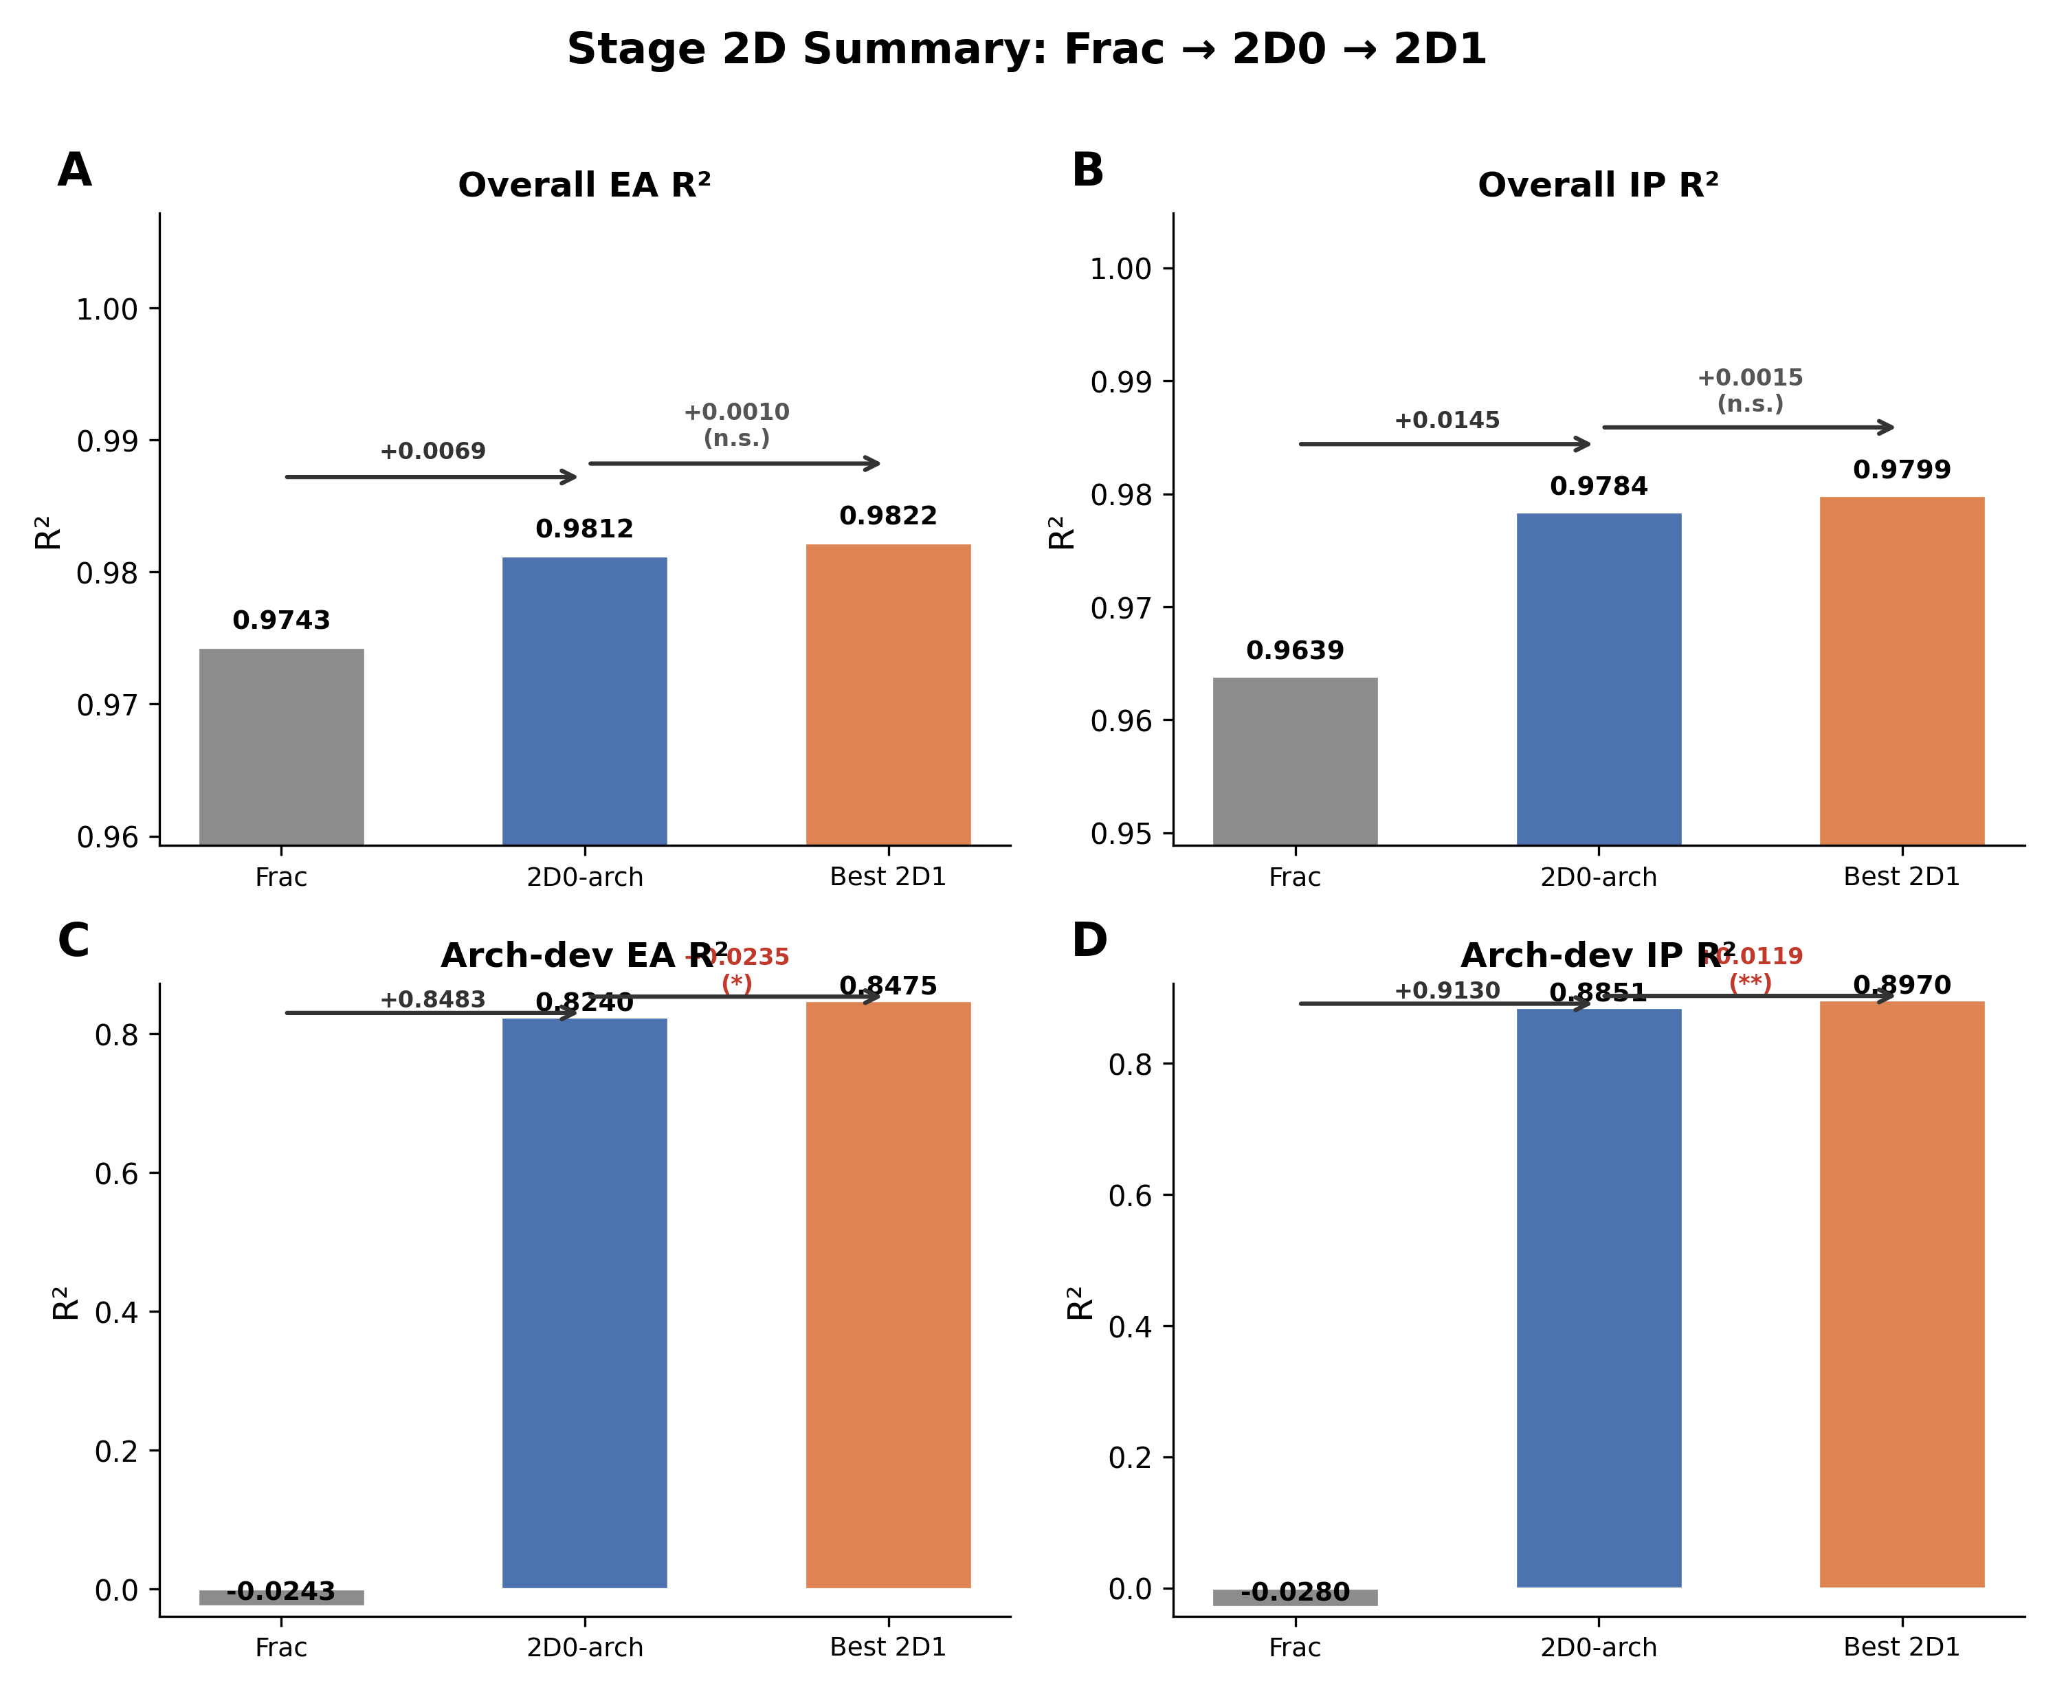
Summary & Recommendation
Recommendation: 2D1-arch (best overall R²; significantly better architecture-deviation R²)

