Slide 1
RESEARCH PROGRESS UPDATE · POLYMER REPRESENTATION LEARNING
Objective, Not Representation:
Recovering Architecture Signal in a Graph Polymer Model
A within-group loss term lifts wDMPNN's architecture ordering 0.854 → 0.888 (≈55–70% of the gap to ChemArch) with overall R² unchanged — representation frozen.
Chloe Lin 15 July 2026 Group-disjoint · Fold 0 pilot

Slide 2
WHERE WE LEFT OFF
The benchmark raised a question we couldn't yet answer
LAST UPDATE — THE BENCHMARK
YOUR QUESTION
● wDMPNN vs Frac / GlobalArch / ChemArch on overall R² and architecture-deviation R².
● wDMPNN wins overall; ChemArch wins architecture recovery — an asymmetry.
● Read at the time: wDMPNN's weak recovery looks like a training issue, not a representation deficiency.
● Proposed next step: a hierarchical representation to improve ChemArch.
“Why is wDMPNN better overall, and ChemArch better at architecture recovery?”
Pin down the mechanism before committing to a new representation.
→ That is what the diagnostics did.

Slide 3
WHAT THE DIAGNOSTICS FOUND
The asymmetry has two different causes — not one
wDMPNN — OVERALL WIN
ChemArch — RECOVERY WIN
A chemistry-extrapolation win
A representation (backbone) limit
● Group-mean R² 0.93 on unseen monomers vs ≤0.02 for composition models.
● The graph encoder decomposes a novel monomer into seen substructures.
● Its edge is chemistry, not architecture.
● Explicit architecture conditioning → best calibration & ordering in-distribution.
● Its overall failure lives in the composition backbone — the residual actually rescues it.
● Exactly the part a graph backbone would replace.
Net: wDMPNN's recovery gap = an objective problem. ChemArch's overall gap = a representation problem.

Slide 4
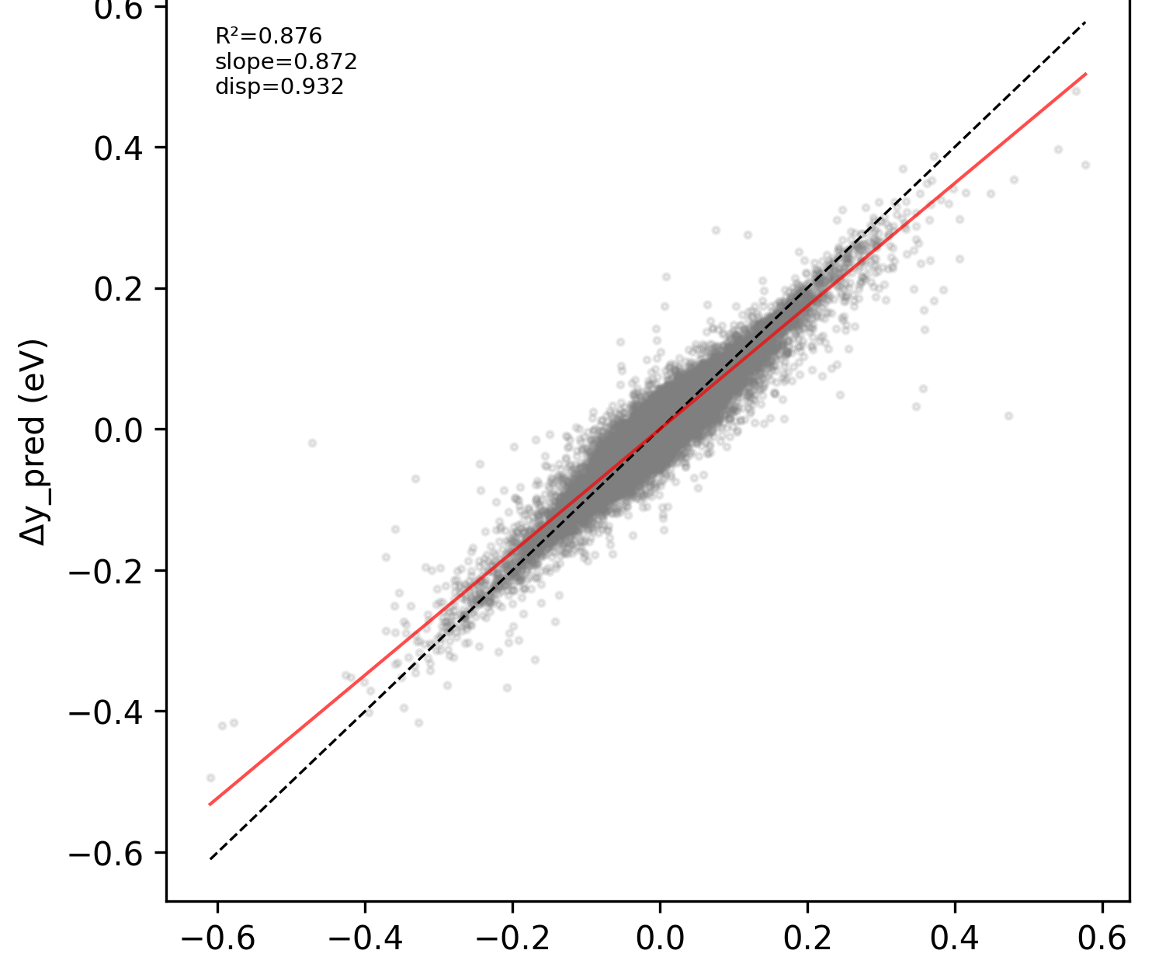
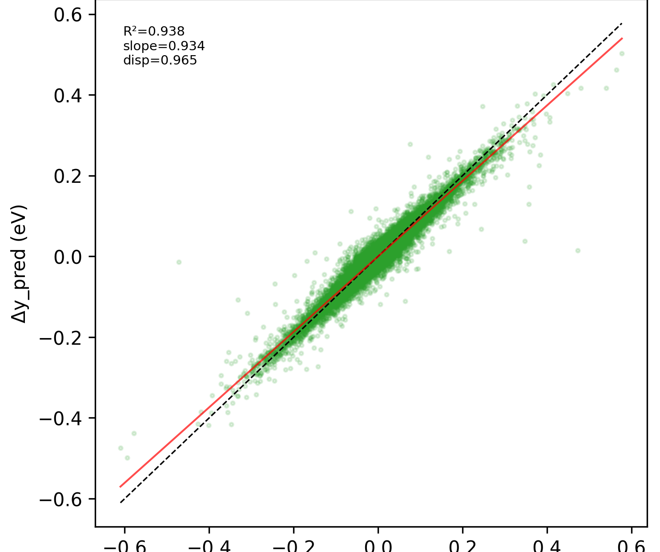
THE RECOVERY CLAIM — MEASURED BY ΔR² AND ORDERING, NOT OVERALL R²
Why ChemArch wins recovery: it preserves the architecture deviation
wDMPNN — shrinks toward 0
ChemArch — hugs the diagonal
slope 0.87 · disp 0.93 — compresses architecture toward the group mean
slope 0.93 · disp 0.97 — preserves both magnitude and rank
Δŷ vs Δy, EA · Group-disjoint. Points on the dashed y=x line = faithful recovery. ChemArch ΔR² 0.94 / ordering 0.89 vs wDMPNN 0.88 / 0.85.

Slide 5
WHY STANDARD TRAINING UNDER-REWARDS ARCHITECTURE
MSE is almost entirely a chemistry objective
96–98%
2–4%
of target variance is chemistry / composition
is sequence architecture (~0.02 eV)
The optimiser is rewarded for reducing chemistry error; it has little incentive to preserve the tiny architecture signal. The gap may be a loss problem, not a model-capacity one.

Slide 6
HOW THIS REFINES THE PLAN
Two levers — test the cheap one first
A
Objective
B
Representation
Change the loss, freeze the representation
The hierarchical step — now precisely targeted
● Does explicitly training wDMPNN to minimise within-group error recover architecture?
● If yes, we may not need a new representation for recovery at all.
● Cheap, fast, no new architecture.
● A graph / hierarchical backbone to fix ChemArch's chemistry extrapolation.
● Still on the table — but gated on Lever A.
● Don't rebuild the representation to solve a training problem.
Either outcome is useful: one experiment decides whether the new representation is even necessary.

Slide 7
LEVER A — PILOT DESIGN
Change only the objective, verify before trusting it
L = Loverall + λ · Lwithin
Lwithin penalises within-group residual variance = MSE of predicted vs true within-group deviations (the loss-form of our error decomposition).
PRE-FLIGHT CHECKS PASSED
PILOT MATRIX
● Invariant to chemistry baseline shifts.
● Within-group gradients sum to ≈ 0 (doesn't move the group mean).
● Backward compatible at λ = 0.
● Gradient cosine to MSE ≈ 0.04 — genuinely new signal.
● wDMPNN · EA · Group-disjoint · Fold 0
● λ ∈ {0, 0.03, 0.10*, 0.30}
● Identical schedule / optimiser / eval to the corrected benchmark.
● Done: 0, 0.03, 0.30. Running: λ = 0.10.

Slide 8
THE METRICS, PRECISELY
Two axes, three metrics — how we score everything
Matched group g = fixed (monomer_A, monomer_B, f_A, f_B), architecture excluded, ≥2 architectures. ȳg = true group mean, ŷ̄g = predicted group mean.
CHEMISTRY BASELINE
ARCHITECTURE RECOVERY
RANK RECOVERY
Group-mean R²
Deviation R² (ΔR²)
Ordering accuracy
1 − Σ(ȳg−ŷ̄g)² / Σ(ȳg−⟨ȳ⟩)² (one point per group)
Δy = y − ȳg , Δŷ = ŷ − ŷ̄g R²( Δŷ vs Δy ), per sample
fraction of within-group architecture pairs ranked right (chance = 0.5)
Did we predict the right property regime for this chemistry, architecture averaged out?
Did we capture the within-group, sequence-induced deviation once chemistry is removed?
Magnitude-invariant and noise-robust — trusted most when the signal is tiny.
→ why wDMPNN wins overall
→ ChemArch's edge; the pilot's target
→ the headline pilot metric
Overall R² ≈ Group-mean R² here because chemistry is 96–98% of the variance — which is exactly why a separate ΔR² is needed.

Slide 9
PILOT RESULTS — GROUP-DISJOINT, FOLD 0
Overall prediction is unchanged — chemistry not sacrificed
λ | Overall R² | MAE (eV)
0.00 (baseline) | 0.99690 | 0.02354
0.03 | 0.99742 | 0.02129
0.30 | 0.99652 | 0.02456
OVERALL R²
0.997
flat across all λ (0.9969 → 0.9974 → 0.9965)
λ = 0.03 even nudges overall R² up. The differences are within noise on one fold — the point is nothing is lost.
Reading: the added loss redistributes error within chemistry groups without disturbing the chemistry baseline.

Slide 10
PILOT RESULTS — GROUP-DISJOINT, FOLD 0
Every architecture metric improves
+3.4 pp ordering vs baseline
≈ 55–70% of the gap to ChemArch closed
−47% within-group residual variance
0.000513 → 0.000270 (λ=0.30)
slope → 1.00 calibration
0.993 → 1.003 → 1.000 — not shrinkage
Ordering is the headline: magnitude-invariant and noise-robust — the cleanest sign the model learns real architecture signal.

Slide 11
INTERPRETATION
The objective moves wDMPNN toward ChemArch — representation frozen
ORDERING UP
CALIBRATION
WITHIN-ERROR
OVERALL R²
+2.7 to +3.4 pp toward ChemArch's 0.903
slope to ≈ 1.0 — preserves magnitude, not damping it
cut by nearly half (−38 to −47%)
unchanged at ≈ 0.997 — chemistry intact
The information a model preserves is shaped by the objective, not only the representation.
Standard MSE under-emphasises the low-variance architecture factor; supervising it explicitly recovers most of the gap — without a new architecture.

Slide 12
LIMITATIONS & RISKS — HELD HONESTLY
Promising, not proven
Single fold, no seeds
Noise floor (the gate)
One Group-disjoint fold; ~0.03 ordering gain needs ≥3 seeds to beat run-to-run noise.
Architecture ≈ 0.02 eV with no replicates — bound the DFT/label noise externally before over-reading gains.
Thin, lopsided groups
Sampler confound
2–3 architectures/group, no replicates; 2/3 are block-vs-random only. Stratify ordering by 2- vs 3-arch.
Grouped batches ≠ original shuffling — run λ=0-with-sampler as a second baseline.
Current status: evidence for feasibility of the objective — not yet definitive proof of effectiveness.

Slide 13
NEXT STEPS — SEQUENCE, DON'T PARALLELISE
The plan: one gated decision, not two parallel builds
PHASE 1 · pin the pilot down now → late Jul
PHASE 2 · stress the objective Aug
● Finish λ=0.10; all Group-disjoint folds × ≥3 seeds; paired significance.
● Noise-floor bound (the gate) + sampler-confound baseline.
● Extend to Pair-disjoint, then Monomer-heldout.
● Monomer-heldout is the real test: does it transfer to unseen chemistry?
DECISION GATE — the Monomer-heldout result
✓ Best-of-both achieved
✗ Doesn't transfer
Architecture recovers AND chemistry extrapolation holds → objective paper; hierarchical representation shelved.
Objective helps in-distribution but fails on unseen chemistry → start Lever B (hierarchical rep), now justified.
In parallel — lightweight only: scope + prototype the representation (literature, data pipeline, λ=0 end-to-end). No full build until the gate opens.

Slide 14
PUBLICATION STRATEGY
Paper plan: one flagship now, one decided by the gate
PAPER 1 · FLAGSHIP
PAPER 2 · CONDITIONAL
Objective design recovers low-variance architecture effects
Decided by the Monomer-heldout gate
● Q: can supervising the within-group factor recover architecture on a frozen representation?
● Contribution: the variance-decomposition diagnostics as instrument + the λ result.
● Venue: workshop (fall) → Digital Discovery / npj Comp Mat / JCIM (Q4 2026).
● Readiness ≈ 55% — analysis done; needs folds + seeds + noise floor.
● Gate opens → hierarchical representation for chemistry extrapolation.
● Gate closed → framework / benchmark extension (external models + datasets).
● Target: 2027.
Positioning: differentiate from multi-task loss balancing (uncertainty weighting, GradNorm, PCGrad) and imbalanced regression — ours is a loss derived from a physical variance decomposition.

Slide 15
WHAT I NEED FROM YOU TODAY
Four decisions
DECISIONS
“Objective-first,
gated on Monomer-heldout.
● Endorse objective-first, representation-second.
● Agree the Monomer-heldout result as the gate for starting Lever B.
● Sign off the paper plan & target venue.
● Approve compute for the multi-seed sweeps.
A two-week test
before a two-month build.”
That's the whole ask.

