Slide 1
PAPER 1 — PROPOSED FRAMING
Current evaluation cannot see the property the field claims to model
No new compute required to write this paper.
Notes:
Framing: this is not 'here are better metrics'. It is 'the metric everyone reports cannot answer the question everyone is asking', and here is the evidence.

Slide 2
The problem, and the six things needed to fix it
Chain architecture is what we claim to model. It is ~1% of the variance in the target.
1
2
3
Variance decomposition
Establishes that the signal is invisible to the standard metric
Two-axis metric
Separates chemistry placement from architecture recovery
Null floor
The best achievable without the thing being tested
4
5
6
Split design
Two chemistry-extrapolation regimes, folds not exchangeable
Noise floor
What difference is measurable at all
The demonstration
Two metrics, same predictions, opposite conclusions
Together they answer a question the field currently cannot: is a representation better, or does it merely score higher?

Slide 3
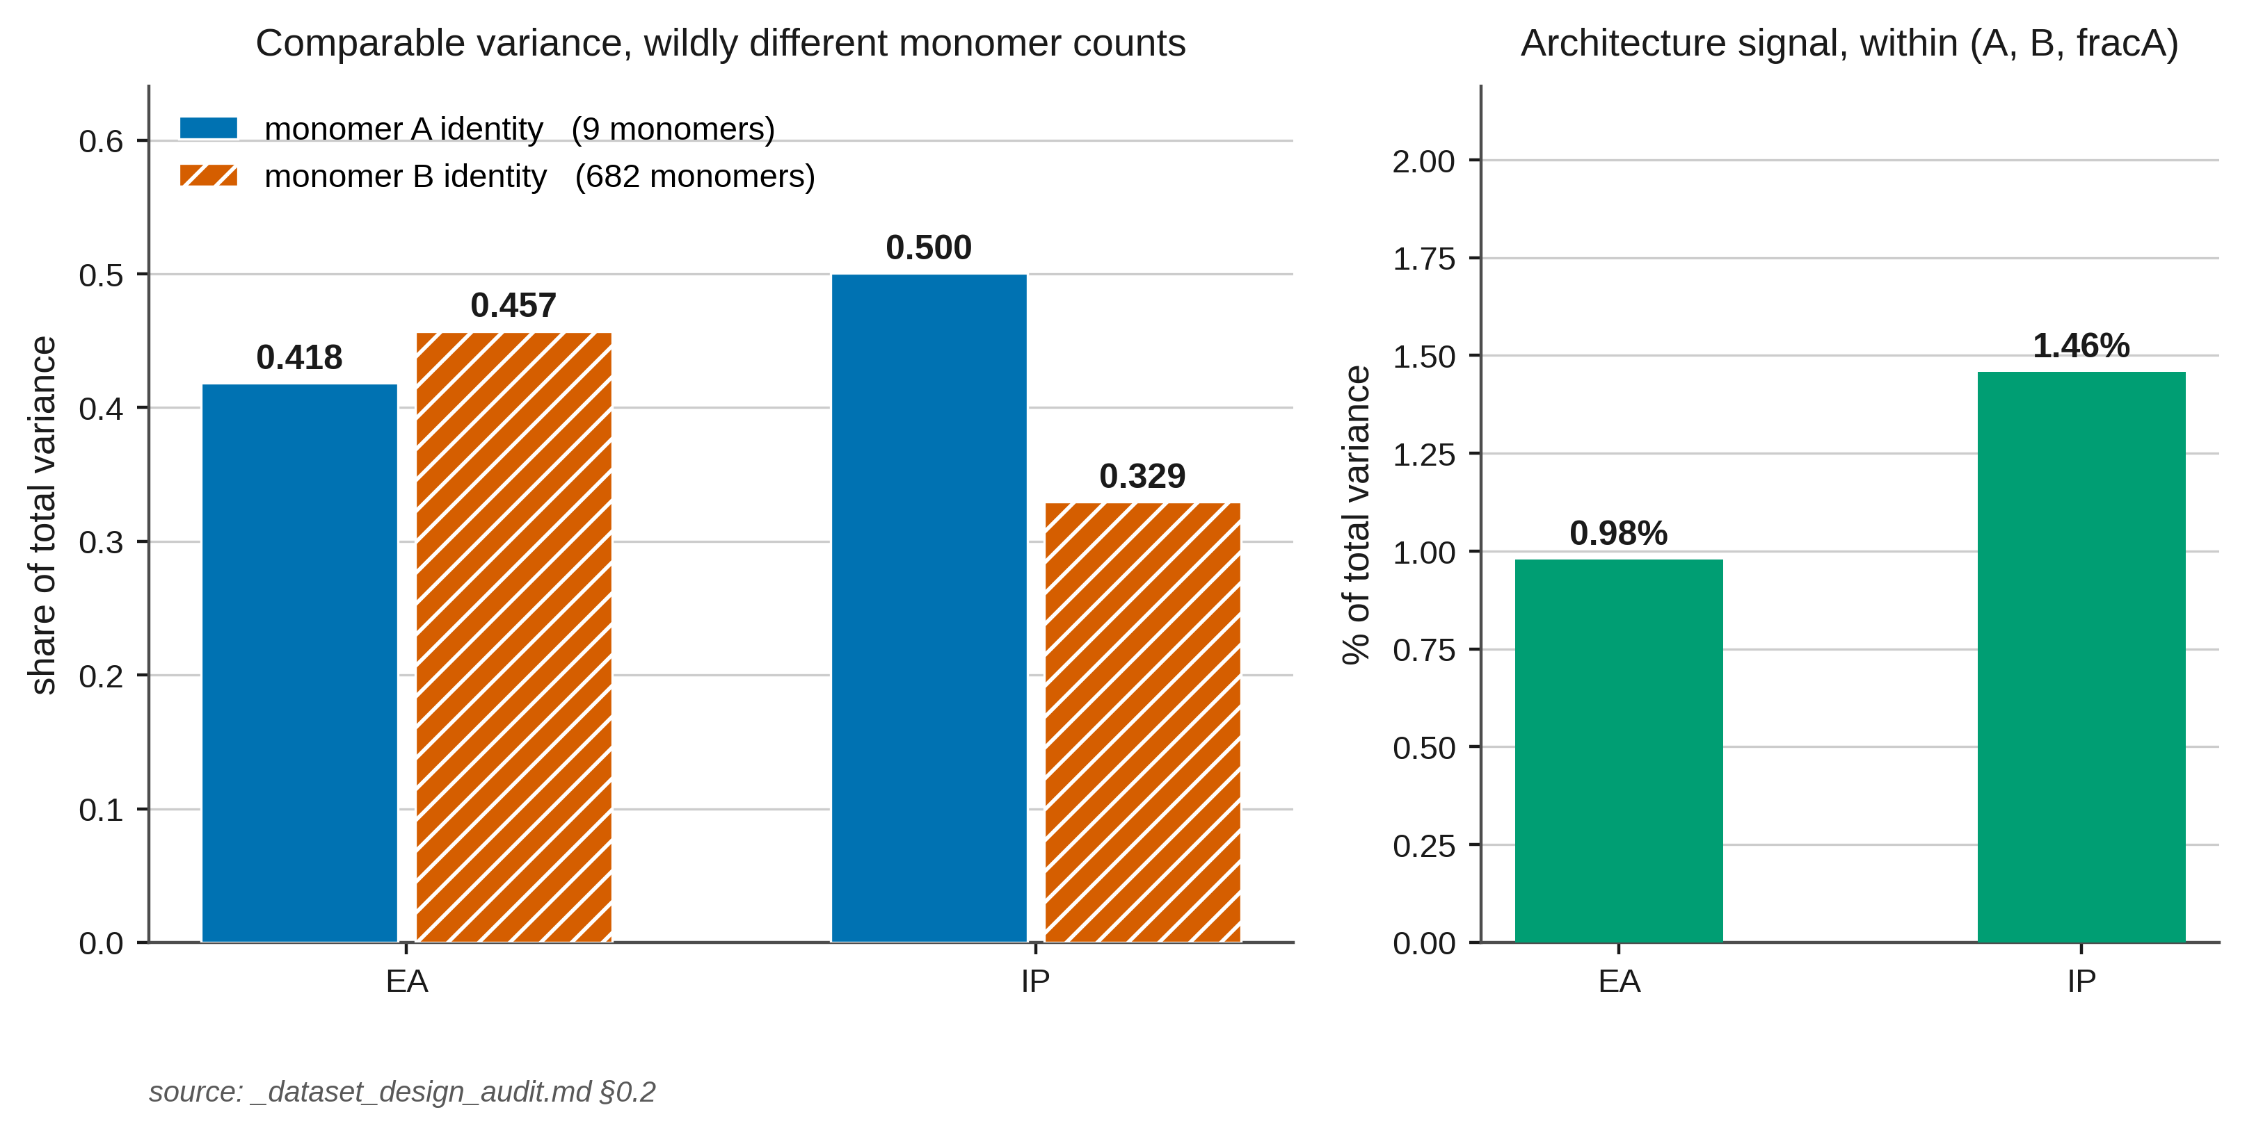
1
Variance decomposition — the signal is 1% of the target
Why the standard metric cannot see architecture
WHAT IS MEASURED
Partition target variance into the part explained by monomer identity and composition, and the part attributable to chain architecture at fixed (A, B, fracA).
Result
Architecture is 0.98% (EA) and 1.46% (IP) of total variance —
but 51–60% of what remains after composition is accounted for.
So a model can score 0.98 R² while being blind to architecture. Reporting overall R² cannot distinguish the two.
fig2_variance_by_axis · corroborated independently four months apart (_dataset_design_audit.md, and the May architecture diagnostic)
This is the premise for everything that follows: the quantity of interest is buried under a 90% chemistry term.

Slide 4
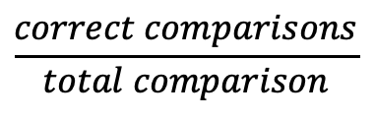


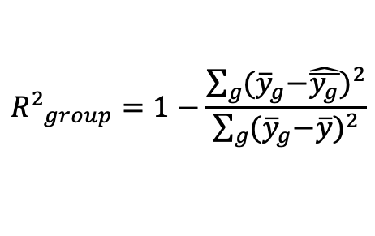
Metrics
Matched group g = fixed (monomer_A, monomer_B, f_A, f_B), architecture excluded, ≥2 architectures. ${\overline{y}}_{g}$ = true group mean, $\hat{\overline{y_{g}}}$= predicted group mean.
Chemistry baseline
How accurately does the model predict the average property of each chemistry, irrespective of architecture?
Architecture recovery
How well the model recovers architecture-induced deviations after removing the chemistry baseline?
Rank recovery
Did the model correctly rank the architectures within the same chemistry?
${∆y=y−\overline{y}}_{g}$
$${R^{2}}_{group}=1−\frac{\sum_{g}{{{(\overline{y}}_{g}−\hat{\overline{y_{g}}})}^{2}}}{\sum_{g}{{{(\overline{y}}_{g}−\overline{y})}^{2}}}$$
$$\frac{correct comparisons}{total comparison}$$
${∆\hat{y}=\hat{y}−\overline{\hat{y}}}_{g}$
Notes:
It compares every pair of architectures within a chemistry group.

Slide 5
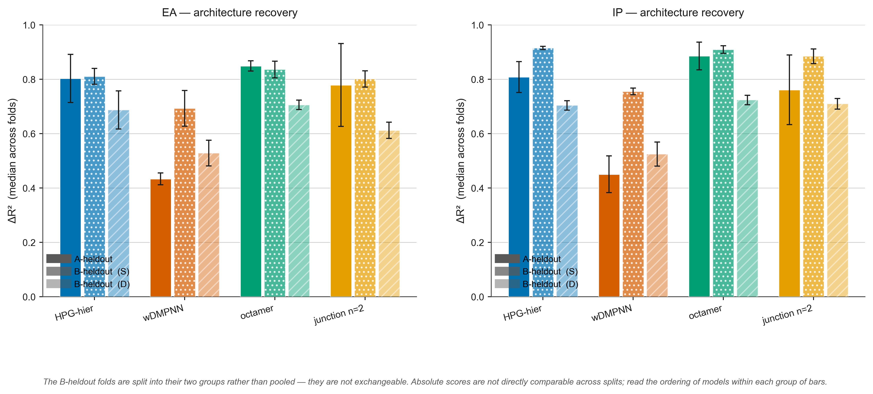
2
Two-axis metric — separate placement from recovery
One number per axis, always reported together
DEFINITION
Group g = (monomer A, monomer B, fracA).
group-mean R² — R² of the per-group means.
Can the model put a chemistry in the right place?
ΔR² — R² of the within-group deviations,y − ȳ_g.
Can it rank architectures inside a group?
Why both
The chemistry term cancels inside a group, so ΔR² isolates architecture. Reported alone, either axis is misleading — a model can win one and lose the other, which is exactly what we observe.
fig_ab_comparison · both axes, three evaluation regimes, five models
A third quantity, pairwise ordering accuracy, is also reported — it is rank-based and less sensitive to scale.

Slide 6
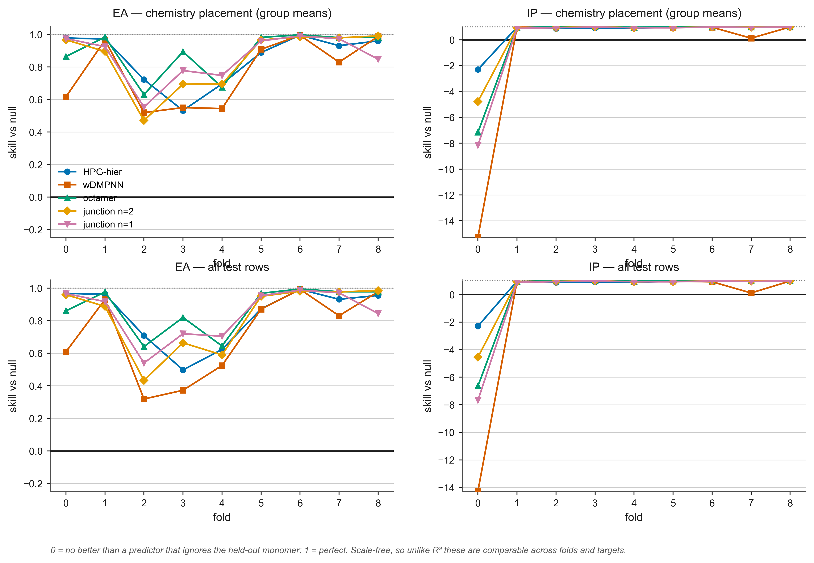
3
Null floor — the best achievable without the thing being tested
The component I would lead the paper with
DEFINITION
An A-blind (or B-blind) group-mean lookup table. No parameters, no fitting, and it never sees the held-out monomer.
skill = (R²_model − R²_null) / (1 − R²_null)
0 = no better than knowing nothing about the held-out chemistry. 1 = perfect. Scale-free, so comparable across folds and targets.
Result
On the A split, EA: the null reaches median group-mean R² 0.676 — and on one fold it beats the trained model, 0.961 vs 0.922.
The same null on IP scores −0.034. The EA metric on this split is near-degenerate, and you cannot tell without a null.
fig_r1_skill_vs_null · skill collapses to 0.32–0.55 on folds 2–4 — those models are barely better than knowing nothing
Nobody in this literature reports a null floor. This is a finding about the field, not about our model.

Slide 7
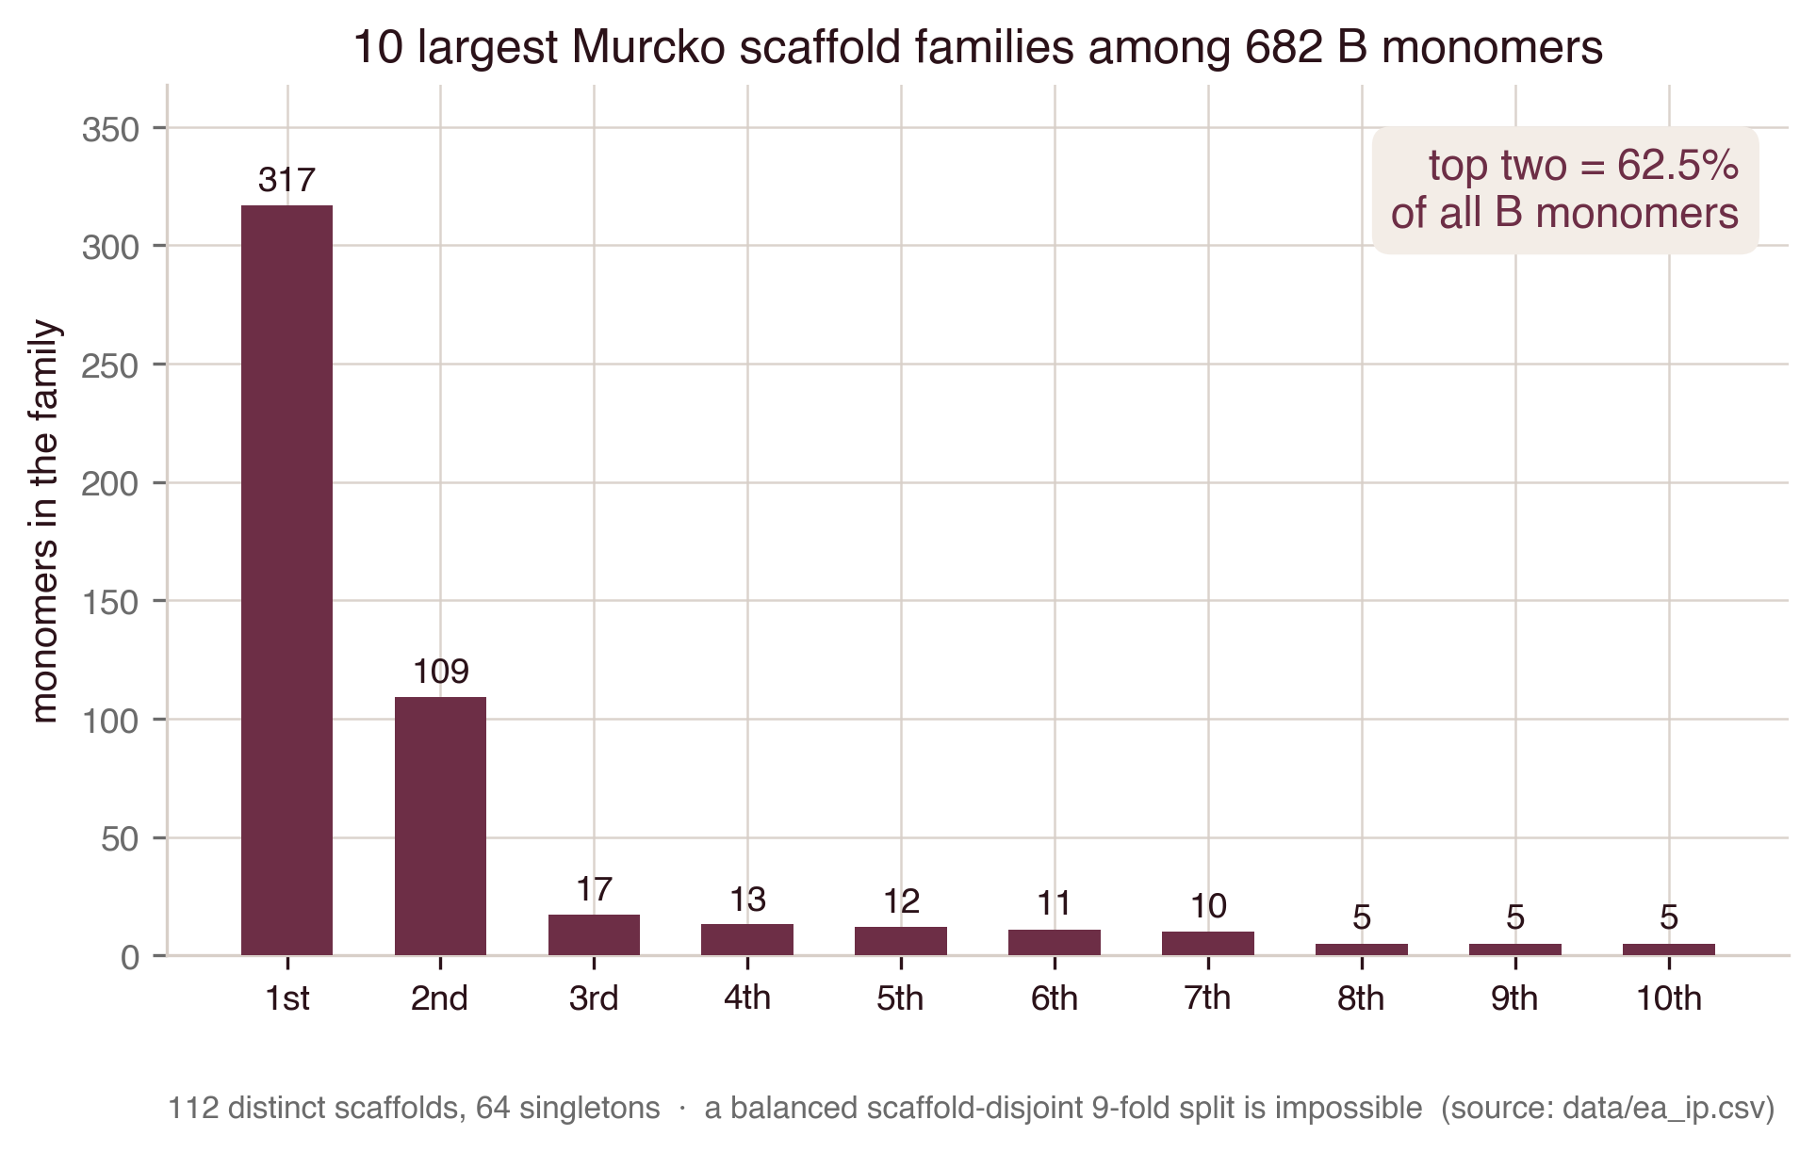
4
Split design — two extrapolation regimes, folds not exchangeable
And an honest account of what each split can support
THE TWO SPLITS
R1 · monomer-A-held-out — 9 folds, one A monomer held out each. Reproduces the original paper's design.
R3 · monomer-B-held-out, scaffold-clustered — 9 folds over 682 B monomers, capacity-balanced Murcko scaffold packing.
The finding that forces the fold grouping
112 Murcko scaffolds, the largest two covering 62.5% of all B monomers.
A balanced scaffold-disjoint split is therefore impossible and the nine folds are not exchangeable. We derive S (within-scaffold, folds 0–3) and D (cross-scaffold, 4–8) and never pool them.
fig3_scaffold_cluster_sizes · two families dominate the monomer-B space
Pooling nine non-exchangeable folds into one mean is the error this component exists to prevent.

Slide 8
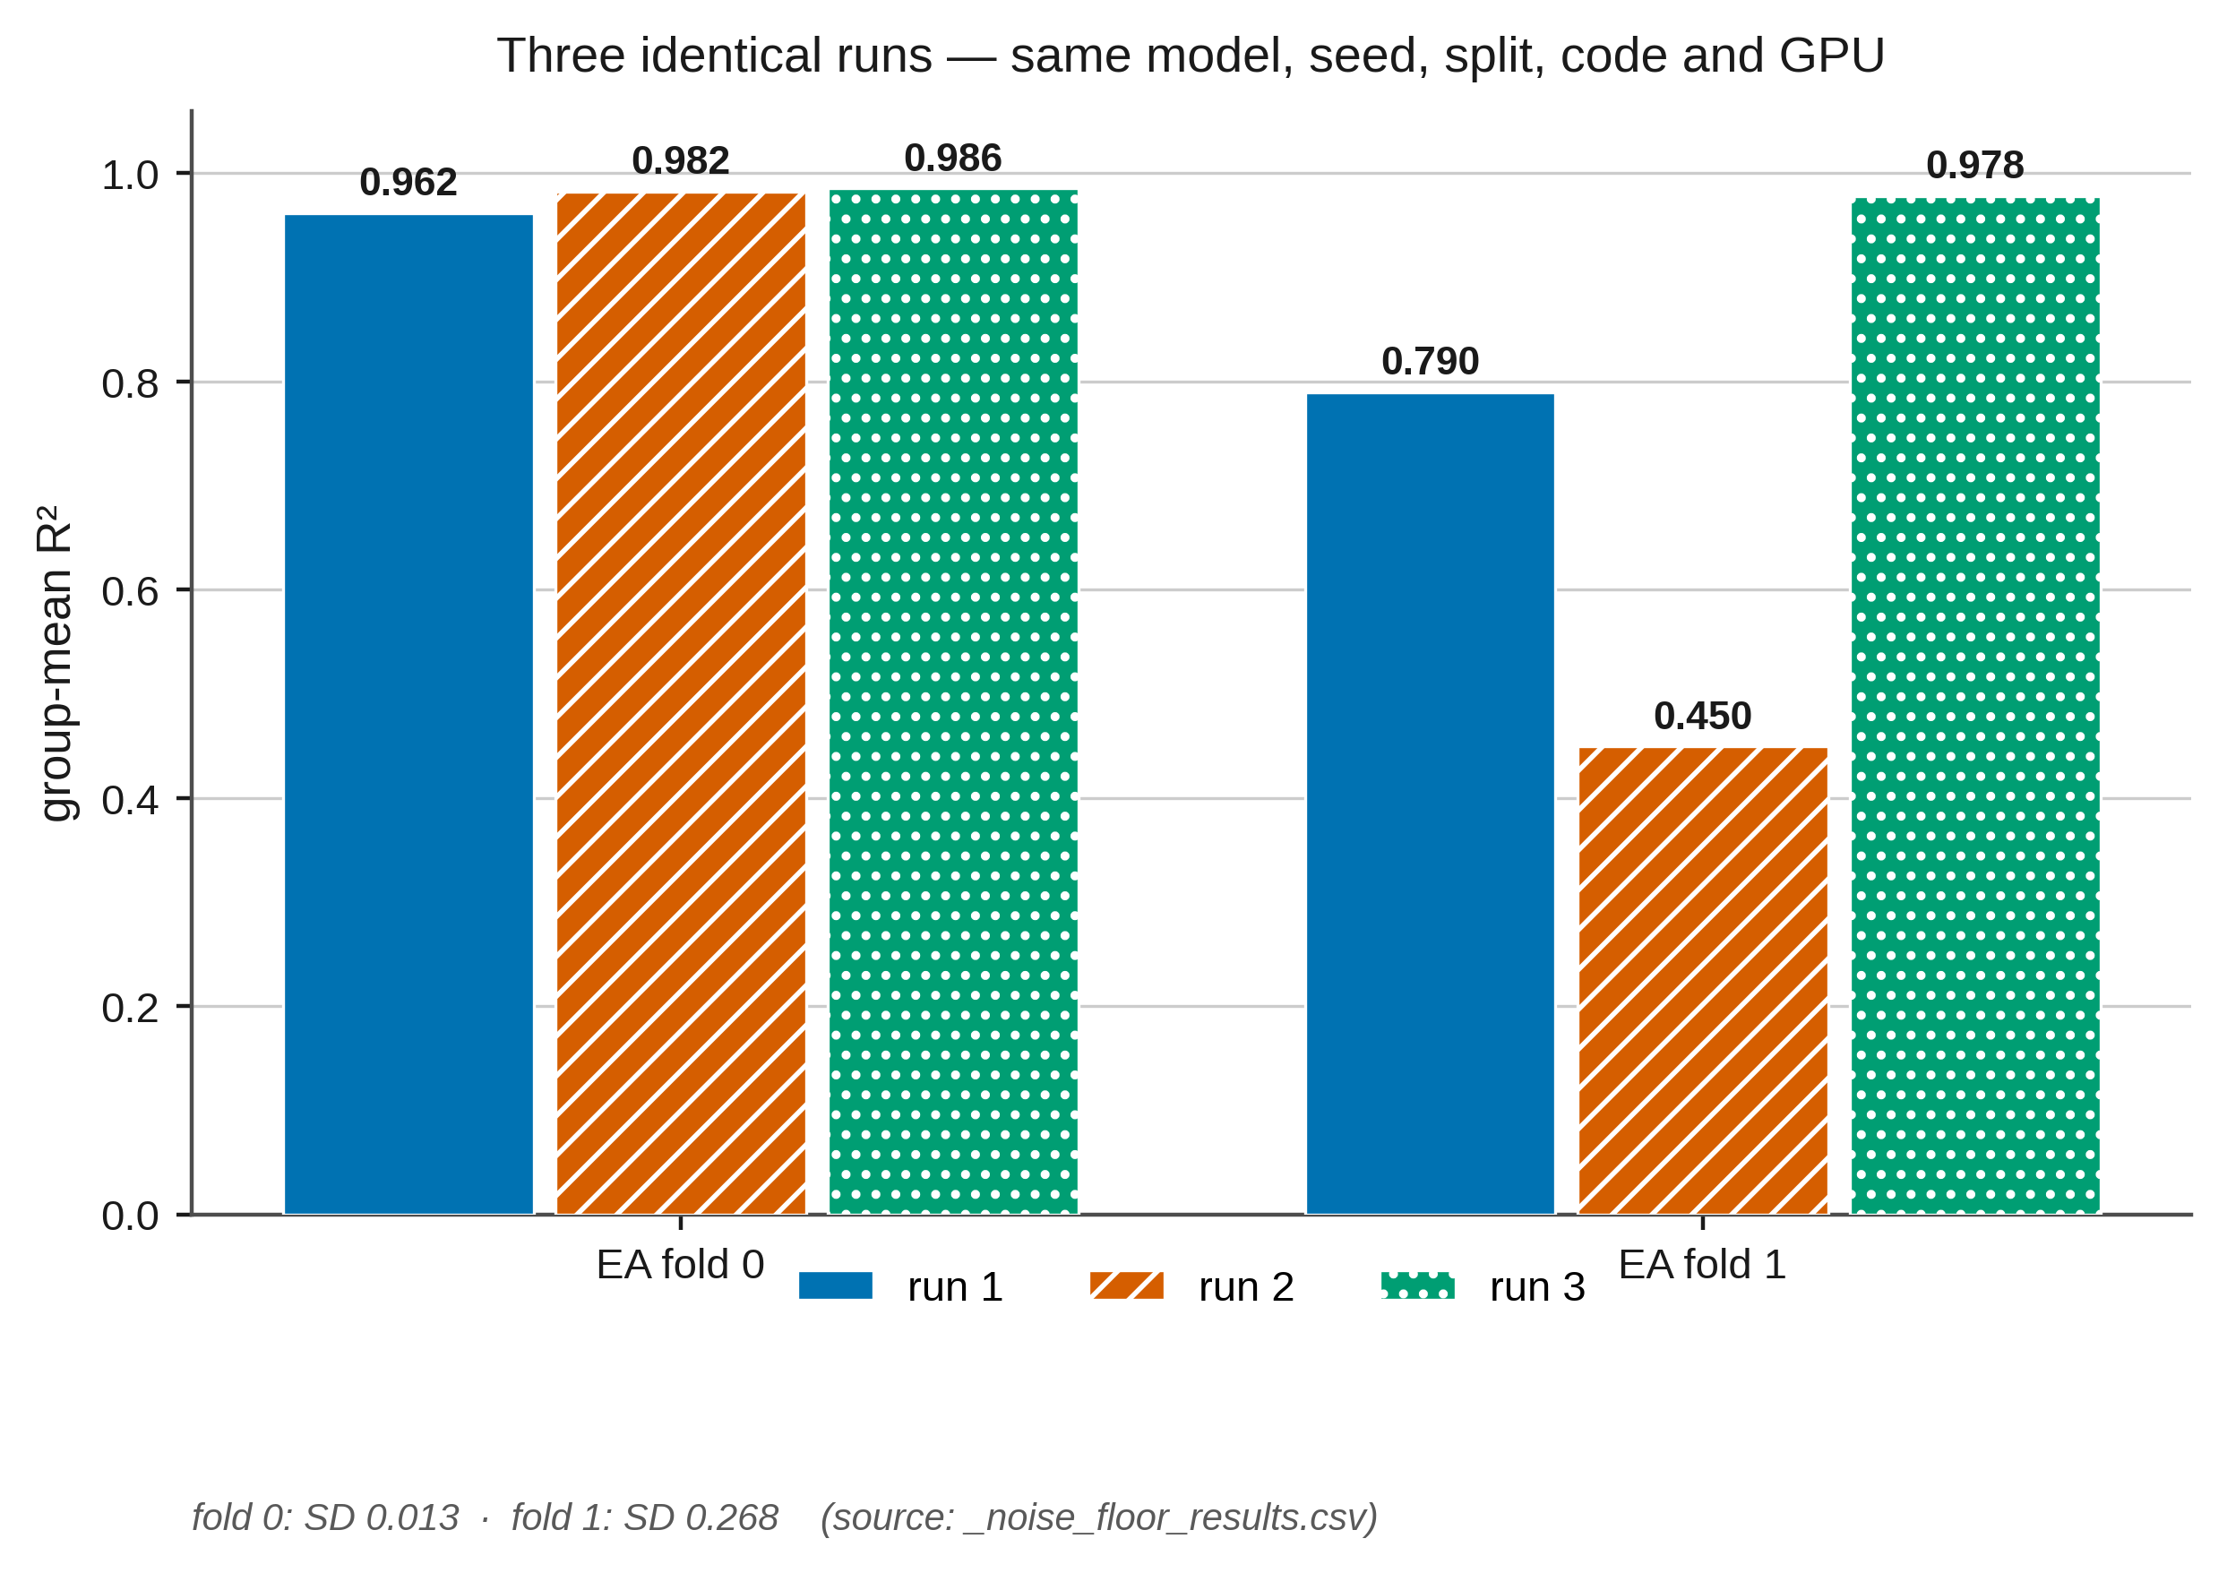
5
Noise floor — what difference is measurable at all
Measured, not assumed
PROTOCOL
Repeat runs identical in model, seed, split, code and GPU. Report the spread of every metric across repeats, and the per-cell across-seed SD for every model.
Result
Three identical runs, EA fold 1:
group-mean R² = 0.450 / 0.790 / 0.978
SD 0.268. Single-run benchmark numbers are not measurable at this scale.
We therefore average three seeds at the prediction level as the replicate unit, and quote a per-split materiality threshold before running any ablation.
fig1_run_to_run_variance · same model, same seed, same code
No polymer representation paper we are aware of publishes a measured noise floor. Shipping one is itself a contribution.

Slide 9
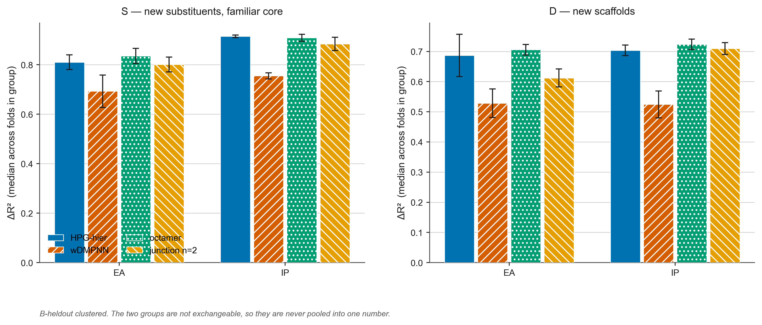
6
The demonstration — same predictions, opposite conclusions
B split, cross-scaffold folds: octamer versus wDMPNN
MEDIAN PAIRED DIFFERENCE, D FOLDS
Overall R²
+0.003
3 / 5
p = 1.00
MAE
−0.000
3 / 5
p = 1.00
group-mean R²
+0.002
3 / 5
p = 1.00
ΔR² (architecture)
+0.260 EA / +0.152 IP
5 / 5
p = 0.062
On genuinely new chemistry the two models are statistically indistinguishable on every conventional measure — and separated by 0.15–0.26 on architecture recovery.
The metric everyone reports cannot see the effect being studied.
fig_r3_architecture · S and D fold groups, four models. The conventional metrics for these same runs are in the table on the left.
[ADD: a single side-by-side figure of these two panels would make the point in one image — worth building for the paper.]

Slide 10
What the framework still cannot test — and what that motivates
Two of the three axes have an extrapolation split. The third does not.
BUILT
BUILT
MISSING
Monomer A
held-out chemistry
R1 · 9 folds
Monomer B
held-out scaffold family
R3 · 9 folds, S/D grouped
Architecture
held-out arrangement
impossible on this dataset
Why it is impossible today
There are only three distinct chain-arrangement descriptions in all 42,966 rows — one per architecture type, and identical across compositions. Hold one out and the model has nothing to interpolate from; it would be extrapolating to a category it has never seen, with no intermediate cases in between.
A continuous blockiness axis would make the third split possible — and that is the argument for the dataset, independent of any model.

Slide 11
Proposed framing, and what I would like your view on
THE CLAIM
Not "here are better metrics" — but "current evaluation cannot answer the question the field is asking, and here is the evidence."
The metrics are the remedy, not the contribution.
WHY NOW
All six components are built and measured. No new compute is needed to write it.
It also does not depend on the octamer being the best model — the framework stands whichever model wins, which insulates it from the protocol-matching confound.
QUESTIONS FOR YOU
1. Is "the evaluation cannot see the property" a strong enough central claim, or does it need a model result attached to be publishable?
2. Which of the six carries the most weight? My view is the null floor — a parameter-free predictor beating a trained model is the most striking single result.
3. Venue — a methods/benchmark venue, or a chemistry venue where the audience is the one making the mistake?
4. Should the architecture-held-out gap be stated in this paper as motivation for the next one, or held back?

