Slide 1
PAPER 1 — EVALUATION FRAMEWORK
Current evaluation cannot see the property the field claims to model
Six components of an evaluation framework for polymer representation learning. All six are built, measured, and demonstrated on data already held.
Every figure carries a manifest recording its sources and selection rule. No new compute is required to write this paper.
Notes:
Framing: this is not 'here are better metrics'. It is 'the metric everyone reports cannot answer the question everyone is asking', and here is the evidence. Rebuilt 11 August against six purpose-built, verified figures.

Slide 2
The problem, and the six things needed to fix it
Chain architecture is what we claim to model. It is ~1% of the variance in the target.
1
F1
2
F2
3
F3
Variance decomposition
Establishes that the signal is invisible to the standard metric
Two-axis metric
Separates chemistry placement from architecture recovery
Null floor
The best achievable without the thing being tested
4
F4
5
F5
6
F6
Split design
Two chemistry-extrapolation regimes, folds not exchangeable
Noise floor
What difference is measurable at all
The demonstration
Two metrics, same predictions, opposite conclusions
Together they answer a question the field currently cannot: is a representation better, or does it merely score higher?

Slide 3
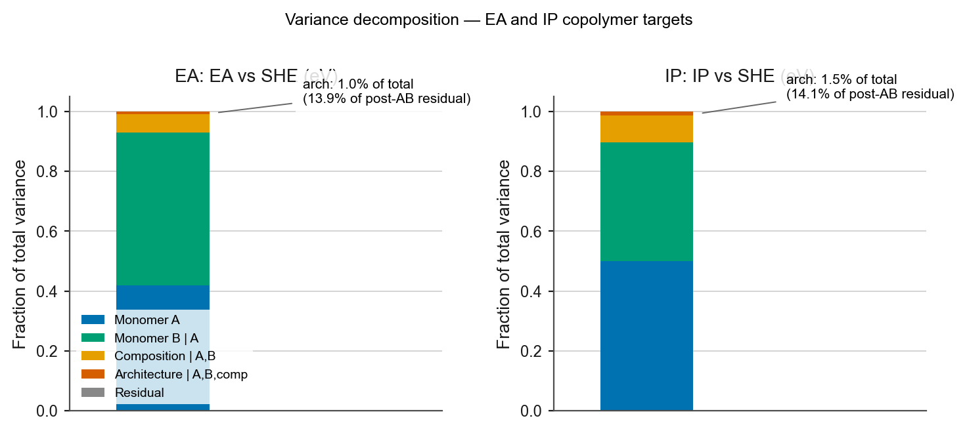
1
Variance decomposition — the signal is 1% of the target
Why the standard metric cannot see architecture
ARCHITECTURE, SHARE OF TOTAL VARIANCE
0.98% / 1.46%
EA / IP. Monomer identity alone accounts for 92.9% (EA) and 89.7% (IP).
ARCHITECTURE, SHARE OF POST-AB RESIDUAL
13.9% / 14.1%
Once monomer identity is removed, architecture is a seventh of what remains.
F1 · data/ea_ip.csv, 42,966 rows · sequential R² on group-transform means · no model predictions
Why this matters
A metric dominated by a 90% term cannot resolve a 1% term. Overall R² is not a weak measure of architecture — it is not a measure of it.
Component shares sum to 1.000 on both targets; residual is 0.000 — the four factors are exhaustive.

Slide 4
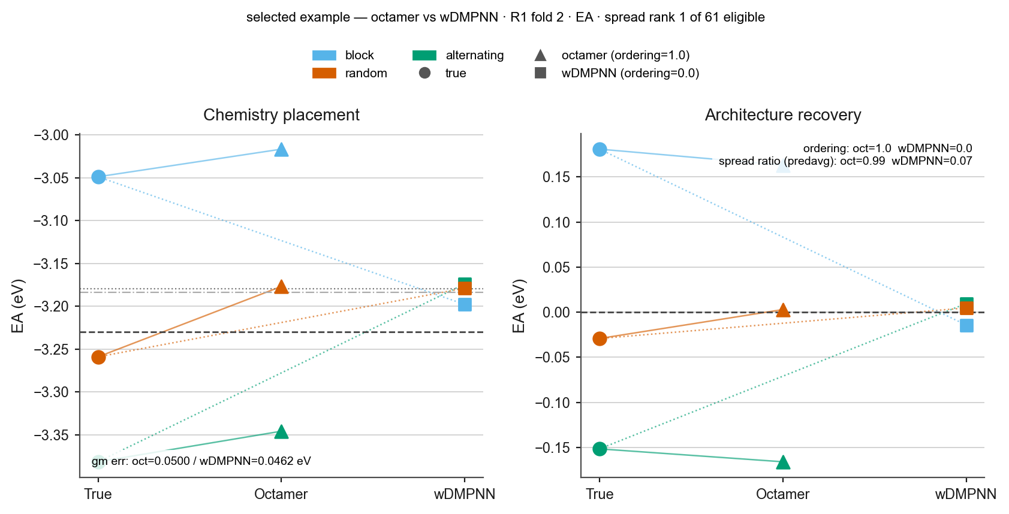
2
Two-axis metric — separate placement from recovery
One group of three polymers: same chemistry, same composition, different architecture
THE TWO AXES
Group-mean R² — did the model put the chemistry in the right place?
ΔR² — within a group, did it recover the architecture ordering?
The second is computed on the residual after the first is removed.
ON THIS GROUP
Both models place the chemistry within 0.05 eV. The octamer recovers 99% of the true architecture range; wDMPNN recovers 7%.
F2 · selected example · R1 fold 2, EA · three seeds averaged at prediction level · 1 of 61 eligible group-folds (1.0%)
wDMPNN does not rank the architectures wrongly — it predicts nearly one value for all three.
Notes:
Say 'selected example' out loud. Base rate is in the manifest: 61 of 6,138 group-folds on EA (1.0%), 54 on IP (0.9%), present in 8 of 9 folds on each target. Median architecture-spread recovery across all groups: octamer 0.768 EA / 0.947 IP, wDMPNN 0.610 / 0.551. That ratio is TWO-SIDED — closer to 1 is better, not larger — so do not quote it as a ranking without the caveat.

Slide 5
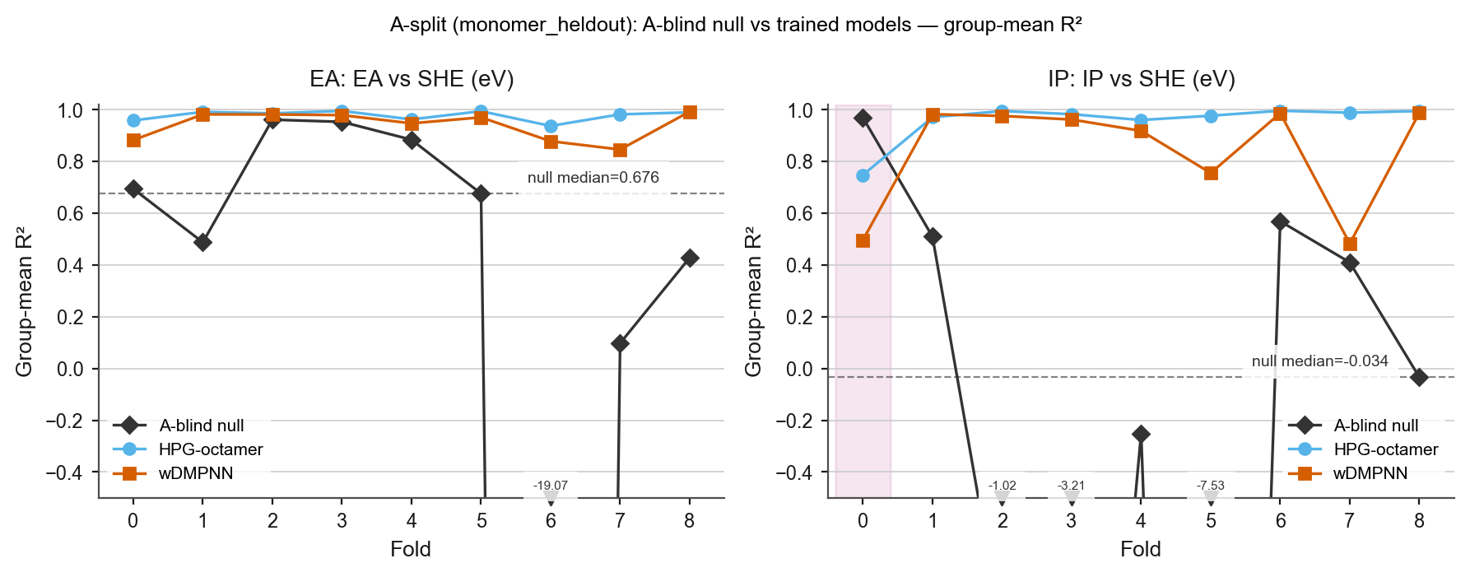
3
Null floor — the best achievable without the thing being tested
A parameter-free group-mean lookup table that never sees the held-out monomer
NULL MEDIAN GROUP-MEAN R²
0.676 vs −0.034
EA / IP. Same benchmark, same split design, opposite conclusions about difficulty.
THE HEADLINE CASE
On IP fold 0 the null scores 0.969 — beating both trained models.
On EA folds 2 and 3 it reaches 0.961 and 0.953 while knowing nothing about the held-out monomer.
F3 · A split, 9 folds × 2 targets × 3 series · null reused from aggregate_lomo_seeds.null_floor · no missing cells
A reported group-mean R² of 0.95 on those folds is a number a lookup table matches. Without a null floor you cannot tell.
Values below the axis limit are clipped — EA fold 6 null = −19.07; IP folds 2, 3, 5 = −1.02, −3.21, −7.53.

Slide 6
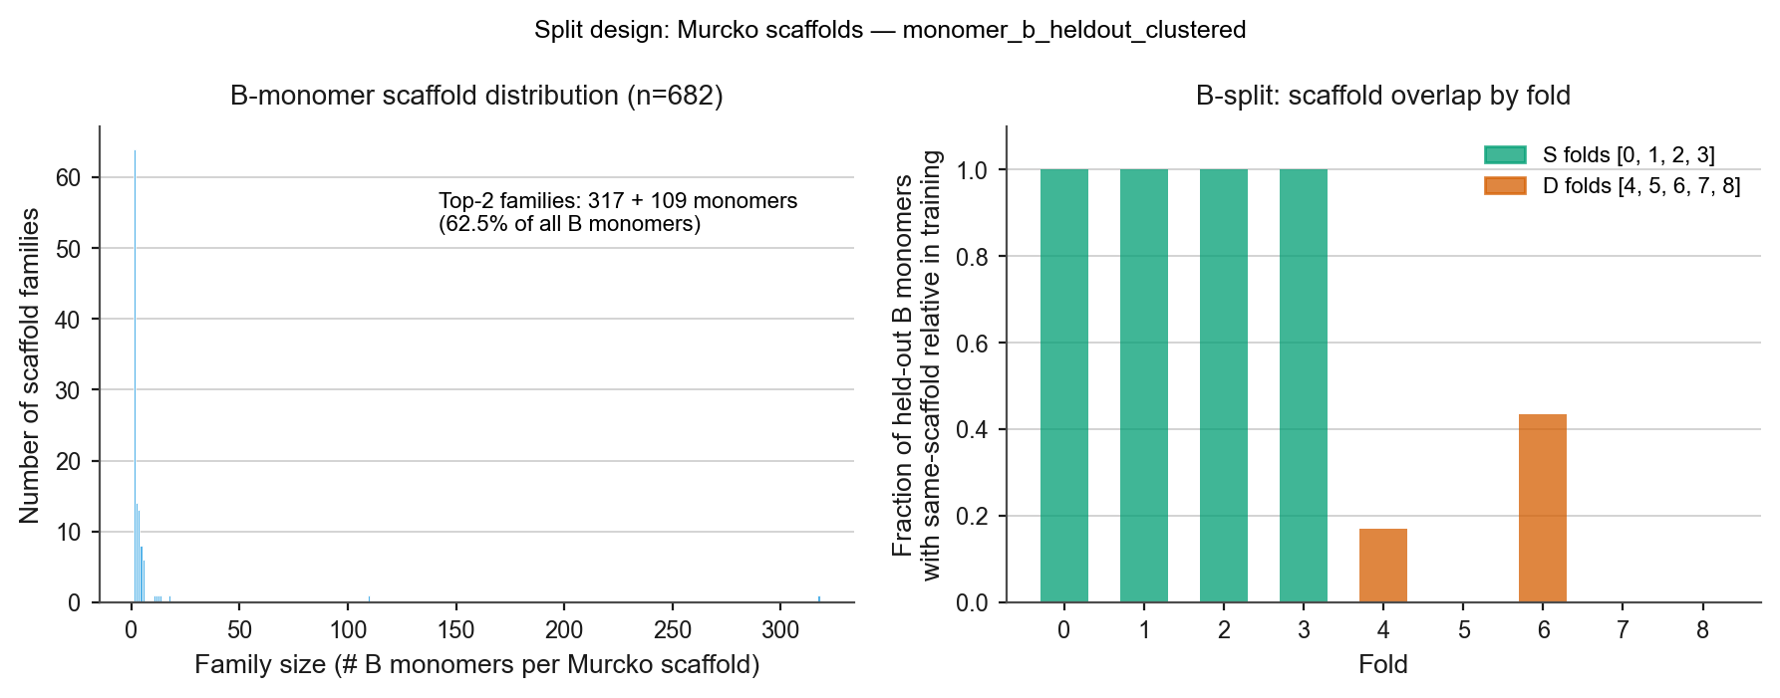
4
Split design — two extrapolation regimes, folds not exchangeable
The benchmark's B-monomer space is dominated by two scaffold families
TOP TWO SCAFFOLD FAMILIES
62.5%
317 and 109 of 682 B monomers. A balanced scaffold-disjoint split is therefore impossible.
FOLDS ARE NOT EXCHANGEABLE
S folds (0–3): every held-out B monomer has a same-scaffold relative in training.
D folds (5, 7, 8): none do.
Pooling them averages two different experiments.
F4 · Murcko scaffolds over 682 B monomers · split monomer_b_heldout_clustered
So S and D folds are reported separately throughout, never pooled.

Slide 7
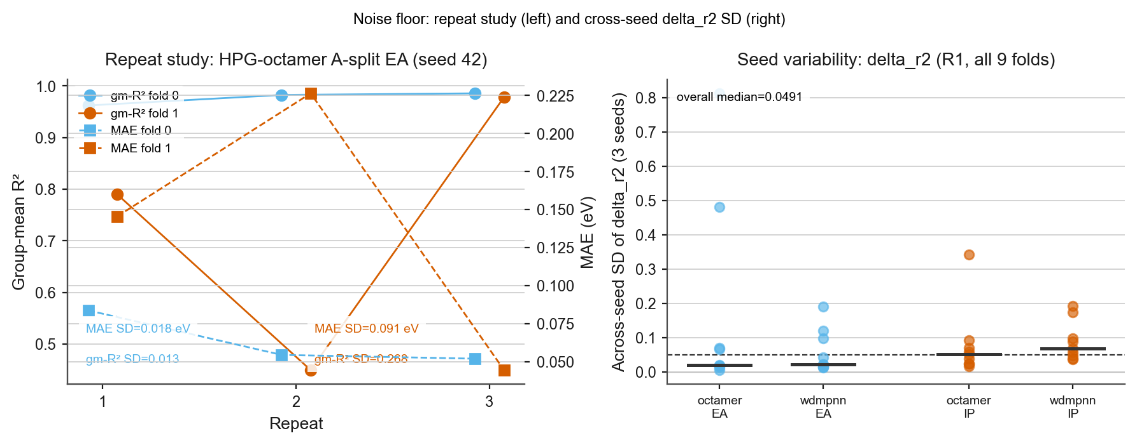
5
Noise floor — what difference is measurable at all
Identical configuration, identical seed, three repeats
GROUP-MEAN R², EA FOLD 1, THREE REPEATS
0.450 / 0.790 / 0.978
SD 0.268. Same configuration, same seed.
WHAT THIS BOUNDS
Any single-run comparison smaller than ~0.27 on this metric is unmeasurable.
MAE is far more stable — SD 0.091 eV on the same cell, 0.018 eV on fold 0. Stability is metric-specific.
F5 · left: 2 folds × 3 repeats, HPG-octamer A-split EA · right: across-seed SD of ΔR², all 9 folds, both models
Nobody in this literature publishes a noise floor. Most reported improvements are smaller than this one.
Notes:
If asked why the variance is so large on one fold and not the other: we do not fully know. It is a property of that fold's group structure, not of the model. That is itself worth reporting — and it is why every comparison in this work uses three seeds averaged at the prediction level.

Slide 8
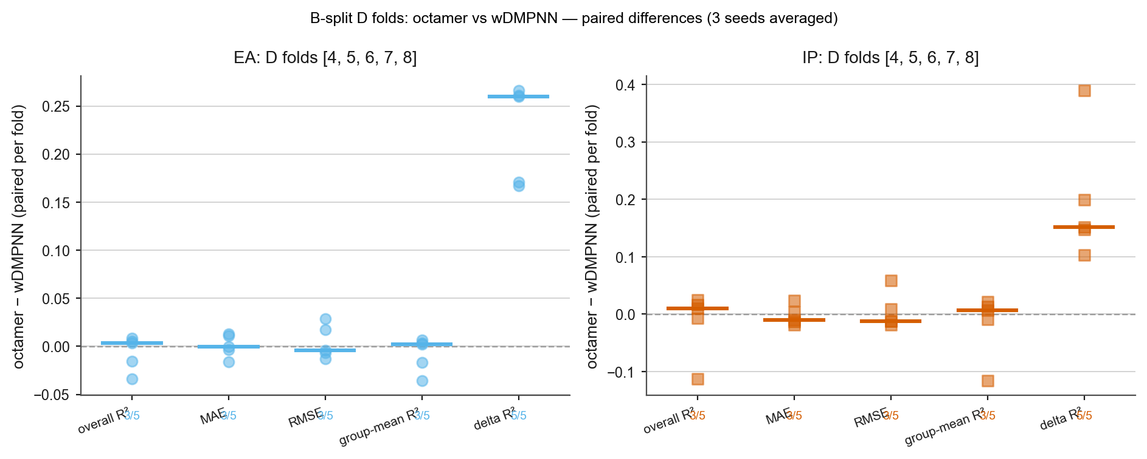
6
The demonstration — same predictions, opposite conclusions
B split, cross-scaffold D folds: octamer against wDMPNN at its published configuration
FOUR METRICS SAY 'TIE'
Overall R², MAE, RMSE and group-mean R² each split 3 of 5 folds — exactly what a coin does.
Medians: EA +0.003, IP +0.010 on overall R².
ΔR² SAYS OTHERWISE
5 of 5 folds, both targets.
Median +0.2597 (EA) and +0.1518 (IP) — two orders of magnitude larger than the accuracy differences.
F6 · paired per-fold differences, D folds [4,5,6,7,8] · three seeds averaged at prediction level
One set of predictions. Two defensible metrics. Opposite answers.
5 folds gives a minimum attainable two-sided sign-test p of 0.0625 — 5/5 is the strongest result the design permits, and is reported as such.

Slide 9
What the framework establishes
Four claims, each tied to one figure
The standard metric cannot see the property
F1
Architecture is 0.98% (EA) and 1.46% (IP) of total variance. Overall R² is dominated by a term two orders of magnitude larger.
A split can be degenerate for one target and not another
F3
A-blind null median group-mean R² is 0.676 on EA against −0.034 on IP. On IP fold 0 the null beats every trained model.
Benchmark numbers at this scale are not measurable single-run
F5
Three identical repeats give group-mean R² of 0.450, 0.790 and 0.978 — SD 0.268, larger than any improvement in the literature.
Two defensible metrics disagree on the same predictions
F6
Four accuracy metrics split 3/5 folds. ΔR² splits 5/5 on both targets, with medians of +0.26 and +0.15.
None of these depends on which model wins.

Slide 10
Where this sits — four papers, and why this one goes first
The through-line comes from the accepted review's own Future Perspectives section
0
Review — accepted, Digital Discovery
DONE
Argues in the literature that representation quality needs evaluating beyond predictive accuracy. Contains a section titled exactly that.
1
Evaluation framework — this deck
WRITE NOW
Demonstrates that argument empirically on the field's standard copolymer benchmark. All six components built and verified; no new compute needed.
2
Architecture-aware benchmark dataset
COSTED
Enables the architecture-held-out split that Paper 1 shows is missing. ~8–9 kSU CPU, pipeline verified portable.
3
The model — octamer versus baseline
EVIDENCE IN HAND
Significant on two comparisons at p = 0.004. Held until external validity is tested, so it does not carry the protocol-matching confound alone.
Year 1 argues it in the literature. Year 2 demonstrates it on the benchmark everyone uses. Year 3 builds the dataset the argument requires.

Slide 11
Why Paper 1 first — three reasons, one of them defensive
The alternative was to lead with the model result
It is writable today
Every component is built, measured and verified against a manifest. The model paper depends on external-validity tests not yet run; the dataset paper depends on compute not yet approved.
It does not depend on which model wins
The framework stands whether the octamer, HPG-hier or something later turns out best. That insulates it entirely from the protocol-matching confound, which is the largest threat to the model paper.
The measurement work invalidates the modelling work
The noise floor, the checkpoint bug, the null floors and the split design collectively void most of the earlier model comparisons. The stronger contribution is the one that did the invalidating.
What Paper 1 deliberately does not claim
That our model is the best. The octamer appears only as one of the models used to demonstrate that two metrics can disagree on the same predictions. Its own significance result belongs to Paper 3, after external validity has been tested.
Target: submit in the first quarter of Year 3. No experiments block it.

Slide 12
Provenance — what stands behind each figure
Every figure has a manifest in analysis/paper1_figures/ recording sources, selection rule and cell count
F1
Variance decomposition
data/ea_ip.csv, 42,966 rows. No model predictions. Shares sum to 1.000.
F2
Worked example
Selected example, criterion stated. 1 of 61 eligible group-folds; base rate reported.
F3
Null floor
9 folds × 2 targets × 3 series = 54 cells, none missing. Null reused, not rebuilt.
F4
Split design
682 B monomers, Murcko scaffolds. Fold composition verified against split metadata.
F5
Noise floor
2 folds × 3 repeats, plus across-seed SD over all 9 folds and both models.
F6
Demonstration
5 D folds × 2 targets. Every median and win count matches expected in f6_summary.csv.
Standing protocol: 3 seeds (42/43/44) averaged at the prediction level, best-checkpoint predictions, paired per-fold sign tests, S and D folds never pooled.

