Slide 1
SECTION 1
Evaluation Paper

Slide 2
What the wD-MPNN paper claims
Section heading: “The wD-MPNN captures how polymer properties depend on chain architecture and monomer stoichiometry”
Representation | EA R² | EA RMSE | IP R² | IP RMSE
Monomers only | 0.917 | 0.173 | 0.883 | 0.165
+ chain architecture | 0.929 | 0.159 | 0.898 | 0.154
+ stoichiometry | 0.987 | 0.069 | 0.982 | 0.065
+ both (full wD-MPNN) | 0.997 | 0.035 | 0.997 | 0.027
Adding architecture on top of stoichiometry:
−49%
EA error
−58%
IP error
Aldeghi & Coley, Chem. Sci. 2022, 13, 10486–10498 — Table 2 and Table S1
Notes:
Open by conceding. Adding chain architecture on top of stoichiometry halves the error — 49% on EA, 58% on IP. That is not a marginal result. It looks small in R2 only because R2 saturates near 1. Their claim is correct and their evidence supports it. My argument is not that they were wrong.
Tactically: lead with a critique of their numbers and the rest of the talk is a fight. Lead with a concession and the room hears the actual point.

Slide 3
But that evidence came from a different regime
Architecture as a share of… | EA | IP
total variance (held-out-monomer) | 0.98% | 1.46%
what remains once monomers known (random) | 13.9% | 14.1%
The ablation runs under random 10-fold splits
The benchmark has only 9 distinct A monomers. Under a random split every one of them appears in training, so monomer identity is effectively memorised.
What is left to explain is composition and architecture — and in that reduced space architecture is large.
Under a held-out-monomer split monomer identity becomes the dominant unknown. Their own RMSE goes from 0.027–0.035 eV to 0.09–0.10 eV.
Grouping | Cumulative R² (EA) | New factor's share
A | 0.4182 | A = 41.8%
A, B | 0.9293 | B given A = 51.1%
A, B, fracA | 0.9902 | composition = 6.1%
A, B, fracA, poly_type | 1.0000 | architecture = 0.98%
The architecture ablation was never run on Monomer Split.
Notes:
It says nothing about whether that ability survives unfamiliar chemistry. Held-out-monomer splits are what the field cites this benchmark for, and there architecture is ~1% of the target

Slide 4
METRIC · 1 OF 2
How the two axes are computed
Everything below comes from one unchanged set of predictions — no retraining
A group g = all test polymers sharing monomer A, monomer B and composition. Within a group, only architecture differs.
yᵢ = ȳ_g(i) + δᵢ where δᵢ = yᵢ − ȳ_g(i)
where the chemistry sits what architecture does within it
AXIS 1 — CHEMISTRY PLACEMENT
group_mean_R² = R²( ȳ_g , ŷ̄_g )
Did the model put each chemistry at the right value?
AXIS 2 — ARCHITECTURE RECOVERY
ΔR² = R²( δᵢ , δ̂ ᵢ )
Cannot be improved by getting the chemistry right — the group mean is subtracted from both.
Notes:
A group is polymers sharing monomer A, monomer B and composition, so within a group only architecture differs. Groups with fewer than two architectures are discarded.

Slide 5
METRIC · 2 OF 2
The null floor, and two supporting quantities
NULL FLOOR
A parameter-free lookup table, never trained. For a test polymer it returns the mean training value of polymers sharing monomer B, composition and architecture.
skill = (R²_model − R²_null) / (1 − R²_null)
0 = matched a lookup table. A model can post R² = 0.98 and skill ≈ 0.
ARCHITECTURE-SPREAD RATIO
ratioₘ = (max ŷ − min ŷ) / (max y − min y)
Of the true spread between architectures, how much does the model reproduce? 1.00 is perfect; 0 = one value for all; above 1 = exaggeration.
Two-sided — 1.4 is as wrong as 0.71. Summarise with median |log₂ ratio|, where 0 is perfect.
PROTOCOL
Three seeds (42/43/44). Predictions averaged first, then the metric computed once — not the other way round. Best-checkpoint predictions, never the final patience-expired model. S and D folds never pooled.
Notes:
The null predictor is scored with the identical metric on the identical fold. Because monomer A is held out by construction it cannot use any information about monomer A.

Slide 6
PROPOSAL
Baselines blind to the tested property should be standard
And the wD-MPNN paper already ran one
Whenever a paper claims a representation encodes property X, it should report a baseline that cannot encode X — scored identically, on every fold.
Diblock phase dataset | PRC
Full wD-MPNN | 0.68
Random forest, size alone | 0.69
Random forest, stoich alone | 0.71
Best RF (stoich + size) | 0.74
A baseline with no architectural information at all scores above the architecture-aware model — on a dataset used to demonstrate architecture awareness.
They ran the comparison and reported it in SI. Propose making it mandatory.
Notes:
=

Slide 7
RESULT
The null floor across every fold
Group-mean R², A split (held-out monomer A)
Fold | EA null | EA octamer | EA wD-MPNN | IP null | IP octamer | IP wD-MPNN
0 | 0.694 | 0.958 | 0.882 | 0.969 | 0.748 | 0.496
1 | 0.487 | 0.991 | 0.982 | 0.509 | 0.970 | 0.982
2 | 0.961 | 0.986 | 0.981 | −1.019 | 0.995 | 0.976
3 | 0.953 | 0.995 | 0.979 | −3.206 | 0.982 | 0.962
4 | 0.884 | 0.962 | 0.947 | −0.251 | 0.960 | 0.918
5 | 0.676 | 0.994 | 0.970 | −7.528 | 0.977 | 0.755
6 | −19.069 | 0.937 | 0.878 | 0.569 | 0.996 | 0.986
7 | 0.098 | 0.982 | 0.846 | 0.410 | 0.988 | 0.482
8 | 0.428 | 0.989 | 0.992 | −0.034 | 0.995 | 0.987
Median | 0.676 | 0.984 | 0.967 | −0.034 | 0.978 | 0.971
EA folds 2–3
Lookup table scores 0.96 and 0.95 knowing nothing about the held-out monomer.
IP fold 0
The lookup table (0.969) beats both trained models.
Median
0.676 on EA against −0.034 on IP. Same split. You cannot tell without computing it.
Notes:
Same split, same benchmark. On EA a lookup table gets 0.68; on IP it gets −0.03. You cannot know which situation you are in without computing it.
On EA folds 2 and 3 it scores 0.96 and 0.95 — a model reporting 0.98 there has learned much less than the number suggests.
And on IP fold 0 the lookup table beats both trained models.
Negative R2 is unbounded below — −19.07 and −7.53 are real, not errors.

Slide 8
SPLIT DESIGN
The folds are not exchangeable
62.5% of the 682 B monomers sit in just two scaffold families (317 and 109)
Fold | 0 | 1 | 2 | 3 | 4 | 5 | 6 | 7 | 8
Held-out monomers with a scaffold relative in training | 1.00 | 1.00 | 1.00 | 1.00 | 0.17 | 0.00 | 0.43 | 0.00 | 0.00
Group | S | S | S | S | D | D | D | D | D
Folds 0–3 test interpolation inside a known scaffold family. Folds 5, 7 and 8 test extrapolation to scaffolds never seen. These are different experiments.
A balanced scaffold-disjoint split cannot be built on this benchmark. So S (same-scaffold) and D (cross-scaffold) folds are never pooled.
Notes:
Folds 0–3 are interpolation. Folds 5, 7 and 8 are extrapolation. Averaging them gives a number that describes neither. So S and D folds are reported separately throughout.

Slide 9
HEADLINE · 1 OF 3
Under interpolation, every metric agrees
Monomer A split, 9 folds. Octamer minus wD-MPNN
Metric | EA median | EA mean | EA wins | p | IP median | IP mean | IP wins | p
Overall R² | +0.017 | +0.030 | 9/9 | 0.004 | +0.021 | +0.070 | 8/9 | 0.039
MAE | −0.018 | −0.023 | 8/9 | 0.039 | −0.026 | −0.026 | 8/9 | 0.039
RMSE | −0.024 | −0.026 | 9/9 | 0.004 | −0.033 | −0.030 | 8/9 | 0.039
Group-mean R² | +0.008 | +0.027 | 8/9 | 0.039 | +0.019 | +0.060 | 7/9 | 0.180
ΔR² (architecture) | +0.190 | +0.236 | 8/9 | 0.039 | +0.278 | +0.267 | 9/9 | 0.004
Every metric points the same way. Metric choice is immaterial here.
Notes:
On the A split all five metrics favour the octamer on 8 or 9 of 9 folds. If that were the only regime we looked at, none of this machinery would be needed.

Slide 10
HEADLINE · 2 OF 3
Under extrapolation, they come apart
B split, cross-scaffold D folds, 5 folds.
Metric | EA median | EA mean | EA wins | IP median | IP mean | IP wins
Overall R² | +0.003 | −0.006 | 3/5 | +0.010 | −0.014 | 3/5
MAE | −0.000 | +0.001 | 3/5 | −0.010 | −0.003 | 3/5
RMSE | −0.004 | +0.005 | 3/5 | −0.012 | +0.005 | 3/5
Group-mean R² | +0.002 | −0.008 | 3/5 | +0.007 | −0.016 | 3/5
ΔR² (architecture) | +0.260 | +0.225 | 5/5 | +0.152 | +0.198 | 5/5
Mean and median disagree in sign on 4/4 accuracy metrics (EA) and ¾ (IP). ΔR² does not.
Same predictions. Four metrics say tie; architecture recovery says 5 of 5.
Minimum attainable p at 5 folds is 0.0625 — this cannot reach 0.05 by design.
Notes:
Four accuracy metrics split three-to-two, which is what a coin does. Architecture recovery splits five-to-zero on both properties. Same predictions.
And mean and median disagree in sign for four of the four accuracy metrics. It is not just that they are insensitive — the answer depends on which average you pick. ΔR² does not do that.
With 5 folds the smallest achievable p is 0.0625, so this cannot reach 0.05 by design.

Slide 11
SECTION 2
Paper strategy

Slide 12
Paper Plans
 | Paper | Status | Note
0 | Review — accepted, Digital Discovery | done | Argues in the literature that representation quality needs more than accuracy
1 | Evaluation framework | write now | Demonstrates it empirically.
2 | Architecture-aware benchmark dataset | Design to be confirmed | Builds the data the argument requires — and resolves question on octamer
3 | The model — octamer vs baseline | Potential | Held until external validity is tested

Slide 13
THE ASK
What Paper 2 builds
The existing benchmark has three architecture settings — literally three distinct transition matrices across 42,966 rows
 | Change | Purpose
1 | Blockiness varies continuously at fixed chemistry and composition | Turns a 3-way classification into a real measurement axis
2 | Publish the un-averaged per-chain values, not only the ensemble average | Share per-label uncertainty/distribution
3 | Sweep the label chain length: 8, 12, 16 and 24 units | Resolves octamer design
COST
~2,000 polymers · ≤512,000 structures · ~30 CPU-seconds each → ≈ 8–9 kSU CPU. That is a ceiling; a one-day pilot would measure the real figure.
FOR SCALE
Reproducing the full 42,966 would be ~150 kSU. We are proposing about 5% of that — and it is CPU, not GPU.
The pipeline is published, verified portable, and runs on monomers we already hold.

Slide 14
SECTION 3
Why does the octamer win?
What we have excluded, and what remains

Slide 15
STARTING POINT
The result being explained
Median over 9 A-split folds, baseline at its published configuration
 | EA overall R² | EA MAE | EA ΔR² | IP overall R² | IP MAE | IP ΔR²
HPG-octamer | 0.984 | 0.055 | 0.849 | 0.978 | 0.035 | 0.886
wD-MPNN (published cfg) | 0.967 | 0.070 | 0.397 | 0.971 | 0.050 | 0.565
Median over 4 B-split folds, same scaffold
 | EA overall R² | EA MAE | EA ΔR² | IP overall R² | IP MAE | IP ΔR²
HPG-octamer | 0.980 | 0.049 | 0.836 | 0.982 | 0.036 | 0.909
wD-MPNN | 0.969 | 0.065 | 0.693 | 0.978 | 0.049 | 0.755
Median over 5 B-split folds, cross scaffold
 | EA overall R² | EA MAE | EA ΔR² | IP overall R² | IP MAE | IP ΔR²
HPG-octamer | 0.951 | 0.089 | 0.706 | 0.924 | 0.076 | 0.724
wD-MPNN | 0.947 | 0.092 | 0.528 | 0.908 | 0.086 | 0.525
The accuracy gap is real but modest. The architecture-recovery gap is more than double.
Notes:
The accuracy gap is real but modest. The architecture-recovery gap is more than double.

Slide 16
ABLATION
Five differences, tested one at a time
Each elimination pre-registered before running
 | Factor | Status
1 | 8-slot chain instead of a 2-node graph | open
2 | Learned position embeddings | excluded — next slide
3 | Attention readout instead of stoichiometry-weighted | open
4 | Discards the 16-d port-pair edge features | open
5 | 16 sampled sequences averaged, instead of 1 | excluded — next slide
Two excluded, three open — and two of the three are confounded with each other.
Notes:
The octamer differs from our own HPG-hier in five ways at once.

Slide 17
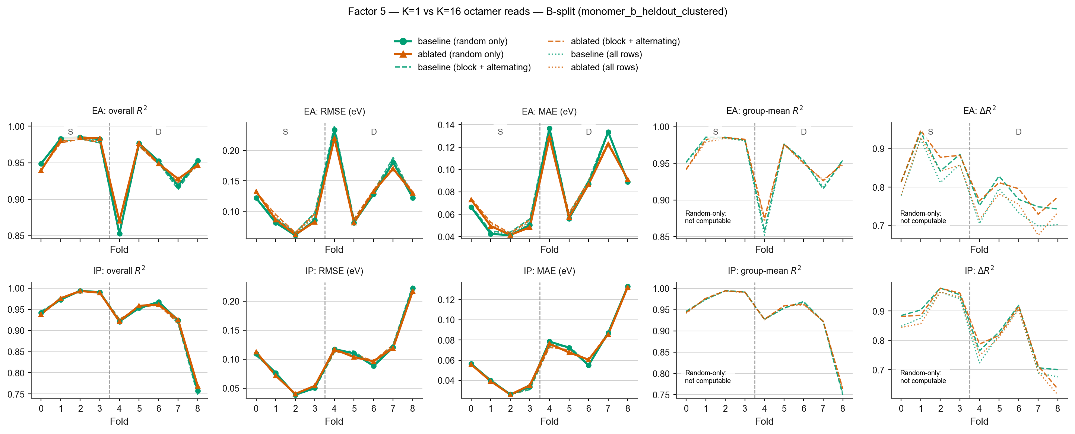
EXCLUDED
Factor 5 — the 16-sequence ensemble is not doing the work
Retrained with K = 1: one fixed sequence per polymer, never resampled. B split, both targets, three seeds, random rows
Metric (K=1 minus K=16) — full range across folds | EA · S folds | EA · D folds | IP · S folds | IP · D folds
Overall R² | −0.010, +0.001 | −0.006, +0.018 | −0.003, +0.003 | −0.006, +0.010
RMSE | −0.002, +0.011 | −0.015, +0.007 | −0.004, +0.003 | −0.006, +0.008
MAE | −0.001, +0.008 | −0.010, +0.002 | −0.000, +0.002 | −0.004, +0.005
Group-mean R² | −0.010, +0.001 | −0.006, +0.019 | −0.004, +0.003 | −0.006, +0.010
ΔR² | −0.002, +0.029 | −0.024, +0.032 | −0.019, +0.005 | −0.062, +0.025
The biggest single-fold change anywhere is 0.062. The averaging is not where the advantage comes from.
Notes:
Dropping from sixteen sampled sequences to one changed nothing measurable on any metric — accuracy, error, chemistry placement or architecture recovery. The averaging is not where the advantage comes from. That is a negative result and I am reporting it as one.

Slide 18
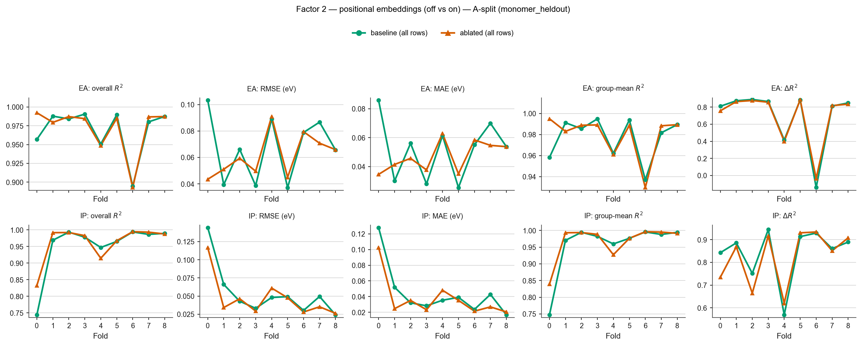
EXCLUDED
Factor 2 — position embeddings are not doing the work either
Retrained with the 8 learned slot vectors removed. A split, 9 folds, both targets, three seeds — 54 runs, completed this week
Metric (ablated minus baseline) | EA median | EA range across folds | EA p | IP median | IP range across folds | IP p
Overall R² | −0.002 | −0.008, +0.035 | 0.51 | +0.002 | −0.032, +0.088 | 0.51
RMSE | +0.001 | −0.060, +0.012 | 0.51 | −0.002 | −0.032, +0.013 | 0.51
MAE | +0.001 | −0.051, +0.011 | 0.51 | −0.004 | −0.027, +0.013 | 0.51
Group-mean R² | −0.001 | −0.008, +0.037 | 0.51 | +0.001 | −0.032, +0.092 | 0.51
ΔR² | −0.010 | −0.053, +0.105 | 0.51 | −0.010 | −0.108, +0.051 | 1.00
No consistent effect. Two known-unstable cells account for most of the spread.
Notes:
Removing the position embeddings moved nothing — every metric's median is within four thousandths of zero except ΔR², which moved by one hundredth against a threshold of five hundredths fixed before running.
Caveats: scope is R1 only, the B split has not been run. EA fold 6's +0.105 is the largest number in the arm but that cell's baseline ΔR² is −0.14 with a seed SD of 0.81 — it is noise. And EA fold 0 moves in opposite directions on the two axes; on one fold at these magnitudes that is not a finding.
Say the mechanism precisely: without position embeddings, slots holding the same monomer get identical embeddings, but end and interior slots still differ through path structure. This is a REDUCTION of positional information, not its elimination. Do not say 'position-blind'.

Slide 19
THE HONEST LIMIT
The issue, and how Paper 2 could resolves it
Labels were computed on 8-unit chains averaged over up to 32 sequences. The octamer uses an 8-slot chain, 16 sequences, averaged
If the octamer's advantage is… | then as label chain length moves away from 8…
protocol matching | performance peaks sharply at 8 and degrades at 12, 16, 24
correct physics | performance is flat, or improves with longer chains
This is change 3 on the Paper 2 slide. The same monomers, the same pipeline, a subset run at four chain lengths instead of one — a clean, pre-registerable discriminator at no extra cost.
Cheaper first: test on the glass-transition and block-copolymer datasets we already hold, whose labels have nothing to do with 8-unit averaging.
Notes:
Two readings, both legitimate. Favourable: we encoded the right physics. Sceptical: the advantage is alignment with this dataset's recipe.
No ablation on this dataset can separate them — every label was made at 8 units, so there is no variation to exploit. But a dataset can, and it is the one we already want to build.
Cheaper things first: the glass-transition and block-copolymer datasets are already in the repository and their labels have nothing to do with 8-unit averaging. And freezing the model to test whether architecture is linearly decodable separates 'predicts better' from 'represents better'.

