Slide 1
UI Design for RecyclingBuddy
By Cao Zheran, Chloe Koh Yi Xuan, Tan Tian Kovan, Goh Jie Ling

Slide 2

Conceive:
Background Info & Problem Statement

Slide 3
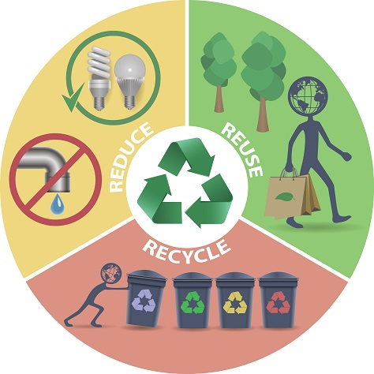
Background Information
In Singapore, people do not actively participating in recycling which leads to a lot of waste generated in the country.
Based on a study conducted by the Singapore Environment Council (SEC), about 70% of people surveyed do not know which materials are recyclable and which are not.
Since a high percentage of greenhouse gas is caused by the production and use of goods. Reducing, reusing, and recycling products will decrease the amount of greenhouse gas emitted which also helps to reduce climate impact.
By educating and encouraging people on reducing, reusing, and recycling, production of goods will be less. Thus, conserving energy and reducing greenhouse gas emissions.
e.g.
Illustration of
The 3Rs
(Reduce, Reuse,
Recycle)

Slide 4

Challenge
To promote reduce, reuse, and recycle, we thought of creating an application that encourages people to recycle.

Slide 5

Research into Existing Solutions:
Proposed Solution

Slide 6
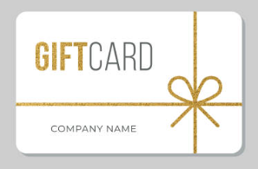

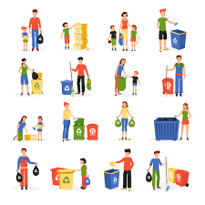
Solution
Existing solutions:
Promote zero waste through campaigns and applications that provide the location of nearby recycling venues, recycled products, and recycling games for kids.
Our Solution:
The application shows the nearest recycling venue for users to easily approach it. Recycling will award users with points according to the recycling actions they have done.
Playing recycling games on the app also accumulates points to be used in exchange for e-vouchers and prizes.
This feature, attracts more people to recycle since people tend to be more willing to do contribute when there are rewards to be gained.

Slide 7

Evaluate pros and cons of proposed solution:
Application Specification

Slide 8
What is Recycling Buddy about?
Purpose:
For people who unmotivated to recycle, the point collection system will encourage them to recycle more to exchange reusable goods and e-vouchers.
Benefits:
With the information provided by the application(e.g. tips on how to recycle and what materials are recyclable), it makes the process of recycling easier.
Other Benefits:
Application also provides information on workshops/campaigns held by green groups in Singapore for users to sign up if they are interested.
Social Activity Benefits:
If satisfied with the usage experience, users can share their referral code to invite friends which also accumulates points. (Spreading awareness about the app)
Users can also view the rankings of their friends’ points, motivating them to recycle and do more for the environment.

Slide 9

Design:
Splash & log in page
Sign up
Explore
Menu
Setting
MAP
Recyclable materials
Friends
News
My Progress
Organisations
Games
Shop
Questions

Slide 10
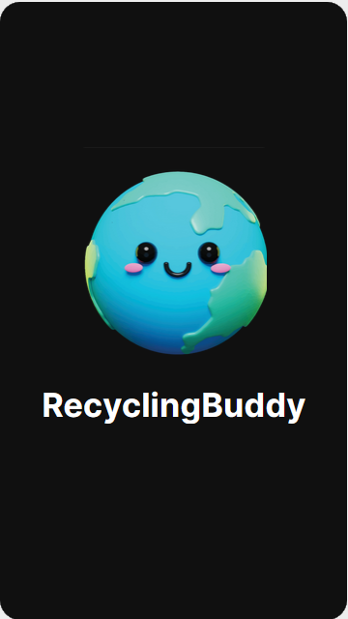
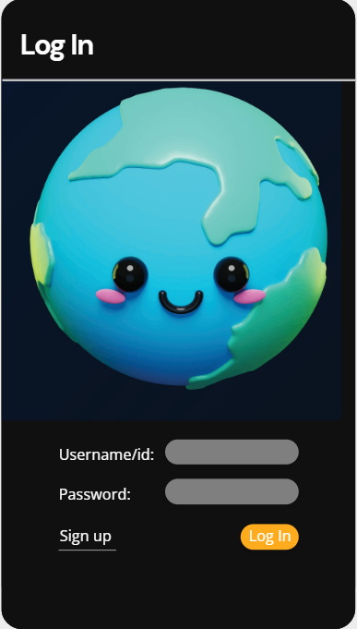
Splash & log in page
For first time login, users will be brought to the log in page. If the user is new, the user may click on the 'sign up' to register account

Slide 11
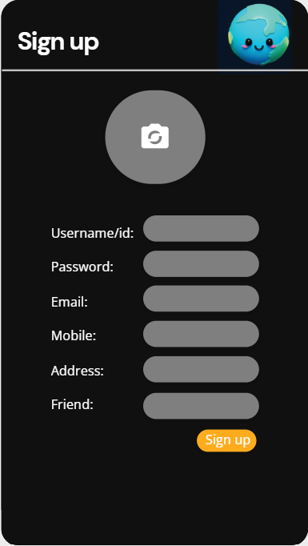
Sign up
User can enter friend’s username/id for friend who introduced the application.
User can invite their friends to earn points too

Slide 12
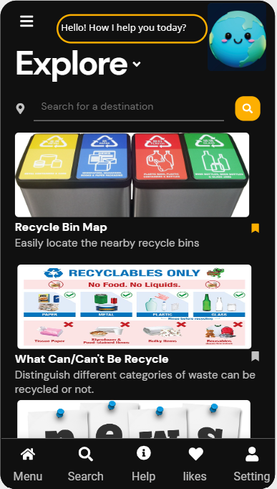
Explore
Homepage: user may directly type in their location to locate the nearest recycling bins
User may also click on the bookmark icon beside the tabs to pin the tab that they frequently use

Slide 13
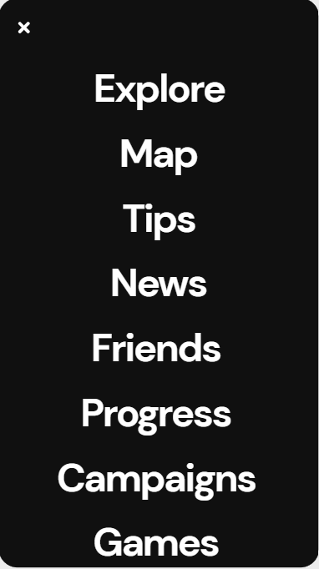
Menu
List of the feature
Allows user to change tabs easily without the need to go back to the homepage

Slide 14
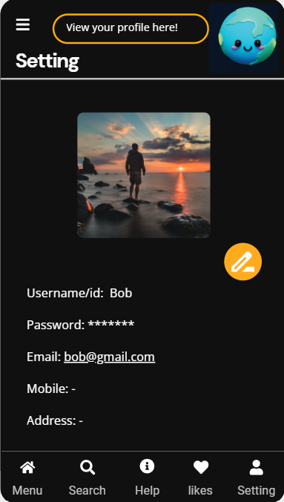
Setting
User can check and edit their profile

Slide 15
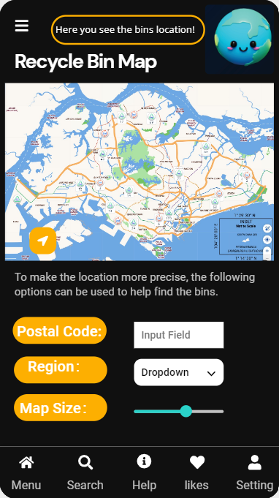
MAP
User can find the nearest recycling bin around them

Slide 16
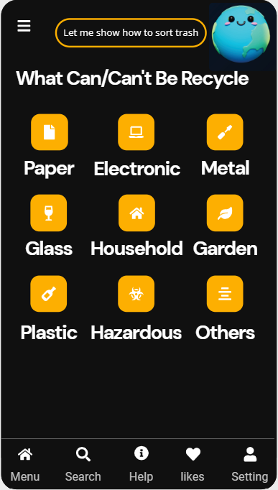
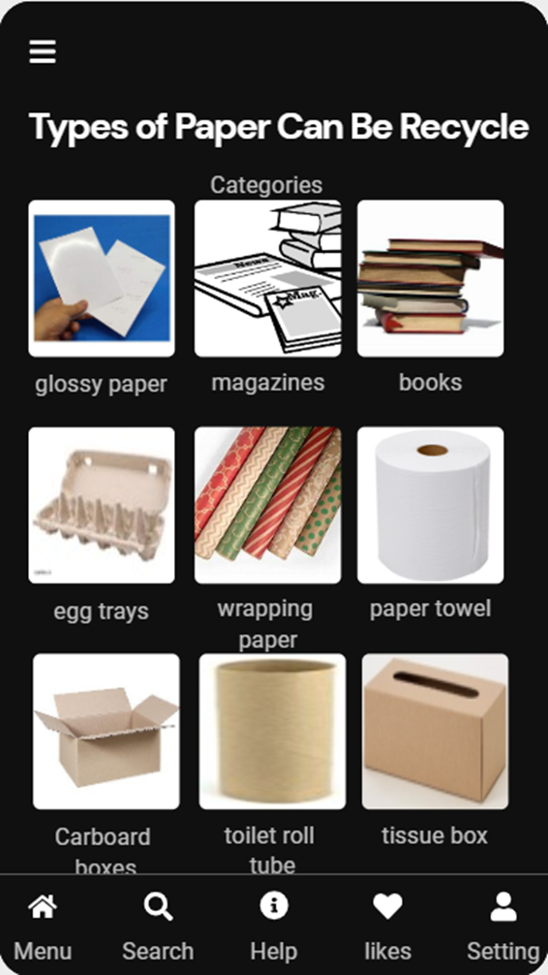
Recyclable materials
To help user learn and identify which items are recyclable and which items are not

Slide 17
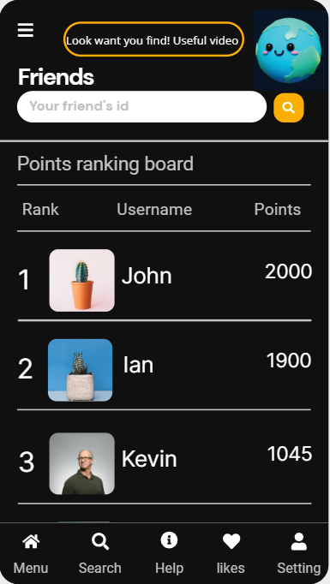
Friends
User can check their friend’s recycling progress by searching for their id
Top users with points will be shown on the ranking board

Slide 18
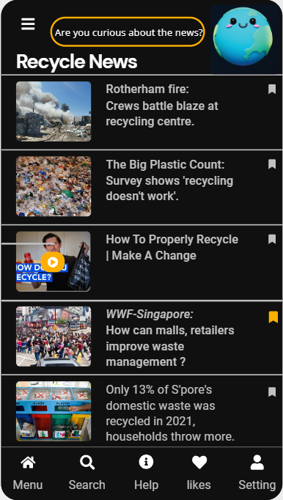
News
News, information and videos on recycling can be found in this section.

Slide 19
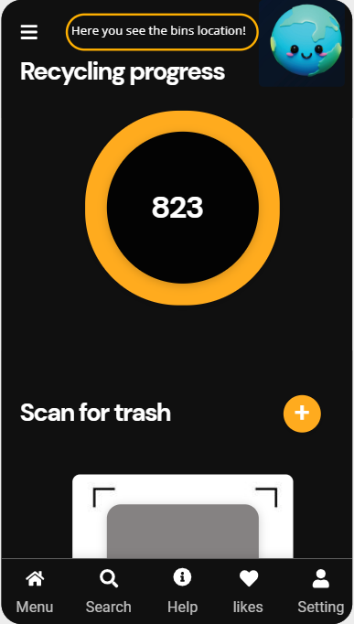

My Progress
User can check their points
When user clicks on ‘+’ button camera function will be activated to scan QR code on recycling bins
User will also have to scan the object they are recycling. If the object is identified to be recyclable, user will earn points
Points earned can be used to exchange for goods in the shop tab

Slide 20
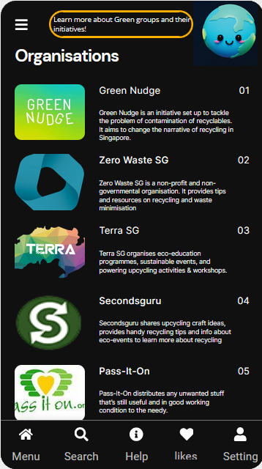
Organisations
Users can find green groups in Singapore and learn more about their initiatives here
Campaigns and workshops organised by the groups will be showed here. Users will be able to sign up for such activities

Slide 21
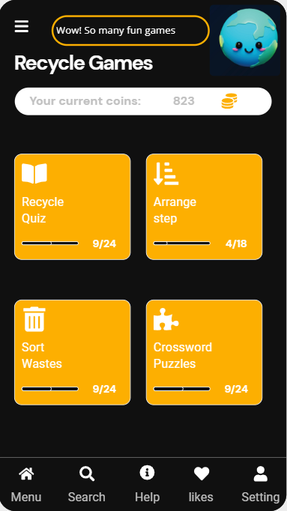
Games
Each game can only be played once per day
Depending on the user's game result, the points earned will differ
User can play games that test their recycling knowledge to earn points

Slide 22
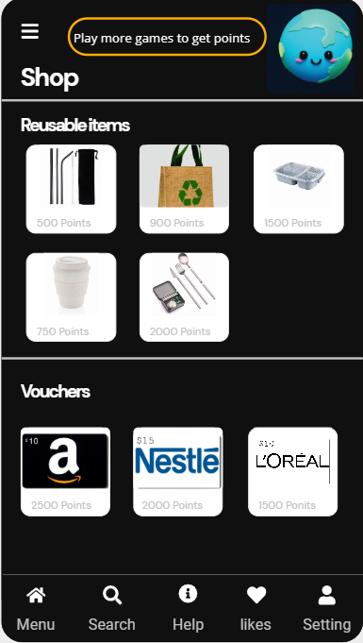
Shop
Reusable items can be collected at the user's nearest Community center
“Points” are used to exchange for e-vouchers or reusable items

Slide 23
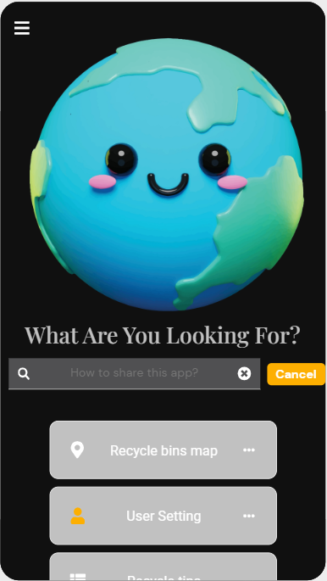
Questions
User can ask questions about the application here

