Slide 1
Artificial Greenspace and Urban Cooling in Palm Springs, CA
Chloe Kuntz
April 15, 2026

Slide 2
Introduction
Palm Springs is located in a desert environment in southern California
Artificial greenspaces exist in Palm Springs, such as golf courses, which maintain very different environmental standards
Greenspaces use intensive care through water resources and monetary requirements

Slide 3
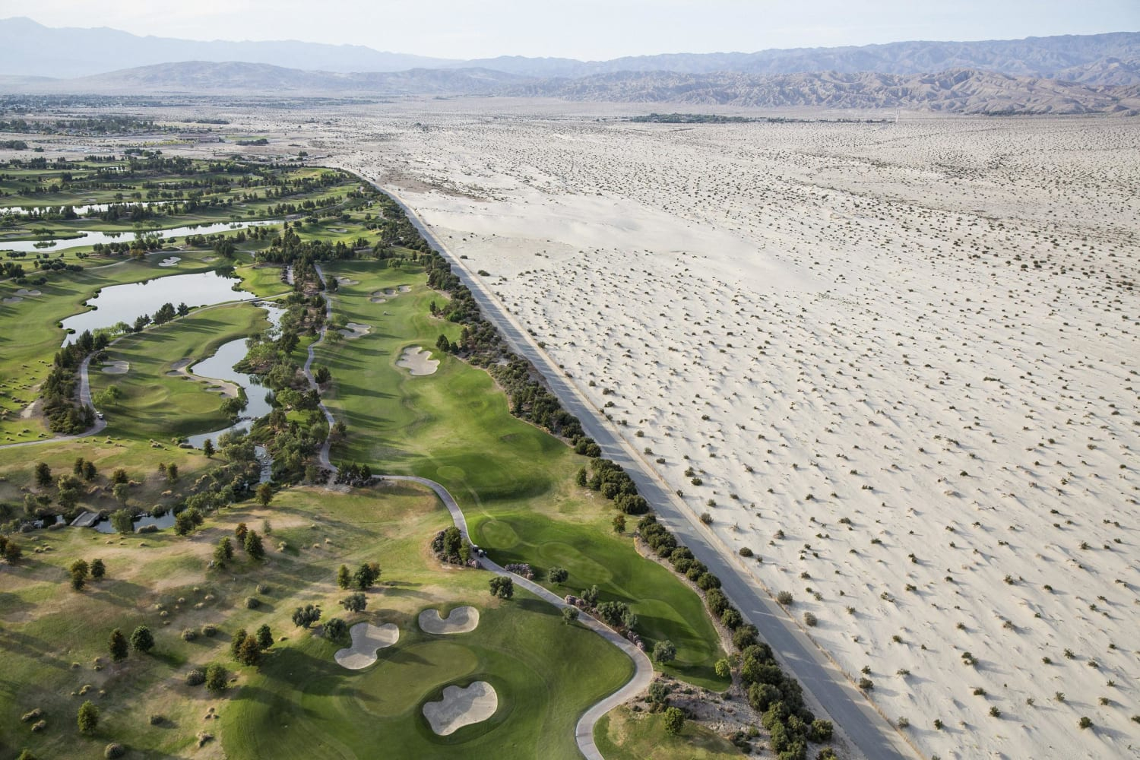
Purpose
High temperatures and limited water resources play a large role in the daily lives of those in Palm Springs
Greenspace in Palm Springs requires irrigation for its upkeep
Are these greenspaces exhibiting significant land surface temperatures lower than their surroundings? Is there any unintentional benefit to adjacent areas?

Slide 4
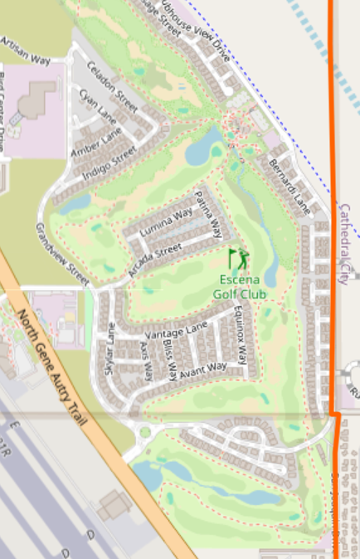
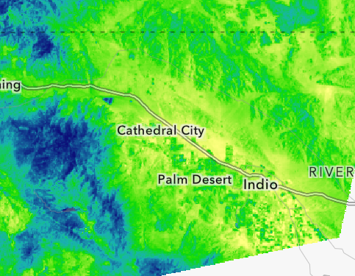
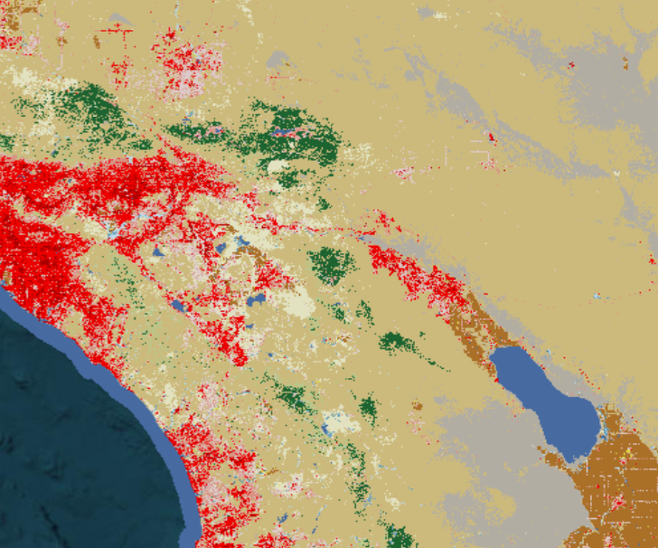
Data
Landsat 8 Thermal Image
NLCD
OpenStreetMap
Notes:
thermal band, raster data, vector

Slide 5

Methodology
Calculating average land surface temperatures for golf courses, and for desert areas
Using zonal statistics
Defining adjacent desert areas to golf courses of non-irrigated land
Buffering of vector data

Slide 6

Anticipated Outcomes
A thermal map visualizing the varying land surface temperatures in Palm Springs
Expectation of not showing LST that calls for the resource use
Clear distinction of golf course greenspaces
Quantified comparison of land surface temperatures of golf courses and their adjacent areas

Slide 7
Sources
https://www.openstreetmap.org/relation/2866485#map=14/33.82779/-116.53808
https://www.mrlc.gov/viewer/

