Slide 1
Do We Actually Have a Population Problem?
Chloe Rushing
October 2022

Slide 2
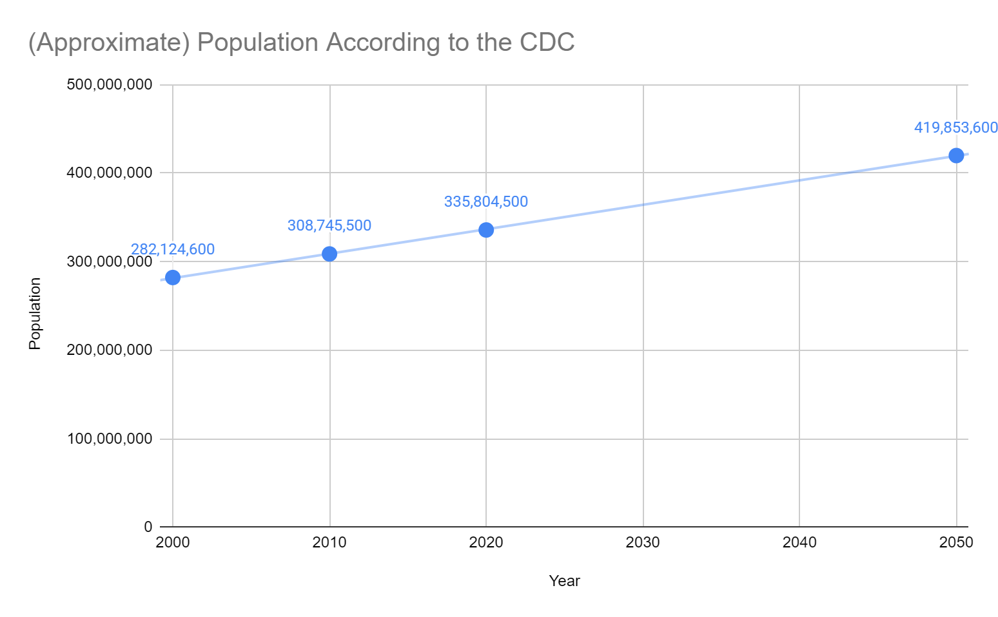
Issue
“The U.S. population was 309 million in 2010; by 2050, the U.S. population is estimated to be greater than 400 million persons.”^{[2]}
- U.S. CDC
The rapidly growing U.S. population may cause overpopulation which will lead to a lack of food and resources necessary to maintain us.
Hypothesis: A high birth rate greatly increases population. How do we prevent overpopulation?
Notes:
2000 U.S. population was over 280 million
2022 U.S. population currently over 330 million
Means at least 50 million jump in population between 2000 and 2020
Essentially: Are we having too many babies?

Slide 3
U.S. Birth Rate Trends by Age Group
Notes:
Data pulled directly from U.S. CDC website
Separated and analyzed by race and age group
Calculated percentage of live births each year per race
Calculated difference in percentages by year

Slide 4
Process and Approach
U.S. CDC birth rate data^{[1]}
Separated data by race/ethnicity
Percentage of yearly births per 1,000 women; excluded ages 10-14 and 45-54 due to outlier data
Percentage differences from previous year; used 2000-2019 as most common timespan

Slide 5
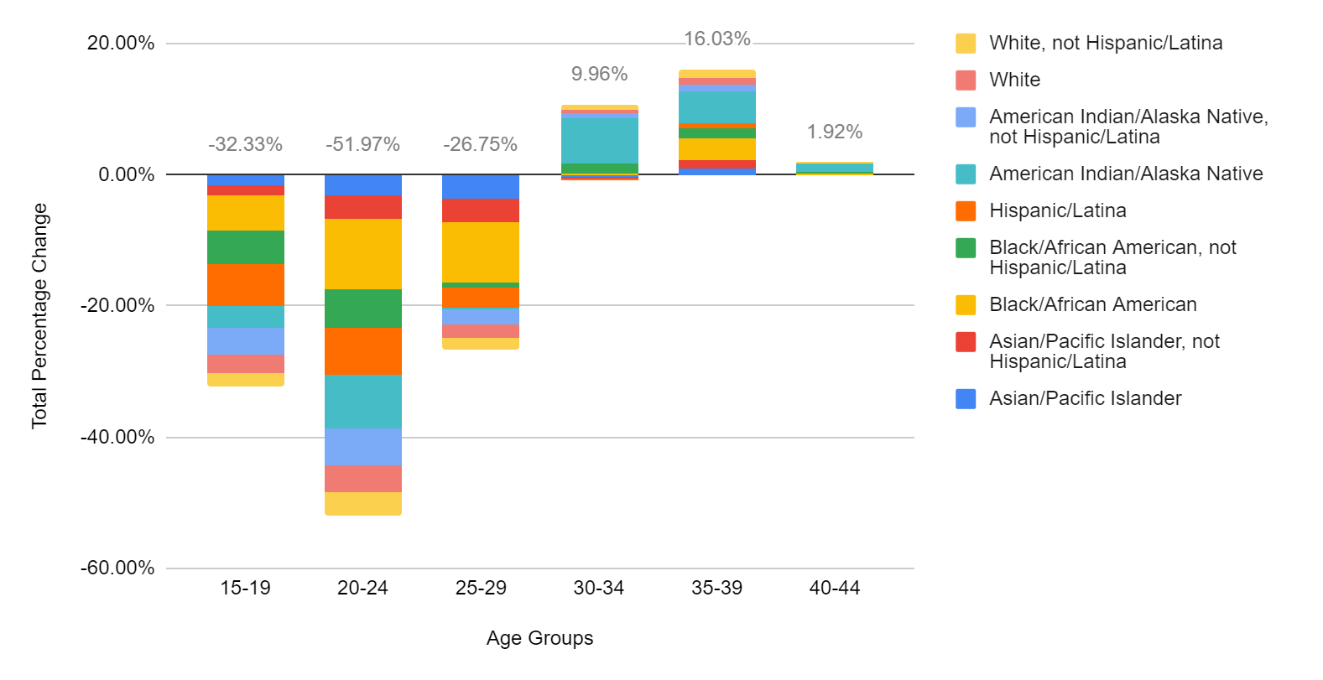
Total Percentage Change In Birth Rate From 2000-2019 By Age Group

Slide 6
What Does This Tell Us About Birth Rates From 2000-2019?
Decrease for ages 15-29
Increase for ages over 30, not significant portion of live births
Smallest and largest increase between 40-44 and 35-39 at 1.92% and 16.03% respectively
Smallest and largest decrease between 25-29 and 20-24 at 26.75% and 51.97% respectively

Slide 7
So…What do We Need to do?

Slide 8
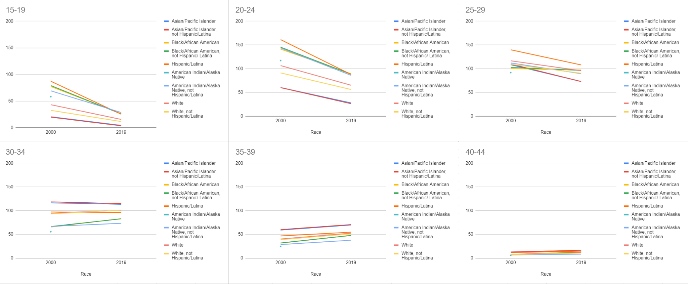
2000 vs. 2019 Live Births

Slide 9
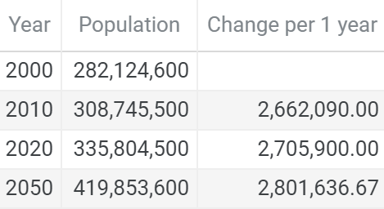
Increasing Birth Rate ->? Overpopulation
Hypothesis: A high birth rate greatly increases population
Data shows greater decrease in birth rate than increase
Conclusion: Birth rate does not contribute much to U.S. population
Approximately 3000 total births between 2019-2020; way less than 2,705,900
No need to act on birth rate as it is already so low

Slide 10
Further Exploration
What other contributors are there to the U.S. population?
How did the pandemic affect the current U.S. population?
How does the U.S. population and its growth represent the world’s population?

Slide 11
References and Appendix
[1] “Births - Health, United States.” Centers for Disease Control and Prevention, Centers for Disease Control and Prevention, 12 Aug. 2022, https://www.cdc.gov/nchs/hus/topics/births.htm#explore-data.
[2] “CDC Surveillance System: Estimated and Projected Population in the U.S.” Centers for Disease Control and Prevention, Centers for Disease Control and Prevention, https://nccd.cdc.gov/ckd/detail.aspx?Qnum=Q155#tab-KeyPoints.
[3] Rushing, Chloe. “Chloelinli.github.io/Projects/US_BIRTH_RATE_TRENDS_20221006 at Main · Chloelinli/Chloelinli.github.io.” GitHub, https://github.com/chloelinli/chloelinli.github.io/tree/main/projects/us_birth_rate_trends_20221006.

Slide 12
Thank You.

