Slide 1
What Are My Listening Habits?
Chloe Rushing
November 2022

Slide 2
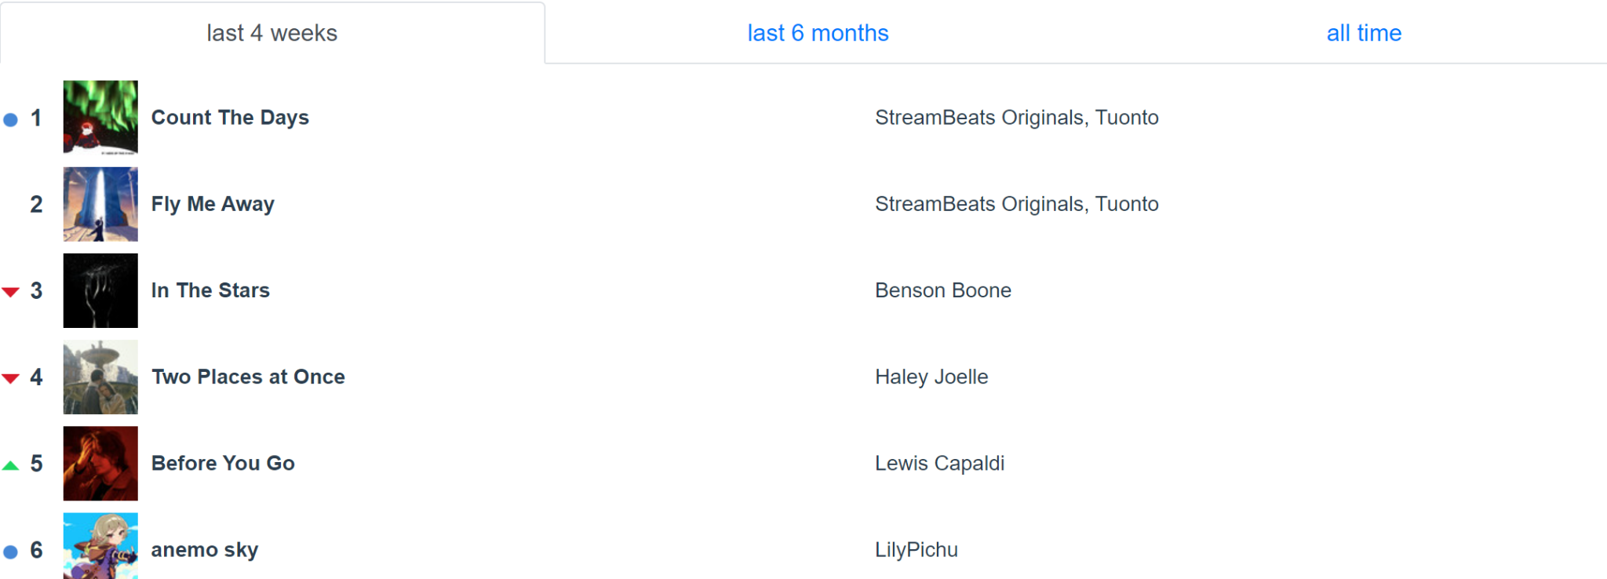
Objective
Analyze how my listening habits have changed
Use these findings to consider what my future music taste might be
Indicators:
Blue dot: new song added to top 50
Red arrow: lower rank than previous
Green arrow: higher rank than previous
Source: Personal statistics on statsforspotify.com

Slide 3
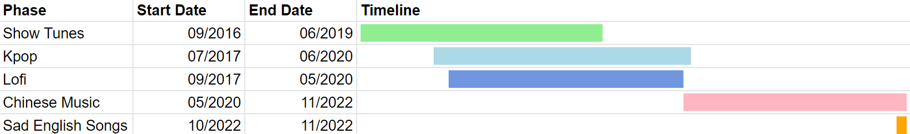
Context: Music Phases
Current phases: Chinese music (2+ years), sad English songs (1+ months)
Past phases: Show tunes (almost 3 years), Kpop (about 3 years), lofi (almost 3 years)
Listened to Kpop and lofi during show tunes phase
Listened to Chinese music during Kpop phase

Slide 4
Data Collection
Personal Spotify streaming history from past year
Found total times listened for each song
Split by genre and language

Slide 5
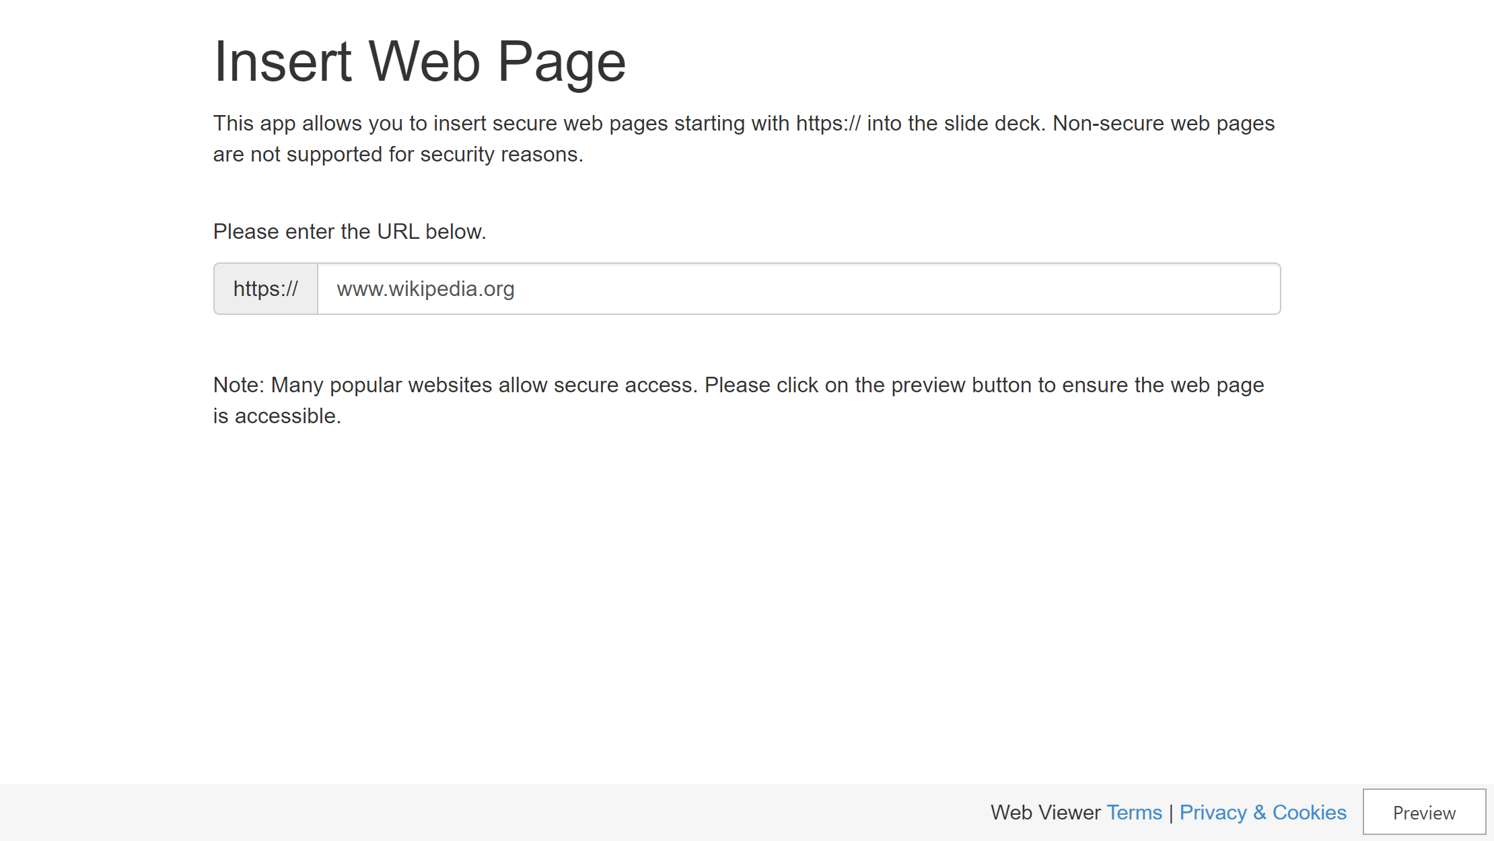

Slide 6
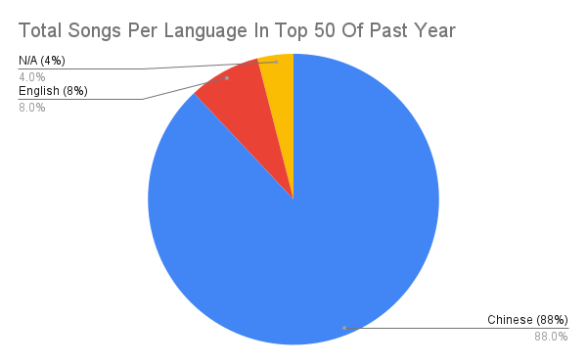
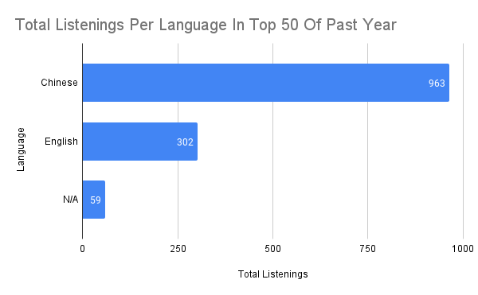
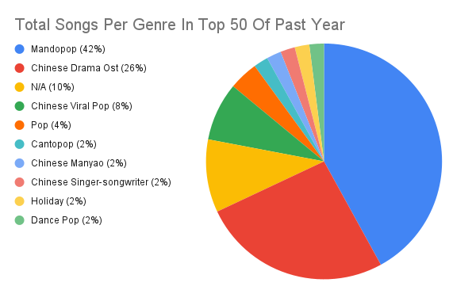
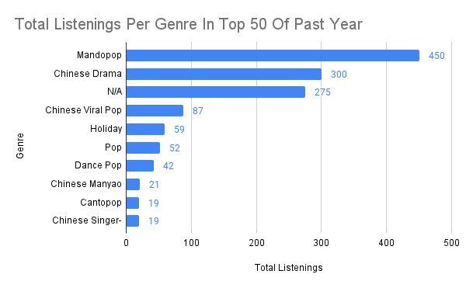

Slide 7
Data vs. Phases
Matches
Current:
Chinese music and sad English songs - mostly Chinese language, all English songs in top 10 recently released
Past:
Kpop, lofi, and show tunes - not in top 50
Doesn’t match
Current:
Chinese music phase longer than sad English song phase - English songs top 3 most listened to

Slide 8
Other Observations
Fly Me Away released June this year - most listens in past year
Count The Days released barely a week ago - second most listens in past year
Altogether, more listens to Chinese language than English or languages and genres of music
Notes:
- Reason for replaying Fly Me Away and Count The Days – more artist streams

Slide 9
What Can I Infer About My Listening Habits?
More than likely to continue listening to Chinese music
Fly Me Away a favorite since release; likely to remain a top song
Occasional other languages and genres, but not as often
Notes:
Chinese music because shorter time but greater listening
Fly Me Away because listening since release and current most repeats in the entire past year

Slide 10
Sources
Personal Spotify streaming history from the past year.

