Slide 1
Do We Actually Have a Population Problem?
Chloe Rushing
October 2022

Slide 2
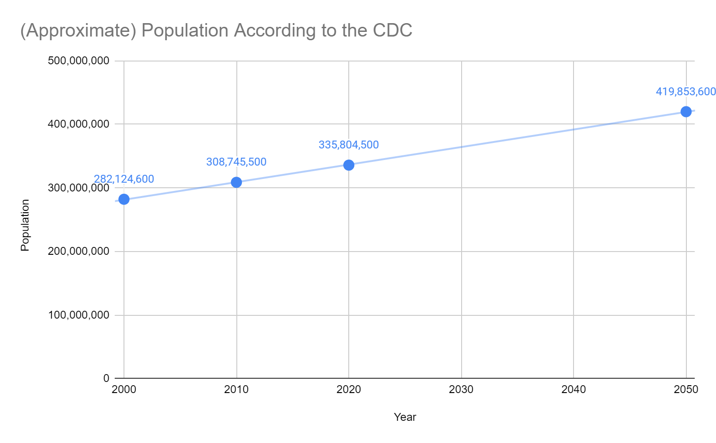
Issue
Overpopulation may cause severe exhaustion of natural resources, environmental degradation, rising unemployment, rising living costs
- Sustainability for all^{[3]}
Hypothesis: Birth rates are a primary contributor to the U.S. population
Notes:
2000 U.S. population was over 280 million
2022 U.S. population currently over 330 million
Means at least 50 million jump in population between 2000 and 2020
Essentially: Are we having too many babies?

Slide 3
U.S. Birth Rate Trends
CDC birth data between 2011-2020^{[4]}
2010 and 2020 census data^{[1], [2]}
Population and Birth Data
Notes:
Data pulled directly from U.S. CDC website
Separated and analyzed by race and age group
Calculated percentage of live births each year per race
Calculated difference in percentages by year

Slide 4
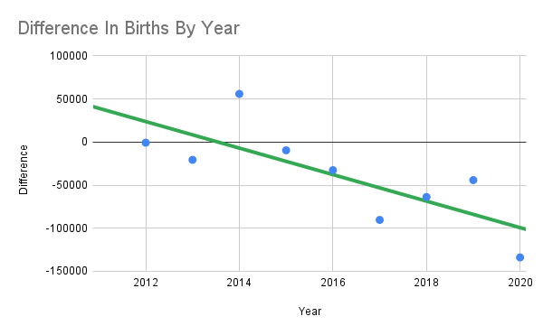
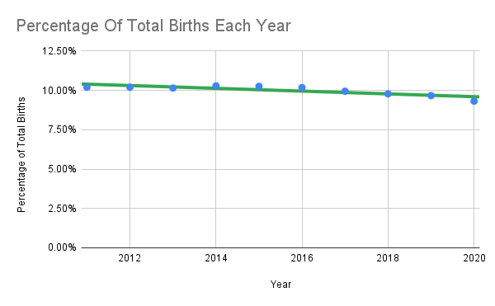
2011-2020 Birth Data
2014 is the only year with an increase in births from the previous year
On average, a 37,771 decrease in live births from each previous year

Slide 5
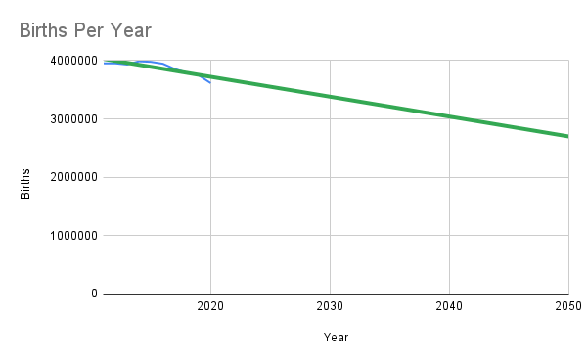
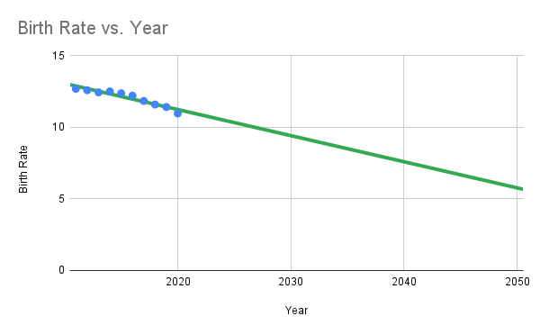
Trajectory for 2050
Data estimates less than 3 million births
Data estimates birth rate (births/total population * 1000) to be only 6.9, about half of 12.69 in 2011

Slide 6
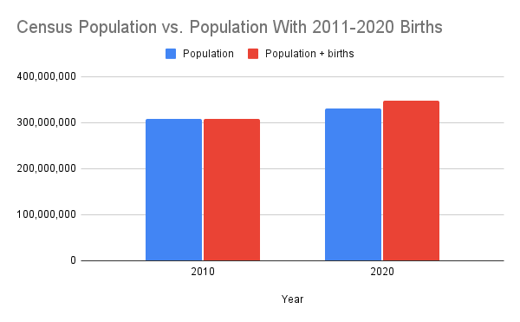
Does Birth Rate Greatly Impact Population Growth?
Adding 2011-2020 births to 2010 census gives us greater population in 2020 than 2020 census
Although there are many births, population is still low, so birth rate is not the main contributor

Slide 7
But Population Still Increases Rapidly?

Slide 8
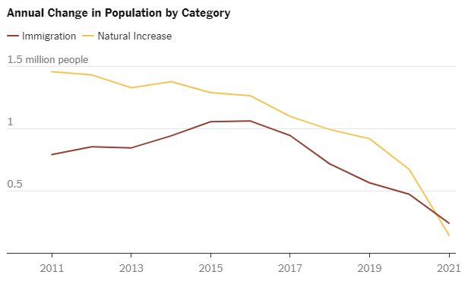
Other Contributors to U.S. Population?
“Immigration, even at reduced levels, is for the first time making up a majority of population growth.
In part this is because Americans are dying at higher rates and having fewer babies, trends accelerated during the coronavirus pandemic. But it’s also because there are signs that immigration is picking up again.”
- New York Times^{[5]}
Source: U.S. Census Bureau, Population Estimates Program By The New York Times

Slide 9
So Why Is The Population Still Rising So Much?
Hypothesis: Birth rates are a primary contributor to the U.S. population
Conclusion: Birth rates are NOT a primary contributor. However, immigration is gradually becoming a major contributor
Although births appear to be on the high end, they continue to decrease year by year
Immigration has begun to pick up, even alone beginning to affect the U.S. population greatly
The increasing immigration will more likely cause overpopulation than birth rates

Slide 10
References and Appendix
[1] Bureau, U. S. C. (n.d.). Explore census data. Retrieved October 30, 2022, from https://data.census.gov/cedsci/table?q=us+population+2010&tid=DECENNIALPLNAT2010.P1
[2] Bureau, U. S. C. (n.d.). Explore census data. Retrieved October 30, 2022, from https://data.census.gov/cedsci/table?q=us+population+2020&tid=DECENNIALPL2020.P1
[3] Causes and consequences of overpopulation. Sustainability for all. (n.d.). Retrieved October 30, 2022, from https://www.activesustainability.com/sustainable-development/causes-consequences-overpopulation/?_adin=02021864894
[4] Centers for Disease Control and Prevention, National Center for Health Statistics. National Vital Statistics System, Natality on CDC WONDER Online Database. Data are from the Natality Records 2007-2020, as compiled from data provided by the 57 vital statistics jurisdictions through the Vital Statistics Cooperative Program. Accessed at http://wonder.cdc.gov/natality-current.html with requested records 2011-2020 on Oct 29, 2022 5:51:00 PM.
[5] Jordan, M., & Gebeloff, R. (2022, February 5). Amid slowdown, immigration is driving U.S. population growth. The New York Times. Retrieved October 30, 2022, from https://www.nytimes.com/2022/02/05/us/immigration-census-population.html

Slide 11
Thank You.

