Slide 1
What is Causing the U.S. Population to Grow so Fast?
Chloe Rushing
October 2022

Slide 2
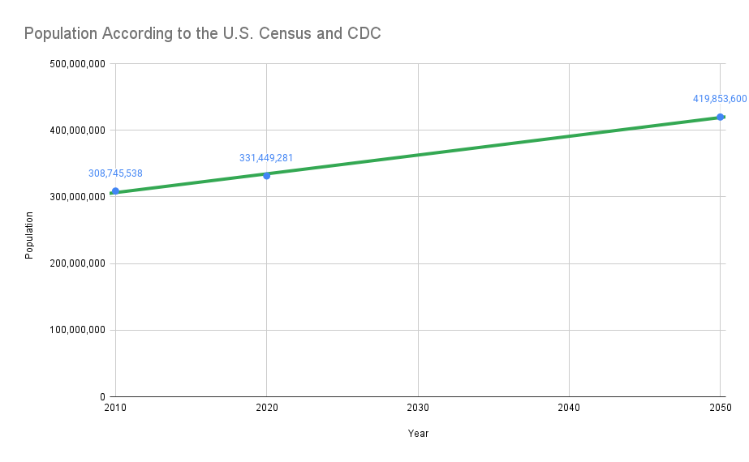
Issue
“...improvements in nutrition, water, medical care and other technological advances have contributed to a sharp decline in deaths while births continue to increase, resulting in population growth.”
- Study Session 2 Population Growth^{[6]}
CDC estimates U.S. population to grow at faster rate from 2020-2050 compared to census in 2010-2020
Hypothesis: Thanks to advanced medicine and other technology, birth rates have become the primary contributor to the growing U.S. population

Slide 3
U.S. Birth Trends
CDC birth data between 2011-2020^{[4]}
2010 and 2020 census data^{[1], [2]} (for [approximate] population)
Population and Birth Data

Slide 4
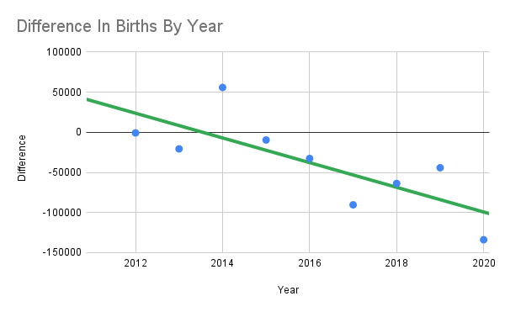
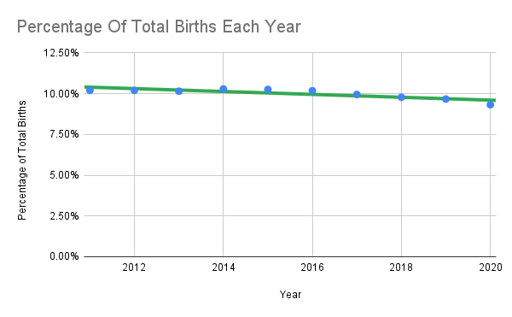
2011-2020 Birth Data
2014 is the only year with an increase in births from the previous year
On average, a 37,771 decrease in live births from each previous year

Slide 5
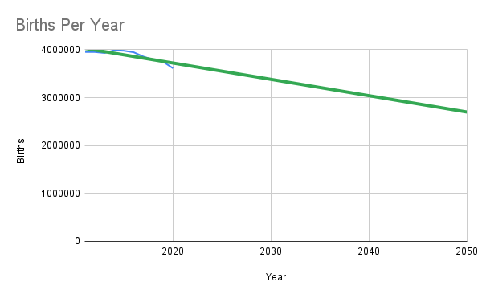
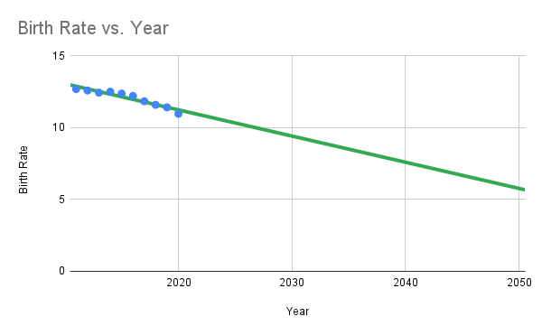
Trajectory for 2050
Data estimates less than 3 million births
Data estimates birth rate to be only 6.9, about half of 12.69 in 2011
Birth rate^{[7]} - ratio of live births to total population [in that year], multiplied by 1000

Slide 6
But Population Still Increases Rapidly?

Slide 7
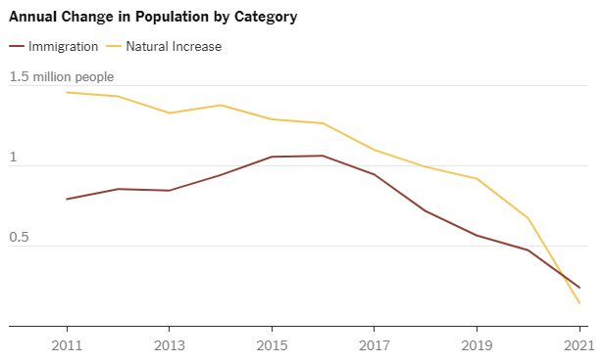
Is Immigration the Primary Contributor?
“Immigration, even at reduced levels, is for the first time making up a majority of population growth.
In part this is because Americans are dying at higher rates and having fewer babies, trends accelerated during the coronavirus pandemic. But it’s also because there are signs that immigration is picking up again.”
- New York Times^{[5]}
The two factors contributing towards population are immigration and natural increase (difference in births and deaths)^{[5]}
Source: U.S. Census Bureau, Population Estimates Program By The New York Times

Slide 8
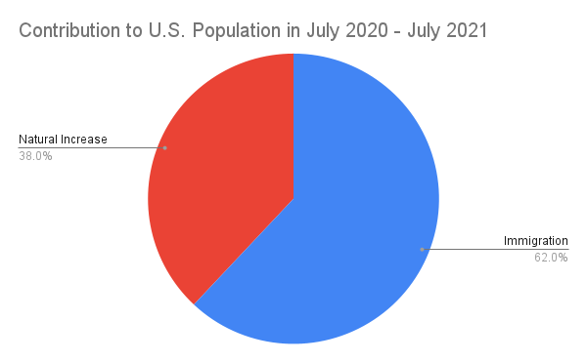
So What is the Primary Population Contributor?
Hypothesis: Birth rates are the primary contributor to the growing U.S. population
Conclusion: While birth rates previously were on the high end, they are NOT the primary contributor anymore
Birth rates decreased over 37,771 a year on average between 2011 and 2020
Increasing immigration trends will potentially result in a 2-to-1 ratio of population contribution compared to natural increase
“With the aging of America’s overall population and baby boomers reaching the oldest ages, deaths are expected to increase more rapidly than births. Consequently, by mid-century immigration is expected to be contributing twice as many people to America’s population as natural increase.”
- Joseph Chamie (The Hill)^{[5]}
Data source: Joseph Chamie^{[5]}

Slide 9
References and Appendix
DATA
[1] Bureau, U. S. C. (n.d.). Explore census data. Retrieved October 30, 2022, from https://data.census.gov/cedsci/table?q=us+population+2010&tid=DECENNIALPLNAT2010.P1
[2] Bureau, U. S. C. (n.d.). Explore census data. Retrieved October 30, 2022, from https://data.census.gov/cedsci/table?q=us+population+2020&tid=DECENNIALPL2020.P1
[4] Centers for Disease Control and Prevention, National Center for Health Statistics. National Vital Statistics System, Natality on CDC WONDER Online Database. Data are from the Natality Records 2007-2020, as compiled from data provided by the 57 vital statistics jurisdictions through the Vital statistics Cooperative Program. Accessed at http://wonder.cdc.gov/natality-current.html with requested records 2011-2020 on Oct 29, 2022 5:51:00 PM.
QUOTES
[3] Causes and consequences of overpopulation. Sustainability for all. (n.d.). Retrieved October 30, 2022, from https://www.activesustainability.com/sustainable-development/causes-consequences-overpopulation/?_adin=02021864894
[5] Joseph Chamie, opinion contributor. (2022, January 11). For the foreseeable future, immigration will fuel US population growth. The Hill. Retrieved October 31, 2022, from https://thehill.com/opinion/immigration/589178-for-the-foreseeable-future-immigration-will-fuel-us-population-growth/
[6] Study session 2 population growth. Study Session 2 Population Growth: View as single page. (n.d.). Retrieved October 31, 2022, from https://www.open.edu/openlearncreate/mod/oucontent/view.php?id=79927&printable=1
[7] World Health Organization. (n.d.). Indicator metadata registry details. World Health Organization. Retrieved October 31, 2022, from https://www.who.int/data/gho/indicator-metadata-registry/imr-details/1139#:~:text=The%20ratio%20between%20the%20number,year%2C%20usually%20multiplied%20by%201%2C000.

Slide 10
Thank You.

