Slide 1
What Primarily Contributes to U.S. Population Growth?
Chloe Rushing
October 2022

Slide 2
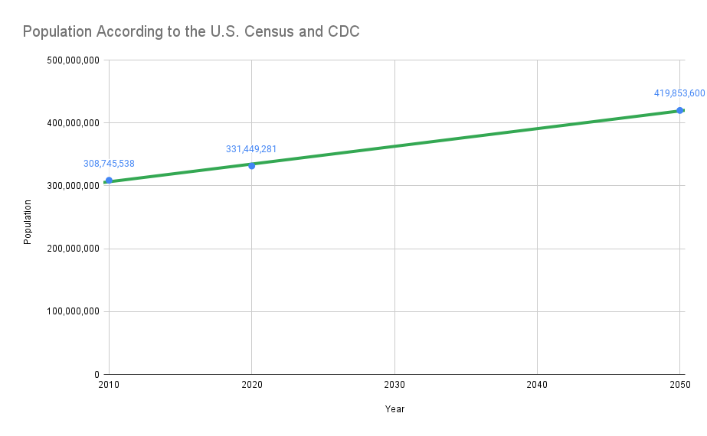
Issue
America’s population exceeds 330 million, with a projected outlook of potentially reaching 400 million by mid-century. “Without a doubt, America’s population growth is a major factor affecting domestic demand for resources, including water, food and energy, and the worsening of the environment and climate change.
- Joseph Chamie^{[6]}
CDC estimates U.S. population to grow at faster rate from 2020-2050 compared to census in 2010-2020

Slide 3
What is the Main Contributor to the U.S. Population?
The two factors contributing towards population are immigration and natural increase (difference in births and deaths)^{[5]}
Hypothesis: Advanced medicine and technology has increased longevity and decreased death rates, making birth rates the primary contributor to the growing U.S. population
“...improvements in nutrition, water, medical care and other technological advances have contributed to a sharp decline in deaths while births continue to increase, resulting in population growth.”
- Study Session 2 Population Growth^{[7]}

Slide 4
U.S. Birth Trends
CDC birth data between 2011-2020^{[4]}
2010 and 2020 census data^{[1], [2]} (for [approximate] population)
Population and Birth Data

Slide 5
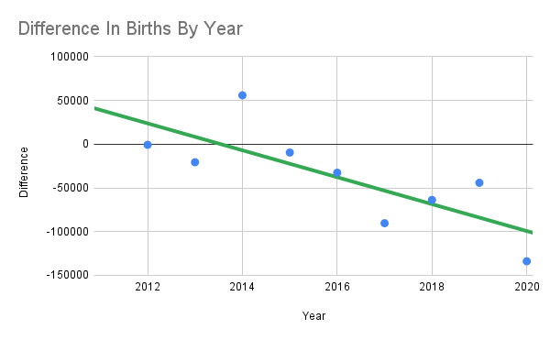
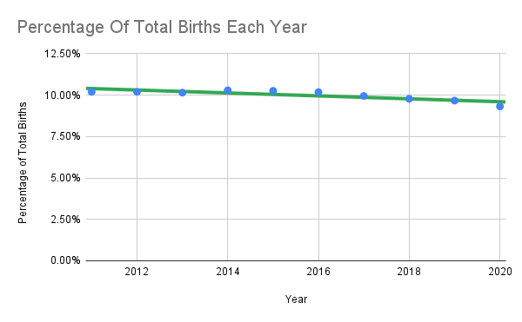
2011-2020 Birth Data
2014 is the only year with an increase in births from the previous year
On average, a 37,771 decrease in live births from each previous year

Slide 6
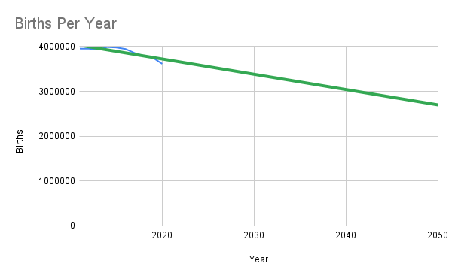
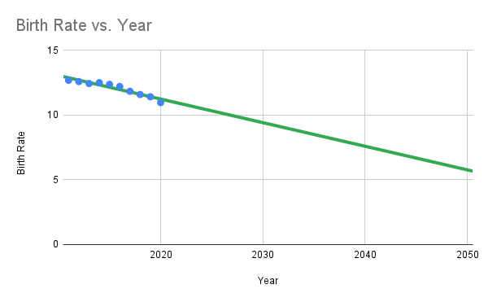
Trajectory for 2050
Data estimates less than 3 million births
Data estimates birth rate to be only 6.9, about half of 12.69 in 2011
Birth rate^{[8]} - ratio of live births to total population [in that year], multiplied by 1000 - i.e. the frequency of births in a given population

Slide 7
But Population Still Increases Rapidly?

Slide 8
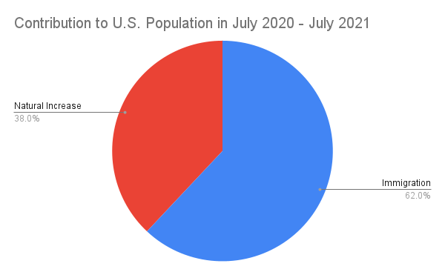
How Does Immigration Affect The U.S. Population?
According to Joseph Chamie^{[5]}:
Historic high of 46.2 million immigrants in America; 14.2 percent of U.S. population
Total immigrant population in 2030 expected to be 54 million; about 15 percent of total population
Total in 2050 expected to be 65 million; about 17 percent of population
“With the aging of America’s overall population and baby boomers reaching the oldest ages, deaths are expected to increase more rapidly than births. Consequently, by mid-century immigration is expected to be contributing twice as many people to America’s population as natural increase.”
- Joseph Chamie (The Hill)^{[5]}
Data source: Joseph Chamie^{[5]}

Slide 9
So What is the Primary Population Contributor?
Original hypothesis: Birth rates are the primary contributor to the growing U.S. population
Final conclusion: Immigration is the primary contributor; birth rates are not.
While birth rates previously were on the high end, they are NOT the primary contributor anymore.
Birth rates decreased over 37,771 a year on average between 2011 and 2020
Immigration trends expected to continue rising and making up larger portions of population than previous years

Slide 10
References and Appendix
DATA
[1] Bureau, U. S. C. (n.d.). Explore census data. Retrieved October 30, 2022, from https://data.census.gov/cedsci/table?q=us+population+2010&tid=DECENNIALPLNAT2010.P1
[2] Bureau, U. S. C. (n.d.). Explore census data. Retrieved October 30, 2022, from https://data.census.gov/cedsci/table?q=us+population+2020&tid=DECENNIALPL2020.P1
[4] Centers for Disease Control and Prevention, National Center for Health Statistics. National Vital Statistics System, Natality on CDC WONDER Online Database. Data are from the Natality Records 2007-2020, as compiled from data provided by the 57 vital statistics jurisdictions through the Vital statistics Cooperative Program. Accessed at http://wonder.cdc.gov/natality-current.html with requested records 2011-2020 on Oct 29, 2022 5:51:00 PM.
[5] Joseph Chamie, opinion contributor. (2022, January 11). For the foreseeable future, immigration will fuel US population growth. The Hill. Retrieved October 31, 2022, from https://thehill.com/opinion/immigration/589178-for-the-foreseeable-future-immigration-will-fuel-us-population-growth/
QUOTES
[3] Causes and consequences of overpopulation. Sustainability for all. (n.d.). Retrieved October 30, 2022, from https://www.activesustainability.com/sustainable-development/causes-consequences-overpopulation/?_adin=02021864894
[6] Npg. (2022, April 13). Opinion piece offers valuable insight on population growth. Negative Population Growth. Retrieved November 3, 2022, from https://npg.org/npg-commentary/em-041322.html
[7] Study session 2 population growth. Study Session 2 Population Growth: View as single page. (n.d.). Retrieved October 31, 2022, from https://www.open.edu/openlearncreate/mod/oucontent/view.php?id=79927&printable=1
[8] World Health Organization. (n.d.). Indicator metadata registry details. World Health Organization. Retrieved October 31, 2022, from https://www.who.int/data/gho/indicator-metadata-registry/imr-details/1139#:~:text=The%20ratio%20between%20the%20number,year%2C%20usually%20multiplied%20by%201%2C000.

Slide 11
Thank You.

