Slide 1
Changes in My Personal Music Taste
Chloe Rushing
November 2022

Slide 2
Objective
Analyze how my listening habits have changed
Use these findings to consider what my future music taste might be

Slide 3
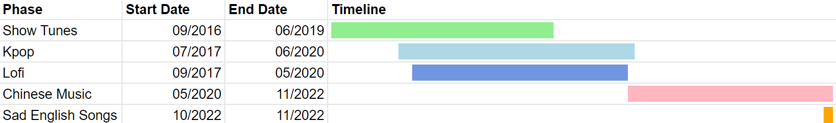
Context: Music Phases
Current phases: Chinese music (2+ years), sad English songs (1+ months)
Past phases: Show tunes (almost 3 years), Kpop (about 3 years), lofi (almost 3 years)
Listened to Kpop and lofi during show tunes phase
Listened to Chinese music during Kpop phase

Slide 4
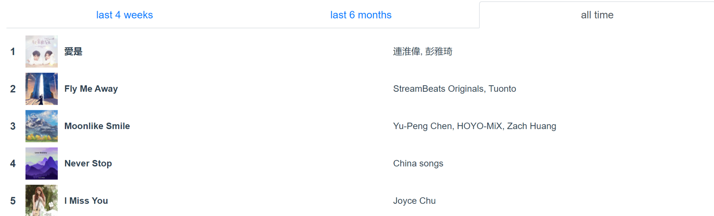
Data Collection
statsforspotify.com
Top 50 songs for all time, past 6 months, past 4 weeks
Split data by genre and language

Slide 5
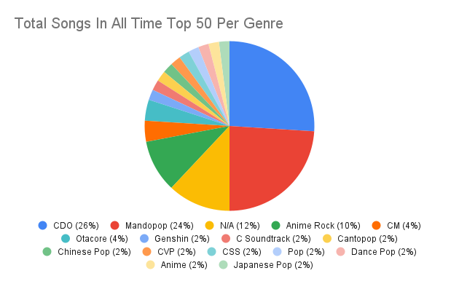
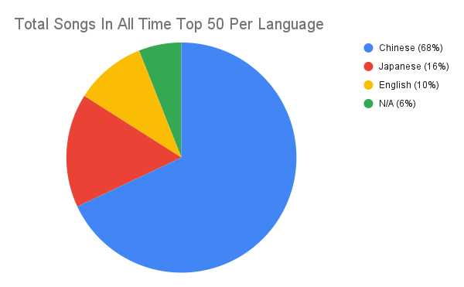
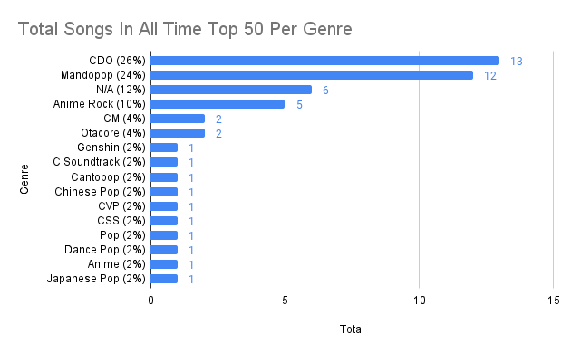
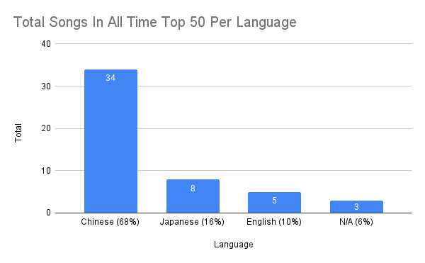
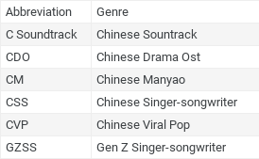

Slide 6
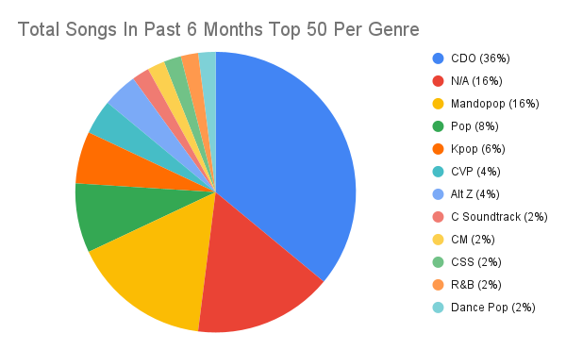
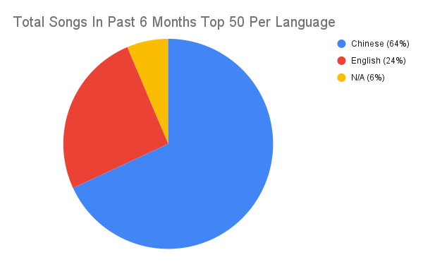
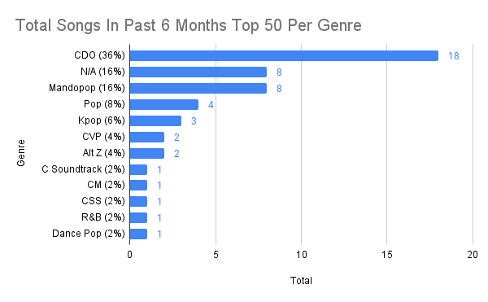
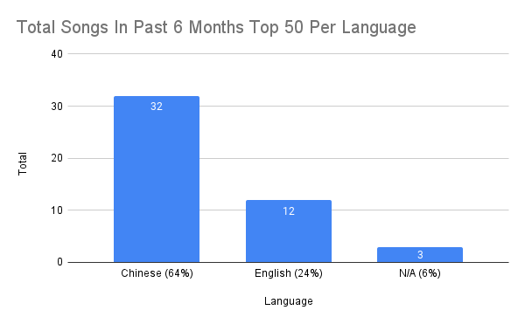

Slide 7
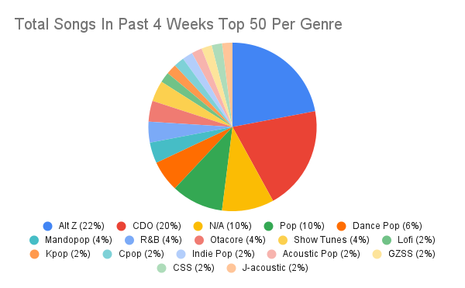
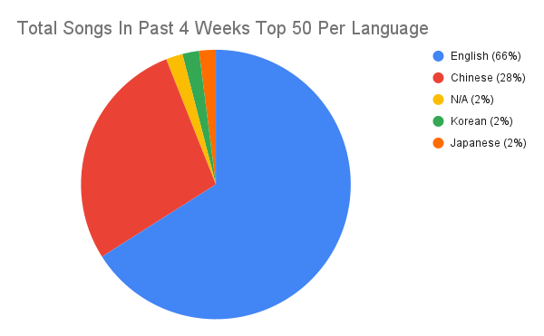
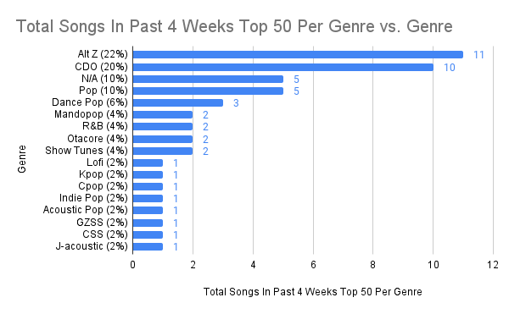
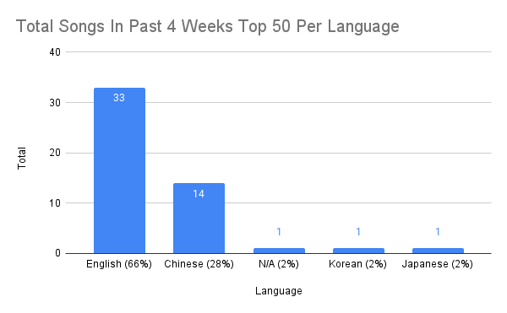

Slide 8
Data vs. Phases
Matches
Current:
Chinese music and sad English song phases - current majority of past 4 weeks
Doesn’t match
Current:
Chinese music phase longer than sad English song phase - English majority for past 4 weeks
Past:
Kpop and lofi phases longer than Chinese music phase - Chinese music majority for all time
No Japanese music phase - all time contains Japanese but no Korean music

Slide 9
What Might Have Caused These Differences?
Playing Chinese songs on repeat, causing higher rank in data
New American music related to specific mood, greater current listening
Favorite American artist, recently playing their songs on repeat

Slide 10
What Can I Infer About My Listening Habits?
More than likely to continue listening to Chinese music
Occasional other languages and genres, but not as much
Notes:
Chinese music because shorter time but greater listening

Slide 11
Sources
https://www.statsforspotify.com/ Personal spotify data, containing top 50 songs for all time, past 6 months, past 4 weeks

