Slide 1
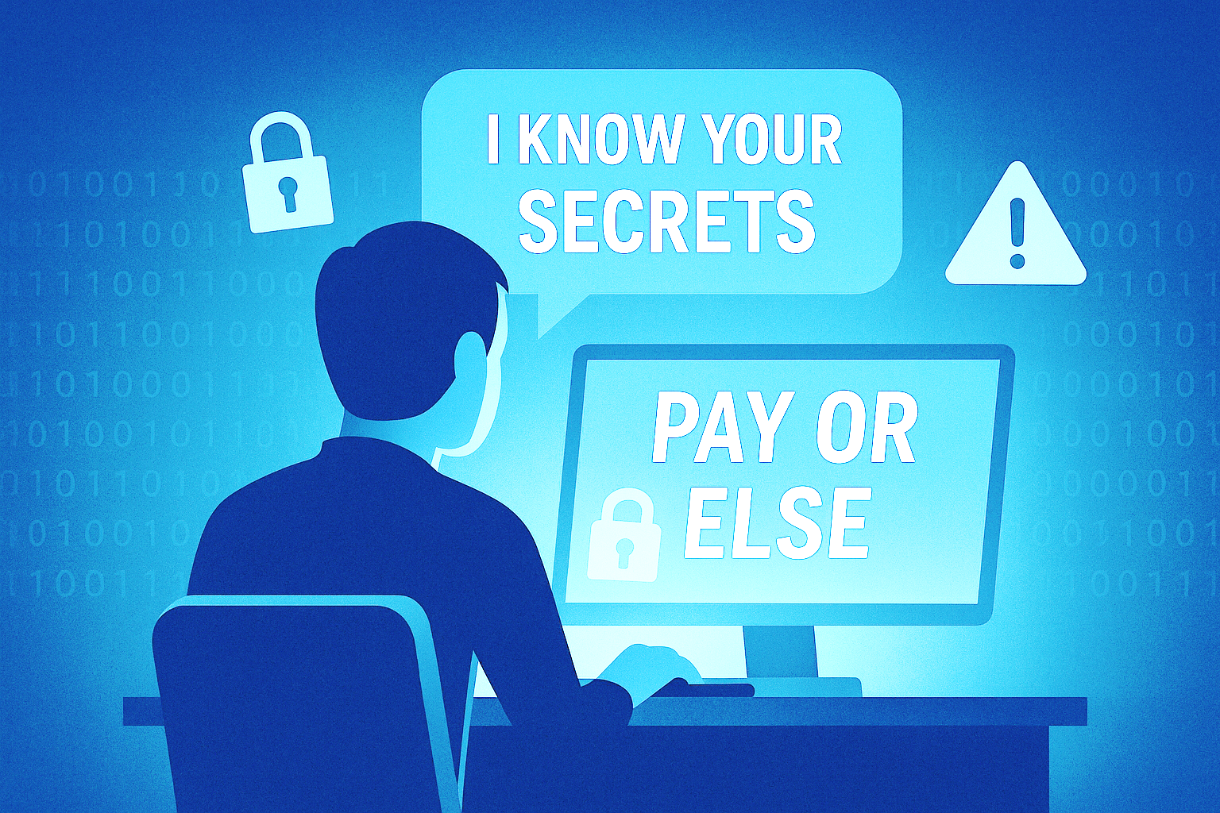
Exploration of Blackmail Scam and Creation of Scammer's Codebook
By: Chloe' Robinson
Major: Computer Science ~ Cyber Security
Mentor: Dr. Bhupendra Acharya
McNair Scholar Program & APRIORI Center
December 3rd, 2025

Slide 2

Introduction
Blackmail scamming is popular yet understudied which made a great starting section for the code book
What is a scammer's code book?
  A resource that can used to see what to look out for in a scam based on a scammer's POV
A lot of people fall victim to these scams because they don't know what to do in such a situation. So, to help people to not become victim, they will need something that tells them "this isn't right" or "red flag!!!"
To do this, I created a code book that tells a person what to look out for, what are the signs, and what to expect
Many people have seen resources that tells them what victims went through and their experience and use that as a guide. But what about a guide that came from the source itself? A guide that tells you what to look out for through the scammers themselves?

Slide 3
Research Questions
For this research, I had the following questions I wanted to answer:
  Why do blackmail scammers scam people? What motivates them, and what psychological or economic drives influence their behavior?
  How do blackmail scammers conduct their attacks? What communication strategies, threat patterns, or persuasive tactics are the most commonly used?
  Who is the ideal target or audience? What characteristics, behaviors, or vulnerabilities of the victim are the most frequently exploited?

Slide 4
Purpose/Significance
Why did I pick this? Have you ever heard of someone getting a "how-to" guide about scamming from a scammer? I never thought of getting information from the source in this scenario.
Getting this information can help a lot of people. It can be a great resource for many people use including cyber intelligence/expert companies or other types of companies, researchers, or even the government
This research can show us a new world that needs to be discovered
The future is getting into more technology, and this can cause an uprising of scamming. We will need to know how the scammers can operate and do what they do
Many authors and researchers have dealt with blackmail scamming, and they mainly focus on the victims and their stories. My research can collab with theirs by showing the other side of those stories. The scammers' stories.

Slide 5
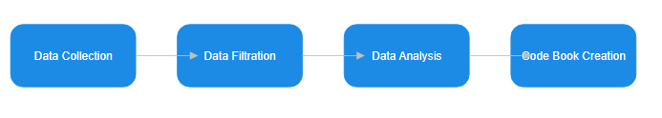
Methodology
Data Collection: Data was collected by searching for good blackmail-related data/reports all around the Internet
Data Filtration: Data was manipulated and modified to get the data I need for the Code Book
Data Analysis: The results of the filtration for the Code Book was examined
Code Book Creation: After the analysis, the data will be used to create the Code Book

Slide 6
Methodology
Data Analysis
  From blackmail data
    The emphasis was placed on emotional tone, intimidation strategies, urgency cues, and manipulative framing (techniques the exploited fear, shame, or secrecy)
  From ransomware data
    Analyzed for operational coercion such as data-leak threats, countdown timers, justification narratives, assurances of "professionalism" and claims of successful decryption
  They both had linguistic patterns (repeated use of conditional threats, emotional hooks, and payoff instructions)
Code Creation
  Definition of tactic
  Example phrases/linguistics markers
  Psychological mechanisms involved
  Brief explanation of why the technique was effective
Data Collection:
  3 datasets ~
    ChainAbuse
    Reddit
    Ransomware.live
  Created data scrapers to get the content in a file
Data Filtration
  Removed duplicate data, incomplete data and irrelevant data
  Created programs that cleaned/removed content that had HTML markups, boilerplate text, etc.
Blackmail data
Ransomware data

Slide 7
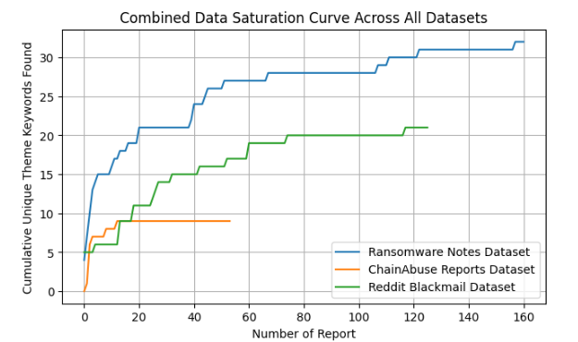
Results
Key words:
threat
warn
expose
leak
share with
secret
privacy
compromised
hacked
shame
nasty
pervert
images
photos
screenshots
deadline
limited time
immediately
act now
tracked
fee
demand
transfer
Data Saturation

Slide 8
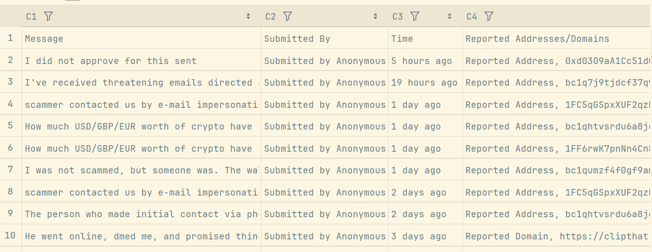
Key Findings #1
ChainAbuse
Reports from victims of blackmail scamming activities
Reports follow formulaic structure emphasizing urgency and payment coercion
Most reports include explicit payment deadlines, and threats of exposure
Scammers used language that made it seem like they were in control of the victim's personal information or devices

Slide 9
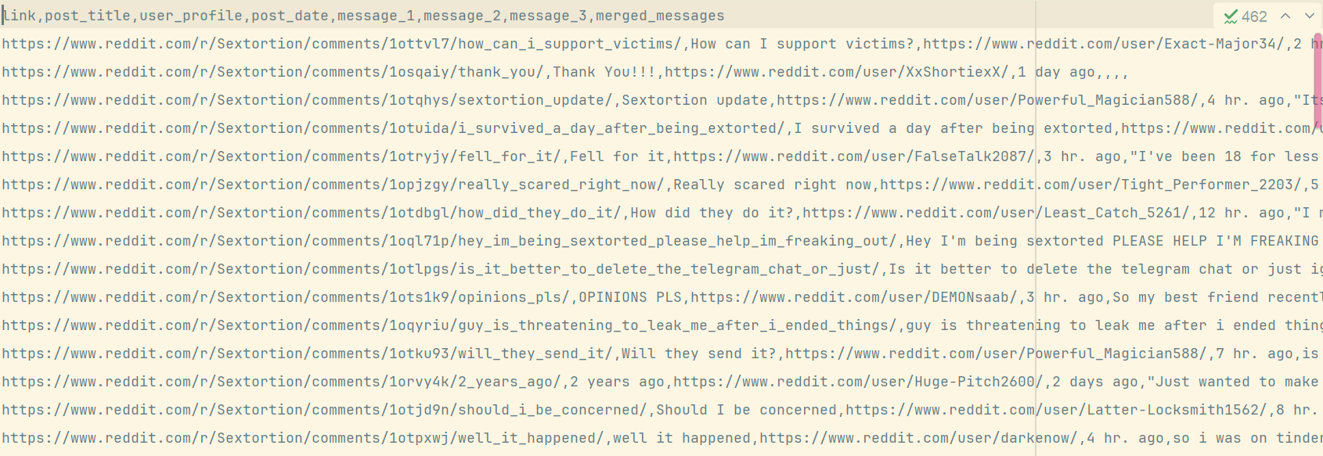
Key Findings #2
Reddit
Posts from victims about their scamming experience
Posts frequently described fear, shame, panic, and uncertainty
Reports highlight the psychological effects scammers cause
Despite the emotional diversity, the scam structures themselves remained consistent

Slide 10
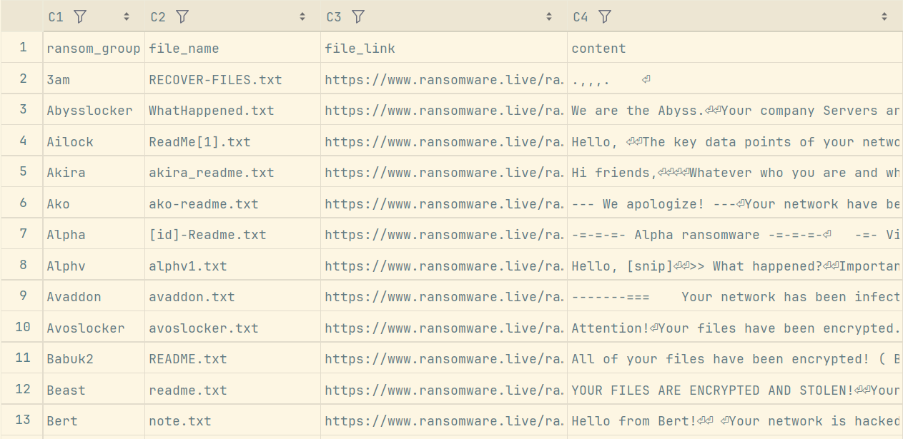
Key Findings #3
Ransomware.live
Ransom notes from ransomware groups
Notes followed a rigid structure that included confirmation of compromise, explanation of encryption or data theft, payment instructions and escalation warnings
Based on data saturation results, ransomware groups operate using predefined communication frameworks that mirror corporate-style processes
The linguistic patterns revealed that scammers rather a professionalized threat format than emotional improvisation
10

Slide 11
Summary of Findings
Although the datasets showed different tone, structure, and origin, they all demonstrate that modern blackmail operations follow a limited and repeatable set of strategies
These strategies may shift in presentation but not in logic
The early saturation from all three datasets confirms that the sources capture a comprehensive range of dominant blackmail tactics, supporting the reliability and legitimacy of the code book framework.

Slide 12
Discussion
Blackmail scammers across email and social media sextortion, social engineering extortion, and ransomware operations heavily rely on emotional and psychological leverage rather than technical sophistication alone
Thematic themes
  threat escalation,
  social exposure fear,
  payment urgency,
  identity claim,
  authority impersonation
Consistency of psychological tactics regardless of platform
Scammers rely on anonymity, automation, low-effort message templates while victims face emotional burden, shame, uncertainty

Slide 13
Conclusion
The findings highlight the consistency and predictability underlying many scam behaviors
Several categories were found across all data types; they showed clear linguistic and behavioral patterns including repeated demands of payment, appeals to urgency or authority, and the reuse of identical or near-identical messages
The insights found from the analytical pipeline reinforce the importance of computational methods for monitoring emergent threats and understanding the evolving nature of online fraud
Structured data processing and pattern-focused analysis can meaningfully enhance our understanding of blackmailing scams/ransomware operations
As online fraud continues to increase, such data-driven approaches will be essential to people like researchers, investigators, and policymakers seeking to develop targeted countermeasures and improve public awareness

Slide 14
Future Thoughts
Conduct an experiment to get high-quality data
  Collect data from a scammer
Collect data from the Dark Web
  Use this data against scammers all around
Research other types of scamming to add to the code book
  Look into other scams and try to create a resource/countermeasures against them

Slide 15
Questions?

