Slide 1


404-data-not-found
| Alekya T | Dinesh A | Mallesh J | Rasheed O | HariKrishna T |

Slide 2
Problem Statement
Big Query's Power can lead to high compute time and costs and carbon emissions when queries are inefficient and not monitored.
Bad Query
Monetary
Cost
Environment
Emission
CO$
CO₂

Slide 3
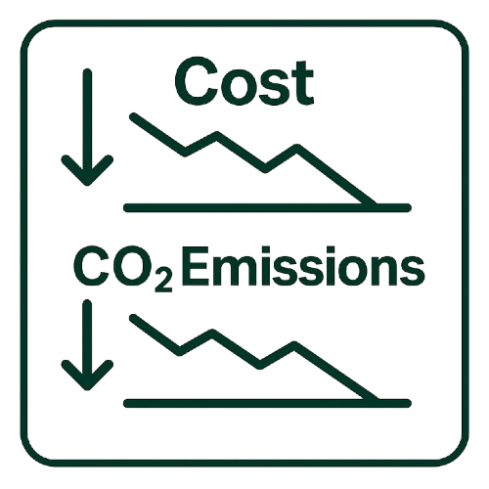
Vision
Empower teams to forecast costs and emissions with actionable insights

Slide 4

Architectural Solution
Audit log ingestion
SQL transformations
Dry Run estimates(Cost & emissions)
BQML for forecasting & anomalies
Looker studio dashboards
Optimization suggestions and alerts

Slide 5





Key features
  Real-time cost and carbon estimation using Dry Run
  Query monitoring and optimization recommendations
  Forecasting with BQ-ML (carbon footprint estimate number of recommendations and total Bytes processed)
  Looker Studio dashboard monitoring user level activities
  Alerts for inefficiencies and cost anomalies

Slide 6
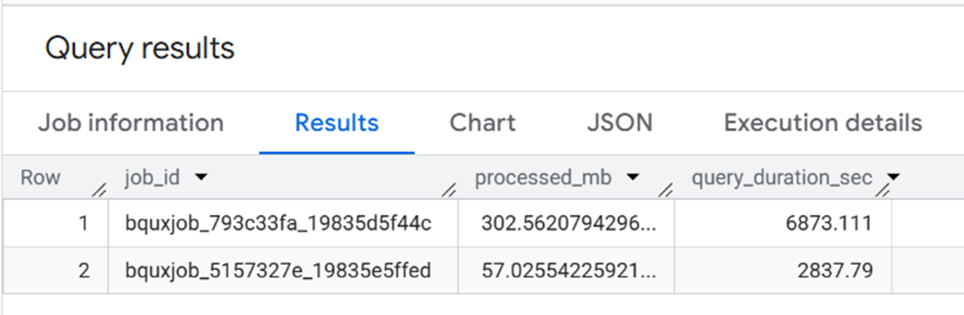
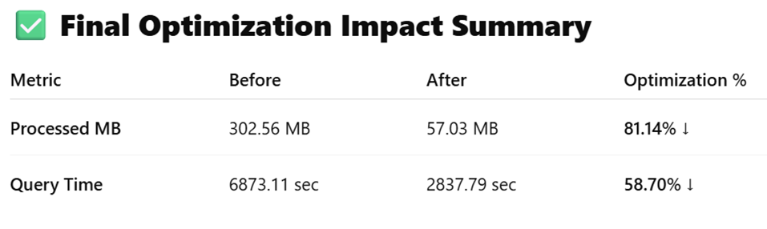
Cost and Emission Evaluation
Evaluated the performance of an SQL query before applying optimization
recommendations versus after implementing the optimized version using BigQuery.
This analysis clearly demonstrates the measurable improvements in cost efficiency, execution speed, and carbon footprint reduction.

Slide 7
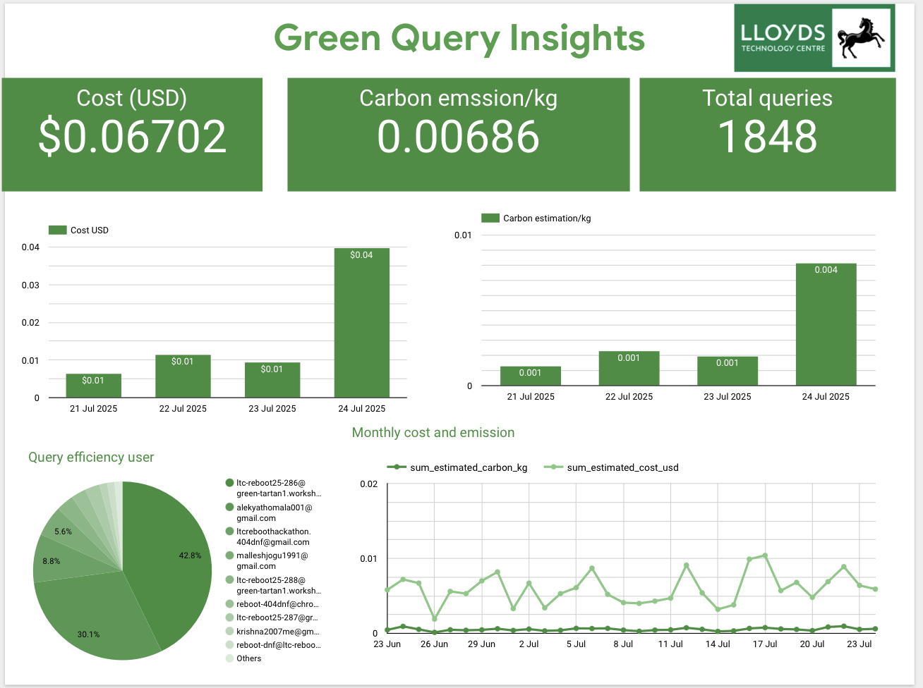
Functionality & Extensibility
Query monitoring and optimization recommendations
Real-time cost and carbon estimation using Dry Run
Forecasting with BQ-ML(carbon footprint, estimate number of recommendations and total Bytes processed)
  Looker Studio dashboard monitoring user level activities
Alerts for inefficiencies and cost anomalies

Slide 8
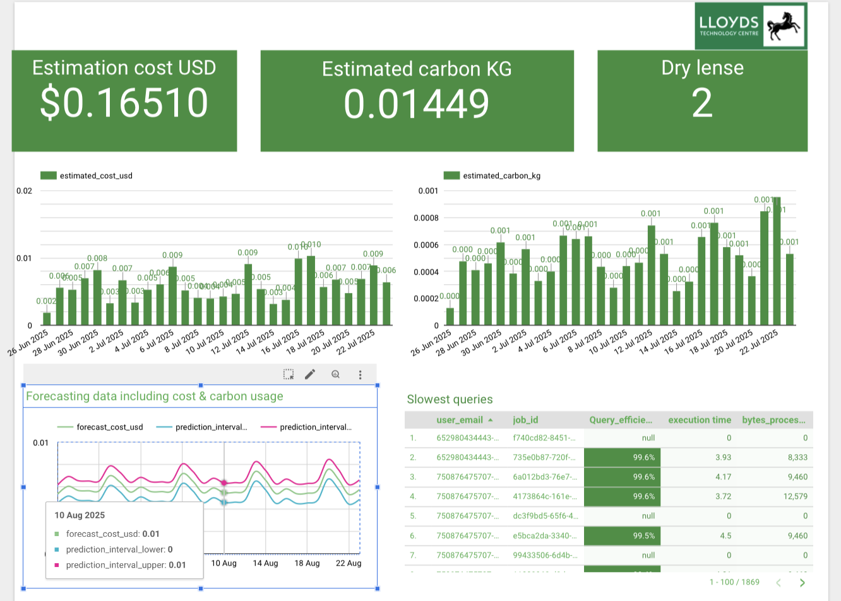
Cost and Carbon usage

Slide 9
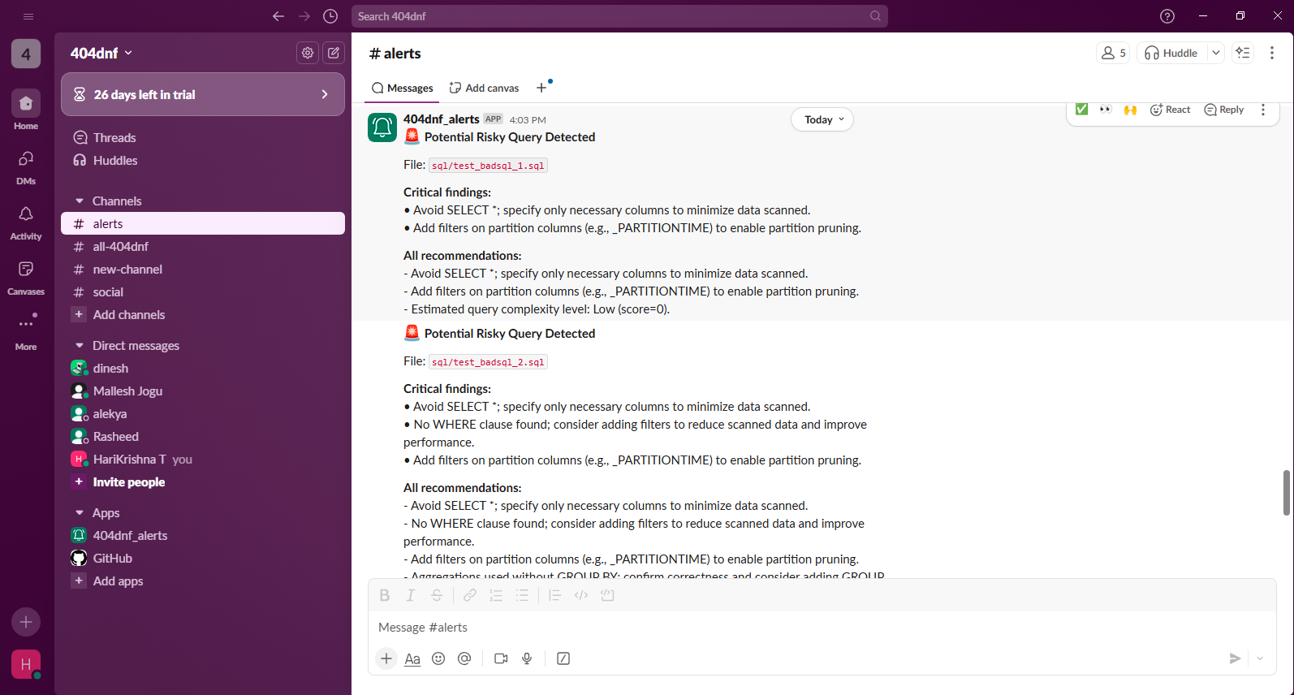
Integration Support
Advisory APIs
Alerts and Support

Slide 10

Conclusion
GreenQuery aligns cost control sustainability and team accountability built entirely on Google Cloud Platform

Slide 11

Thank You!
Questions and Suggestions

