Slide 1
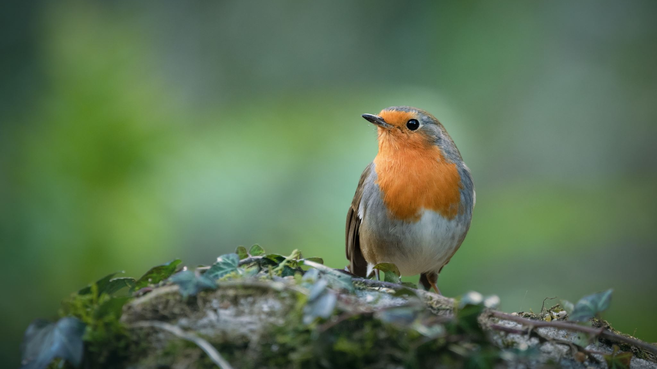
TwitTwat: A Local Wildlife Photo Sharing Journal
Chloe Tatunay Samara Sherven Giovani Jonenson Zachary Karanja
Akshu Ariga Diya Jibu Yoojin Lee Tee Nguyen

Slide 2
Objective
Develop a mobile app for wildlife enjoyers to log and share their sightings with other local UTD enthusiasts.
Create a platform for local wildlife enthusiasts
Easy logging and sharing of wildlife sightings
Promote observation and discussion of campus wildlife
Design the app to allow for future expansion

Slide 3


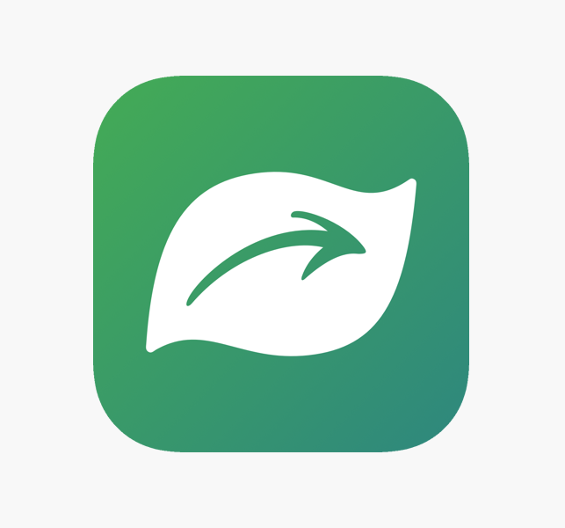
Similar apps
Merlin bird finder
Seek

Slide 4
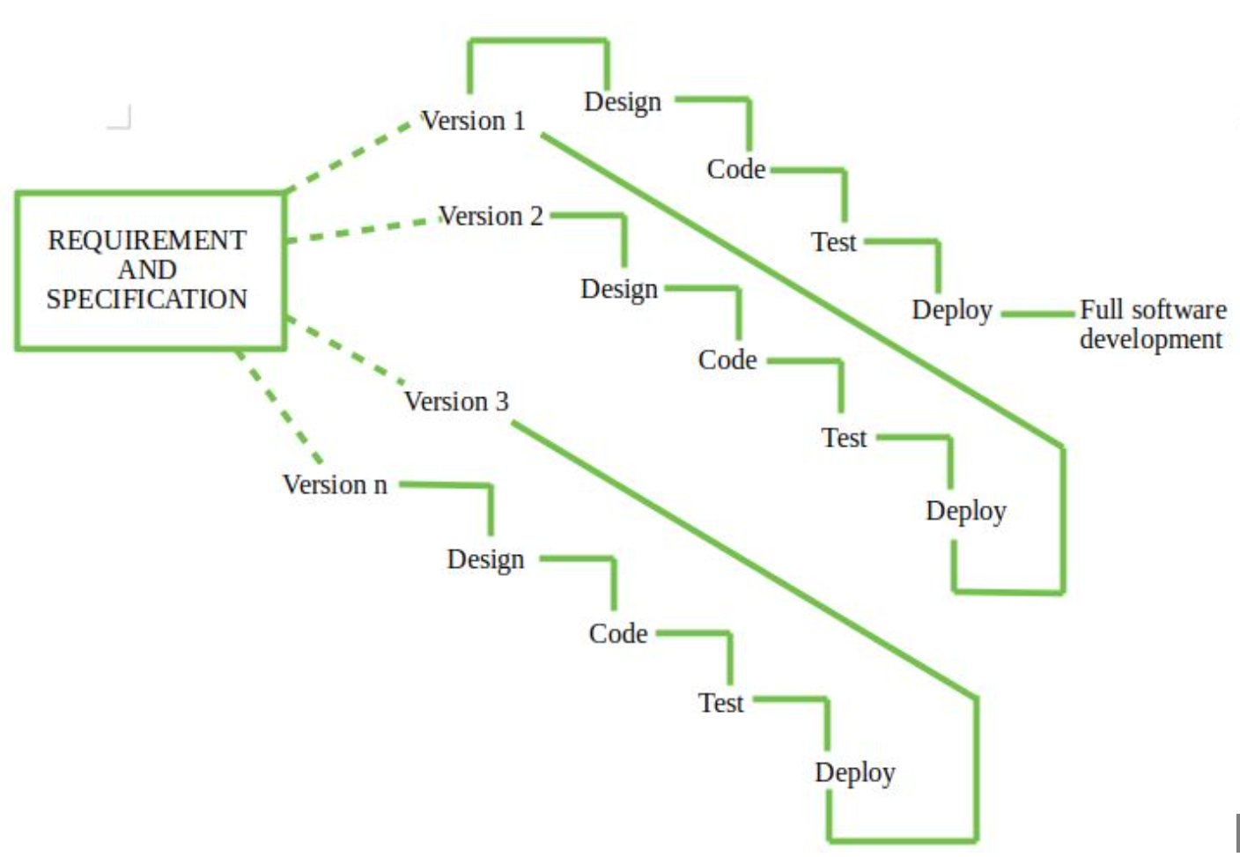
Software Process Model – Incremental Process Model

Slide 5
Cost Estimation
$1,200
$5,460
$21,000
$98,000

Slide 6
Cost Estimation
Chosen Approach:
Application Composition
Hardware:
Development Machines: $1,500 each X 3 developers = $4,500
Server: $160 per month * 6 months = $960
Software
Google maps API access: $200 a month * 6 months = $1,200
Personnel:
Persons: $98,000
Training: $21,000
Total:
$124,700

Slide 7
Project timeline
Month 1: UI Design
Develop wireframe
Visual designs
User feedback on wireframe
Month 2: Backend
Database
User Authentication
API
Sighting log, login and store data
Month 3: Backend
Photo upload
Data retrieval
Navigation
Interface
Back and front end API

Slide 8
Project timeline
Month 4: Frontend
Community feed
Views
Search/Filter
Likes
Test UX
Month 5: Testing
Comprehensive
Security
Debug
Optamize
Month 6: Adjust and Document
Adjust to feedback
User Documentation

Slide 9
Functional Requirements
A user shall be able to post a photo containing an animal that can be automaticallyidentified via an AI-assisted scanning API.
A user shall be able to share and view their uploaded photos in a news feed-like interface,mixed in with other users as desired.
A user shall be able to share via an automatically generated HTTPS link their individualuploaded photos or profile outside the TwitTwat service itself.
A user shall have full control over the visibility of their profile to other users and outsidethe service such as through a search engine.
A user shall have the ability to delete their uploaded photos from the service as desired.
The service shall be able to reject uploaded photos that do not contain an animal or allow for an appeal from a user via manual moderation from the development team if the AI-assisted scanning API detects a human face or doesn’t detect an animal.

Slide 10
Non-Functional Requirements
Product Requirements:
Easy to use + Good performance
Encrypt data + handle errors
Organizational Requirements:
Flexible to multiple different devices + updates
External Requirements:
Follow external requirements such as best practices, government regulation, and corporate policies
Prohibit harmful content and actions

Slide 11
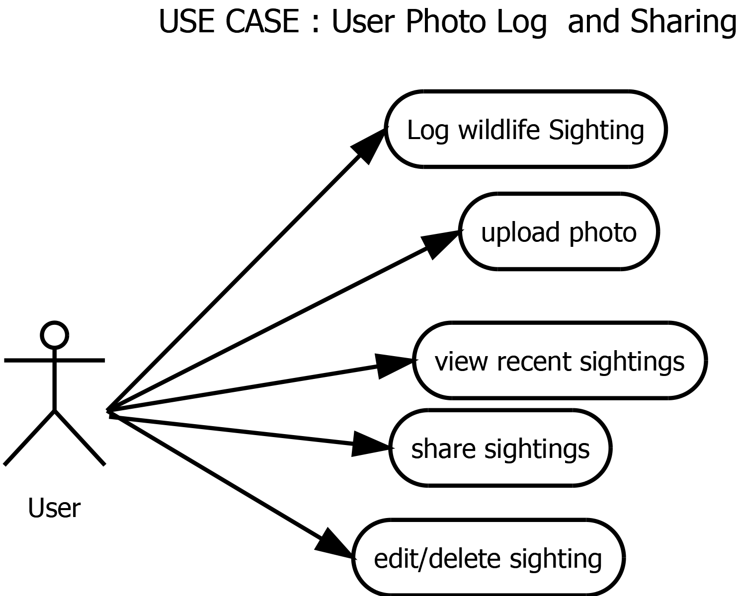
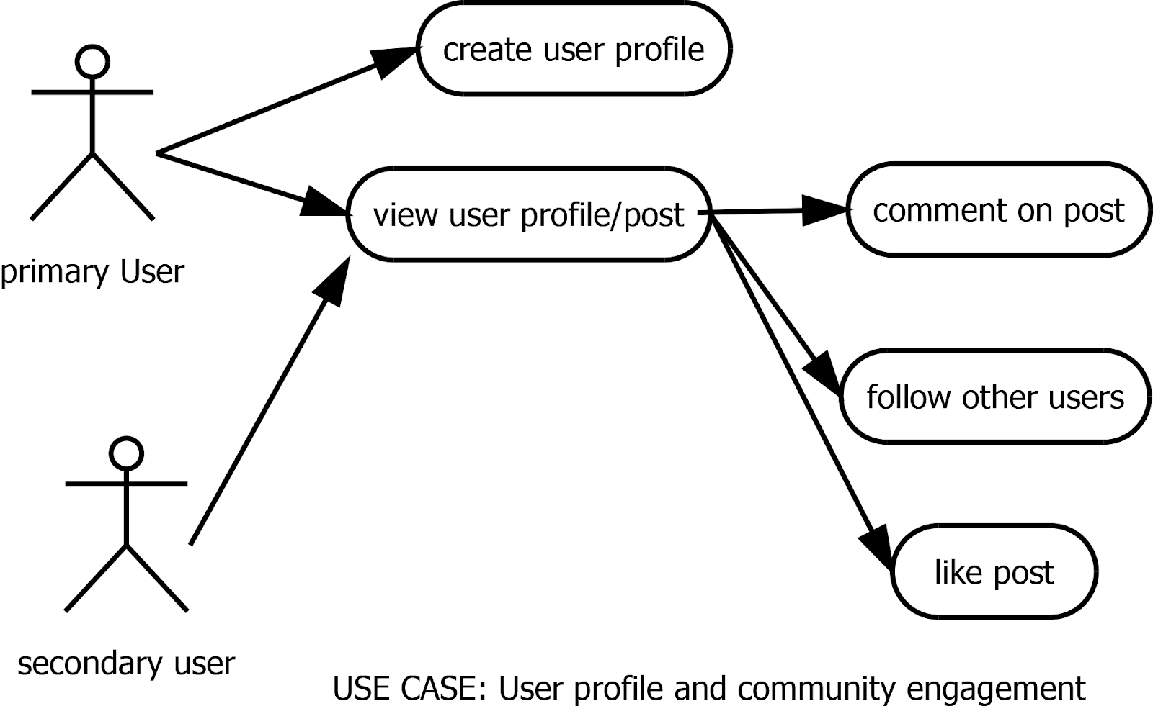
Use Case Diagram

Slide 12
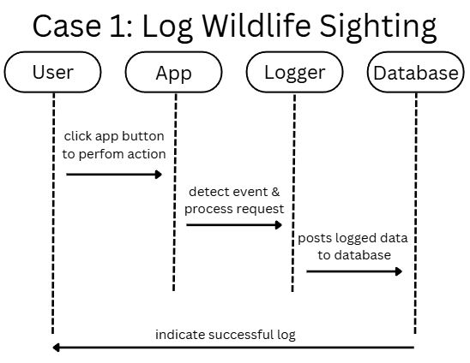
Sequence Diagram
App will send a log request to the Logger, including details of the post
Animal Type
Location
Timestamp
Message, etc.
Logger sends data to database for storage/record
Once confirmed, returns success to the user

Slide 13
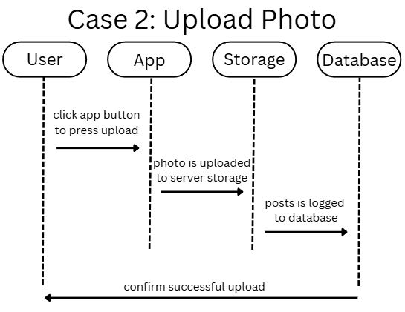
Sequence Diagram
App will format the photo to be compatible with the database
Photo will be sent to storage, such as a cloud or a local file server
Once it is stored, it will be sent to the database for easy retrieval
Links to the user's profile/gallery

Slide 14
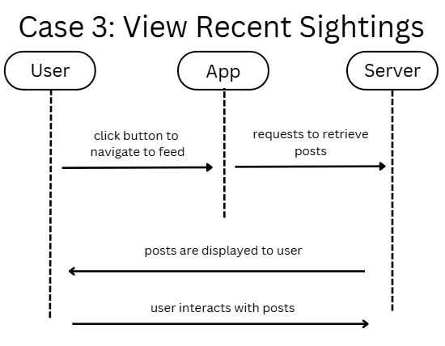
Sequence Diagram
The app will request for the server to retrieve the post
Through feed or another user's profile
Server can work with the database to get more data such as timestamps, user info, etc
Returns a list of posts which the user can view and interact with

Slide 15
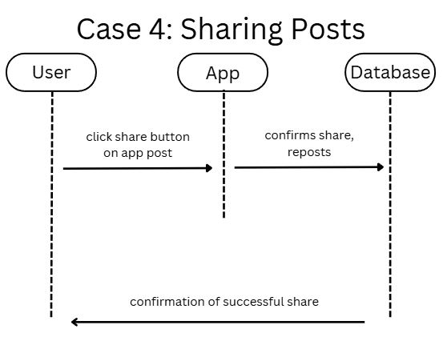
Sequence Diagram
App gathers information about the posts and requests the share from the database
Which post
User ID
How they want to share (reposting, sending to others, etc.)
Database will confirm the entry and will repost or share, returning a confirmation to the user

Slide 16
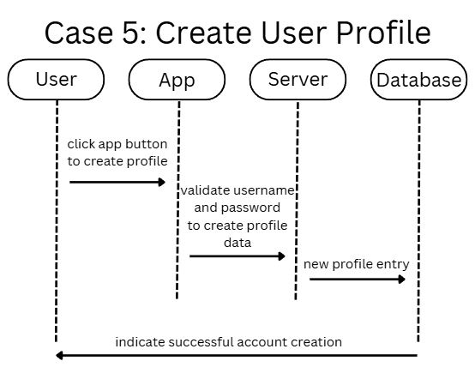
Sequence Diagram
App makes user input items
ID/username
Password
Server will do additional checks on this, validating the username and password
No one can have the same ID
Password must be at least 8 characters
Server sends the validated username and password to the database
Confirmation of account creation

Slide 17
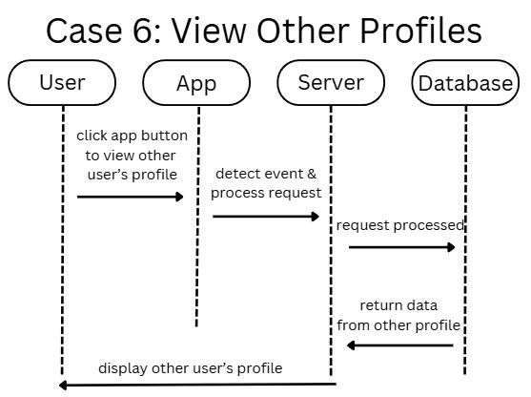
Sequence Diagram
App will request the specified other user's profile data through their ID, or through clicking on their account
Server will search the database for the associated user and show their details
ID, name, bio, profile pic, etc.
Database will return the data to the server depending on the request
Server will process the profile data and display it back to the user

Slide 18
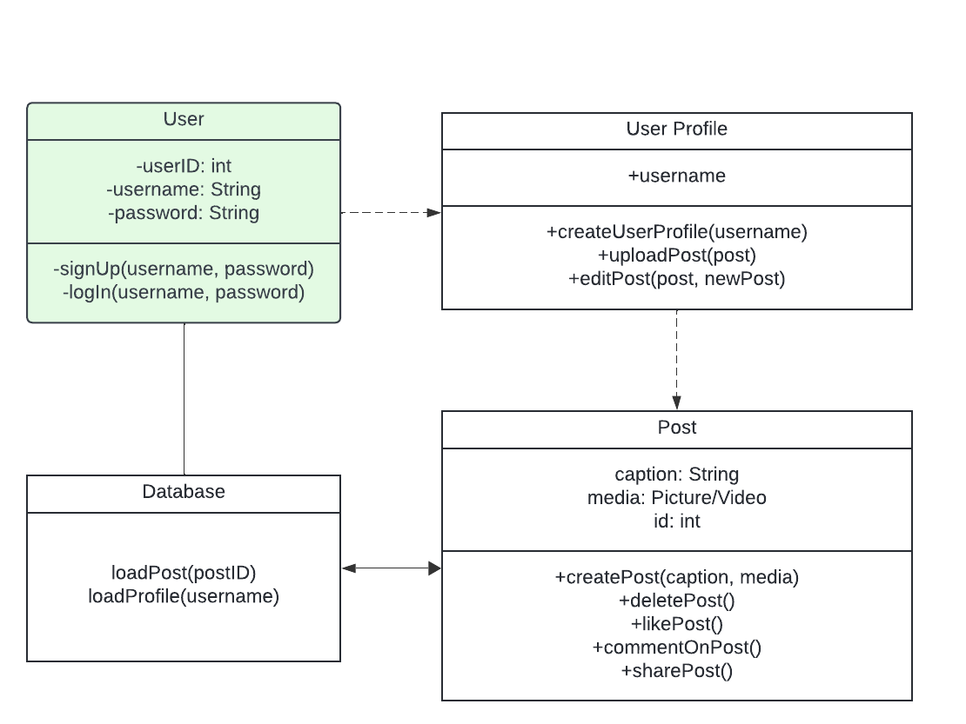
Class Diagram
This class diagram shows how the user, indicated in the green square, would interact with this system.
The user would give data like the username and password to the user profile and use the user profile to access the ability to post to the database
The database would also allow the user to load posts and profiles

Slide 19
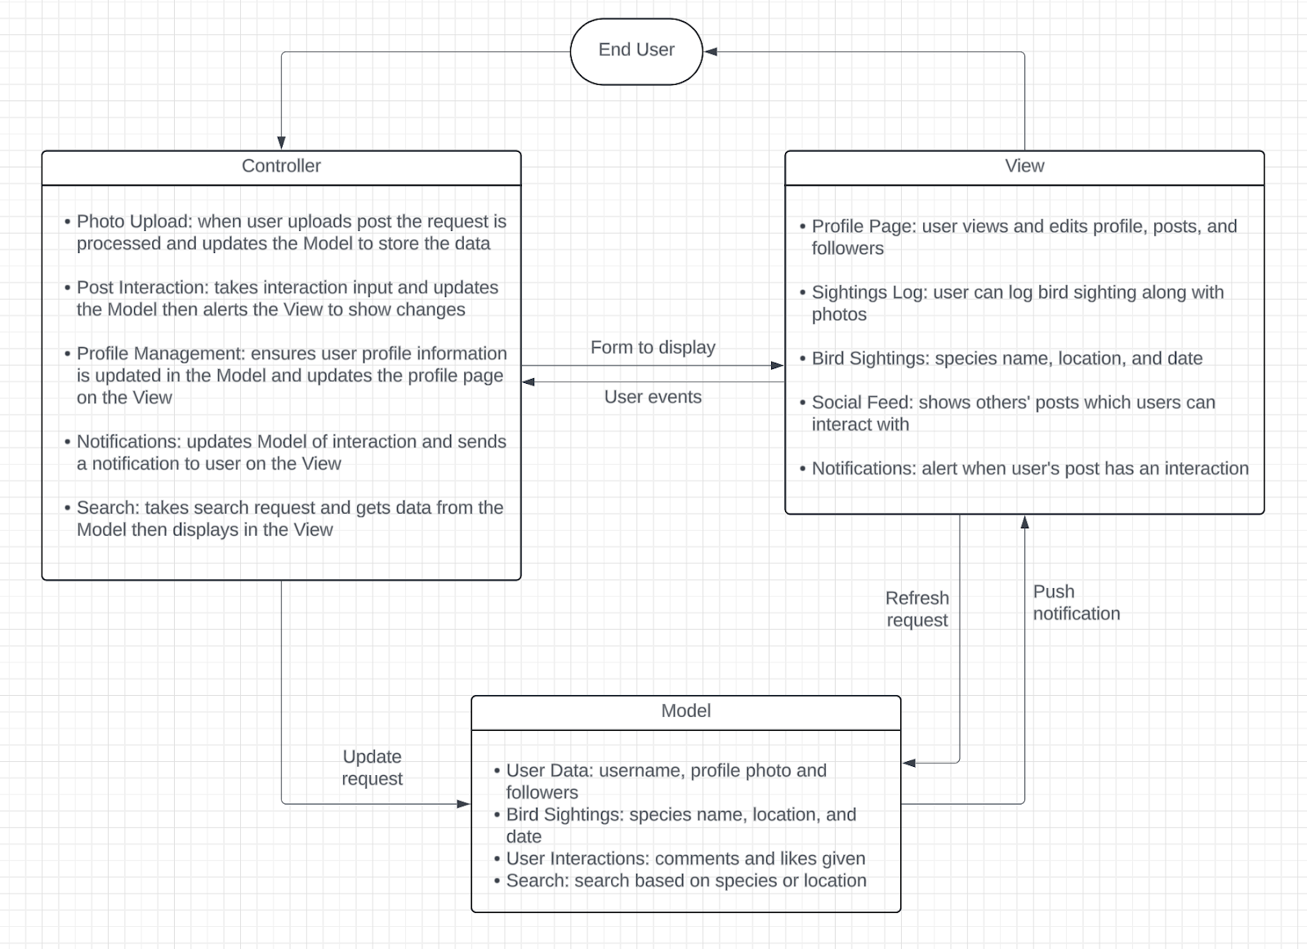
Architectural Design Model-View-Controller Pattern
The MVC pattern would show how the View captures user input (like log bird sighting along with photos), sends it to the Controller, which then updates the Model, and finally, the updated data is reflected in the View for the user to see.

Slide 20
Citations
[1] “Entry Level Back End Developer,” ZipRecruiter, 2024. https://www.ziprecruiter.com/Salaries/Entry-Level-Back-End-Developer-Salary--in-Texas#Monthly (accessed Nov. 10, 2024).
[2] M. Pratt, “How Much Should a Business Computer Cost?,” Business.org, Feb. 15, 2023. https://www.business.org/finance/cost-management/much-computer-cost/ (accessed Nov. 10 2024).
[3] “Dedicated Servers Custom for Windows & Linux | ServerMania,” www.servermania.com. https://www.servermania.com/dedicated-servers-hosting.htm (accessed Nov. 10, 2024).
[4] “Platform Pricing & API Costs,” Google Maps Platform, 2024. https://mapsplatform.google.com/pricing/?_gl=1 (accessed Nov. 10, 2024).
[5] Cornell Lab of Ornithology, “Merlin Bird ID – Free, instant bird ID help for 4,500+ birds,” Allaboutbirds.org, 2019. https://merlin.allaboutbirds.org/
‌[6] Cornell Lab of Ornithology, “Merlin Bird ID – Free, instant bird ID help for 4,500+ birds,” Allaboutbirds.org, 2019. https://merlin.allaboutbirds.org/‌
[7] “Seek by iNaturalist,” iNaturalist. https://www.inaturalist.org/pages/seek_app

