Slide 1



Home
About
Getting Started
Demos
Documentation
Community

Slide 2
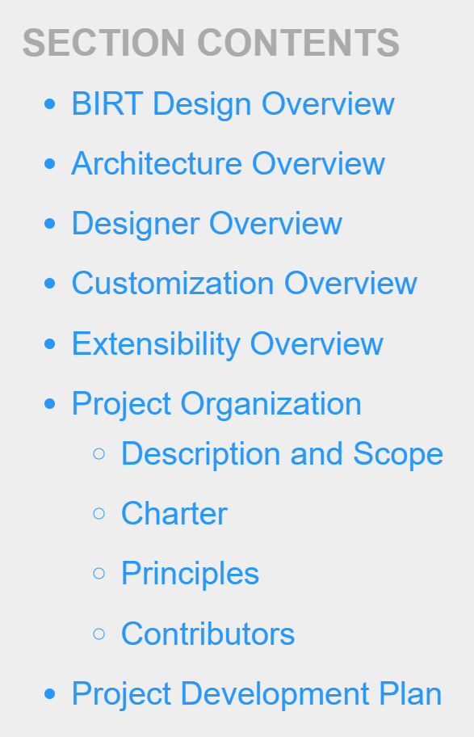
Home
About
Getting Started
Demos
Documentation
Community

Slide 3
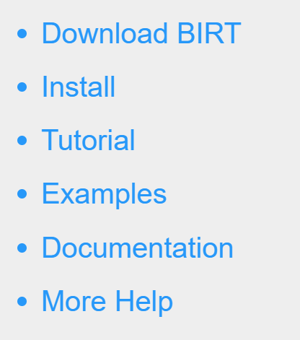
Home
About
Getting Started
Demos
Documentation
Community

Slide 4
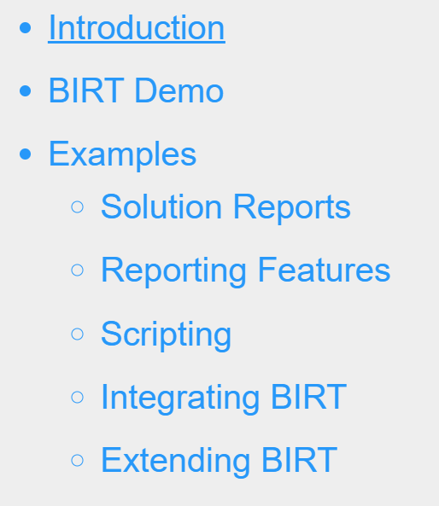
Home
About
Getting Started
Demos
Documentation
Community

Slide 5
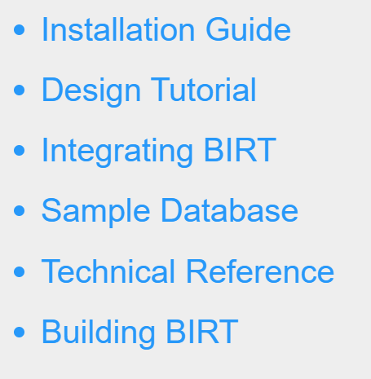
Home
About
Getting Started
Demos
Documentation
Community

Slide 6
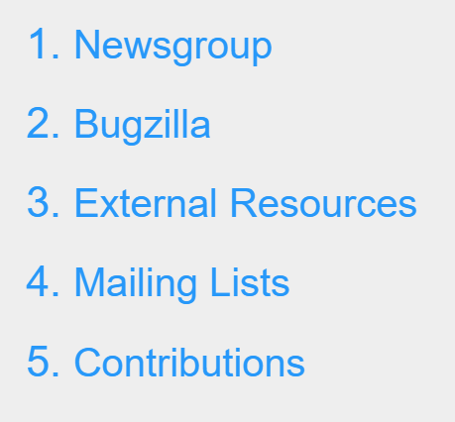
Home
About
Getting Started
Demos
Documentation
Community

Slide 8
Report
Designer
DTP,
WTP,…
Chart
Designer
Custom
Designer
Report Design Engine
Data
</>
XML
Data
Transform
Services
Charting
Engine
Gerneration
Service
Presentation
Service
HTML
PDF
EXCEL
Word
Power Point
…

Slide 9
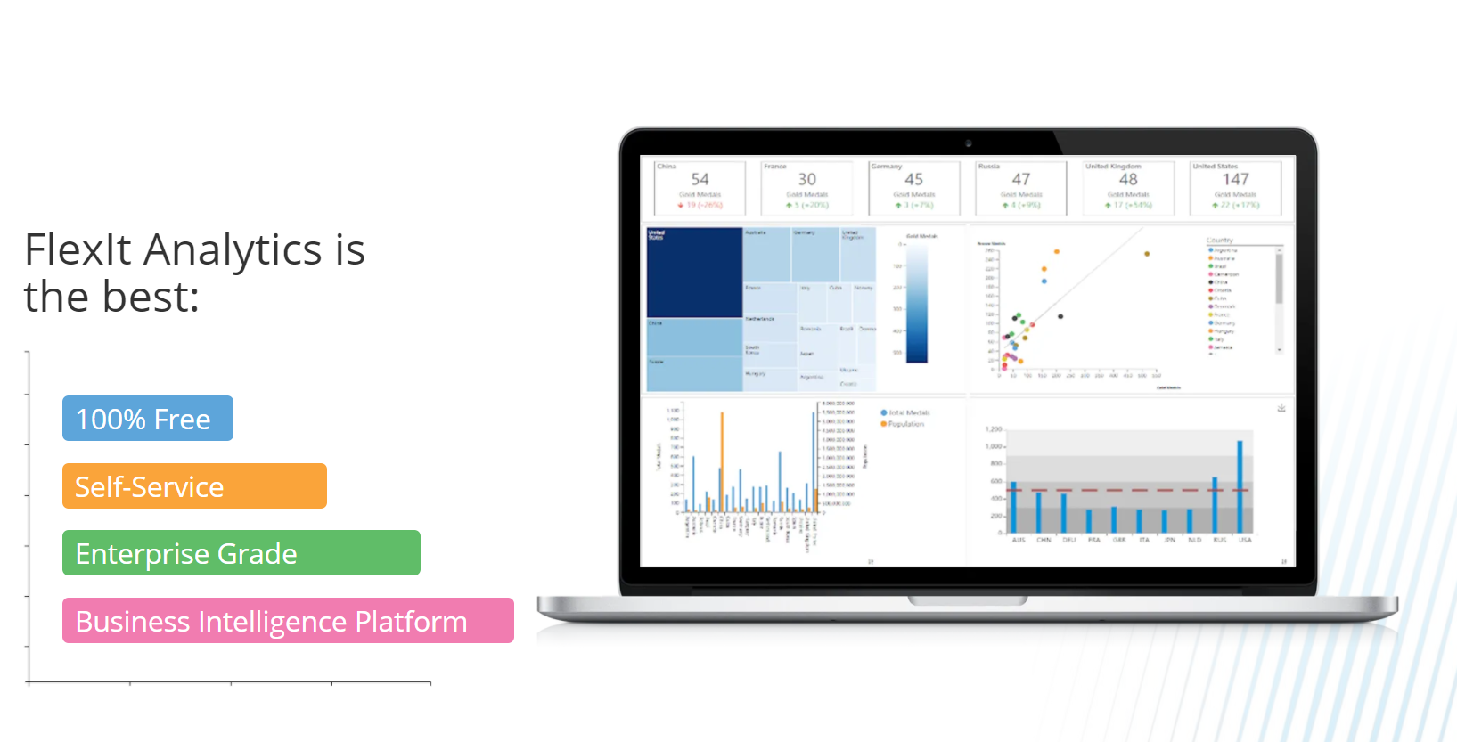


Slide 10


Slide 11


