Slide 1
What Are Neural Networks? An Introduction to Machine Learning
Have you ever wondered how the AI tools we use every day actually work? What's happening behind the scenes? And if modern AI is a huge building, what are the bricks it is built from?
How can machines automatically learn useful features from data and perform tasks that once required human intelligence? When AI engineers talk about "training a model," what exactly are they training? What is a "model" in the first place?
Why do people call AI a "black box"? Why can't even AI researchers always explain exactly how AI comes up with an answer? And why can AI give different answers to the exact same question?
By the end of this session, you'll have a much clearer understanding of these questions and the fundamental ideas behind them.
Let's start with one of the fundamental building blocks of modern AI: neural networks. The foundational research behind them even earned a Nobel Prize in Physics in 2024. Yes, physics!
This session is for everyone. No background in math, computer science, biology, or neuroscience required. Through simple explanations, visual examples, and a little humour, we'll explore what neural networks are and how they learn.
My goal is for you to understand at least 90% of the session and enjoy the process. The remaining 10%? That's my buffer for unexpected confusion — and a little humility.
Trust me, we'll explore some deep ideas, but in a way that's fun and easy to follow. It'll be time well spent!
Come explore the beauty of computer science and the remarkable human ideas behind artificial intelligence.
What Will You Take Away?
If you have no computer science background:
Don't worry — you're exactly who this session is designed for! Expect a fun, visual introduction that makes neural networks and machine learning easy to understand. You'll leave ready to explain the basic ideas behind neural networks (like multilayer perceptrons and convolutional neural networks) to a friend. You might even explain them more clearly than most computer science professionals! And yes, that's cool.
If you have a technical background (or simply have a development environment set up) but are new to machine learning:
You'll get a starting point for training a simple model yourself, along with an understanding of what's happening behind the code.
If you already know machine learning:
You might pick up some ideas for explaining technical concepts in a way that is simple, interesting, and perhaps even a little poetic.
If you're a machine learning expert AND a great presenter:
Sorry, you're not welcome.
Just kidding! Please come — I'd love your feedback and advice on how to make this session even better.

Slide 2
What are Neural Networks? An Introduction to Machine Learning
Chloe Zhang
Date: 17/Oct/2026

Slide 3
Content
A Toy Project: The Starting Point of Our Story
Real-Time Hand Gesture Recognition , Cat or Dog Classification
2. How It Works — The Underlying Mechanism of Neural Networks
Multilayer Perceptron and Convolutional Neural Network

Slide 4
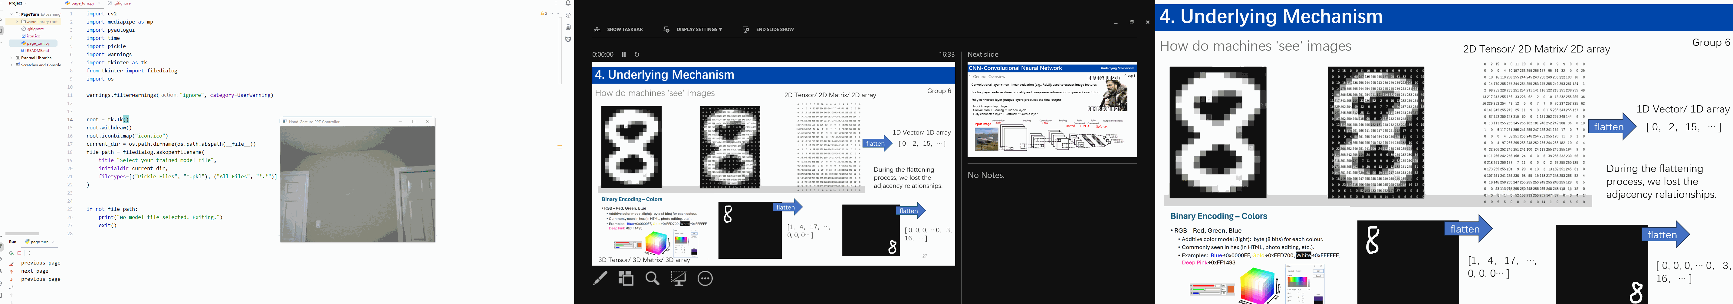
A Toy Project: The Starting Point of Our Story
Project Structure
GestureRecognition/
├── collect_data.py # Collect gesture data
├── train_model.py # Train model
├── recognize_real_time.py # Real time recognize program --->
├── gesture_model.pkl # Model (output of train_model.py)
└── hand_gesture_data.csv # Data (output of collect_data.py)
Run collect_data.py to collect gesture data -> generates hand_gesture_data.csv
Run train_model.py to train model -> generates gesture_model.pkl
Run recognize_real_time.py to recognize gesture in real time

Slide 5
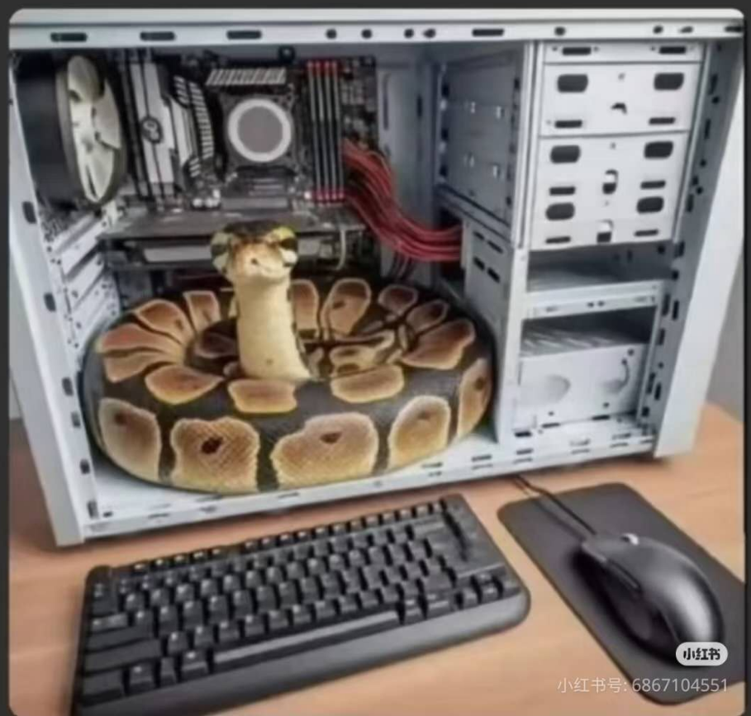
A Toy Project: The Starting Point of Our Story
Environment Setup
Install python and an IDE
Prepare a camera
Install packages
git clone https://github.com/chloexj/gesture_recognition.git
pip install mediapipe opencv-python scikit-learn numpy pandas
Our environment for reference(not mandatory):
Python: 3.9
IDE: PyCharm
Operating system: Windows
Package versions: Latest available versions

Slide 6
1. collect_data.py - how do we collect and process data
Code Implementation
1.1 How to use
Run the script, then follow the instructions to press the corresponding keys and make gestures to collect data
Press number keys 0~5, or 'o' and 'g' to set the label. Press 's' to save data, and 'q' to quit.

Slide 7
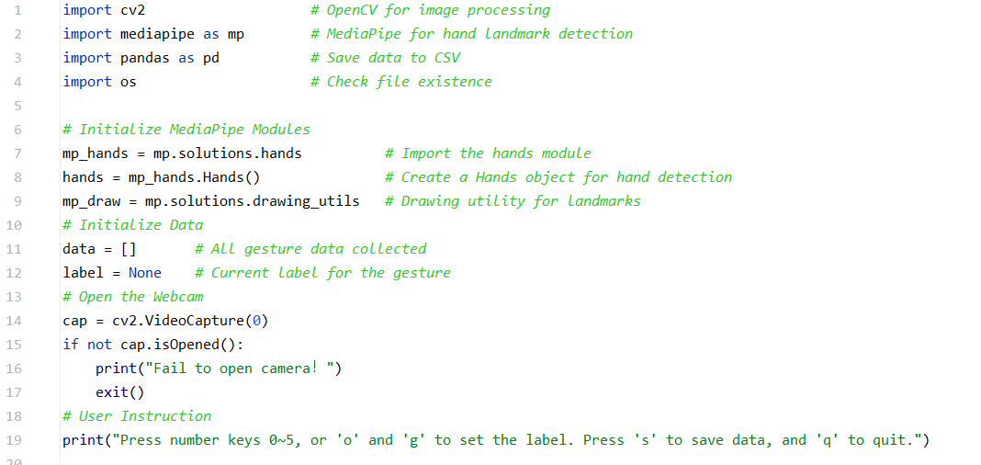
1. collect_data.py - how do we collect and process data
Code Implementation
1.2 Import library

Slide 8
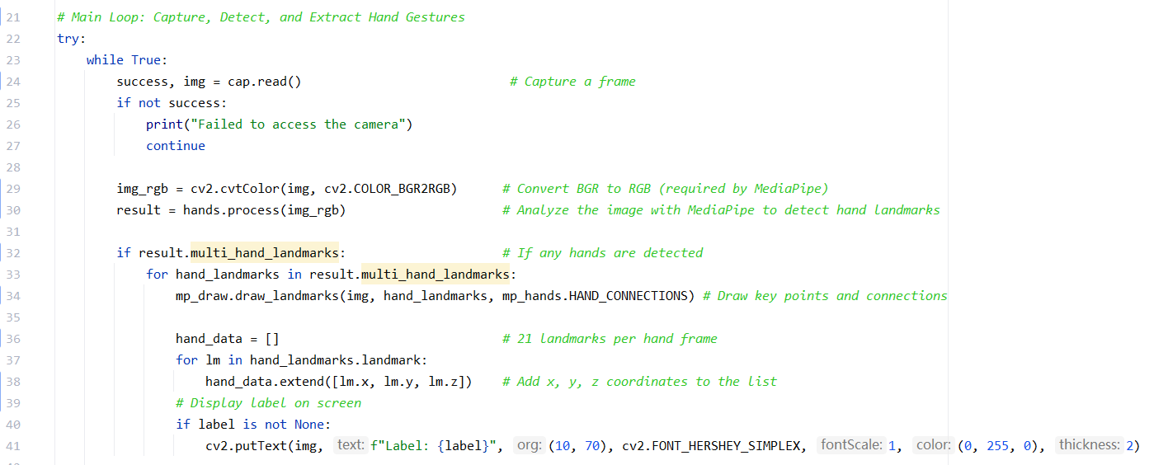
1. collect_data.py - how do we collect and process data
Code Implementation
1.2.2 Main loop

Slide 9
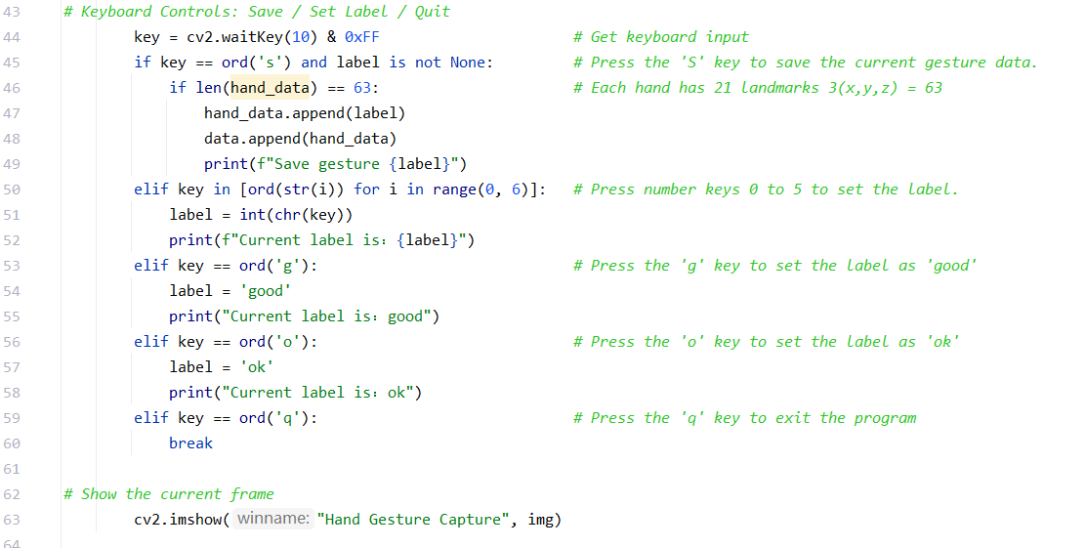
1. collect_data.py - how do we collect and process data
Code Implementation
1.2.3 Keyboard controls

Slide 10
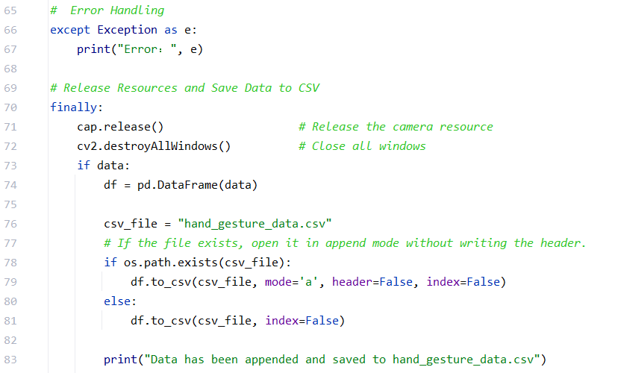
1. collect_data.py - how do we collect and process data
Code Implementation
1.2.4 Save Data to CSV

Slide 11
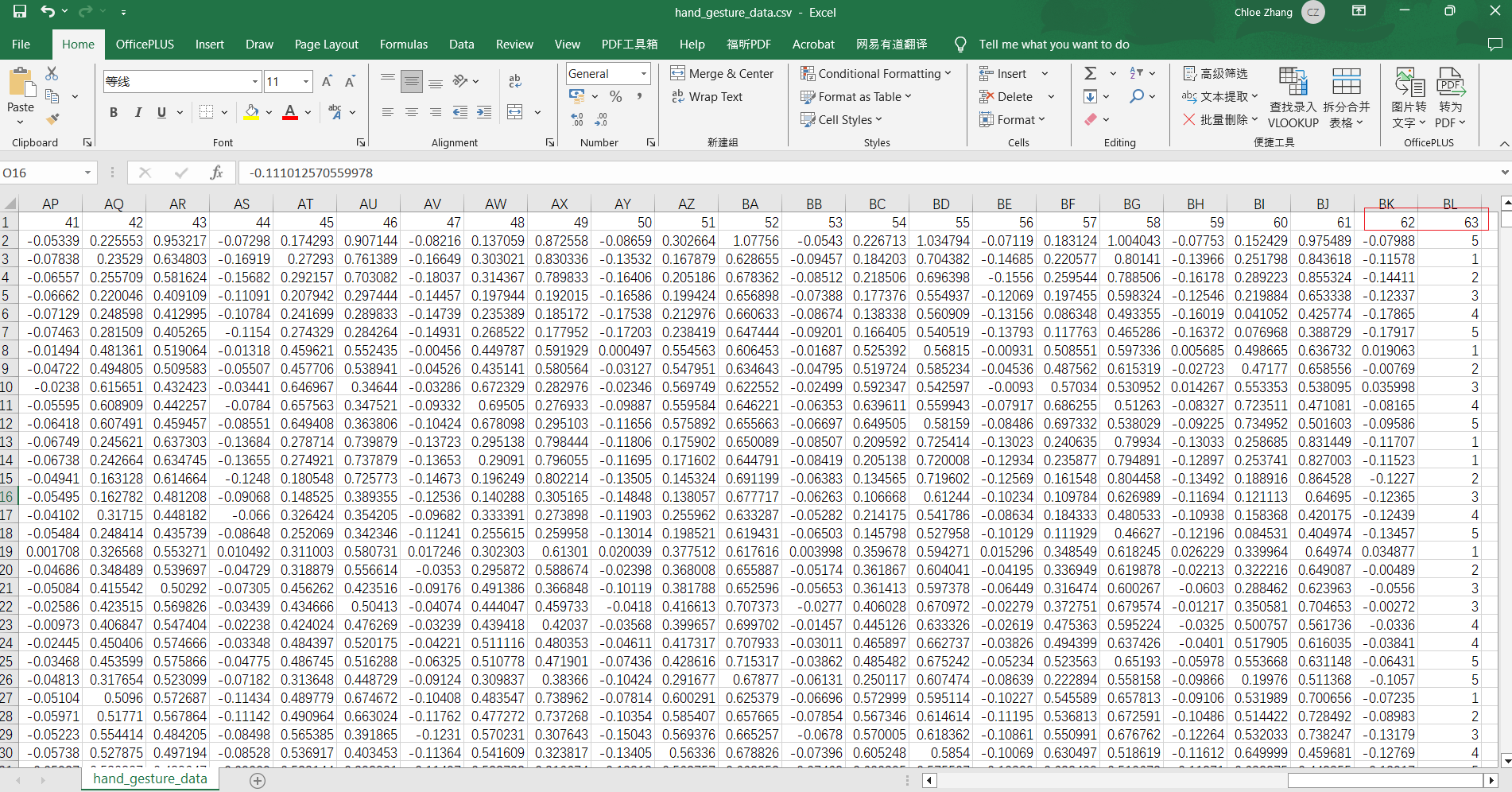
1. collect_data.py - how do we collect and process data
Code Implementation
1.3 Data
3*21 (21 landmarks per hand frame) +1(label) = 64 columns

Slide 12
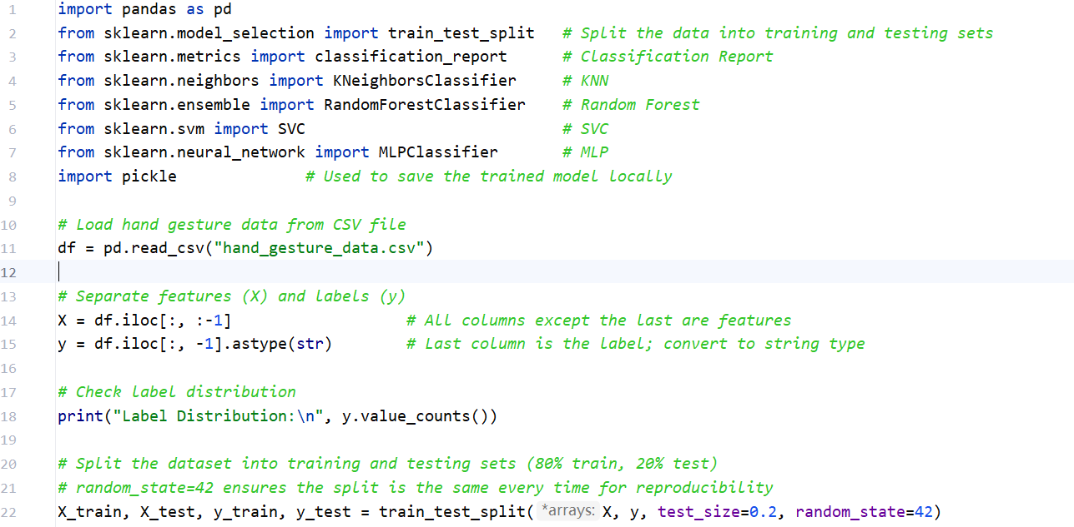
2. train_model.py
Code Implementation
2.1 Load data, check class distribution, Split the dataset

Slide 13
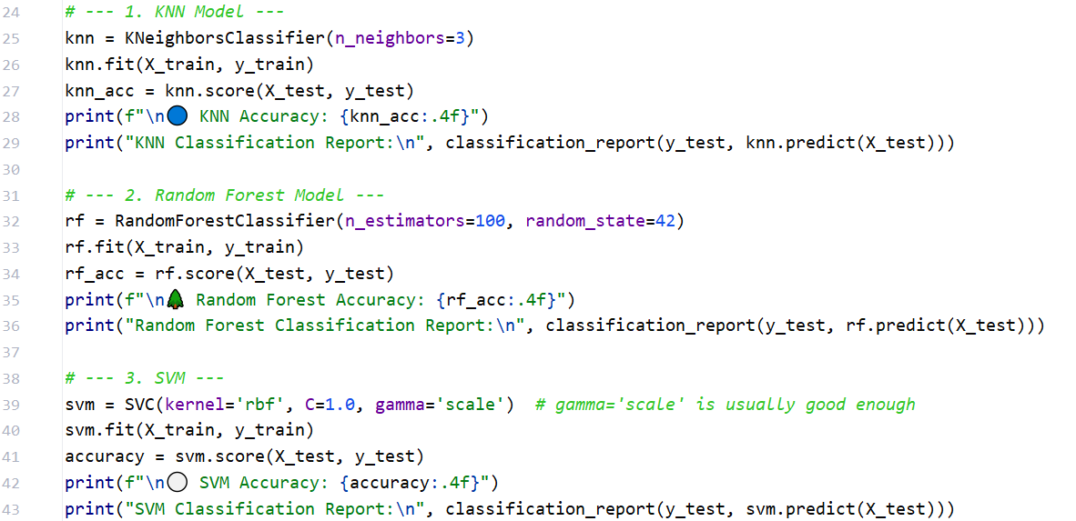
2. train_model.py
Code Implementation
2.2 Train using ①K-Nearest Neighbors, ②Random Forest, ③ SVM

Slide 14
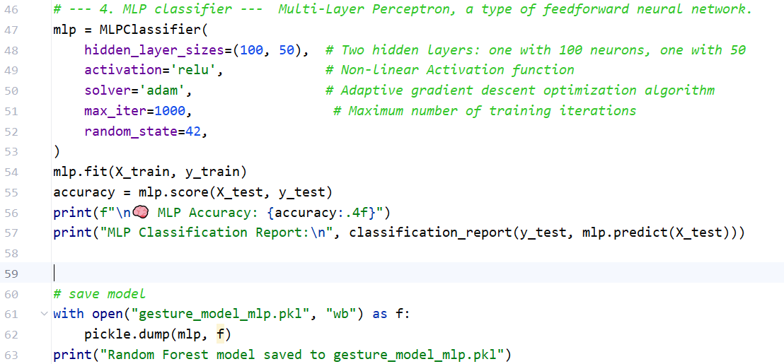
2. train_model.py
Code Implementation
2.3 Train using ④MLP and save model

Slide 15
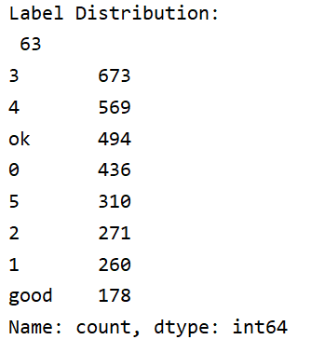
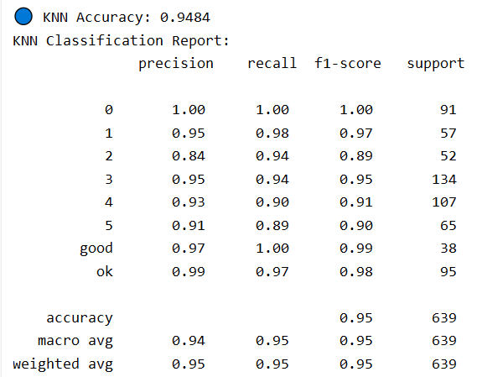
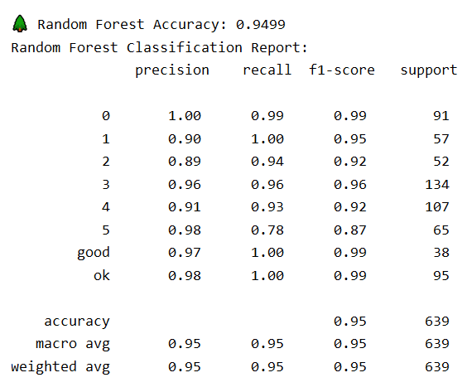
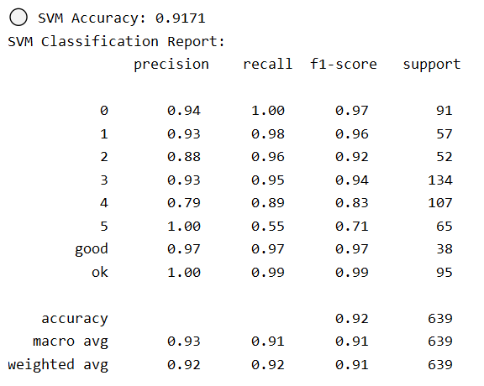
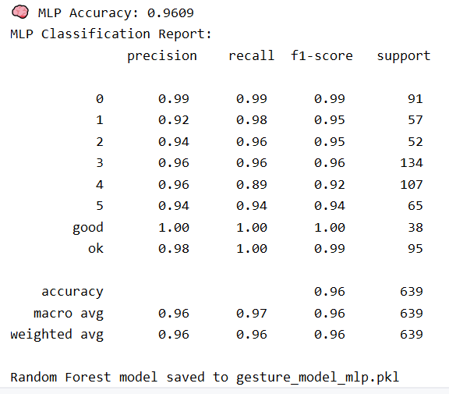
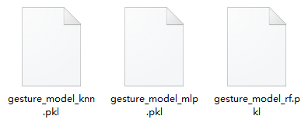
2. train_model.py
Code Implementation
①
②
2.4 Output
We tried training the data using four different models: ①KNN, ②Random Forest, ③SVM, and ④MLP. In the end, MLP won by a narrow margin.
Multi-Layer Perceptron, a type of feedforward neural network.
③
④
WIN
①
④
②
1.24MB
383KB
4.92MB
WIN

Slide 16
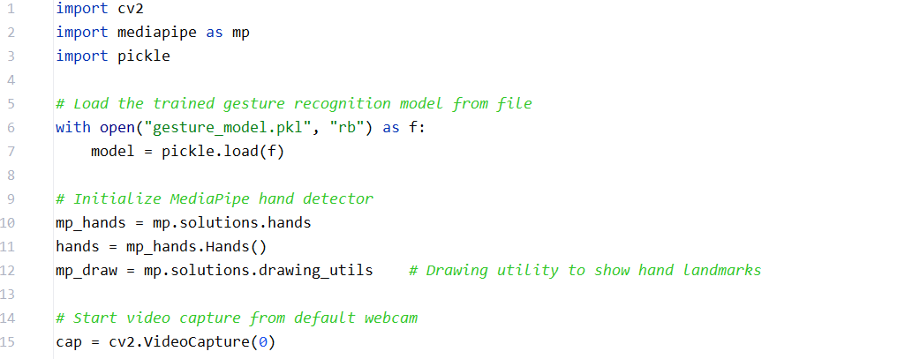
3. recognize_real_time.py
Code Implementation
3.1 Initialization

Slide 17
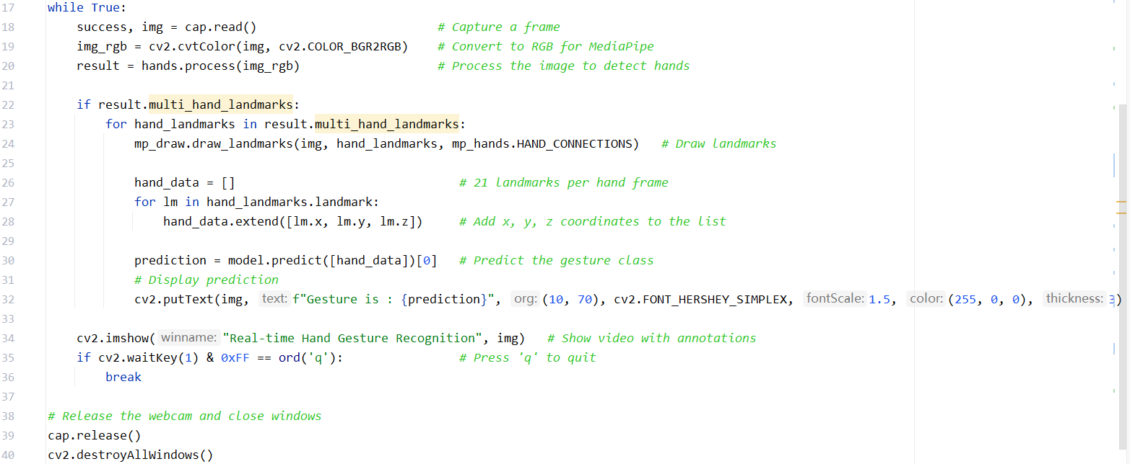
3. recognize_real_time.py
Code Implementation
3.2 Capture and process data to predict

Slide 18
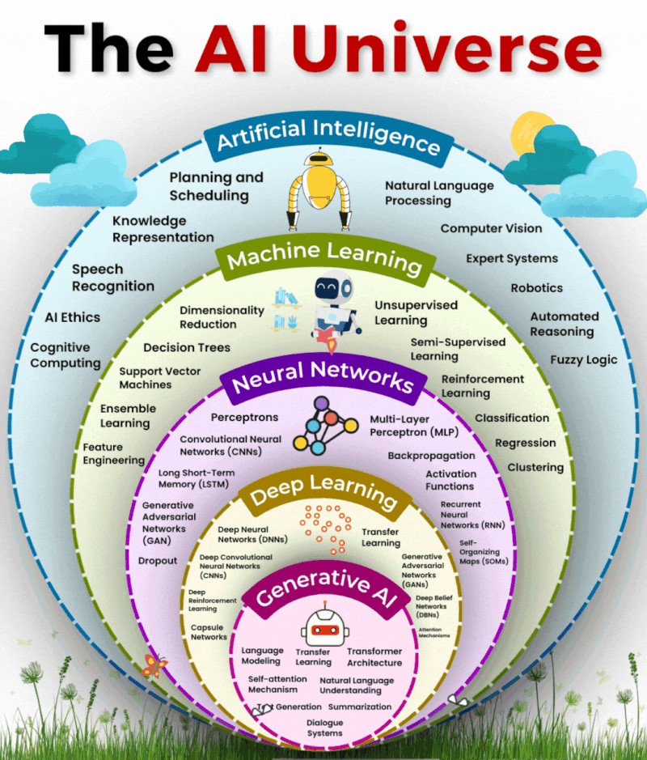
Content
A Toy Project: The Starting Point of Our Story
Real-Time Hand Gesture Recognition , Cat or Dog Classification
2. How It Works — The Underlying Mechanism of Neural Networks
Multilayer Perceptron and Convolutional Neural Network
Agentic AI

Slide 19

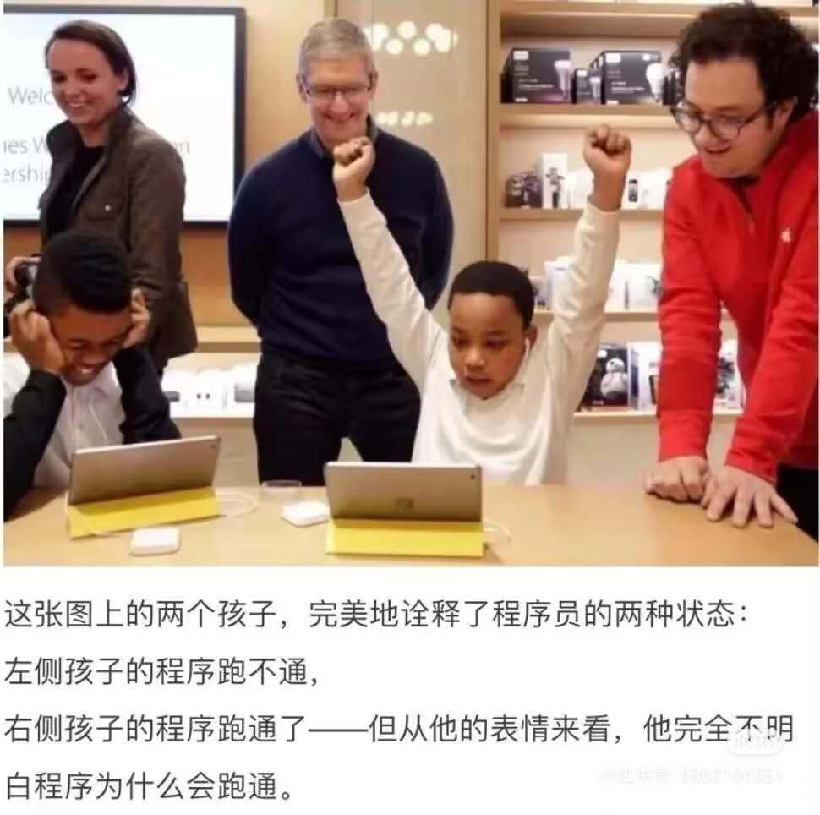
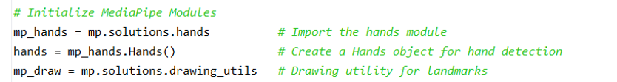
Underlying Mechanism
1. MediaPipe
MediaPipe is an open-source, cross-platform framework developed by Google. It enables real-time processing of key points such as faces, hand gestures, poses, and objects in videos or images, making it ideal for computer vision applications.
Extension: We can even use it for more advanced applications, like recognizing facial expressions, identifying faces, or detecting actions.
But what is the underlying mechanism behind MediaPipe?
Can we build our own hand detection model from scratch?
These two kids in the picture perfectly illustrate the two states of a programmer:
The kid on the left: the program doesn’t run.
The kid on the right: the program runs — but judging by his expression, he has no idea why it works

Slide 20
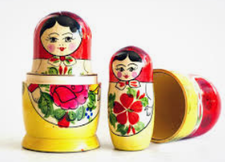
Underlying Mechanism
2. Deep learning and CNN
MediaPipe is a system developed based on deep learning, particularly using CNN (Convolutional Neural Network) architectures.
It uses pretrained models (mostly trained by Google) internally to perform keypoint detection tasks.
Then, What is Deep learning? What is CNN?
Deep Learning ⊂ Machine Learning

Slide 21
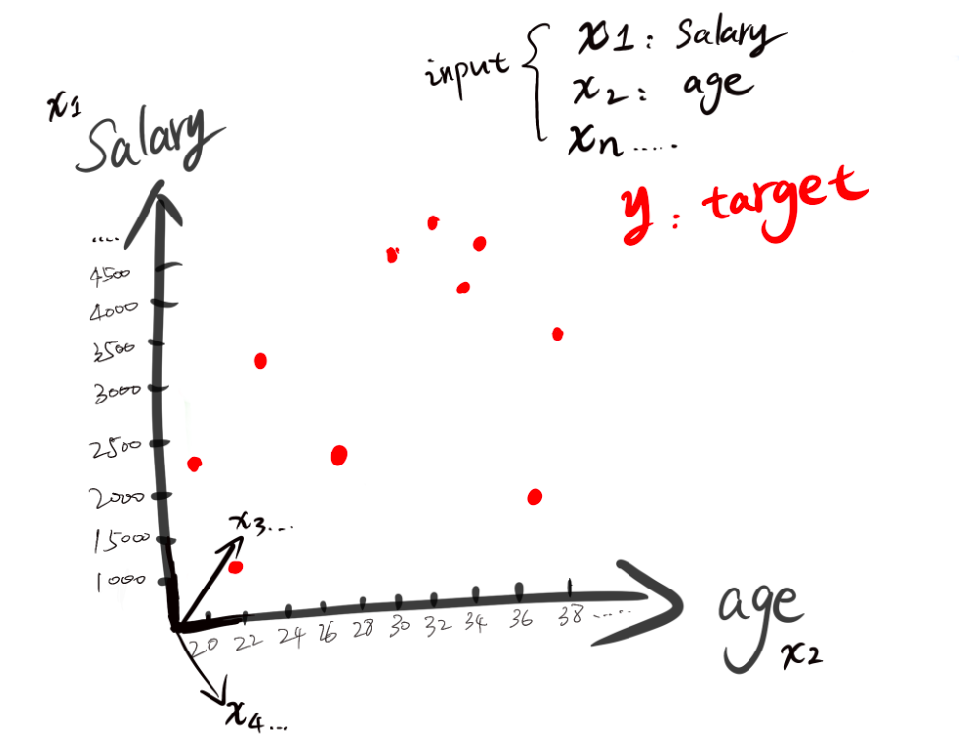
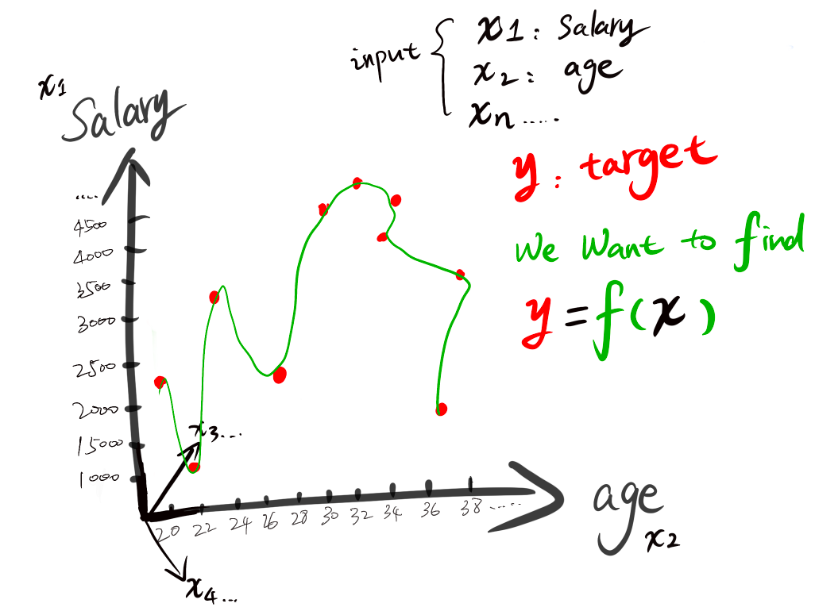
Underlying Mechanism
3. What is a model?
Classification — Predict which category an input belongs to
Example: Will a client pay their credit card bill on time or pay late?
X — Client information: income, age, and other features
y — Actual outcome: on-time or late payment
ŷ = f(X) — Our prediction
The goal is to learn a mathematical function from data: input X, predict y.
Each red dot represents a person who will be late on their credit card payment.

Slide 22
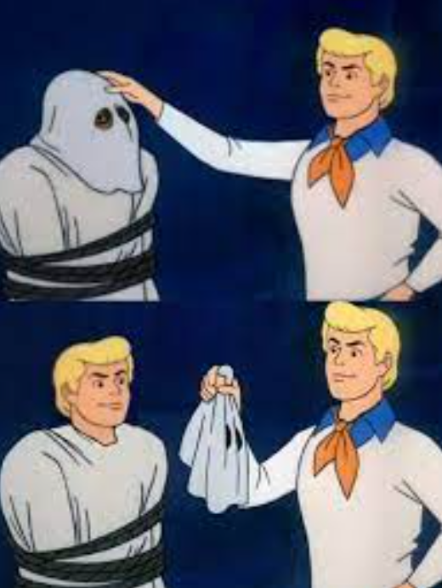
Underlying Mechanism
4.1 Neural Network
Deep Learning ≈ Neural Network
Deep learning is an artificial intelligence method that uses multi-layer neural networks to automatically extract features from data and make predictions or decisions.
It can learn useful information directly from raw data such as images, speech, and text, without the need for manually defined rules.
Then, What is neural network?

Slide 23
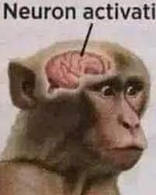
Underlying Mechanism
4.2 Neural Network
A neural network is a mathematical model that mimics the structure of neurons in the human brain, allowing computers to "learn" and solve problems.
Basic Components of a Neural Network
Layer Type | Function
Input Layer | Receives the input data, such as image pixels or hand gesture coordinates.
Hidden Layers | Perform intermediate computations across multiple layers to automatically extract features.
Output Layer | Produces the final prediction result, such as identifying which gesture it is.

Slide 24
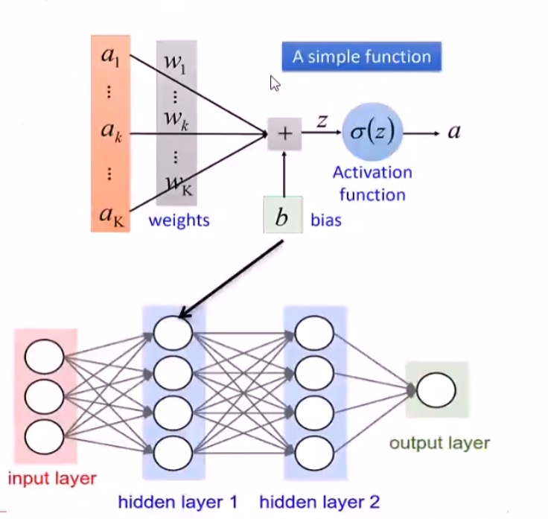
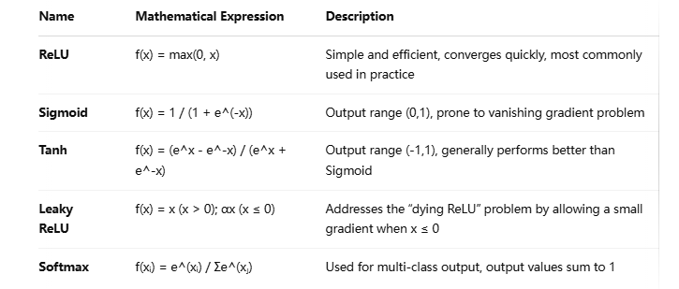
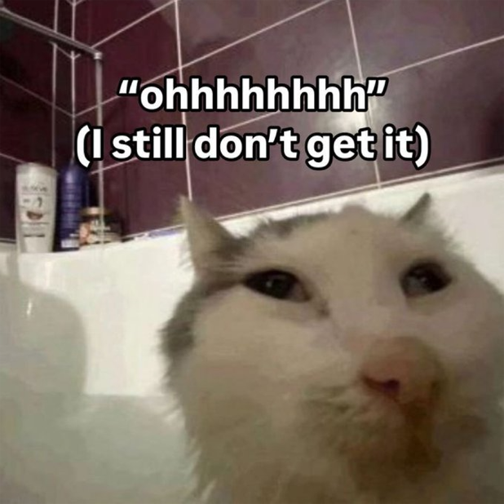
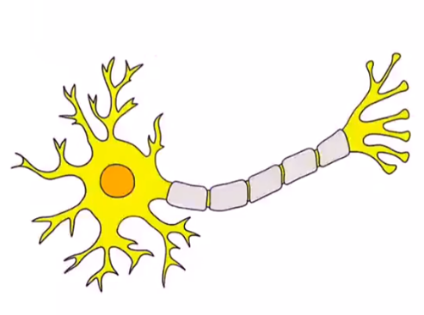
Underlying Mechanism
4.3 Neural Network

Slide 25
Underlying Mechanism
4.4 Neural Network Model Family
Model Name | Full Name | Specialty | Example Applications
MLP | Multilayer Perceptron (basic) | General tasks, tabular data | Digit recognition, house price prediction
CNN | Convolutional Neural Network | Visual tasks | Hand gesture recognition, face detection, image classification
RNN | Recurrent Neural Network | Time series, language | Sentiment analysis, speech recognition, translation
Transformer | — | Self-attention mechanism | GPT, ChatGPT, BERT
GAN | Generative Adversarial Network | Image generation | AI-generated art, face synthesis, super-resolution
CNN is a member of the neural network family that's especially good at understanding images.

Slide 26
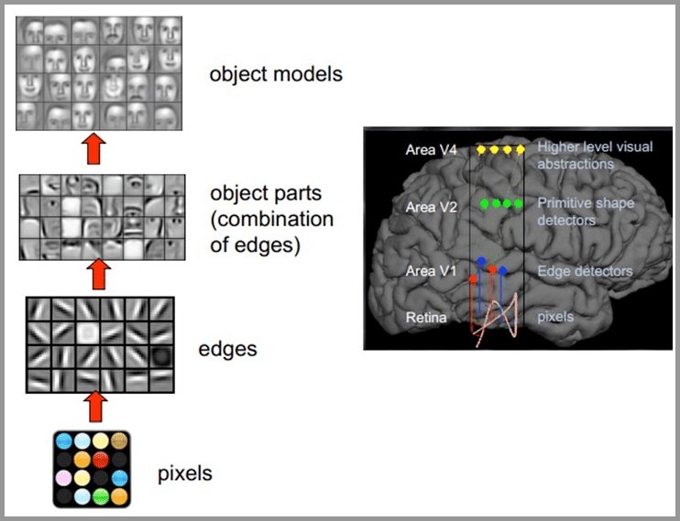
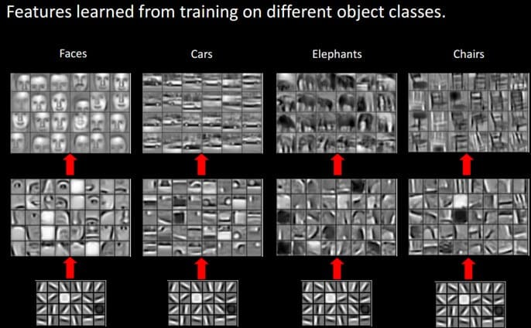
Underlying Mechanism
How do human beings understand images

Slide 27
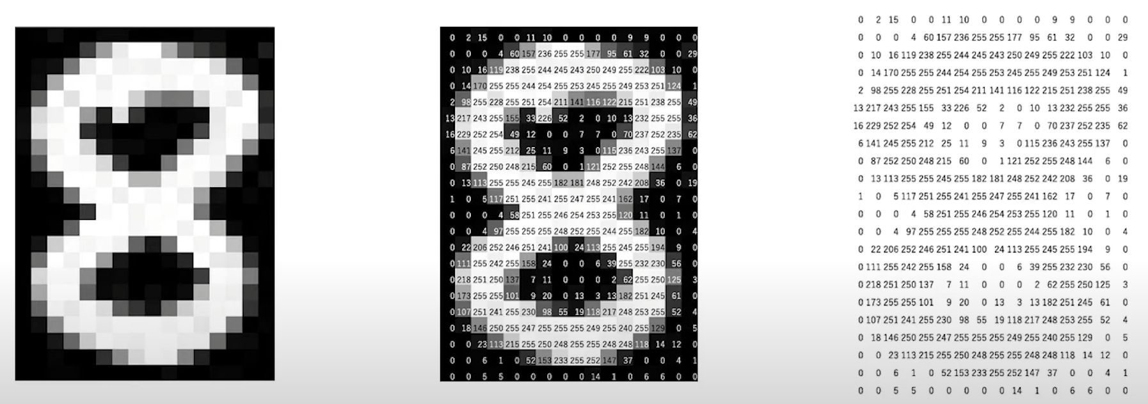
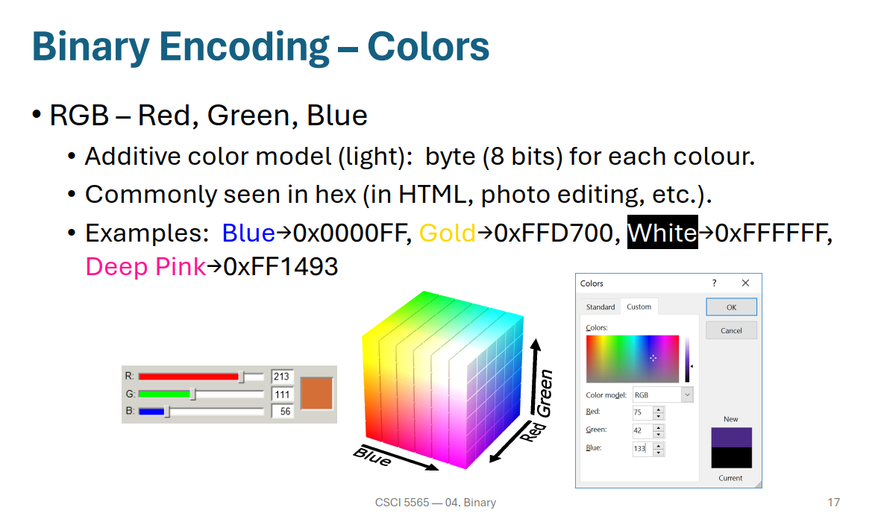
Underlying Mechanism
How do machines 'see' images
2D Tensor/ 2D Matrix/ 2D array
1D Vector/ 1D array
flatten
[ 0，2，15，… ]
During the flattening process, we lost the adjacency relationships.
flatten
flatten
[1，4，17，…, 0, 0, 0… ]
[ 0, 0, 0, … 0，3，16，… ]
3D Tensor/ 3D Matrix/ 3D array

Slide 28

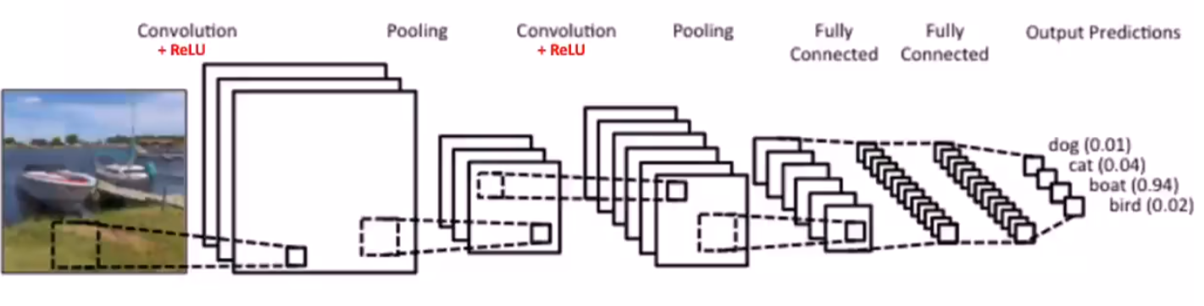
CNN-Convolutional Neural Network
Underlying Mechanism
1. General Overview
Convolutional layer + non-linear activation (e.g., ReLU): used to extract image features
Pooling layer: reduces dimensionality and compresses information to prevent overfitting
Fully connected layer (output layer): produces the final output
Input image = Input layer
Convolution + Pooling = Hidden layers
Fully connected layer + Softmax = Output layer
Input image
Flatten
+ReLU
Softmax

Slide 29
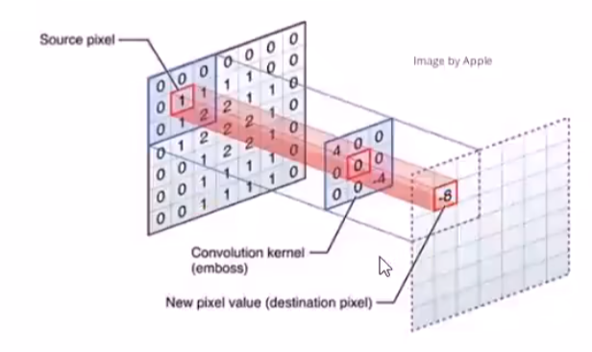

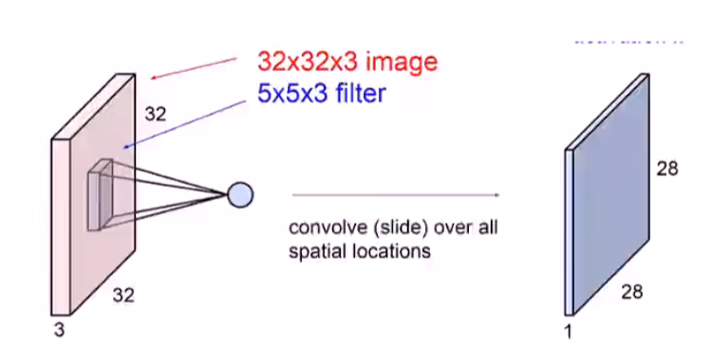
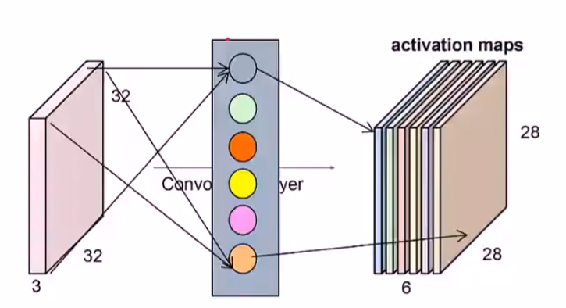


1. Convolutional Layer
Underlying Mechanism-CNN
1.1 Convolutional kernel
dot product
kernel size (in this case: 3*3)
Stride (Step) (in this case: 1)
kernel number (in this case: 6)
Padding (in this case: no)
…
Feature Maps

Slide 30
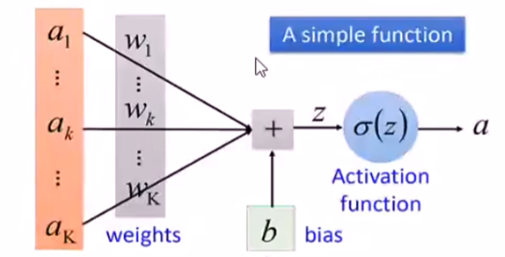
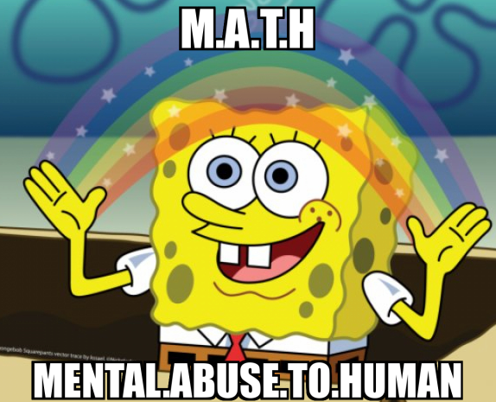
1. Convolutional Layer
Underlying Mechanism-CNN
1.2 Typical computation flow in forward pass
x (input data)
│
▼
Linear Layer (weights w, bias b)
│
▼
z = wx + b (linear transformation — this is where the convolution kernel scans over the image and performs dot products)
│
▼
ReLU (non-linear activation function)
│
▼
a = ReLU(z) (activation result)
│
▼
Pass to the next layer

Slide 31
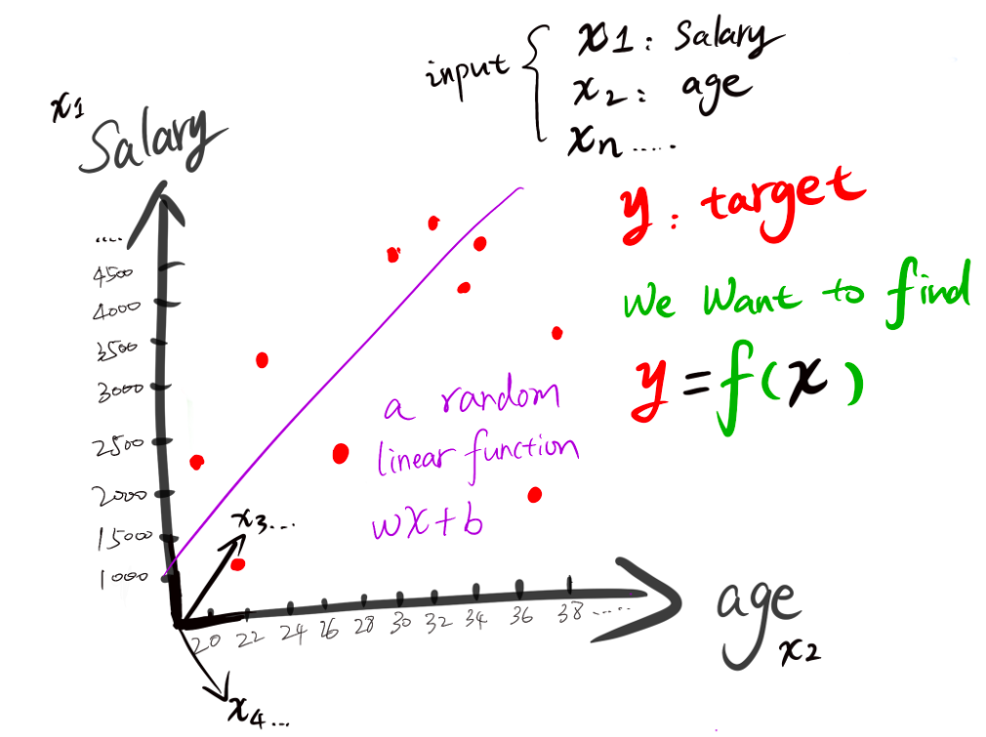
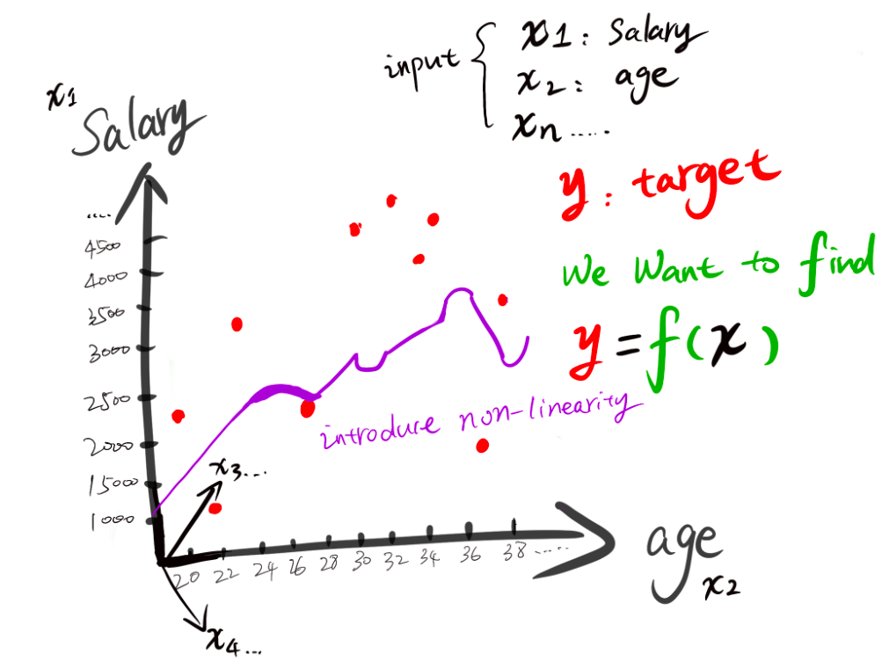
1. Convolutional Layer
Underlying Mechanism-CNN
1.3 None-linear activation layer
None-linear activation function introduces non-linearity, allowing the network to model complex relationships. It also helps emphasize important features by filtering out low-activation signals.

Slide 32
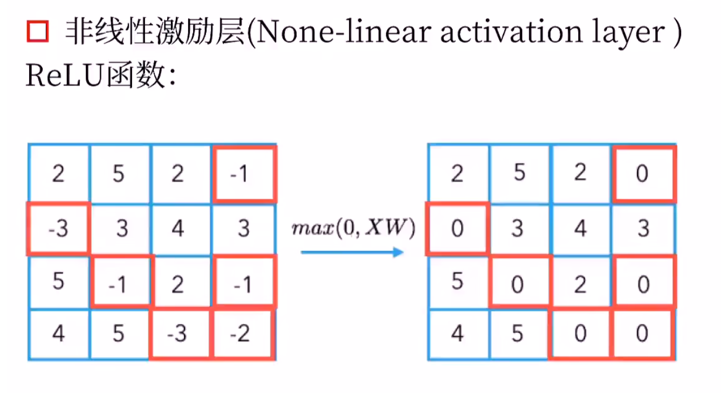
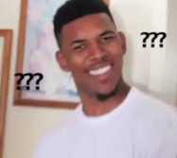
1. Convolutional Layer
Underlying Mechanism-CNN
1.4 None-linear activation layer - ReLU
Rectified linear operator
gradient descent？？？
ReLU is widely used because it provides stable gradient flow during training, converges quickly, avoids the vanishing gradient problem, and is computationally simple.

Slide 33
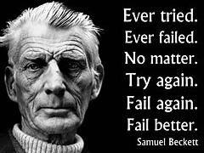
1. Convolutional Layer
Underlying Mechanism-CNN
1.5 Weights
The numbers (weights) in the convolutional kernel are not manually set by humans — they are learned automatically from data by the model through the following process:
Forward propagation → Loss calculation → Backpropagation → Gradient descent → Weight update
Iteration
Forward propagation : The model “submits the exam” → makes a prediction (e.g., cat or dog)
Loss Calculation: The teacher “grades the exam” → realizes the answer is wrong (predicted cat but it's actually a dog)
Backpropagation: Analyzes where and how the mistake happened → traces responsibility back through each layer (each neuron and weight)
Gradient Descent + Weight Update: Corrects the mistakes → updates the model’s “way of thinking” (i.e., updates the weights)

Slide 34
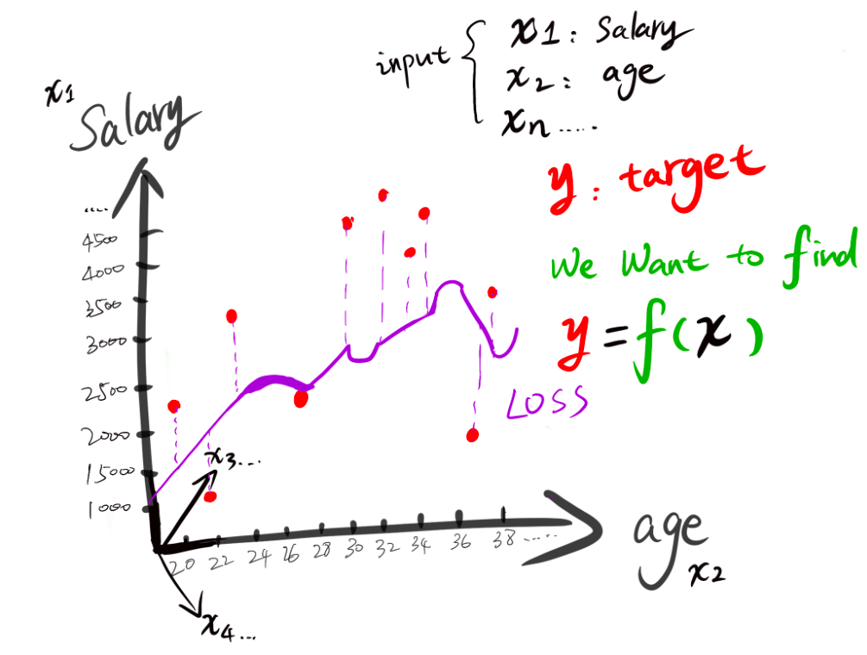
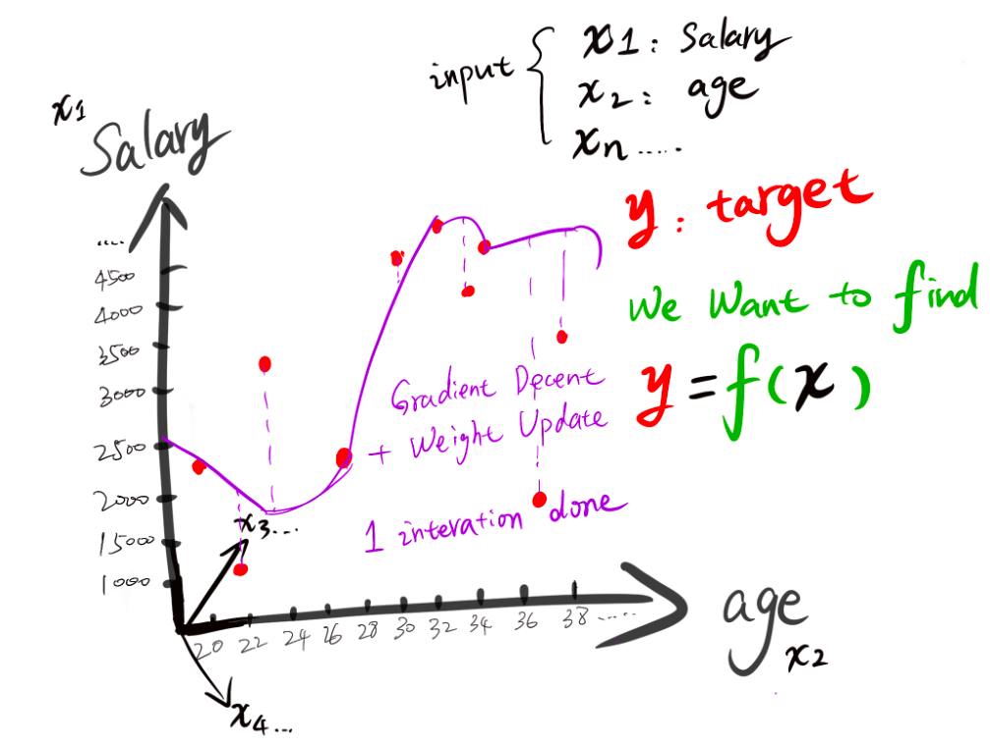
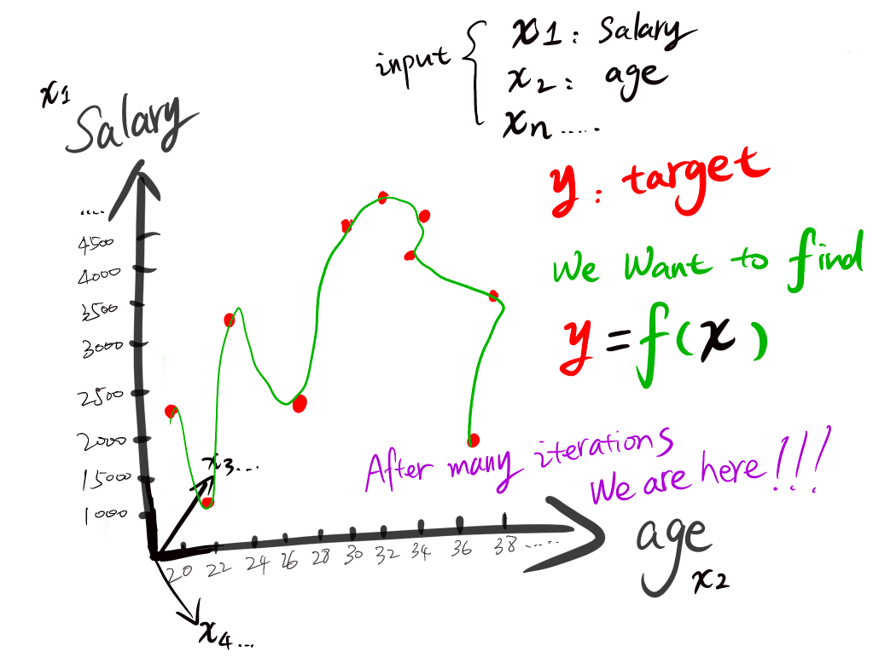
1. Convolutional Layer
Underlying Mechanism-CNN
1.6 Gradient Descent
Gradient descent is based on calculus. A derivative tells us the instantaneous rate at which the loss changes with a parameter: if we increase that parameter slightly, will the loss go up or down, and how quickly?
Imagine standing on a mountain, where the height represents the loss. The negative gradient points in the steepest downhill direction. We take a small step, recalculate, and repeat.
If you curious about the exact calculation process (scary mathematic things😫), this site is helpful!
https://mladdict.com/neural-network-simulator

Slide 35
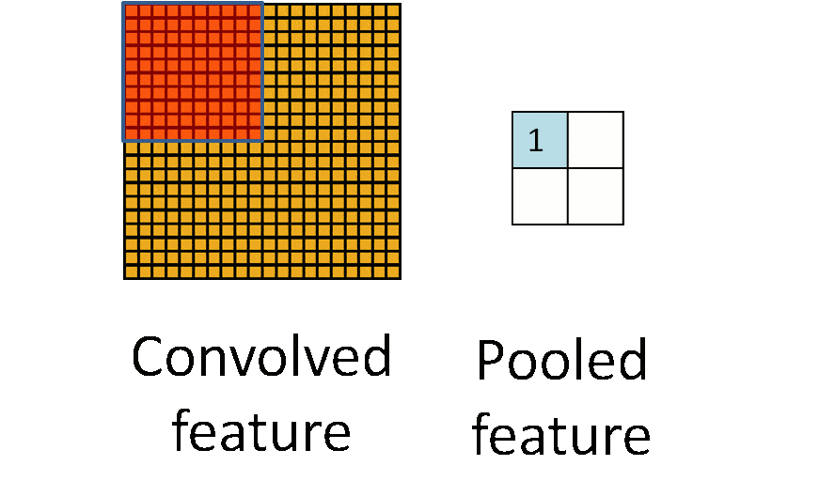
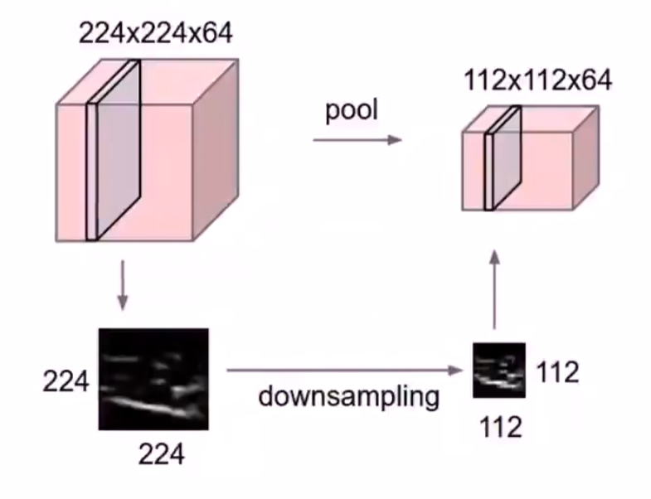
2. Pooling Layer
Underlying Mechanism-CNN
Compress data
Pooling layer: reduces dimensionality and compresses information to help prevent overfitting.
Max Pooling
Emphasizes the most prominent activation ("the strongest wins")
Average Pooling
Provides a more balanced representation of all features ("everyone gets a say")

Slide 36

3. Fully Connected Layer
Underlying Mechanism-CNN
Fully connected layer (output layer): produces the final output
1D Vector
1. Flatten 3D activation maps
For example, we have a 3D activation map with a shape of 64×7×7 (from 64 convolution kernels). We can then flatten it into a 1D vector of size 3136.
2. Pass through the fully connected layer → obtain raw outputs (logits) → apply Sigmoid/Softmax/... → get the final prediction

Slide 37



3. Fully Connected Layer
Underlying Mechanism-CNN
Example: How to obtain the output
How to obtain the final output (Softmax)
How to obtain the raw output (logits)
y = W·x + b
 | Input 1 (56) | Input 2 (231) | Input 3 (24) | Input 4 (2) |  | + bias | logits
Cat | 0.2 | -0.5 | 0.1 | 2 |  | 1.1 | -96.8
Dog | 1.5 | 1.3 | 2.1 | 0 |  | 3.2 | 437.9
Ship | 0 | 0.25 | 0.2 | -0.3 |  | -1.2 | 60.75
b
x

Slide 38






Other Training Parameters
Underlying Mechanism-CNN
Example
Forward propagation → Loss calculation → Backpropagation → Gradient descent → Parameter update
1 iteration
Item | Value
Dataset size | 3000 images
Batch size | 100 images
Iterations per epoch | 30 (3000/100)
Number of training epochs | 20
Number of weights updates | 20 × 30 = 600 times

Slide 39

Underlying Mechanism
Can we build our own hand detection model from scratch?
Prepare a large dataset labeled with 21 hand keypoints
Train a CNN network using deep learning frameworks such as PyTorch or TensorFlow (requires high GPU performance)
Output the (x, y, z) coordinates of the 21 keypoints
Use OpenCV to render the connection graph
In theory, it is achievable.
However, due to hardware limitations, we did not implement it in practice.
Instead, we used TensorFlow to train a simple model based on VGG16 to classify cats and dogs.
The underlying mechanism is similar (though much simpler in practice).

Slide 40




Application
sign language recognition
Smart home interaction
Future technology
VR
https://www.youtube.com/watch?v=YrtANPtnhyg

Slide 41




Machine Learning and Human Learning
What you’re seeing under the microscope are neurons “reaching out” to one another.
These tiny, hand-like structures at the tips are called growth cones. They explore their surroundings, looking for targets to connect with.
When neurons form connections called synapses, information can pass from one neuron to another.
Vast numbers of these connections form neural networks, allowing us to feel, move, think, learn, and remember.
Human Learning
Machine Learning
https://www.overfitting.io/neural-network-playground

Slide 42
Final call back
②
Each red dot represents a person who will be late on their credit card payment.
Why Neural network is “black box”?
Why MLP is much smaller?
Why LLM cannot always provide same answer?
④
WIN
①
④
②
1.24MB
383KB
4.92MB
WIN

Slide 43



Next Session?
Not sure if it will happen though…
What is LLM?
What ChatGPT stands for?
What is transformer?
What happened in 2017?
Attention is all you need!
What is attention?
Agentic AI

Slide 44
https://github.com/chloexj/gesture_recognition.git
https://github.com/chloexj/catOrDog.git
https://github.com/chloexj/PPT_page_turn
Chloe Zhang
Date: 17/Oct/2026

