Slide 1
MONGODB Aggregation Framework
ITP 249

Slide 2
Topics
MongoDB Aggregation Framework
Match
Project
Group
Match
Sort
Limit
And many more

Slide 3
Recall: SELECT
SELECT … *
FROM …
WHERE …
GROUP BY…
HAVING …
ORDER BY …
LIMIT …

Slide 4
Conversion to MongoDB
SELECT CLAUSE | MONGODB
WHERE | Match
SELECT | Project
GROUP BY | Group
HAVING | Match
ORDER BY | Sort
TOP or LIMIT | Limit

Slide 5
Aggregation Framework
In Mongo, the aggregation framework is sequential
Which means, each of the functions is executed in a sequential order on a collection
The results of the previous function are used for the next function
Each step in the sequence is called stage

Slide 6
Code
db.collectionname.aggregate()
Followed by stages function (e.g):
Match
Project
Group
Match
Sort
Limit
Count

Slide 7
Studio3T Aggregate Pipeline
A stage by stage methodology to create an aggregate pipeline
Sample
Use the Yelp Business dataset
Go to Aggregate
Click Run to see the raw data

Slide 8
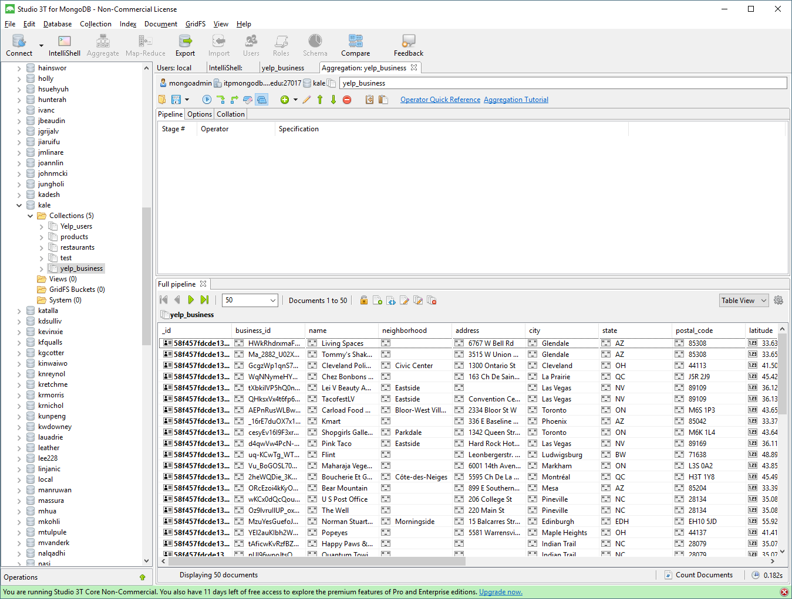

Slide 9
Adding a filter
Add a new stage. Change the Option to Match
We will filter businesses in AZ.
Add the filter { state: “AZ”}. Then execute.
You can also click on Output of Selected Stage to see the output of the current stage.
You can also click on Input of Selected Stage

Slide 10
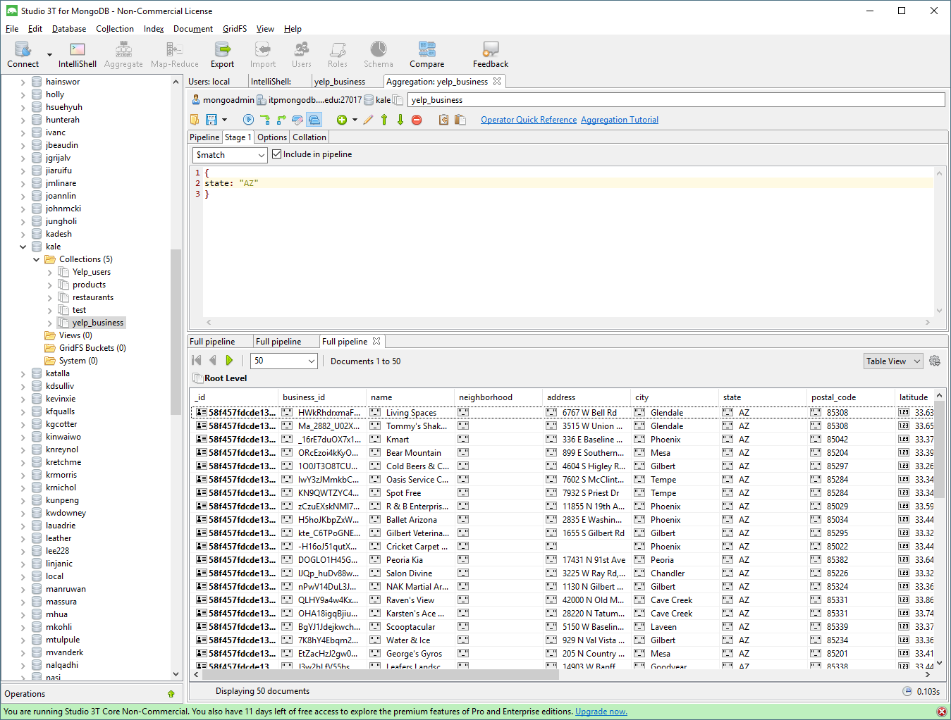

Slide 11
Adding a group
Add a new stage. Change Option to group
Let’s count the number of businesses per postal_code
Add this to the group stage
{
_id: "$postal_code",
numberofbiz: {$sum: 1}
}
Notes:
{
_id: "$postal_code", numberofbiz: {$sum: 1}
}

Slide 12
Group syntax
{ $group:
{ _id: <expression>,
<field1>: { <accumulator1> : <expression1> }, ... }
}

Slide 13
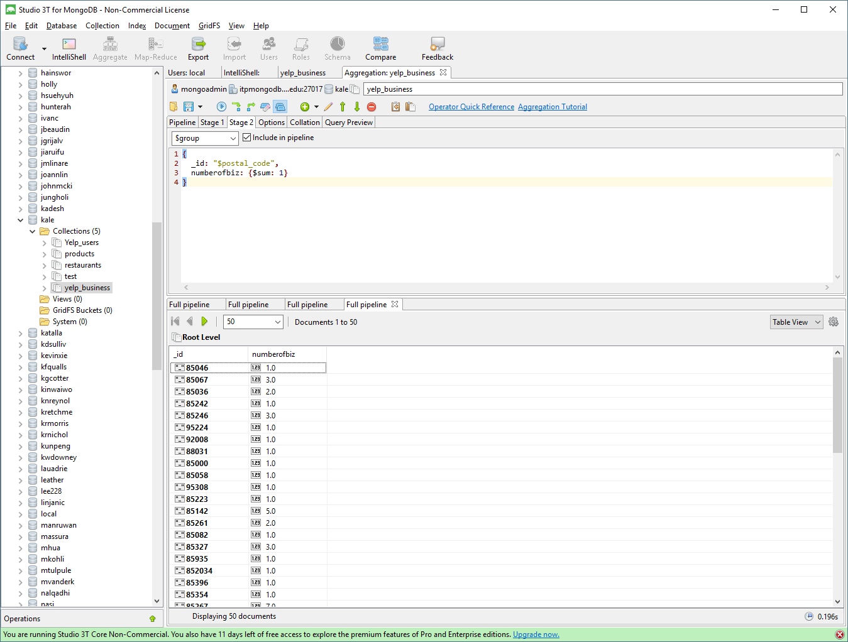

Slide 14
Sort the results
Add a new stage, Option sort
Sort by numberofbiz in descending order
Add the following
{
numberofbiz: -1
}

Slide 15
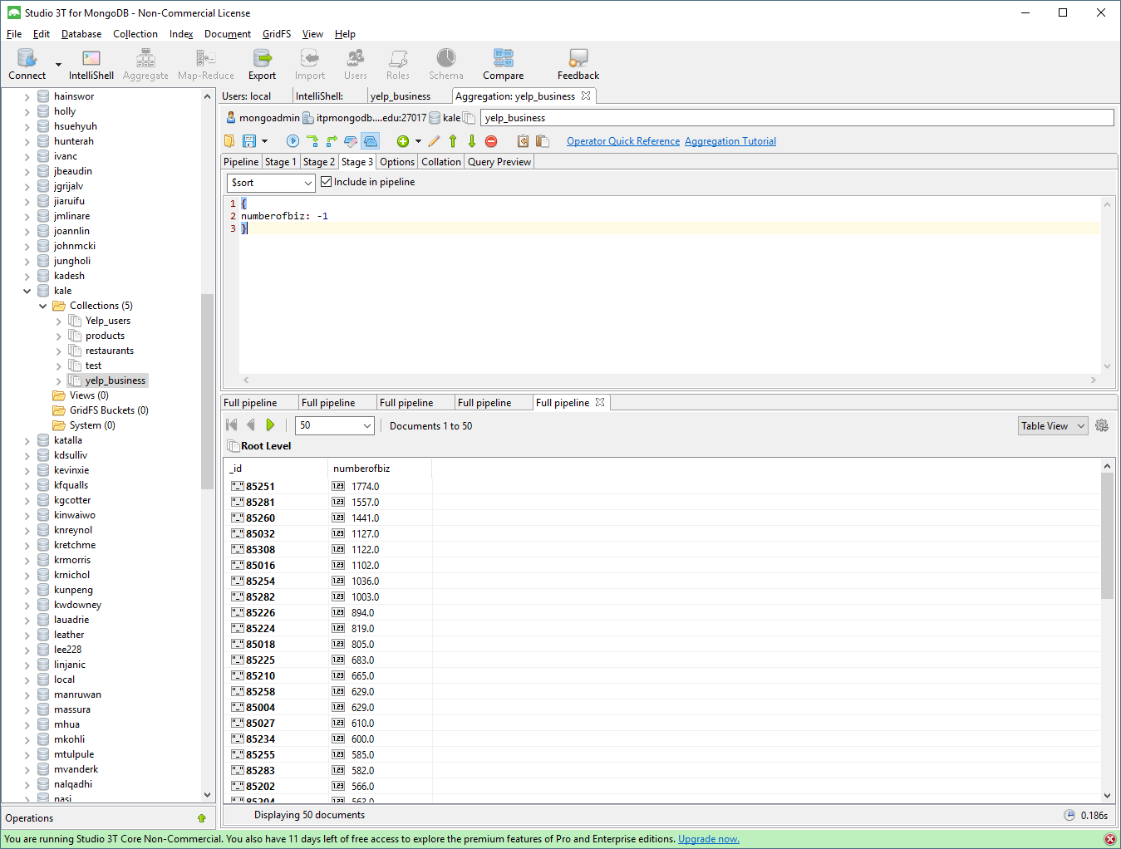

Slide 16
Query
Right click the aggregate pipeline and preview
db.yelp_business.aggregate(
// Pipeline
[
// Stage 1
{
$match: {
state: "AZ"
}
},
// Stage 2
{
$group: {
_id: "$postal_code",
numberofbiz: {$sum: 1}
}
},
// Stage 3
{
$sort: {
numberofbiz: -1
}
},
],

Slide 17
On your own
Limit the results to the top 5 postal codes
Only show postal codes with more than 1000 businesses

Slide 18
Summary
We explored aggregation using Mongo
db.restarurants.aggregate({$project: {name: 1, totalscore: {$sum:
["$field1",
"$field2",
"$field3",
"$field4",
"$field4”
]}}},
{$sort:{totalscore:-1}},
{$limit:1})
Notes:
db.restarurants.aggregate(
{$project: {name: 1, totalscore: {$sum: ["$field1","$field2", "$field3", "$field4", "$field4”]}}},
{$sort:{totalscore:-1}},
{$limit:1})

