Slide 1
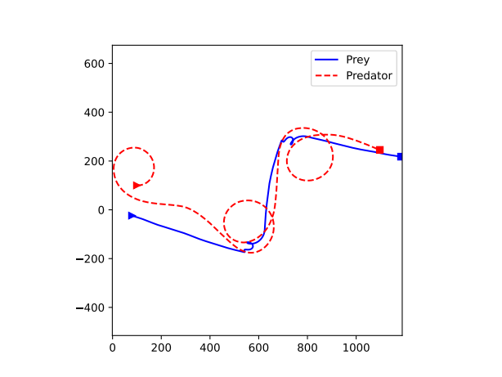
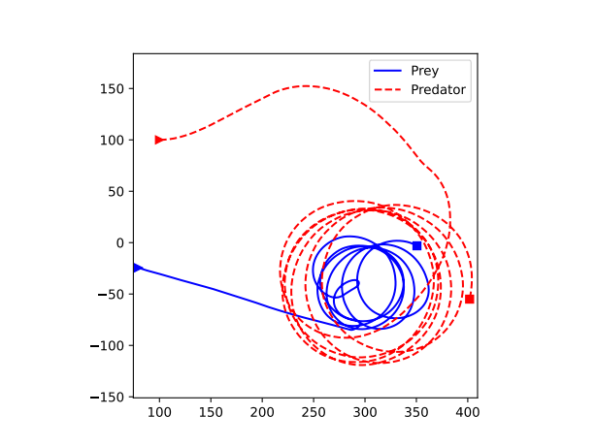
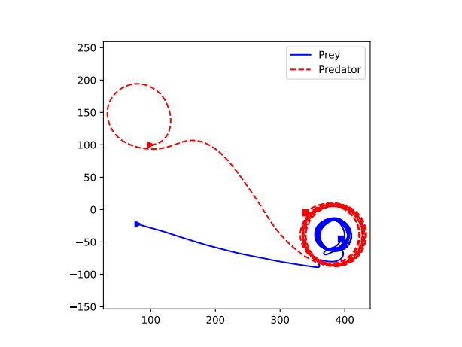
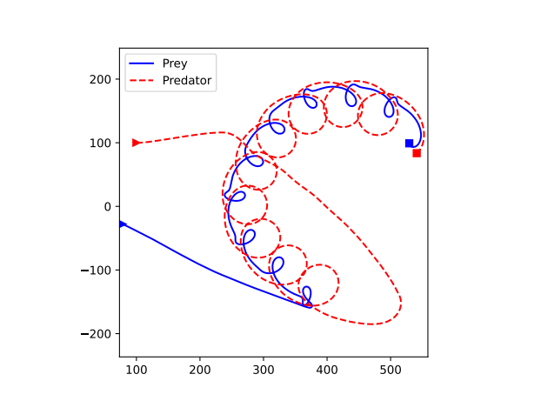
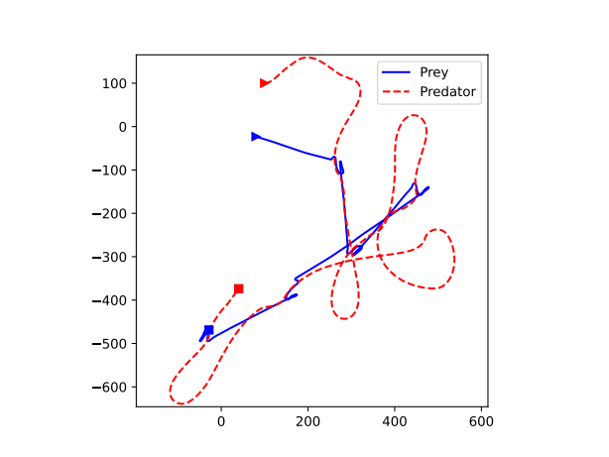
μ < 0.2
μ ≈ [0.2, 0.3]
μ ≈ [0.3, 0.4]
μ ≈ [0.4, 0.5]
μ ≈ [0.5, 0.6]
μ > 0.6

