Slide 1
Lab 4 Convolutional Neural Networks
Simili Abhilash
Sept 27, 2025
CSCIE-89 Deep Learning Professors: Zoran Djordjevic & RAHUL JOGLEKAR

Slide 2
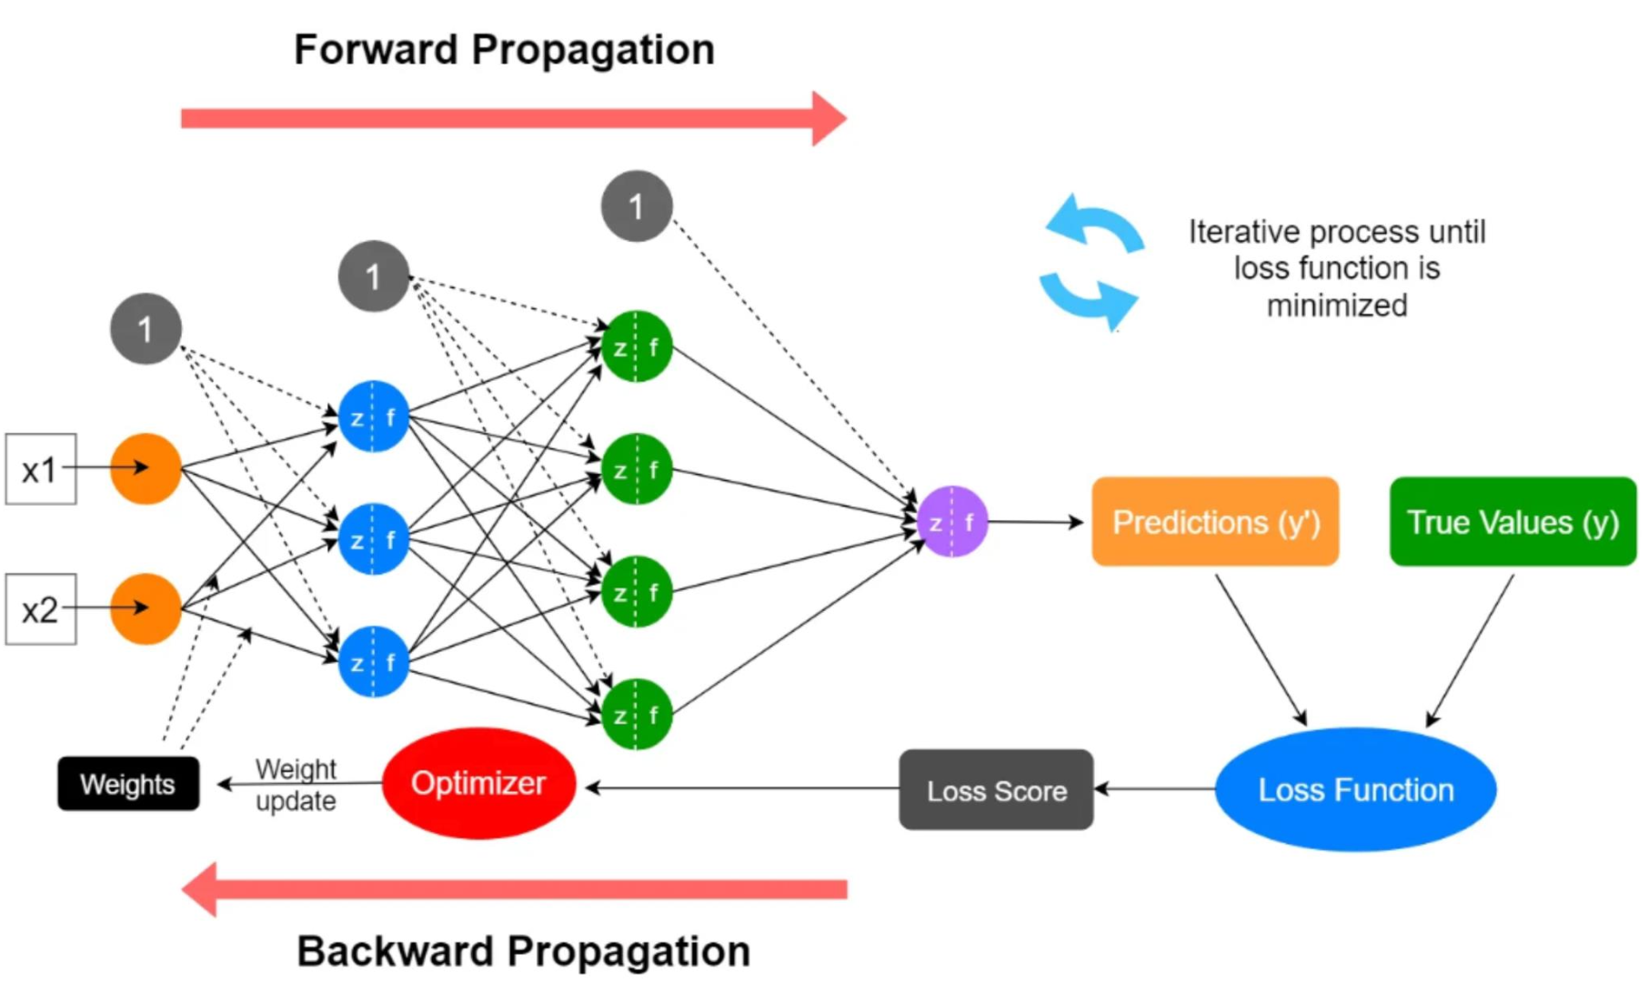
Feed Forward Neural Networks
Activation functions: ReLU, Sigmoid, Softmax etc.
Bias: Constant to adjust the threshold for activation
Weighted sum of inputs + bias
Forward Propagation
Weighted sum of inputs + bias
Apply activation function
Generate predications
Compares to true values
Calculate the loss based on the Loss Function
Backward Propagation
Optimizer adjusts the trainable params (weights and bias), to minimize the loss
Weight updates procedure e.g.: calculate partial derivatives (i.e., find the rate of change of the function with respect to 1 variable, by keeping all other variables constant.)
Optimizers: Stochastic Gradient Descent (SGD), Adam, RMSProp etc.
Loss functions: Mean Squared Error (MSE), Cross Entropy, Cosine Similarity etc.

Slide 3
Feed Forward Neural Networks
Fully Connected, Dense layers
Every input is fed to every neuron
All neurons from one layer are connected to other subsequent layer
Do not scale well
Huge number of parameters – optimization is not easy
Remember the example from lecture: For a 200x200x3 image - neurons in the first fully connected layer would have 200*200*3 = 120,000 weights

Slide 4
Convolutional Neural Networks (Covnets)
Neural Network consisting of convolution layers
Mainly used in computer vision applications (e.g., image classification)
Each neuron in the convolutional layer is connected only to a local region (receptive field) in the input volume
Multiple filters are used to identify features; each detects a type of feature (like edge, horizontal/vertical lines etc.)
A filter which detects a feature at one location in an image, could detect that feature at another location in the same or other images
Preserves spatial information

Slide 5
Convolution Example - Image Scanning
1st Receptive field
(0 + 0 + 0) +
(0 + 0 + -1 ) +
(0+ -1+ 0) = -2
0 | 0 | 0 | 1 | 0
0 | 0 | 1 | 0 | 0
0 | 1 | 0 | 0 | 0
0 | 0 | 0 | 0 | 0
0 | 0 | 0 | 0 | 0
-1 | -1 | -1
-1 | 8 | -1
-1 | -1 | -1
-2
*
3x3
Image Input
Filter / Kernel
Convolution Layer
Filtered Output
5x5
3x3
Filter is applied to the input image through element-by-element multiplication
Multiplies values in the filter with the original pixel values of the image

Slide 6
Convolution Example - Image Scanning
(0 + 0+ -1) +
(0 + 8 + 0 ) +
(-1+ 0 + 0) = 6
2nd Receptive field
(0 + 0 + 0) +
(0 + 0 + -1 ) +
(0+ -1+ 0) = -2
0 | 0 | 0 | 1 | 0
0 | 0 | 1 | 0 | 0
0 | 1 | 0 | 0 | 0
0 | 0 | 0 | 0 | 0
0 | 0 | 0 | 0 | 0
-1 | -1 | -1
-1 | 8 | -1
-1 | -1 | -1
-2 | 6
*
3x3
Image Input
Filter / Kernel
Convolution Layer
Filtered Output
5x5
3x3
Filter slides from 1 receptive field to another – from left to right and up down in strides
This example shows shifting with stride 1 (i.e., 1px). Stride 2 will shift the position by 2 pixels.
A 5x5 input filtered with a 3x3 kernel will produce a 3x3 matrix
This is because the kernel can only be centered at 3x3 = 9 locations without extending beyond the edges of the input matrix. This can be altered by using zero-padding.

Slide 7
Edge Detection in Image Processing
(0 + 0+ -1) +
(0 + 8 + 0 ) +
(-1+ 0 + 0) = 6
(0 + 0 + 0) +
(0 + 0 + -1 ) +
(0+ -1+ 0) = -2
0 | 0 | 0 | 1 | 0
0 | 0 | 1 | 0 | 0
0 | 1 | 0 | 0 | 0
0 | 0 | 0 | 0 | 0
0 | 0 | 0 | 0 | 0
-1 | -1 | -1
-1 | 8 | -1
-1 | -1 | -1
-2 | 6 | -2
7 | -2 | -1
-1 | -1 | 0
……
……
(0 + 0 + 0) +
(0 + 0 + 0 ) +
(0 + 0 + 0) = 0
*
9th Receptive field
(f * g) (t)
3x3
Kernel g(t)
Convolution Layer
Filtered Output /
Activation Map /
Feature Map
Image Input f(t)
5x5
3x3
This mathematical filter is known as Laplacian kernel
Detect edges by computing the derivative of second order of the image's pixel intensities
Highlights areas of rapid pixel intensity change

Slide 8
Params
Trainable Params (what the model adjusts during back propagation)
With one 3x3 filter and a 1-channel input image - the conv layer will have 3*3 = 9 weights + 1 bias = 10 params
With one 3x3 filter and a 3-channel input image – the conv layer will have 3*3*3 = 27 weights + 1 bias = 28 params
With two 3x3 filters and a 3-channel input image - the conv layer will have (3*3*3 = 27 weights + 1 bias) * 2 = 56 params
Hyper Params (what the model is configured with)
Number of layers, number of filters, size of filters
Number of max-pooling layers, size and stride of max pooling layers
Activation functions, Optimizers, Loss functions
Epochs, batch sizes, learning rate
And more…

