Slide 1
Web APIs in ASP.NET Core

Slide 2
ASP.NET frameworks – Similar but different
Web Pages
MVC
Web API
Razor
HTML Helpers
HTML Helpers
Controllers
Controllers
Actions
Actions
Filters
Filters
Model binding
Model binding
DI
DI

Slide 3
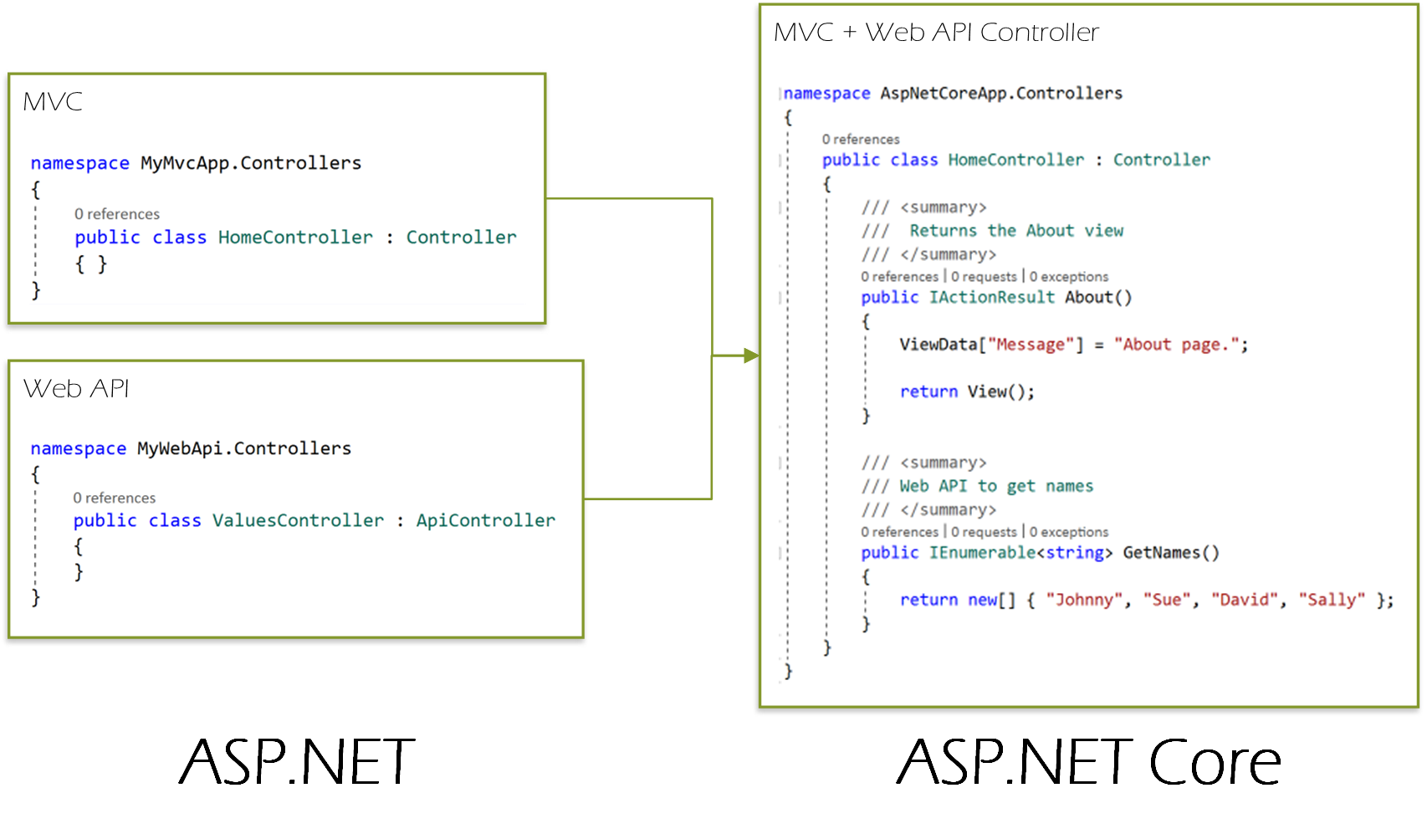
What’s new in ASP.NET Core?
MVC + Web API + Web Pages merged
Controller base is shared
Controllers can return Objects and views!
Notes:
One set of concepts
Focuses on DI

Slide 4
RoutinG
Used to map requests to route handlers
Configured when the application starts up
Can extract values from the URL that will be used for request processing
Also responsible for generating links using the defined routes in ASP.NET apps
https://docs.microsoft.com/en-us/aspnet/core/fundamentals/routing
Notes:
* https://docs.microsoft.com/en-us/aspnet/core/fundamentals/routing
* https://docs.microsoft.com/en-us/aspnet/core/mvc/controllers/routing

Slide 5
HANds on Lab: Web APIs

