Slide 1
Container Basics
Jon Jung

Slide 2
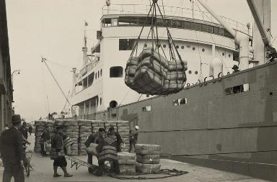
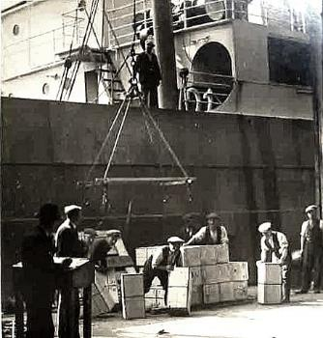
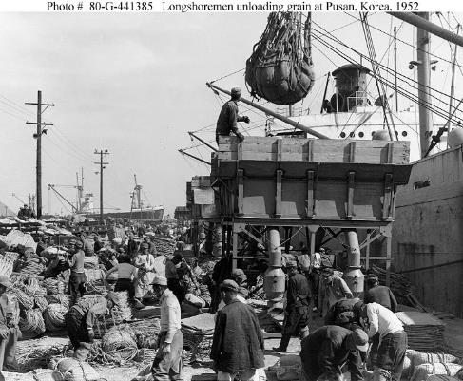
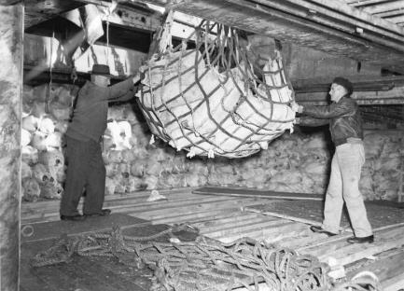
Before Container Standards
Notes:
https://en.wikipedia.org/wiki/Reefer_ship

Slide 3
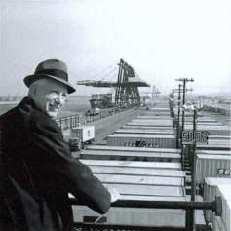
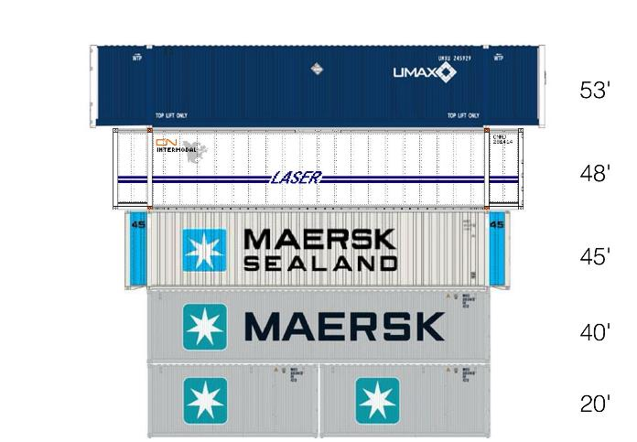
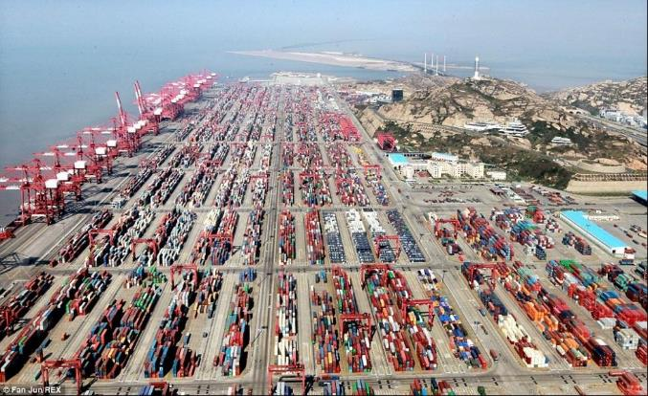
Shipping Containers Invented
In 1956, most cargo was loaded and unloaded by hand. Hand-loading a ship cost $5.86 a ton.
Malcom McLean born in 1913 developed the modern intermodal shipping container, which revolutionized transport and international trade.
McLean knew "A ship earns money only when she's at sea," and based his business on that efficiency.
Using containers, it cost only 16 cents a ton, a 39-fold savings. Containerization also greatly reduced the time to load and unload ships, improving reliability.
https://en.wikipedia.org/wiki/Malcom_McLean

Slide 4

VIRTUAL MACHINES VERSUS CONTAINERS
Host OS - Hardware
Hyper Visor
Application number 1
Application number 2
Application number 3
Guest OS #1 (Virtual Machine)
Guest OS #2
Docker Daemon

Slide 5
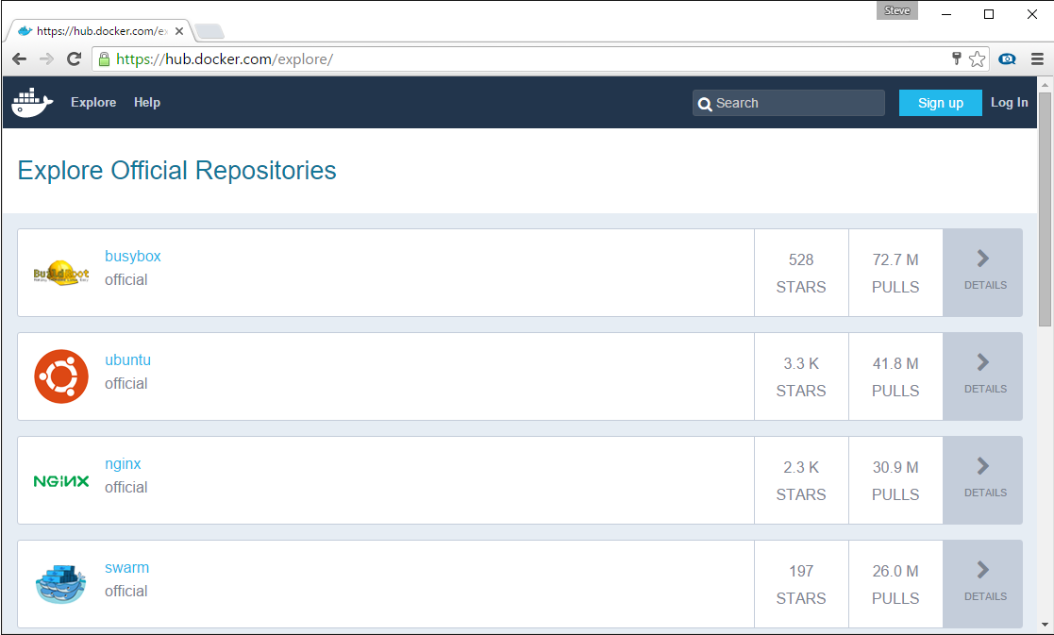
Docker Registry
Stores docker images
Searchable
Public Registry – Hub.Docker.com
Private Registries – Instanced for you
Can be hosted in Docker, Azure, AWS, Google, …

Slide 6
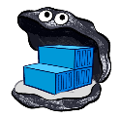










Docker API
Registry
DOCKER_HOST
Private Registry
dockerfile
Docker daemon
FROM microsoft/dotnet:1.0.0-rc2-core
WORKDIR /app
COPY /app /app
ENTRYPOINT dotnet HelloWorld.dll
Containers
Images
Code/Binaries
0001Program.cs110
HelloWorld.dll
111010111011011010
Client
Docker build
Docker run
Docker push

Slide 7
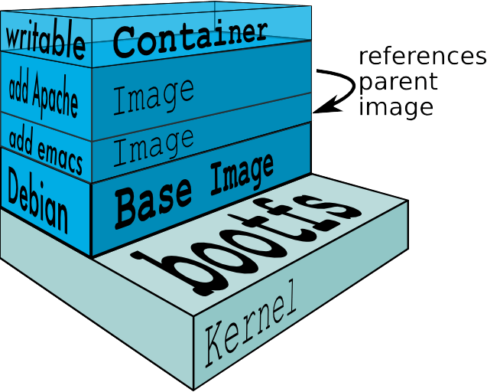
Docker Layers
ImageLayers.io

Slide 8
Persistent Storage
Docker Containers are Immutable
To save data, you must provide external storage
Scenarios:
Logs
Database Files
Inner Loop Development – mounting your source
Volume Drivers

Slide 9
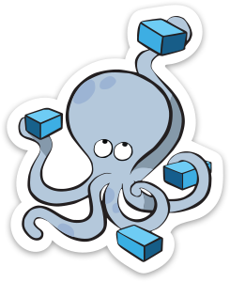



Docker compose
Docker-compose.yml
Registry
version: '2'
services:
multiservice:
image:
- multiservice:latest
environment:
- CustomerAPIService=http://webapi/api/Customer
ports:
- "80:80"
depends_on:
- webapi
webapi:
image:
- multiserviceapi:latest
DOCKER_HOST
Private Registry
Docker daemon
Multi Service
Multi Service
Containers
Images
Multi Service API
Multi Service
Multi Service API
frontend
Dot Net
api
Multi Service API
Client
Docker-compose

Slide 10

Container Workflow
Test
SCC
Registry
Docker-compose
Test.env
CI
Docker-compose.yml
Base Image
Staging
Dockerfile
Build
Docker-compose
Push
Compiled Code
Integration
Client
Stag.env
Int.env
Write/Edit
Docker build
Production
Debug
Docker-compose up
Docker-compose
Docker push
Tests
Run
Prod.env
Local Development Environment

