Slide 1
Breast Density
Supervised approach to learning percentage of FGT density in Breast based on mammograms.

Slide 2
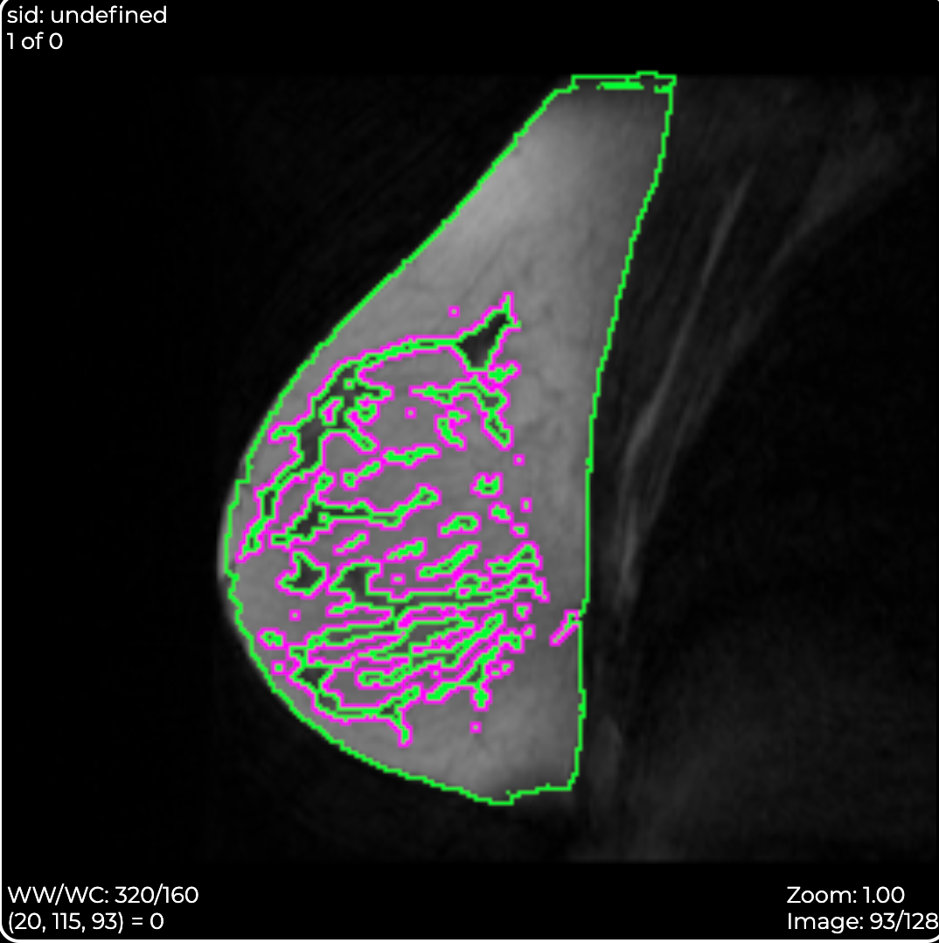
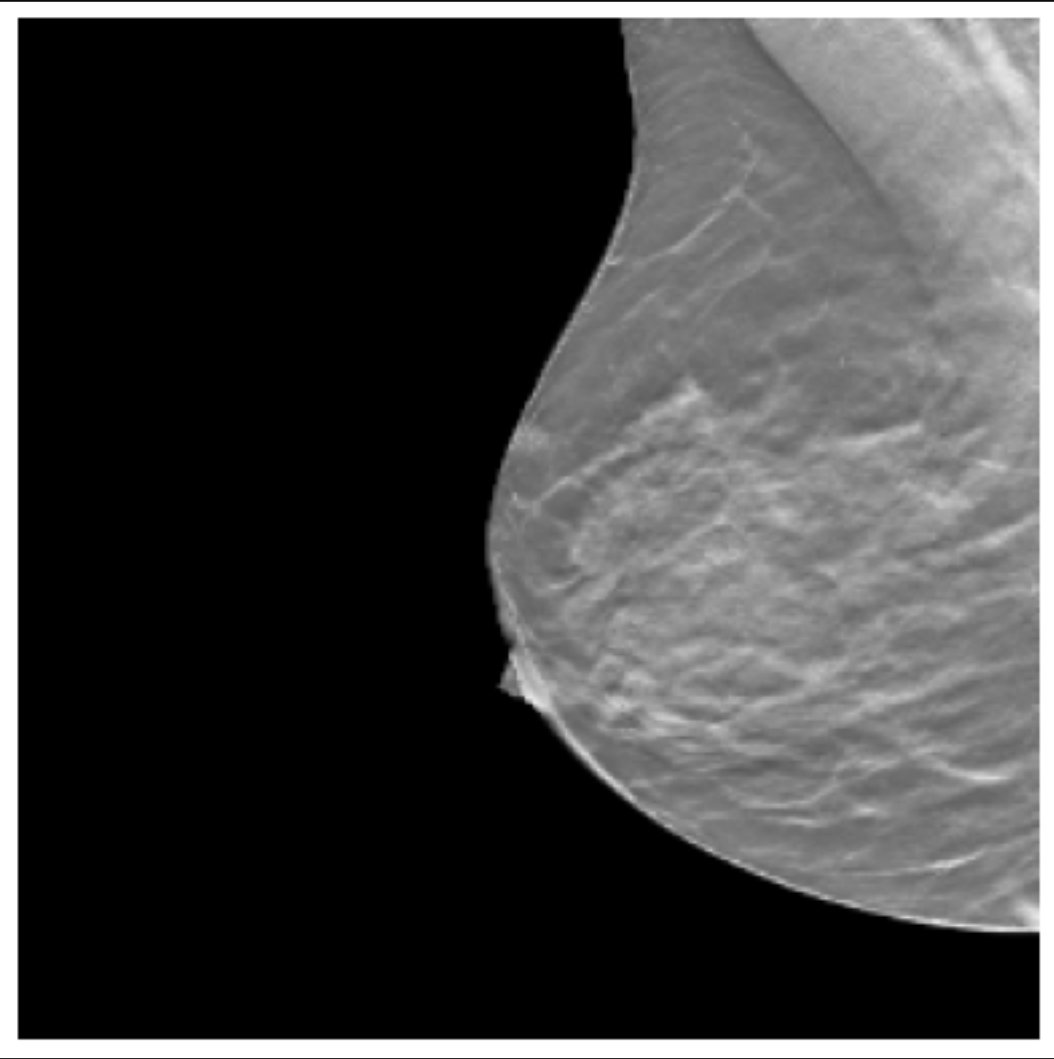
FGT Segmentation → Breast Density
FGT segmentation tool to predict density
Ground truth = 0.3847

Slide 3
Architectures
Simple Linear Regression
Depth/Size
DenseNet
Bottlenecking issue

Slide 4
Initial Results
Metrics:
MAE
MSE
MAPE
Lowest val_loss: 0.04-0.05

Slide 5
Experiments
LR Scheduler – 1% decay rate every 100 steps
Scaling the ground truth
Removed sigmoid activation function
Hyperparameter tuning: L2 regularizer, dropout, # of epochs
Updated results for Linear Regression Model: 0.034-0.025 mae val_loss
Range = [0.0, 0.4]
Scaled by 2.5x
Ground truth
0.3847 ➔ 0.9618

Slide 6
Outliers
Might be due to learning rate scheduler

