Slide 1
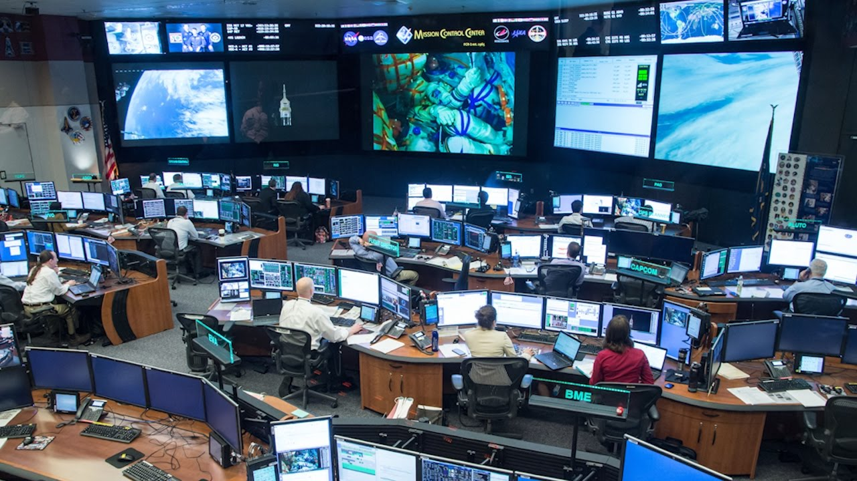
Using Kubernetes
Mission Control for Containers

Slide 2
About Me
Chris Smith
DevOps Engineer
Engineer with 20+ years of IT Professional work experience. A jack-of-all-trades with strong skills in Azure cloud services, MS SQL Server administration, Active Directory, PowerShell, and General Troubleshooting.
Twitter: @chlsmith
Email: csmith@fusionalliance.com

Slide 3
The Points
The Problems with Containers
How Kubernetes Helps
How to actually use Kubernetes without losing your hair

Slide 4
Setting Expectations
Kubernetes Basics
Container 101
DevOps 101
Notes:
We’ll cover basic Kubernetes, not containers or devops. Those are for another time.

Slide 5
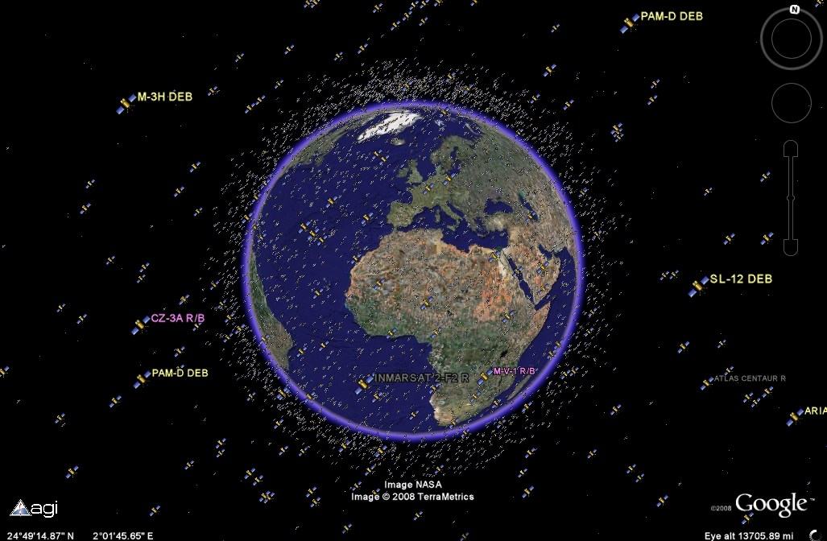
The Problem(s)
Too many containers
Where do you put them?
Too many unknown resource requirements
How do they talk to each other?
How do we make all this work?
Notes:
That’s a picture from Google of the Earth and the artificial satellites in space. Notice how many there are and how it looks like a big mess to manage.
In the age of microservices, the number of “things” that need deploying has grown at a fast pace.
Do you just put them all on one server or do you split them over 20? If you need to split them, how do you decide what goes where?
What if one container on a node goes crazy and eats the memory of an entire server? Everything else dies!
Networking! Networking is hard.
Is this just managed by a team of IT folks?

Slide 6
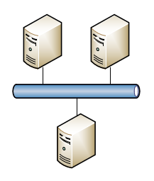
What Kubernetes Does (1 of 2)
Orchestrates the startup, upgrade, monitoring, and replacement of containers
Provides the networking mechanism for the pods to talk to each other
Hopefully you can throw the container out to the cluster and it will “just work.”
Notes:
Thinking about our satellite picture. Someone somewhere has to have a map showing where all the current satellites are located, and hopefully if they are operational or not. That way when we have another satellite to put in space, we will know where it can go and not interfere with the others.

Slide 7
What Kubernetes Does (2 of 2)
Places containers into Pods which get placed onto the appropriate Worker Nodes
Monitors pods and replaces them upon failure
Provides mechanisms for rolling pod upgrades to minimize downtime and for rollbacks upon failures

Slide 8
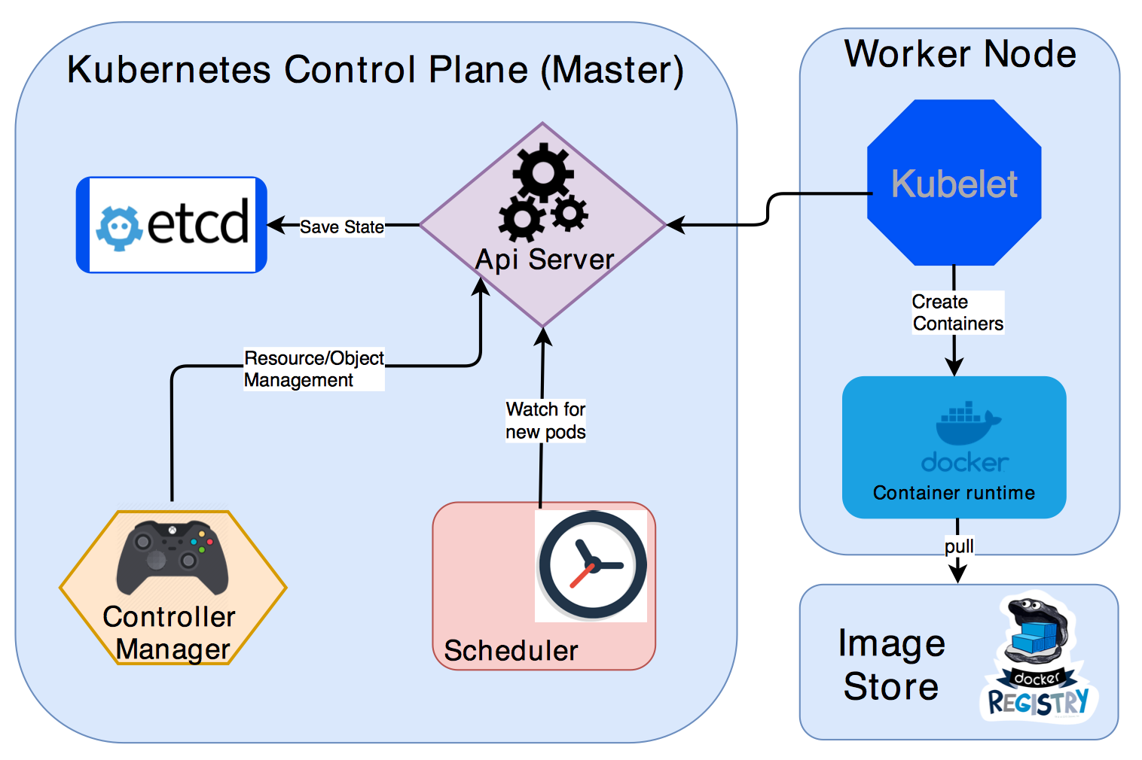
How Kubernetes Does All This
Kubernetes Master Services manage everything for you
Scheduler determines where to place your pods
Worker Nodes run your containers
Notes:
All interactions with k8s happen through the API Server
Etcd is where all the state data of everything in the cluster is stored
The scheduler is the most important part to grasp in terms of “how it works”
Scheduler watches for new pod requests, determines the worker to send the pod to, and then the “kubelet” on the worker creates the pod on using images from some image repository, like Docker Hub or Azure Container Registry
You can scale out your cluster by adding worker nodes, and since the pods can be spread to it immediately, your performance improvement is linear.

Slide 9
Kubernetes Abstracted
Worker Node
Kubernetes
Pod2
Service2
Pod1b
Pod1a
Service1
Ingress2
Deployment 1
Deployment 2
Notes:
A “pod” is the most fundamental object in Kubernetes.
A single pod contains one (or more) containers
Is allocated a single IP address within the cluster. In the case of multiple containers inside a single pod, they share the same address and can actually communicate to each other on address 127.0.0.1. Is monitored to verify that it is either “up” or “down”
A k8s “deployment” is a specific type of object that defines the pod, the containers it has within it, and the number of replicas of each. This way you can create/destroy a deployment that contains multiple objects with a single command.
A k8s “service” is a separate object that provides a single IP address endpoint for a set of pods so you can change out the pods without breaking other apps that are communicating to them. Kinda like a load-balancer inside the cluster. If you have 2 pods behind a single service, and a 3rd pod that needs to communicate to them, it can talk to the “service” and get routed to the appropriate pod.
A k8s “ingress” object is external to the Service and is configured to allow inbound access to the service or pod with an address on the outside of the cluster.

Slide 10
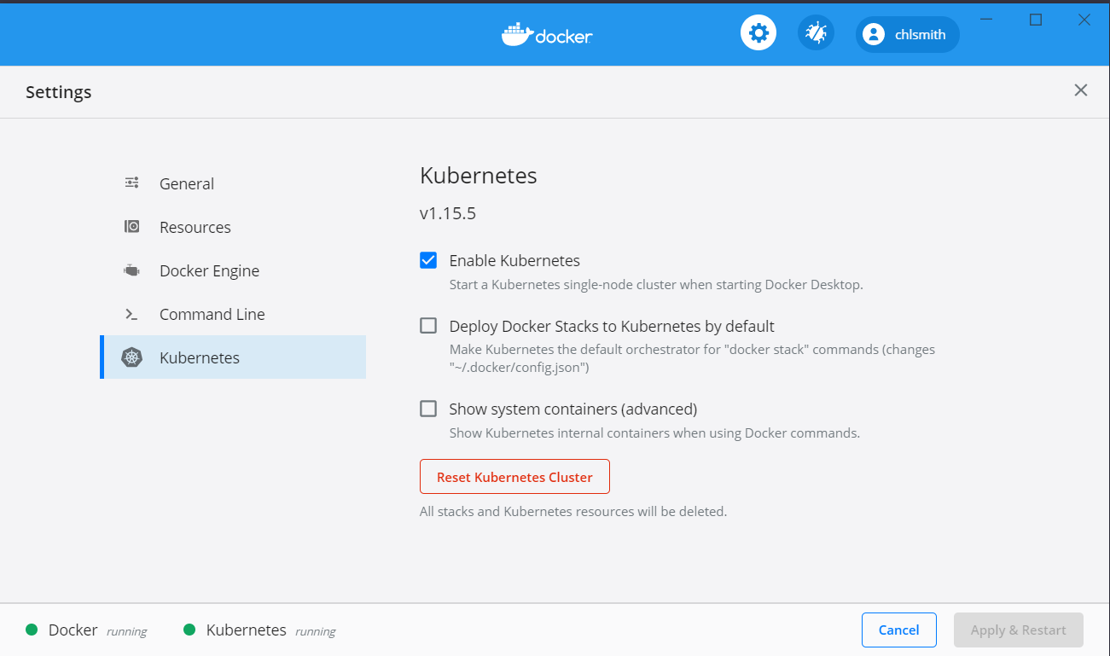
Running K8S on Your Own
Built-in Kubernetes with Docker for Windows (https://docs.docker.com/docker-for-windows/kubernetes/)
Use your favorite cloud vendor:
Azure Kubernetes Service
AWS Elastic Kubernetes Service
Google Kubernetes Engine

Slide 11
Interacting with Kubernetes
Install kubectl on your workstation
https://kubernetes.io/docs/tasks/tools/install-kubectl/
Pronounced all kinds of ways: https://github.com/saada/kubectl-pronounciation
Command | Purpose
Kubectl config get-context/use-context | Switches your client from one k8s cluster context to another
Kubectl get pods | Lists the pods running in the cluster
Kubectl get services | Lists the service running in the cluster
Kubectl port-forward | Forwards a local TCP port to a port on a service or pod within the cluster so you can interact with the running application

Slide 12

Now What?
Notes:
So you now a bit about what Kubernetes is and how to interact with it. You know that you CAN put your containers on it and run them. But how do you do that? One answer is HELM.

Slide 13
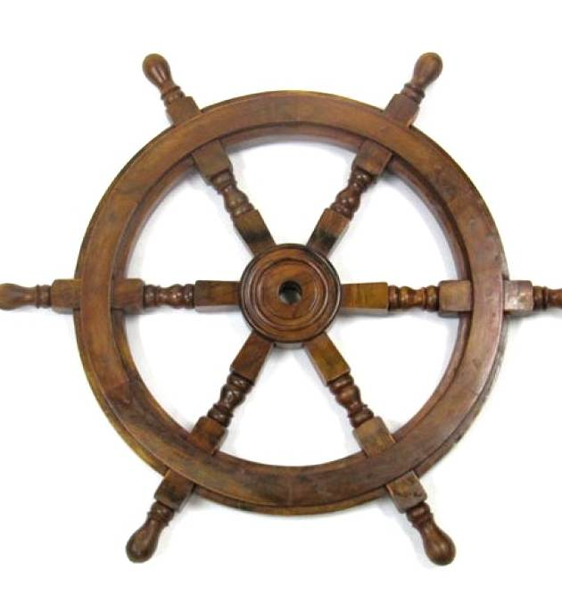
Helm
“The Package Manager for Kubernetes” – from Helm Website
YAML-based Charts define your deployments
Charts can be shared and many are publicly available

Slide 14
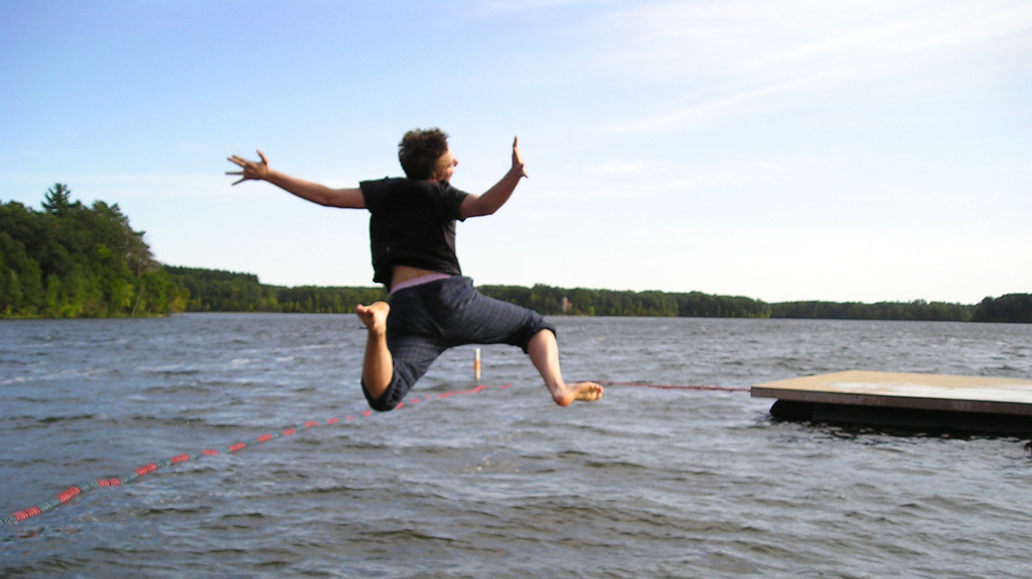
Demo
Notes:
Diving right in:
MSSQL
helm repo add stable https://kubernetes-charts.storage.googleapis.com/
helm install mymssql stable/mssql-linux --set acceptEula.value=Y --set edition.value=Developer --set sapassword=P@ssW0rd
kubectl get pods
kubectl get services
kubectl port-forward service/mymssql-mssql-linux 1433:1433
GRAFANA
helm repo add bitnami https://charts.bitnami.com/bitnami
helm install my-Grafana bitnami/Grafana
kubectl port-forward my-grafana-grafana 8080:80

Slide 15
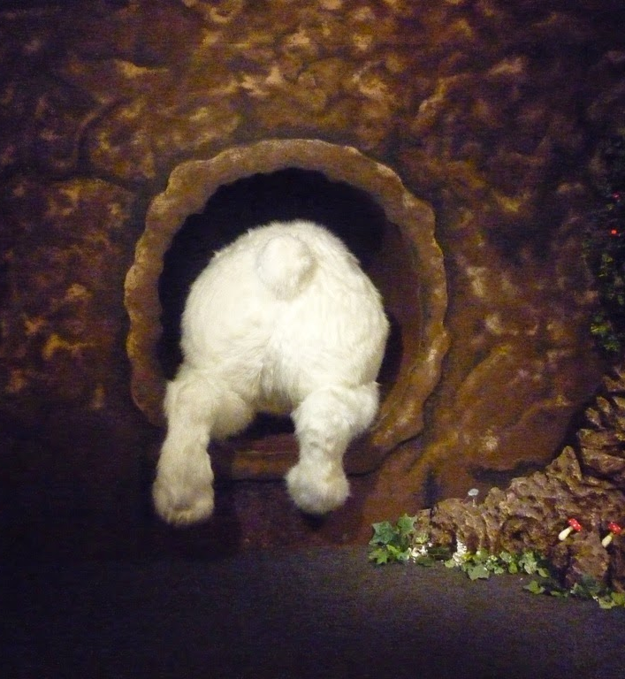
More Information
Kubernetes Documentation
https://kubernetes.io/docs/home/
Helm Documentation
https://helm.sh/docs/
Tons of Helm Charts
https://hub.helm.sh/
Kubernetes the Hard Way
https://github.com/kelseyhightower/kubernetes-the-hard-way
Kubernetes Up and Running
https://azure.microsoft.com/en-us/resources/kubernetes-up-and-running/
Notes:
Go down the rabbit hole

Slide 16

Questions?

