Slide 1
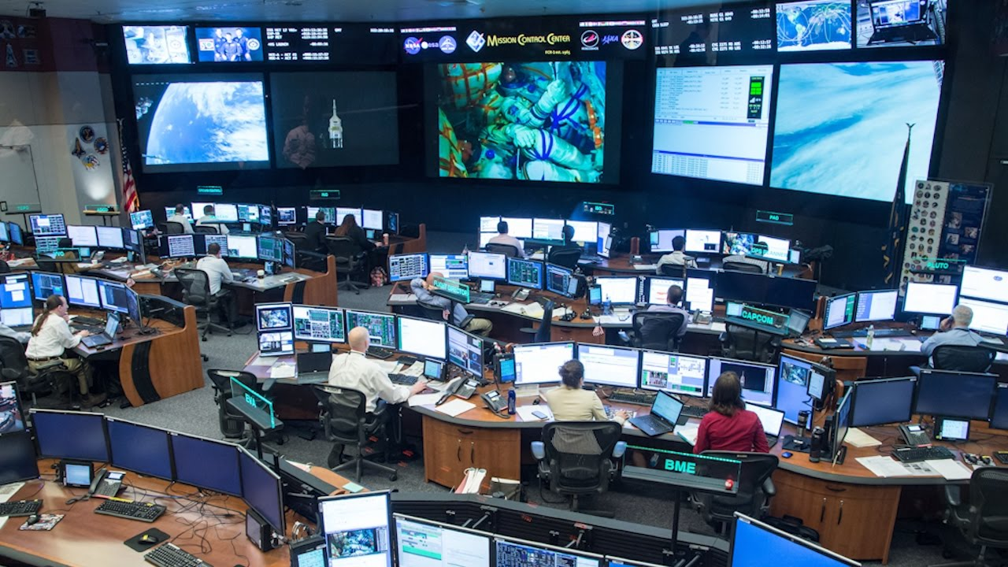
Using Kubernetes
Mission Control for Containers

Slide 2
About Me
Chris Smith
DevOps Engineer
Engineer with 20+ years of IT Professional work experience. A jack-of-all-trades with strong skills in Azure cloud services, MS SQL Server administration, Active Directory, PowerShell, and Troubleshooting.
Twitter: @chlsmith
Email: csmith@fusionalliance.com

Slide 3
The Points
The Problem
How Kubernetes Helps
How to actually use Kubernetes without losing your hair

Slide 4
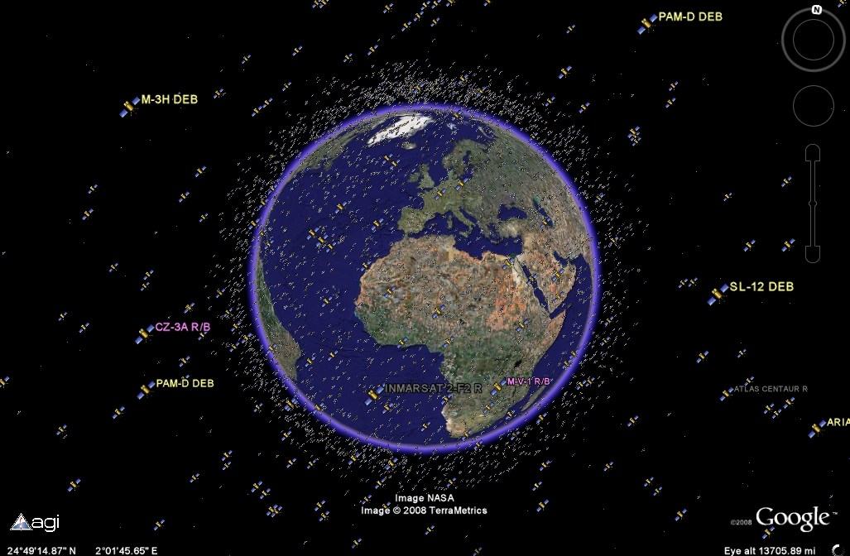
The Problem(s)
Too many containers
Too many places to put them
Too many unknown resource requirements
How do we make all this work?

Slide 5
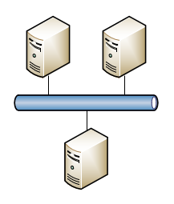
What Kubernetes Does (1 of 2)
Provides management of container deployments
Provides a communication mechanism for the pods to talk to each other

Slide 6
What Kubernetes Does (2 of 2)
Places containers into Pods which get placed onto the appropriate Worker Nodes
Monitors pods and replaces them upon failure
Provides mechanisms for rolling pod upgrades to minimize downtime and for rollbacks upon failures

Slide 7
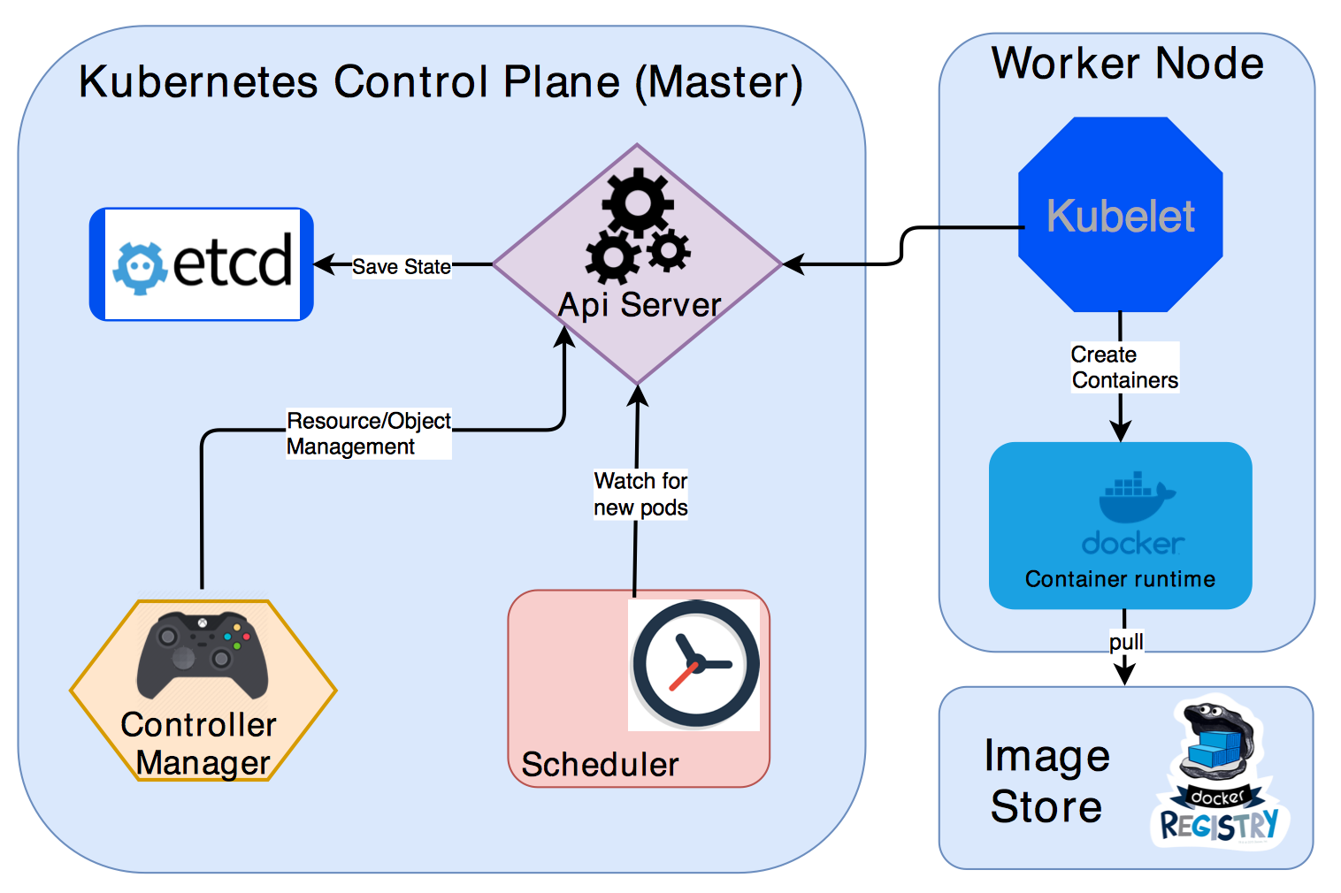
How Kubernetes Does All This
Kubernetes Master Services manage everything for you
Scheduler determines where to place your pods
Worker Nodes run your containers

Slide 8
Kubernetes Abstracted
Deployment 1
Deployment 2
Worker Node
Kubernetes
Pod2
Service2
Pod1b
Pod1a
Service1

Slide 9
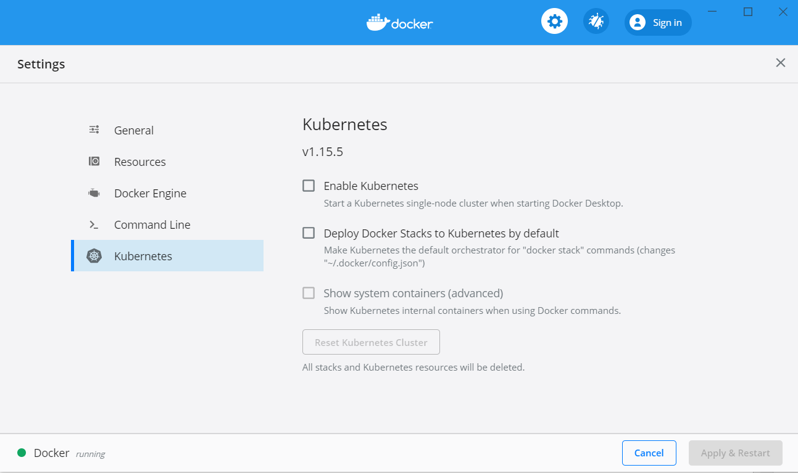
Running K8S on Your Own
Minikube (https://github.com/kubernetes/minikube)
Built-in Kubernetes with Docker for Windows (https://docs.docker.com/docker-for-windows/kubernetes/)

Slide 10

Now What?

Slide 11
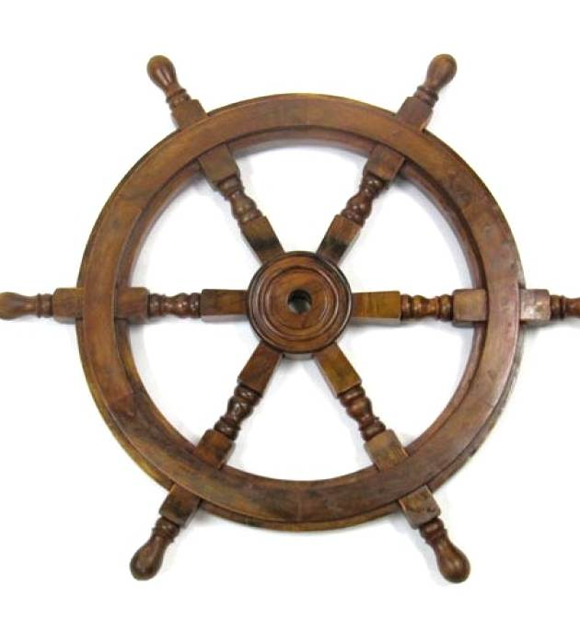
Helm
“The Package Manager for Kubernetes” – from Helm Website
“Like apt for Kubernetes” - from other talks
YAML-based Charts define your deployments
Charts can be shared!

Slide 12
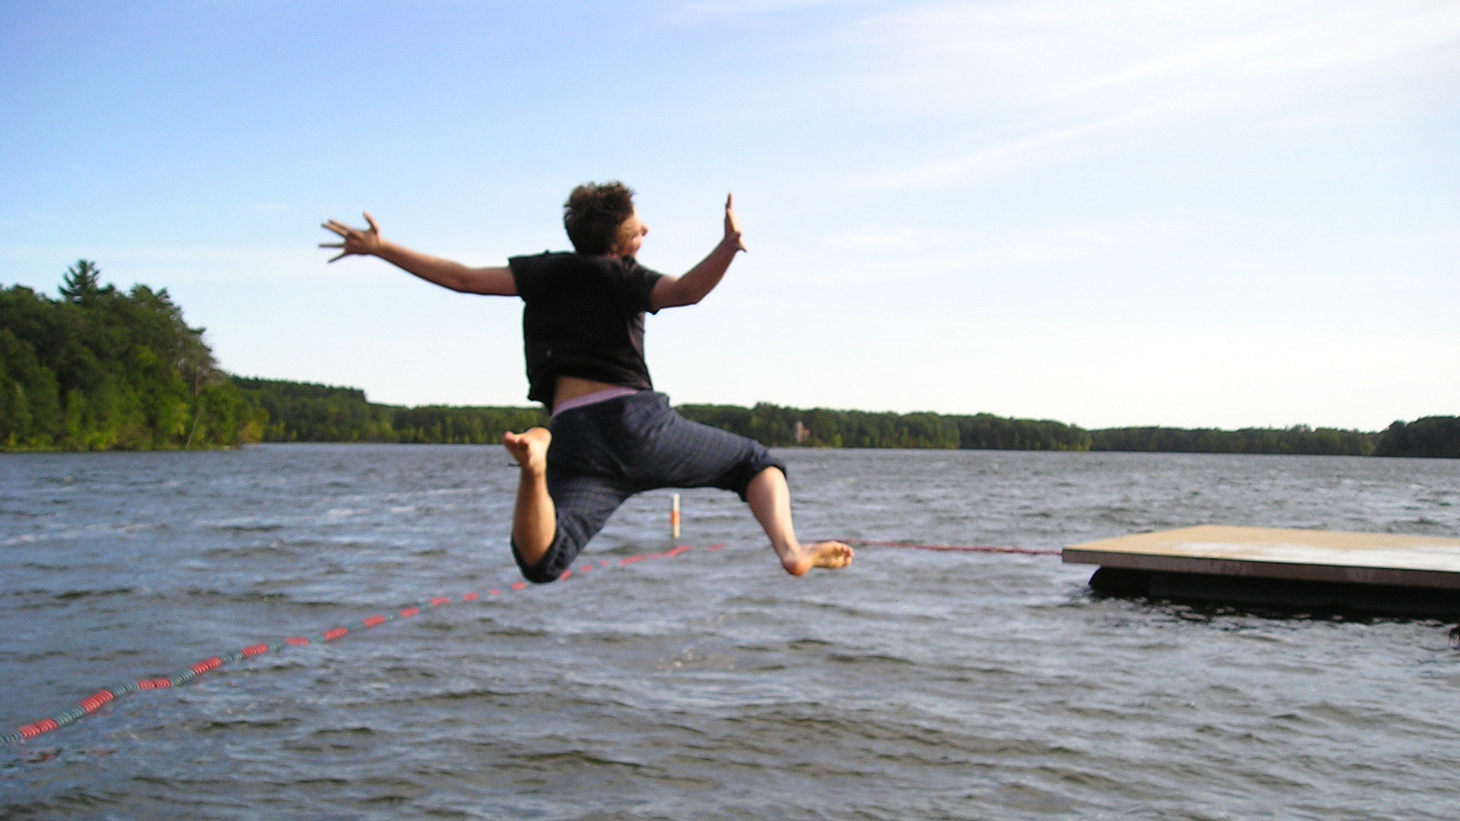
Demo

Slide 13
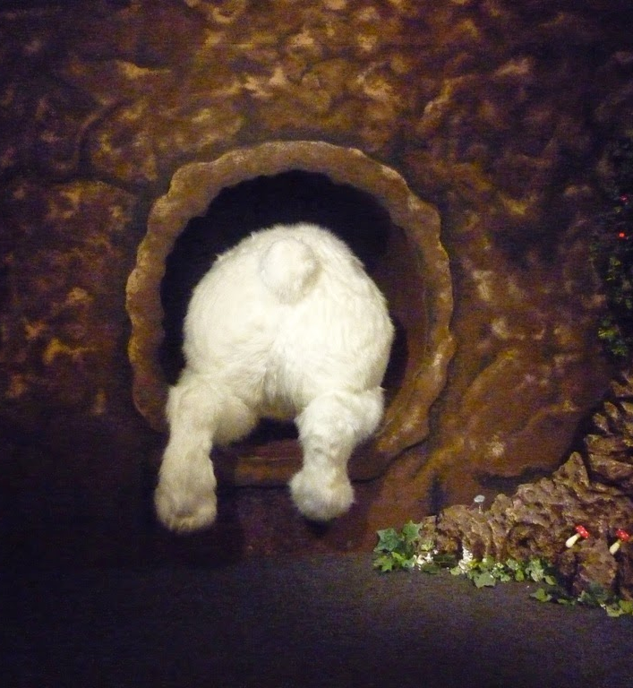
More Information
Kubernetes Documentation
https://kubernetes.io/docs/home/
Helm Documentation
https://helm.sh/docs/
Tons of Helm Charts
https://hub.helm.sh/
Kubernetes Up and Running
https://azure.microsoft.com/en-us/resources/kubernetes-up-and-running/

