Slide 1
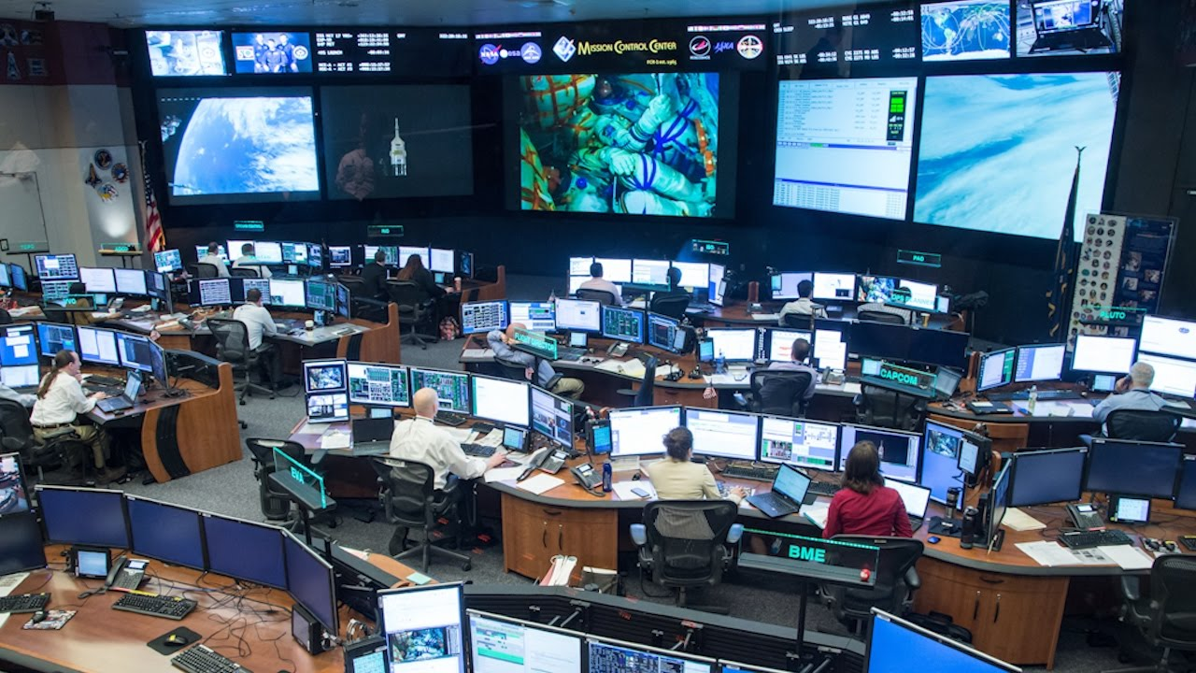
Using Kubernetes
Mission Control for Containers

Slide 2
About Me
Chris Smith
DevOps Engineer
Engineer with 20+ years of IT Professional work experience. A jack-of-all-trades with strong skills in Azure cloud services, MS SQL Server administration, Active Directory, PowerShell, and Troubleshooting.
Twitter: @chlsmith
Email: csmith@fusionalliance.com

Slide 3
The Points
The Problem
How Kubernetes Helps
How to actually use Kubernetes without losing your hair

Slide 4
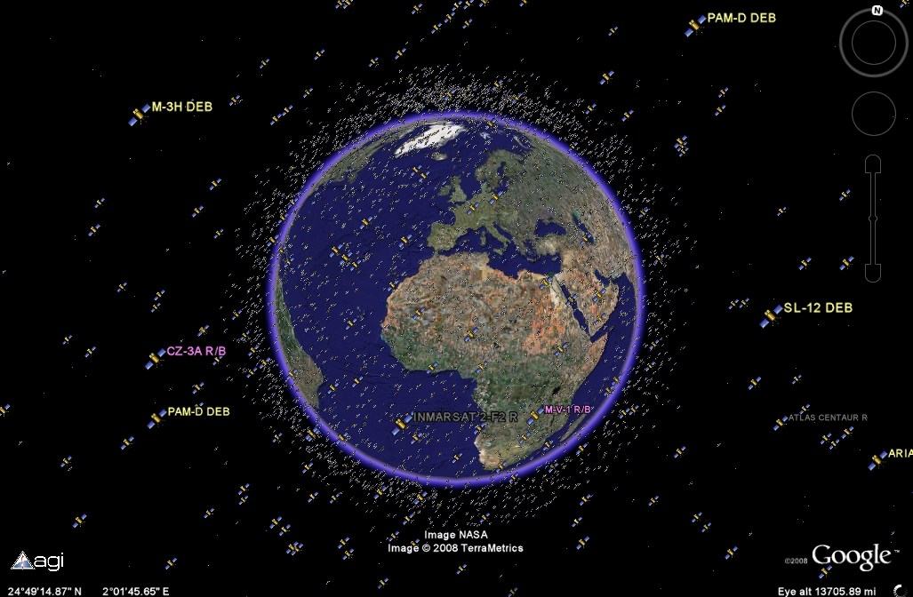
The Problem(s)
Too many containers
Too many places to put them
Too many unknown resource requirements
How do we make all this work?

Slide 5
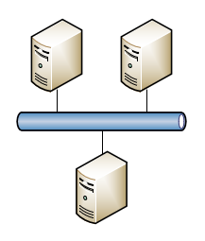
What Kubernetes Does (1 of 2)
Provides management of container deployments
Provides a communication mechanism for the pods to talk to each other

Slide 6
What Kubernetes Does (2 of 2)
Places containers into Pods which get placed onto the appropriate Worker Nodes
Monitors pods and replaces them upon failure
Provides mechanisms for rolling pod upgrades to minimize downtime and for rollbacks upon failures

Slide 7
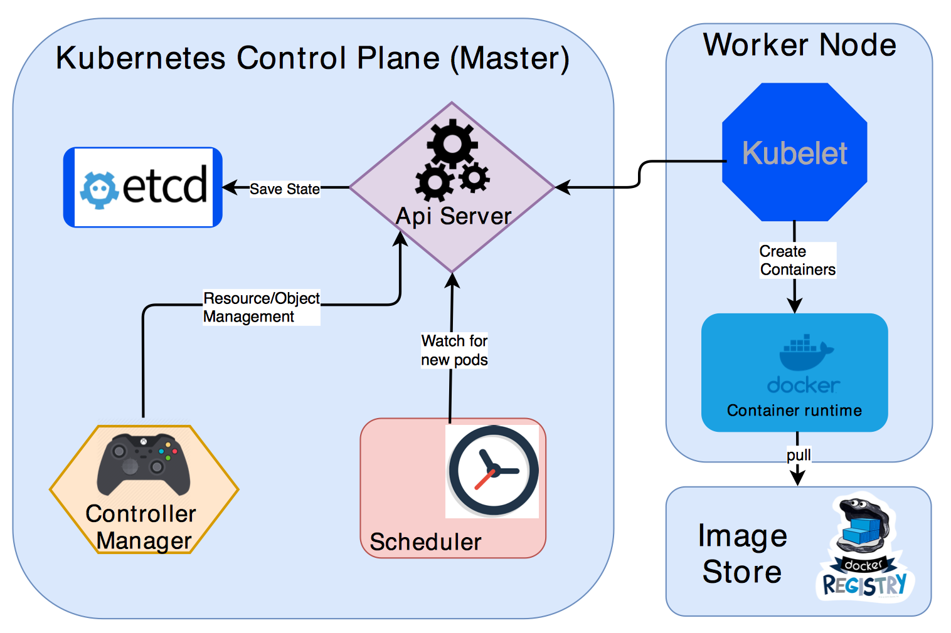
How Kubernetes Does All This
Kubernetes Master Services manage everything for you
Scheduler determines where to place your pods
Worker Nodes run your containers

Slide 8
Kubernetes Abstracted
Deployment 1
Deployment 2
Worker Node
Kubernetes
Pod2
Service2
Pod1b
Pod1a
Service1

Slide 9
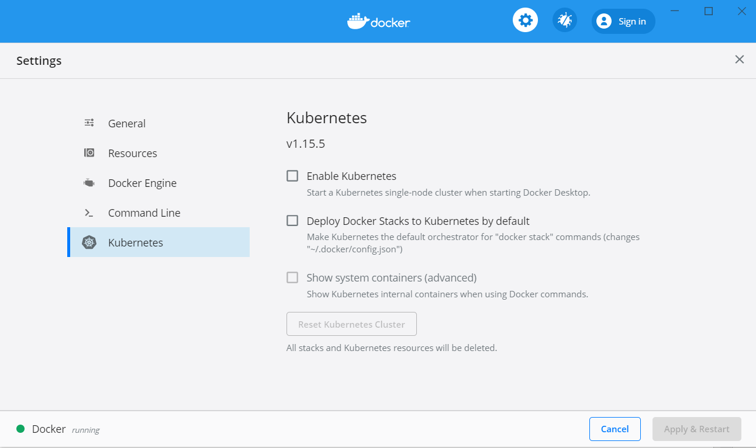
Running K8S on Your Own
Minikube (https://github.com/kubernetes/minikube)
Built-in Kubernetes with Docker for Windows (https://docs.docker.com/docker-for-windows/kubernetes/)

Slide 10
Interacting with Kubernetes
Install kubectl
https://kubernetes.io/docs/tasks/tools/install-kubectl/
Pronouced all kinds of ways: https://github.com/saada/kubectl-pronounciation
Command | Purpose
Kubectl get pods | Lists the pods running in the cluster
Kubectl get services | Lists the service running in the cluster
Kubectl port-forward | Forwards a local TCP port to a port on a service or pod within the cluster so you can interact with the running application
Kubectl config get-context/use-context | Switches your client from one k8s cluster to another

Slide 11

Now What?

Slide 12
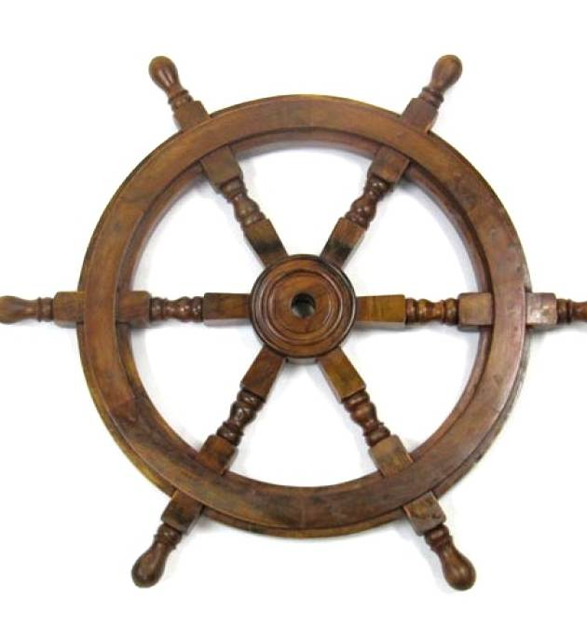
Helm
“The Package Manager for Kubernetes” – from Helm Website
“Like apt for Kubernetes” - from other talks
YAML-based Charts define your deployments
Charts can be shared

Slide 13

Demo
Notes:
MSSQL
helm repo add stable https://kubernetes-charts.storage.googleapis.com/
helm install mymssql stable/mssql-linux --set acceptEula.value=Y --set edition.value=Developer --set sapassword=P@ssW0rd
kubectl get pods
kubectl get services
kubectl port-forward service/mymssql-mssql-linux 1433:1433
JENKINS
helm repo add bitnami https://charts.bitnami.com/bitnami
helm install my-release bitnami/jenkins
kubectl port-forward my-release-jenkins 8080:80

Slide 14
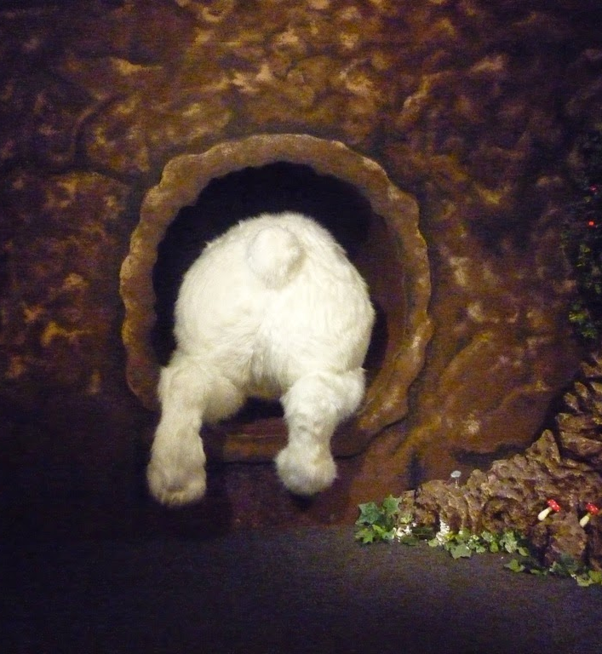
More Information
Kubernetes Documentation
https://kubernetes.io/docs/home/
Helm Documentation
https://helm.sh/docs/
Tons of Helm Charts
https://hub.helm.sh/
Kubernetes Up and Running
https://azure.microsoft.com/en-us/resources/kubernetes-up-and-running/

