Slide 1

A Better Way to Run MsSql
Can You Believe This is Even Possible?!?!

Slide 2
About Me
Chris Smith
DevOps Engineer
Engineer with 20+ years of IT Professional work experience. A jack-of-all-trades with strong skills in Azure cloud services, MS SQL Server administration, Active Directory, PowerShell, and Troubleshooting.
Twitter: @chlsmith
Email: chlsmith@outlook.com
LinkedIn: https://www.linkedin.com/in/christopher-smith-54467a3/

Slide 3
The Problem(s)
Workstation Setup
GSD (Getting Stuff Done)
Leftover Junk
Notes:
Workstation setup: Devs and Admins require a ton of special software
Leftover Junk: When you remove apps or data, things get left out there sometimes.
GSD: You need things to be available when you need them and not when they’re not.

Slide 4
The Points
The basics how to run Docker containers locally.
How to get Sql Server for Linux running on it.
How to connect to it locally for your development needs.

Slide 5
How You Probably Work
Hardware
Operating System
MS Sql Server (Dev Edition)
SSMS
Other Apps
Notes:
Running every piece of your environment “locally”

Slide 6
Another Way You Might Work
Hardware
Host Operating System
Some Virtualization App (VirtualBox or Vmware or Hyper-V)
Virtual Operating System
Other Apps
Ms Sql Server
SSMS
Some Other Apps on your Host OS
Notes:
Running some things in VMs on your local machine.

Slide 7
Docker: A New Way
Adds an isolation layer between your operating system and your apps
Still allows other apps on the host OS that can interact with what is running in Docker
Hardware
Host Operating System
Docker
Other Apps
Ms Sql Server
SSMS
Notes:
Docker baby, yeah!!

Slide 8
Why switch?
Containers are lighter weight than full virtual operating systems
Docker containers are built of a collection of very small image “layers”, so new commits are small.
Images can be pushed to remote repos (Docker Hub, Azure Container Registry, etc) for sharing
Notes:
The last point is the main point here. Share Share Share

Slide 9
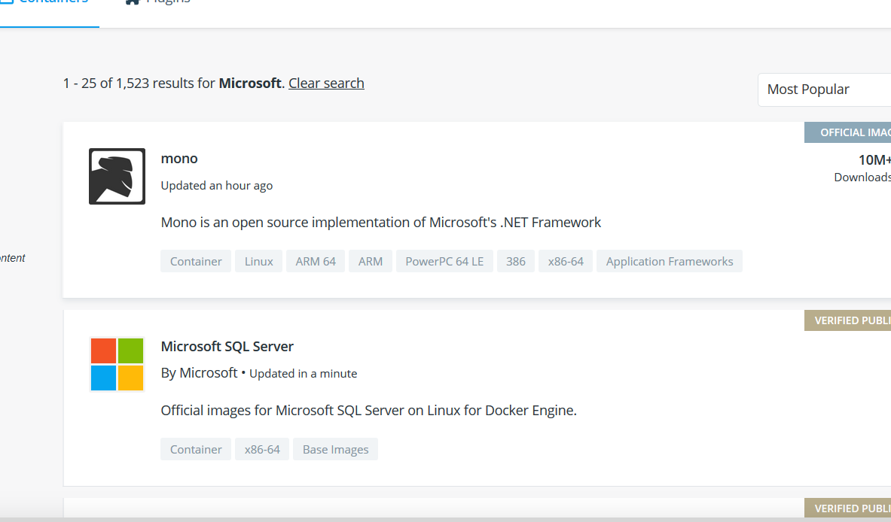
Free Docker Images
https://hub.docker.com

Slide 10
Docker Support on Windows 10
Available for Windows 10 64-bit Pro, Enterprise, or Education (Build 15063 or later)
Hyper-V and Containers features must be enabled
https://docs.docker.com/docker-for-windows/install/
Notes:
Available for Windows 10 Home edition, too, but requires the most recent versions with WSL2.

Slide 11
Special Considerations
Networking
Main Network
Docker Network
App1
App2
App3
Volume Mounts
Shared between Host OS and container
Allows for data persistence when containers are dropped
Watch for AV or Firewall tools that might block this
Notes:
Networking is always hard. Docker doesn’t create a network for your containers, so they just run isolated unless you forward a port from your local machine into them.
Storage is NOT persistent inside a container, so if you have things you want to last when containers are removed, you need to mount that into the container via the command line when you start it.

Slide 12

Demo
Notes:
1. Install Docker for Windows and all prerequisites
2. Pull the mssql-for-linux image
docker pull mcr.microsoft.com/mssql/server:2019-CU4-ubuntu-16.04
3. Run the image
docker run -e "ACCEPT_EULA=Y" -e “SA_PASSWORD=<YourStrong@Passw0rd>" -p 1433:1433 --name sql1 -d mcr.microsoft.com/mssql/server:2019-CU4-ubuntu-16.04
4. Connect with your favorite management app

Slide 13
More Uses
Development Tools
Build image with all your tooling in it, save the image, and use it anywhere on any system
Testing Environments
When you drop and remove a container, IT’S GONE!! No more cleanup tasks necessary.
Experimentation

Slide 14

More Fun Things
Windows Subsystem for Linux
https://docs.microsoft.com/en-us/windows/wsl/install-win10
Docker Integration with WSL https://docs.docker.com/docker-for-windows/wsl-tech-preview/
Kubernetes. Swarm. Nomad. https://www.weave.works/blog/comparing-container-orchestration/

Slide 15
QUESTIONS?
https://github.com/chlsmith/sql-on-docker

