Slide 1
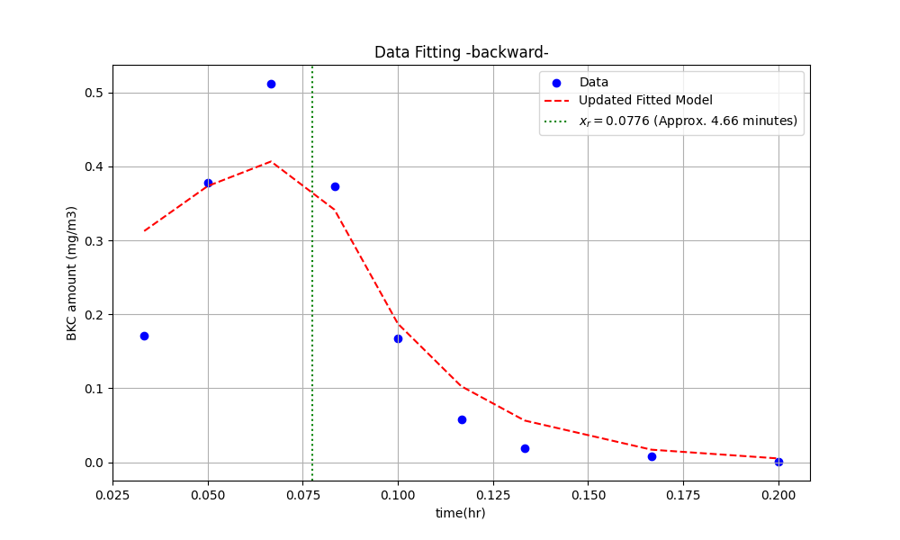
Fitted Equation:
y = a/b(1-e^(-bx)) for x <= xr
y = a/b(1-e^(-bxr))e^(-b(x-xr)) for x > xr
where a = 16.12, b = 36.04
Figure of merit:
Coefficient of Determination (R²) = {r_squared_fixed_xr:.2f}
Sum of Squared Errors (SSE) = 0.04
Value of Vs and Fair:
Vs = 53.07 m/hr
Fair = 0.0014

