Slide 1
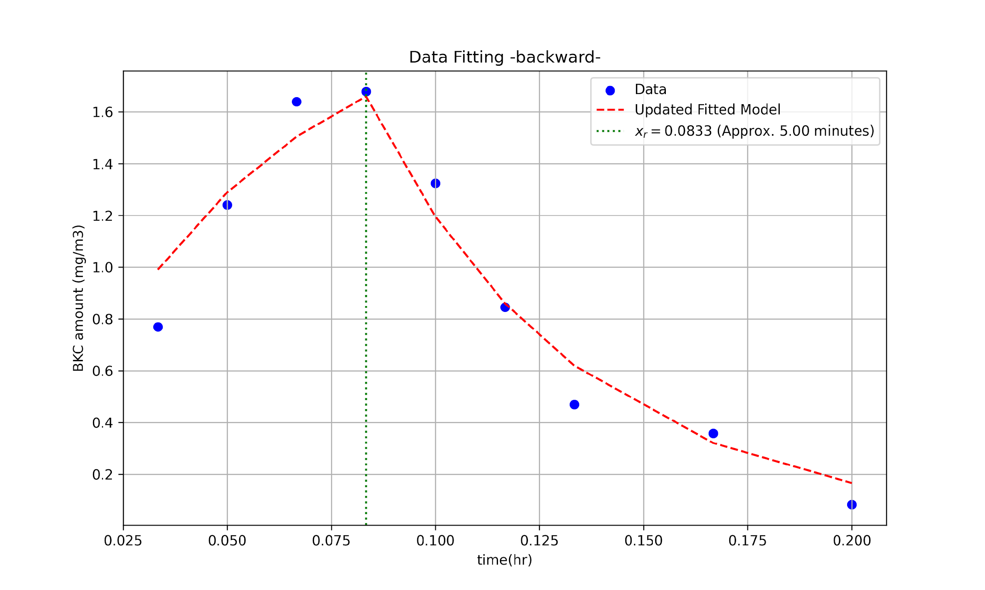
Fitted Equation:
y = a/b(1-e^(-bx)) for x <= xr
y = a/b(1-e^(-bxr))e^(-b(x-xr)) for x > xr
where a = 40.53, b = 19.69
Figure of merit:
Coefficient of Determination (R²) = 0.86
Sum of Squared Errors (SSE) = 0.04
Value of Vs and Fair:
Vs = 28.54 m/hr
Fair = 0.0036

