Slide 1
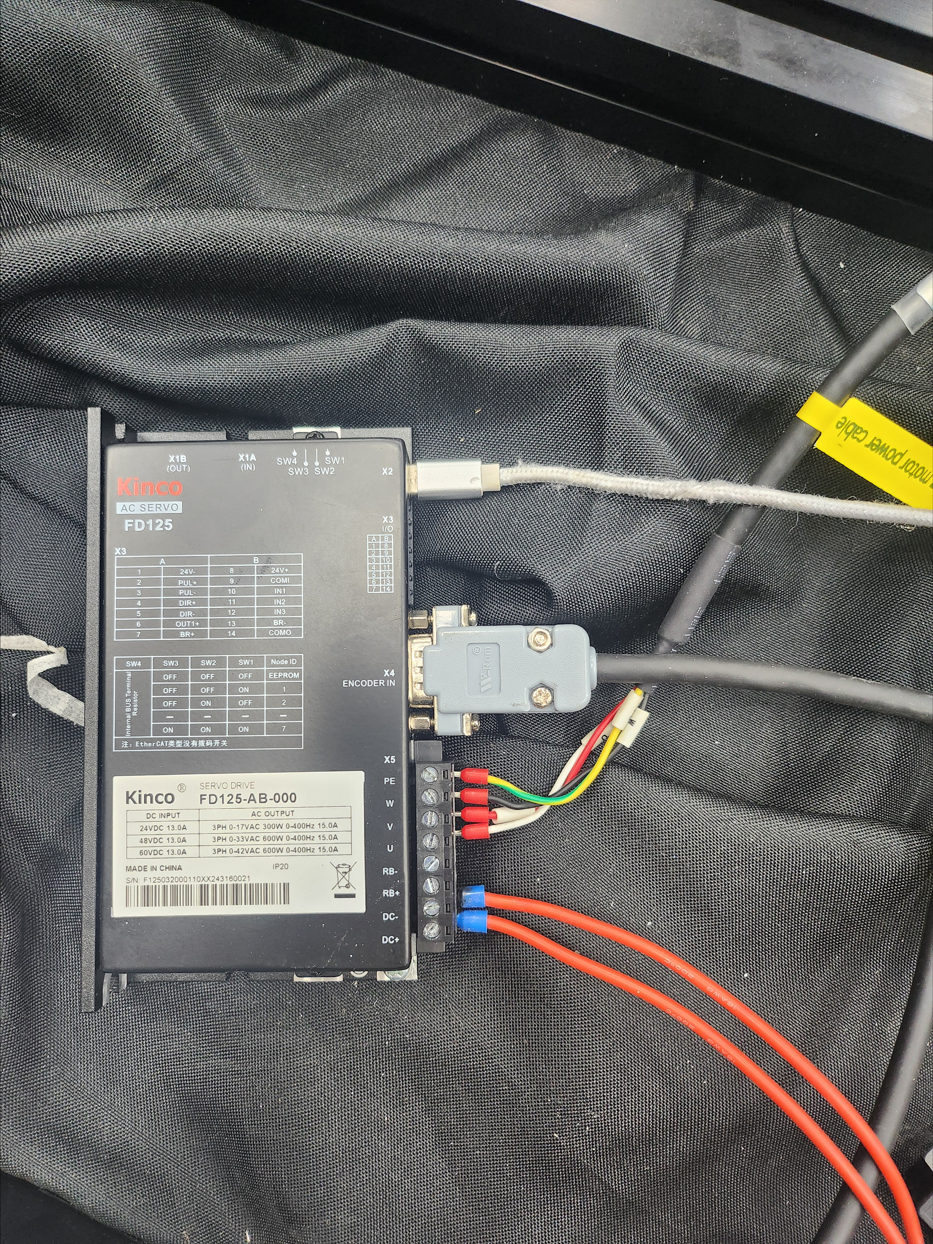
A. Servo Motor Driver Wiring
1. Noise filter is mandatory
2. A Wire section A first, then apply power
3. After powering on, confirm 2 green indicator lights on the side are lit
4. If no issues, connect to laptop via USB-C
*Connecting USB-C first will cause a low voltage error
A

Slide 2
B. Servo Motor Debugging Program Launch
Navigate to the path below
KinkoServo3 folder
KinkoServo3.exe — Run it
* Note: There is also a KinkoServo folder elsewhere in General — do NOT use that one,
General\20. 제품개발\90. (세호마린) POD 드라이브\2. slewing drive\1. 수직조향모듈(Guangzhou Wisdom Wheel Science Technology)\5. 반복선회(파이썬)
General - Pharos Team\20. 제품개발\90. (세호마린) POD 드라이브\2. slewing drive\1. 수직조향모듈(Guangzhou Wisdom Wheel Science Technology)\3. 서보모터\Kinko\KincoServo3 1.2.1 Beta build20240809\KincoServo3

Slide 3
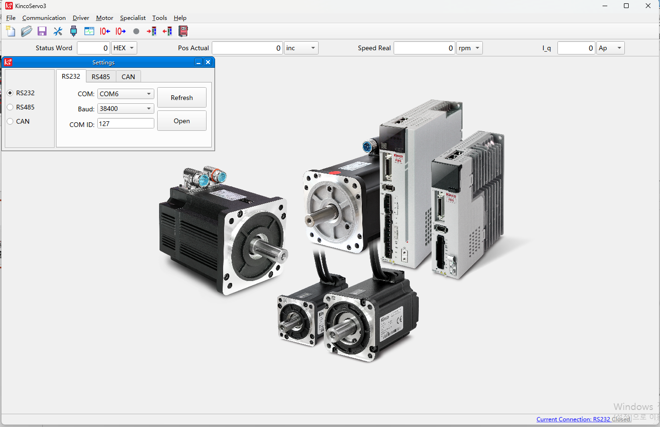
B. Servo Motor Debugging Program Launch
After launching, click “Current Connection RS232 Closed” at the bottom right
“COM”: Find the USB-connected port number. “Baud”/”COM ID”: Do NOT change
How to find the COM port number - Right-click Windows Start button > Device Manager - Double-click “Ports(COM & LPT)” at the bottom - The port labeled "USB-Enhanced..." is connected to the motor driver. - Select that port number in the program
Click “Open” and verify both buttons shown in the image turn green

Slide 4
C. Repetitive Rotation Python Macro
Navigate to the path below
“RunFile(JY-Laptop).bat” Run
Run the .bat file. Avoid using the laptop for other tasks while the macro is running
<Path below>
General\20. Product Development\90. (Seho Marine) POD Drive\2. slewing drive\1. Vertical Steering Module(Guangzhou Wisdom Wheel Science Technology)\5. Repetitive Rotation (Python)

Slide 5
D. Error Handling
When the highlighted area in the motor driver program turns red: - Restart the motor - Click "Specialist" > "Basic Operation" at the top - “Controlword”: Enter 86 and press Enter -If error persists, further investigation required

Slide 6
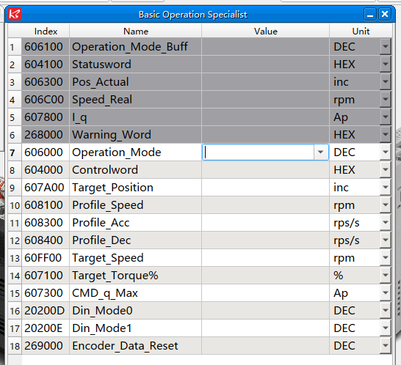
E. Parameter Adjustment
In the motor driver program:
Click "Specialist" > "Basic Operation" at the top
Profile_Acc and Profile_Dec controls acceleration // deceleration (Lower values = smoother stopping)
Modify Operation Mode to 1, or to another appropriate mode.
Adjust the rotational speed by setting Profile_Speed.
For forced operation, enter the Controlword sequence in the following order: 6 → 7 → 103F.

Slide 7
E. Parameter Adjustment (cont.)
“Kinko_AUTO.py” > Open with > Notepad
“#Variable Definition” section: change “pos_value” to adjust rotation angle(max 2500000)
Further below: in the elif idx == 38 section, change the value in "1000{ENTER}" to adjust rotation speed (range: 500–2000)

