Slide 1


Slide 2
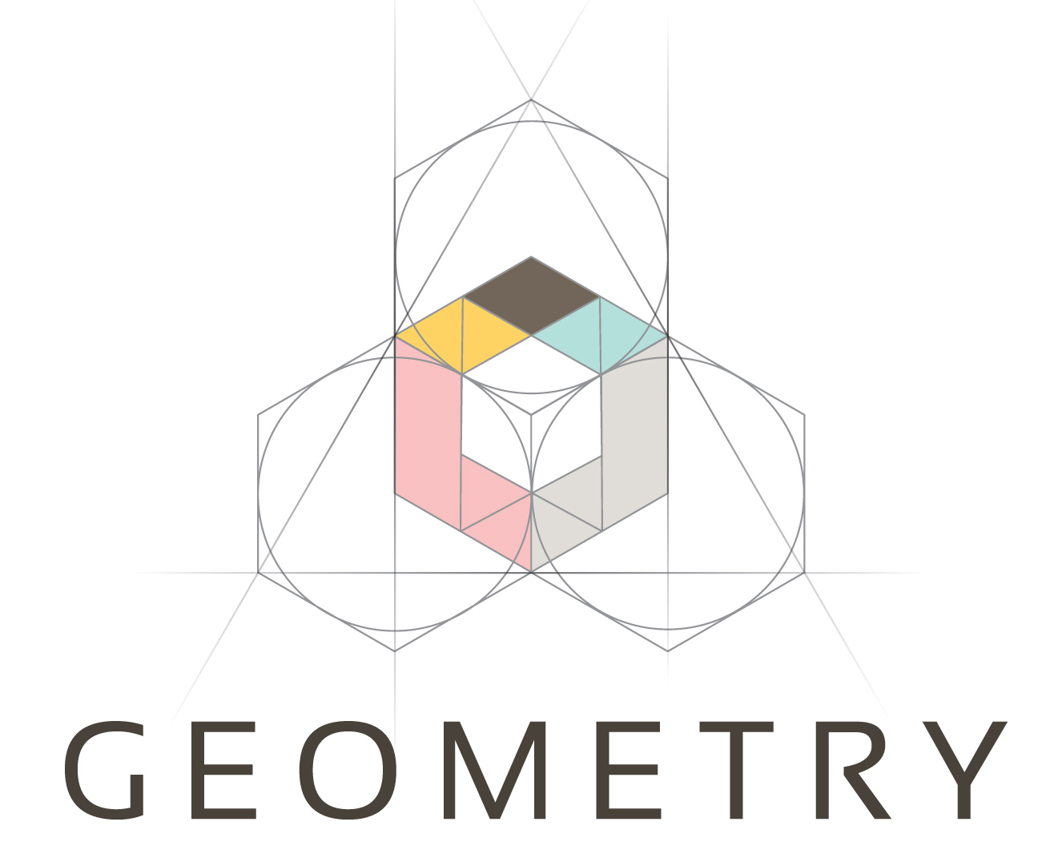
INTRODUCTION
Geometry is the branch of mathematics that deals with shapes, angles, dimensions and sizes of a variety of things we see in everyday life. In Euclidean geometry, there are two-dimensional shapes and three-dimensional shapes.
In plane geometry, shapes such as triangles, squares, rectangles, circles are also called flat shapes. In solid geometry, 3d shapes such as a cube, cuboid, cone, etc. are also called solids.

Slide 3
Fundamental concepts of Geometry
Point: It is an exact location. It is a fine dot which has neither length nor breadth nor thickness but has position i.e., it has no magnitude.
Line segment: The straight path joining two points A and B is called a line segment AB. It has and points and a definite length.
Ray: A line segment which can be extended in only one direction is called a ray.
Intersecting lines: Two lines having a common point are called intersecting lines. The common point is known as the point of intersection.
Concurrent lines: If two or more lines intersect at the same point, then they are known as concurrent lines.

Slide 4
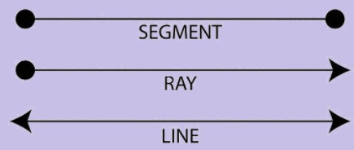

Slide 5
Angles: When two straight lines meet at a point they form an angle.
Right angle: An angle whose measure is 90° is called a right angle.
Acute angle: An angle whose measure is less then one right angle (i.e., less than 90°), is called an acute angle.
Obtuse angle: An angle whose measure is more than one right angle and less than two right angles (i.e., less than 180° and more than 90°) is called an obtuse angle.
Reflex angle: An angle whose measure is more than 180° and less than 360° is called a reflex angle.
Complementary angles: If the sum of the two angles is one right angle (i.e.,90°), they are called complementary angles. Therefore, the complement of an angle θ is equal to 90° – θ.
Supplementary angles: Two angles are said to be supplementary, if the sum of their measures is 180°. Example: Angles measuring 130° and 50° are supplementary angles. Two supplementary angles are the supplement of each other. Therefore, the supplement of an angle θ. is equal to 180° – θ.

Slide 6
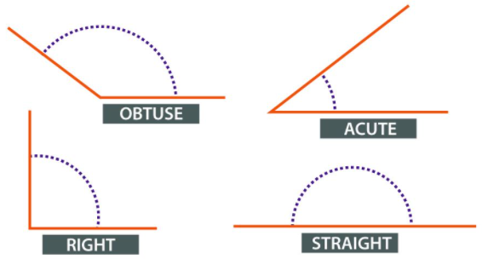

Slide 7
Vertically opposite angles: When two straight lines intersect each other at a point, the pairs of opposite angles so formed are called vertically opposite angles.
Bisector of an angle: If a ray or a straight line passing through the vertex of that angle, divides the angle into two angles of equal measurement, then that line is known as the Bisector of that angle.
Parallel lines: Two lines are parallel if they are coplanar and they do not intersect each other even if they are extended on either side.
Transversal: A transversal is a line that intersects (or cuts) two or more coplanar lines at distinct points.

Slide 8
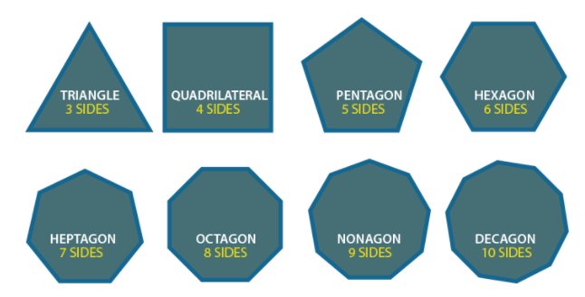

Slide 9
Triangles:-
A centroid divides a median in 2:1 ratio. Centroid is a point of intersection of three medians.
Ratio of two adjacent sides of a triangle is equal to the two parts of third side which makes by the internal angle bisector.
In an equilateral triangle internal angle bisector and the median are same.
Any two of the four triangles formed by joining the mid-point of the sides of a given triangle are-congruent.
Two triangles have the same area if they have the same base and lie between two parallel lines.
In a triangle side opposite to smaller angle is smaller in comparison to the side which is opposite to greater angle.
When the corresponding sides of two triangles are in proportion then the corresponding angles are also in proportion.

Slide 10
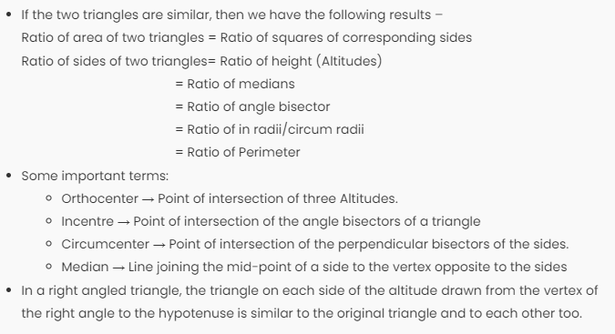

Slide 11
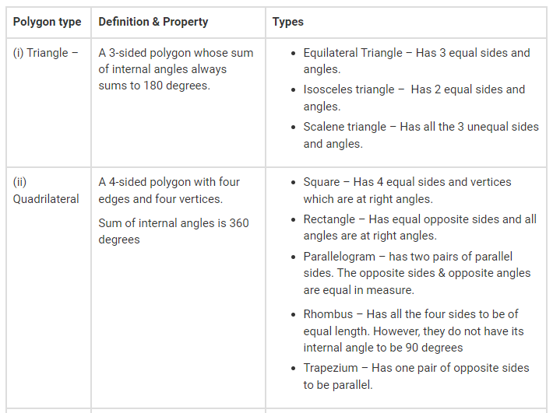

Slide 12
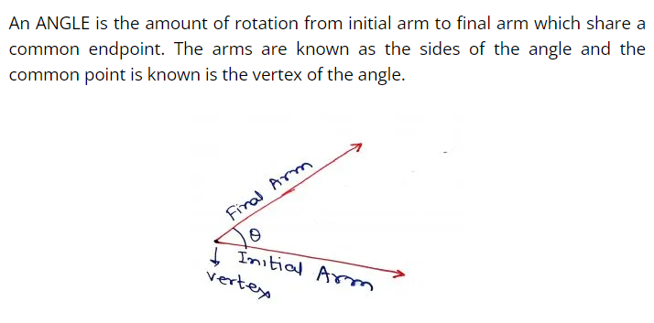

Slide 13
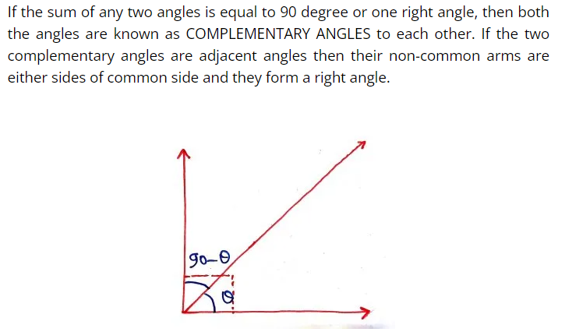

Slide 14
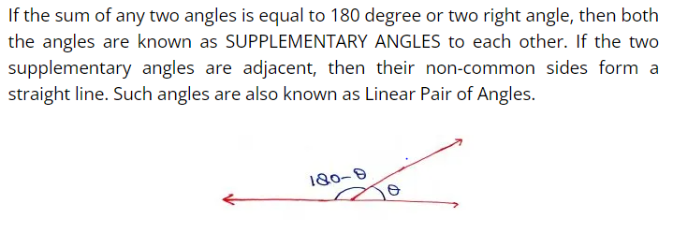

Slide 15
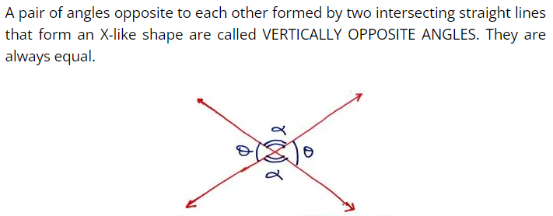

Slide 16
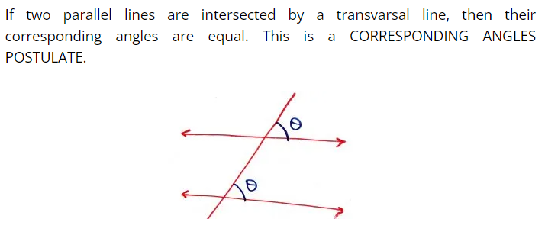

Slide 17
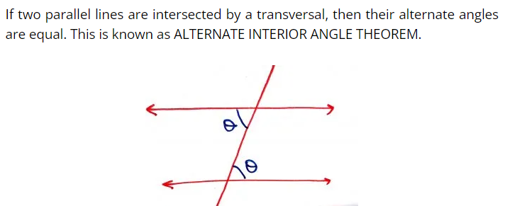

Slide 18
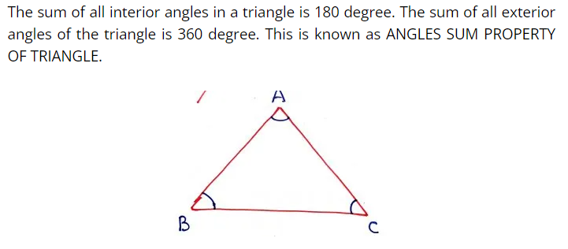

Slide 19
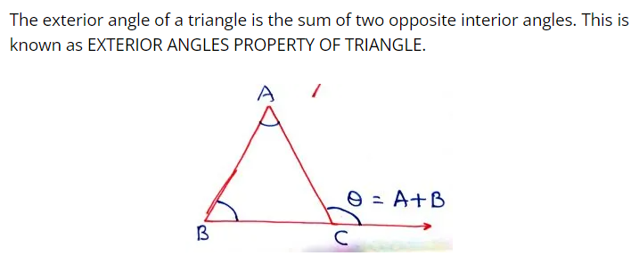

Slide 20
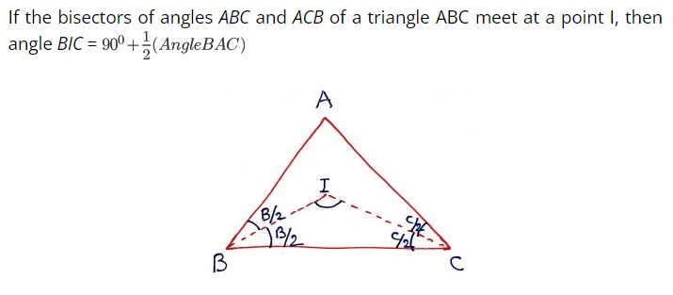

Slide 21
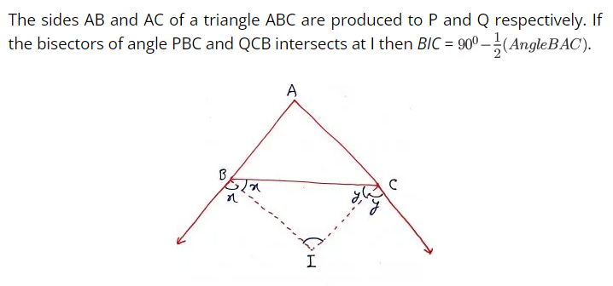

Slide 22
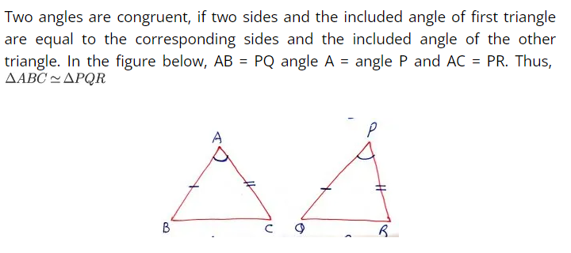

Slide 23
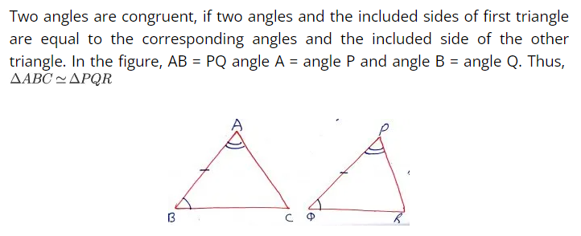

Slide 24
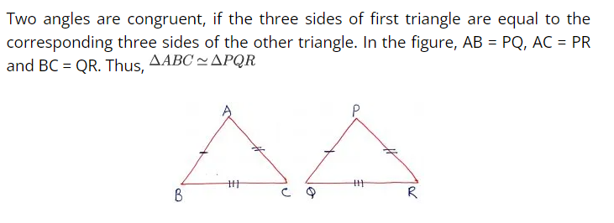

Slide 25
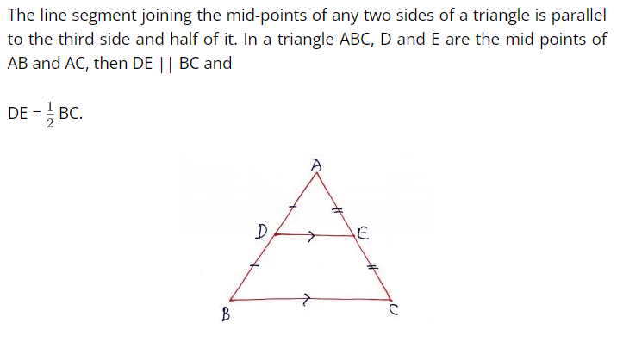

Slide 26
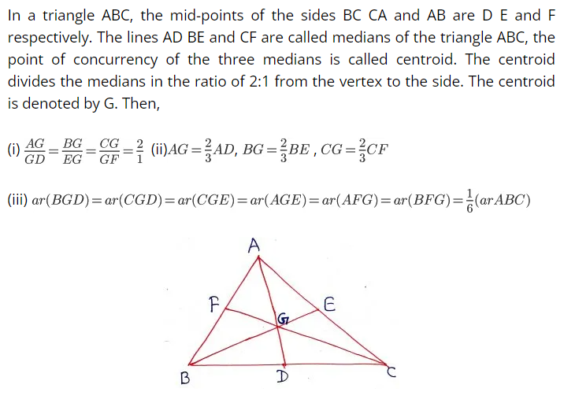

Slide 27
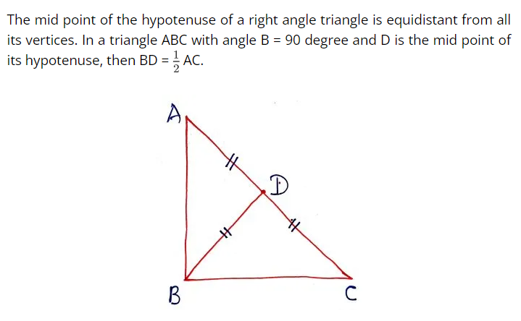

Slide 28
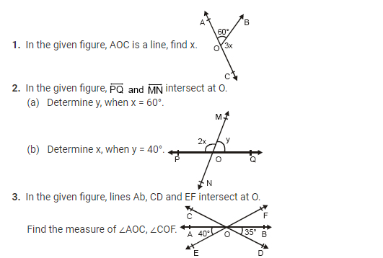

Slide 29
If an angle is half of its complementary angle, then find its degree measure.

Slide 30
The two complementary angles are in the ratio 1 : 5. Find the measures of the angles.

Slide 31
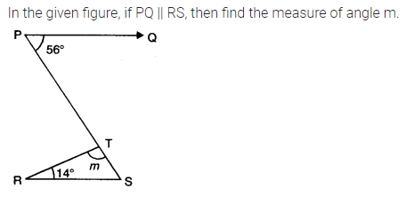

Slide 32
If an angle is 14 degree more than its complement, then find its measure.

Slide 33
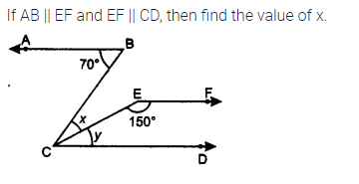

Slide 34
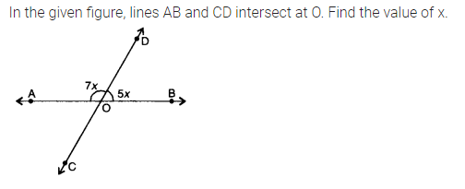

Slide 35
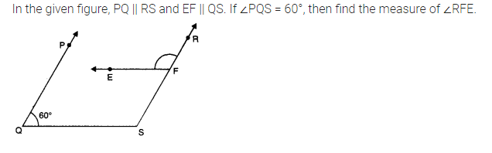

Slide 36
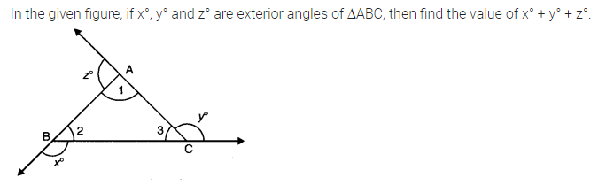

Slide 37
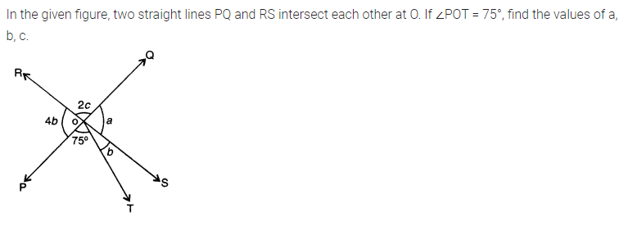

Slide 38
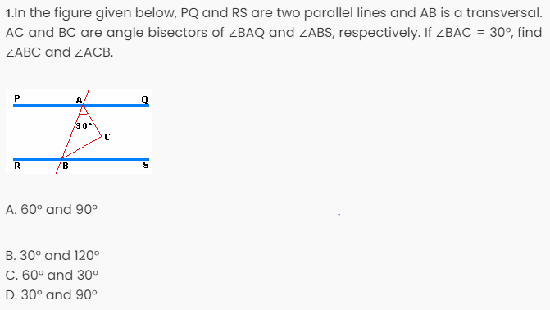

Slide 39
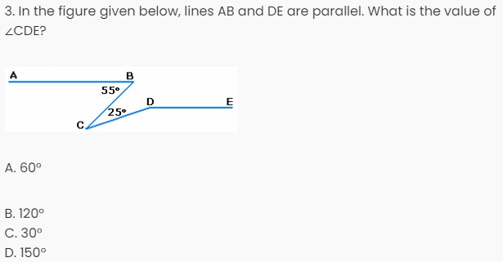

Slide 40
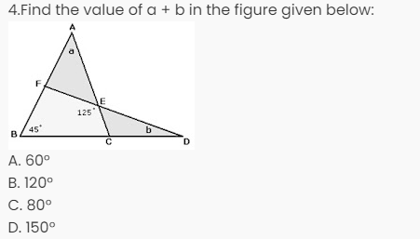

Slide 41
Different Types of Quadrilaterals
There are six basic types of quadrilaterals. They are:
Trapezium
Parallelogram
Rectangle
Rhombus
Square
Kite

Slide 42
Before talking about the types of quadrilaterals, let us recall what a quadrilateral is. A quadrilateral is a polygon which has the following properties
4 vertices and 4 sides enclosing 4 angles.
The sum of all interior angles of a quadrilateral is 360 degrees.
We can also derive the sum of interior angle from the formula of polygon i.e. (n -2) × 180, where n is equal to the number of sides of the polygon
A quadrilateral, in general, has sides of different lengths and angles of different measures. However, squares, rectangles, etc. are special types of quadrilaterals with some of their sides and angles being equal. This is the reason that the area of quadrilateral depends on which type of quadrilateral it is.

Slide 43
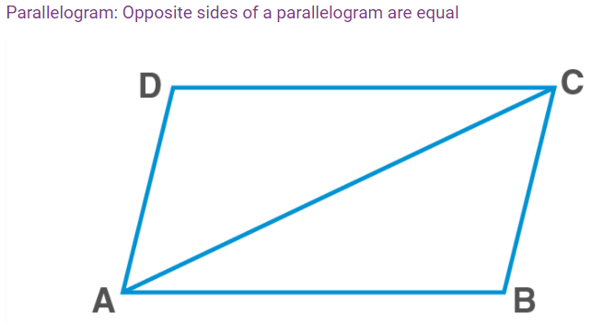

Slide 44
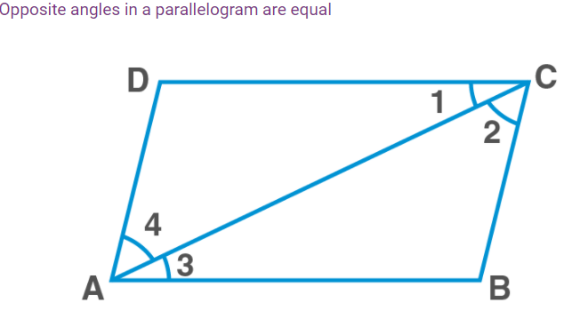

Slide 45
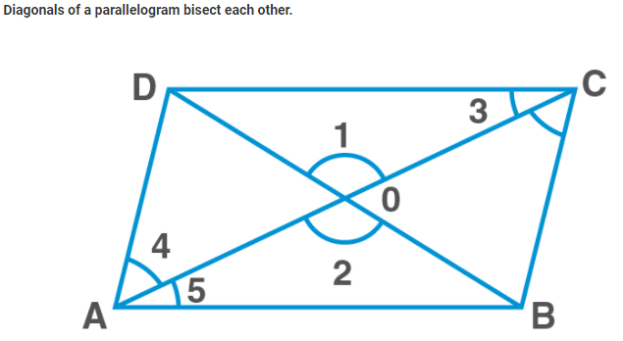

Slide 46
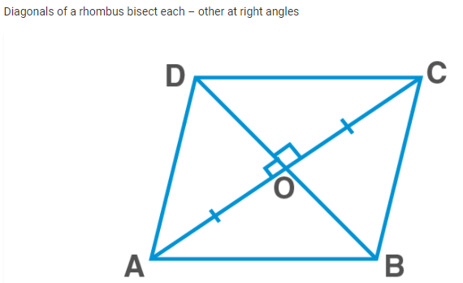

Slide 47
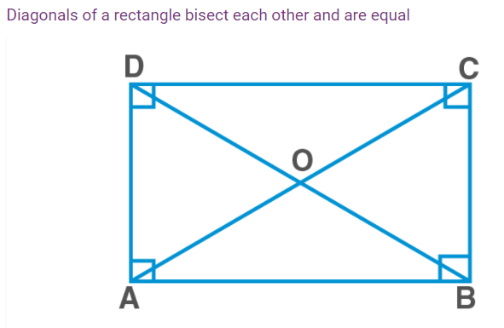

Slide 48
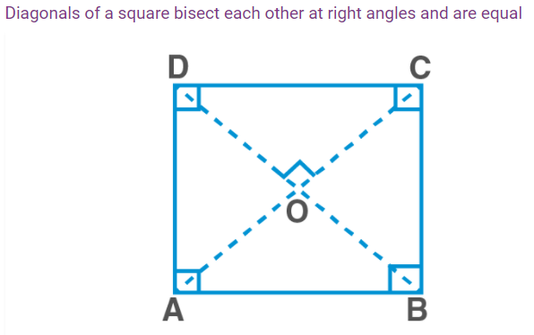

Slide 49
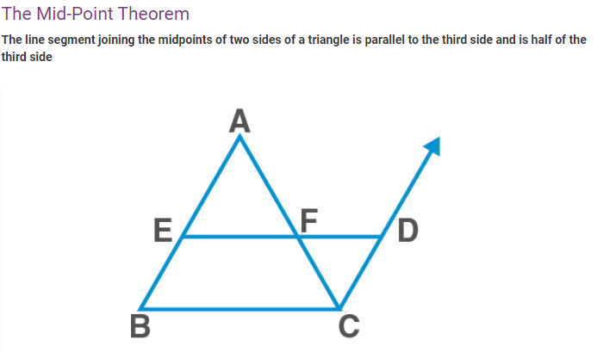

Slide 50
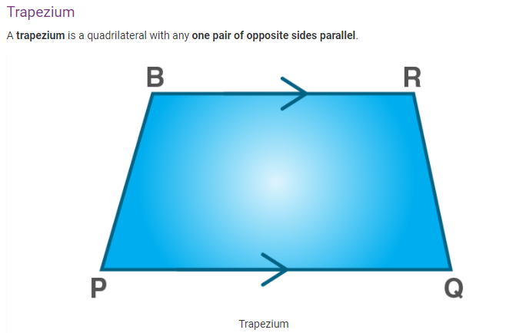

Slide 51
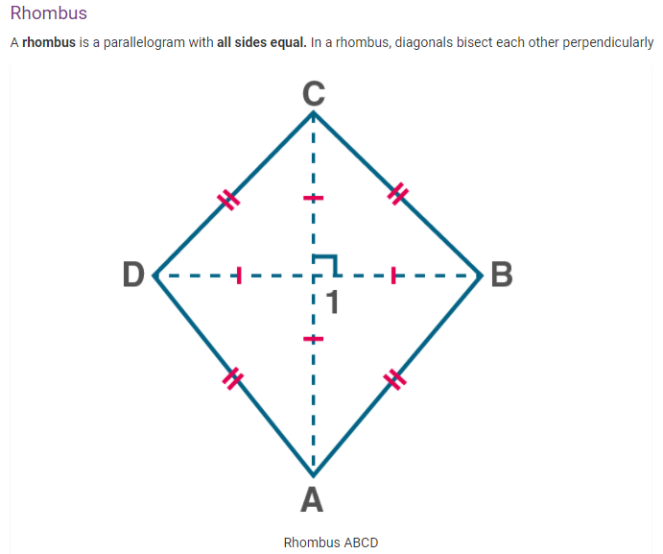

Slide 52
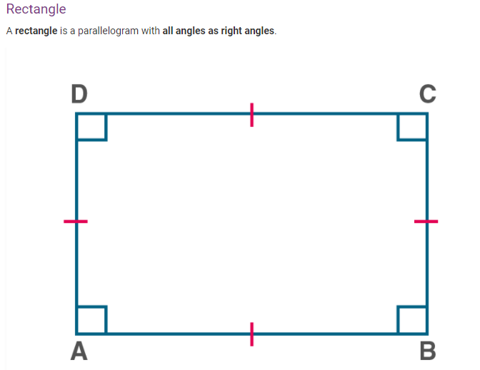

Slide 53
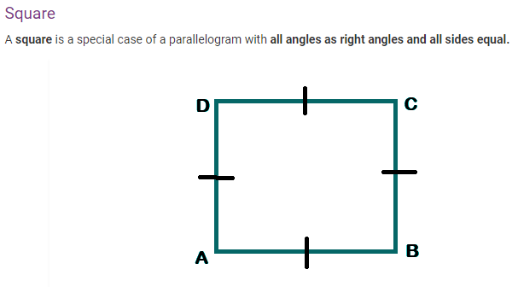

Slide 54
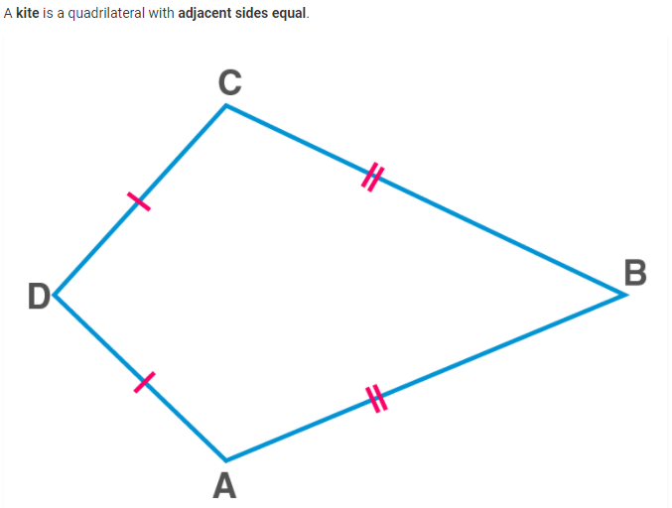

Slide 55
Some points about quadrilaterals to be kept in mind are:
Square, rectangle, and rhombus are types of parallelograms.
A square is a rectangle as well as a rhombus.
Rectangle and rhombus are not a square.
A parallelogram is a trapezium.
A trapezium is not a parallelogram.
Kite is not a parallelogram.

Slide 56
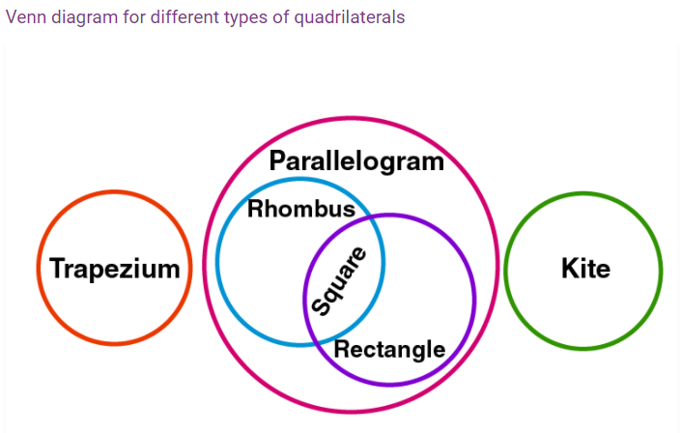

Slide 57
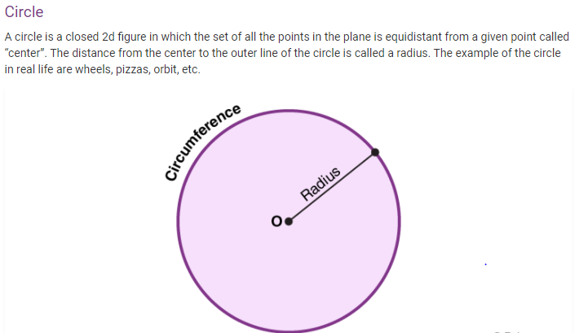

Slide 58
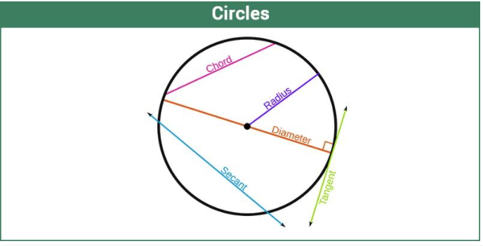

Slide 59
Q1.Identify the type of quadrilaterals:
(i) The quadrilateral formed by joining the midpoints of consecutive sides of a quadrilateral whose diagonals are perpendicular.
(ii) The quadrilateral formed by joining the midpoints of consecutive sides of a quadrilateral whose diagonals are congruent.

Slide 60
Q2.Find all the angles of a parallelogram if one angle is 80°.

Slide 61
Q3.In a rectangle, one diagonal is inclined to one of its sides at 25°. Measure the acute angle between the two diagonals.

Slide 62
Q4.In a trapezium ABCD, AB∥CD. Calculate ∠C and ∠D if ∠A = 55° and ∠B = 70°

Slide 63
Q5.Calculate all the angles of a parallelogram if one of its angles is twice its adjacent angle.

Slide 64
Q6.Calculate all the angles of a quadrilateral if they are in the ratio 2:5:4:1.

Slide 65
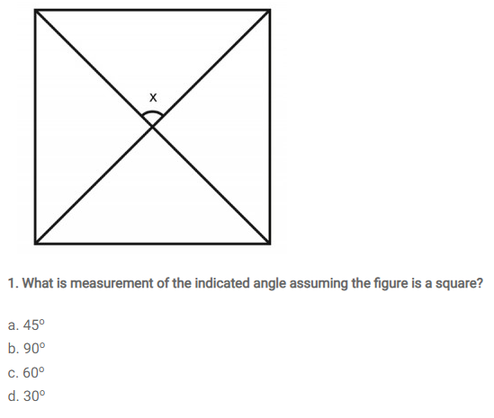

Slide 66
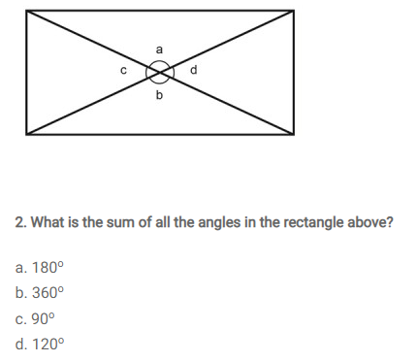

Slide 67
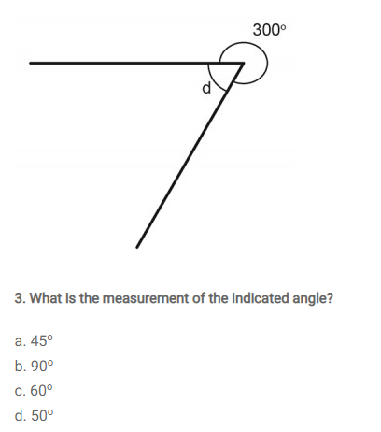

Slide 68


Slide 69


Slide 70

@Choudhary Amjad
8427036871
ecamjad@gmail.com
Room No.-508
Block-38

