Slide 1
Database Languages
A database system provides a data-definition language to specify the database schema and a data-manipulation language to express database queries and updates.

Slide 2
Data Definition Language (DDL)
A database schema is specified by a set of definitions expressed by a special language called a data definition language. The result of compilation of DDL statements is a set of tables that is stored in a special file called data dictionary or data directory.
A data dictionary is a file that contains metadata-that is data about data. This file is consulted before actual data are read or modified in the database system

Slide 3
Data Manipulation Language (DML)
A data manipulation language DML is a language that enables user to access or manipulate data as organized by the appropriate data model. The types of access are:
Retrieval of information stored in the database.
Insertion of new information into the database.
Deletion of information from the database.
Modification of information stored in the database.

Slide 4
There are basically two types:
Procedural DMLs require a user to specify what data are needed and how to get those data.
Non Procedural DMLs require a used to specify what data are needed without specifying how to get those data.
Non procedural DMLs are normally easier to learn and use than are procedural DMLs. However, since a user does not have to specify how to get the data, these languages may generate code that is not as efficient as that produced by procedural languages.
A query is a statement requesting the retrieval of information. The portion of a DML that involves information retrieval is called a query language.

Slide 5
View Of Data
A DBMS is a collection of interrelated files and a set of programs that allow users to access and modify these files. A major purpose of a database system is to provide users with an abstract view of Data. That is, the system hides certain details of how the data are stored and maintained.

Slide 6
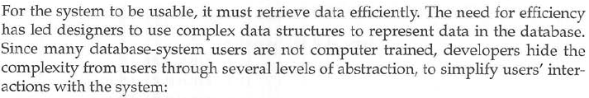
The Three Level Architecture of DBMS ( Data Abstraction)
Physical Level
Logical Level
View Level

Slide 7
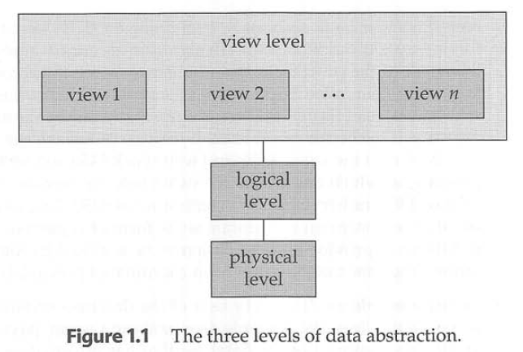

Slide 8
What is meta data?
A. Data with Data B. Data within Data
C. Data about Data D. Data Dictionary Data

Slide 9
In three level data abstraction Physical level is at which level?
A Top level
B Middle level
C Bottom level
D None of the above

Slide 10

Physical Level
Physical Level (Internal Level)
This is the lowest level of abstraction which describes how the data is actually stored.
This also describes data structures and access methods used by database.
At this level certain physical components like buffer and control structures are adjusted to provide optimal performance.
The internal view is expressed by an internal schema.

Slide 11
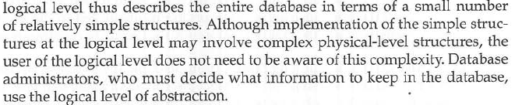
Logical Level
Conceptual Level (Global level or logical level)
This level of abstraction describes what data is stored in the database and their relationship.
The conceptual view is described by the conceptual schema.
One conceptual view represents the entire database, that is, there is one conceptual schema per database.
This level of abstraction is used by database administrations (DBA’s) who decide what information should be kept in the database.
This level also includes features that help to maintain database consistency and integrity.
Various objects like tables, views, procedure are described at this level.
If the underlying hardware is changed then the effects are limited only between physical and the conceptual level.

Slide 12
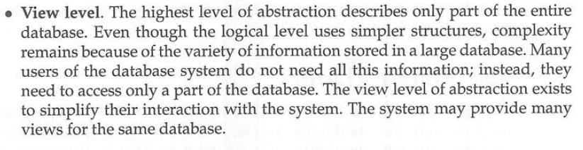
View Level
External Level (User Level or View Level)
This is the highest level of abstraction in which user access is provided as per the user requirements.
There can be many external views for a given conceptual view.
Each external view is represented by an external schema.
The external schema contains the method of deriving objects to the external view from the objects in the conceptual view.
The external level is closest to the user.
The external view is concerned with the way the data is viewed by the individual users.

Slide 13
Mapping
We know that three view-levels are described by means of three schemas. These schemas are stored in the data dictionary. In DBMS, each user refers only to its own external schema. Hence, the DBMS must transform a request on. A specified external schema into a request against conceptual schema, and then into a request against internal schema to store and retrieve data to and from the database. The process to convert a request (from external level) and the result between view levels is called mapping.
The mapping defines the correspondence between three view levels. The mapping description is also stored in data dictionary. The DBMS is responsible for mapping between these three types of schemas.

Slide 14
Mapping Between The Views
External/Conceptual Mapping:- This mapping exists between. External view and the conceptual view. This mapping provides logical data Independence.
Conceptual/Internal Mapping:- This Mapping exists between the conceptual view and the internal view. This mapping provides physical data Independence.

Slide 15
Data Independence
The very important advantage of DBMS is that it provides DATA INDEPENDENCE, that is application programs are independent from the change in the way the data is structured and stored.
Data Independence is the ability to modify a schema definition in one level without affecting a schema definition in the next higher level.
Three levels of abstraction along with mapping from internal to conceptual and from conceptual to external, provides two levels of data Independence

Slide 16
Logical Data Independence
It is the ability to change conceptual schema without affecting external schemas. The changes would be absorbed by the mapping between the external and the conceptual levels.
Modifications at the logical level are needed whenever logical structure of the database altered.
Logical data independence is provided by the external view of the database and external/conceptual mapping.
Logical data independence is more difficult to achieve than physical data independence because programs are strongly dependent on logical structure of data.

Slide 17
Physical Data Independence
It is the ability to change physical schema without affecting existing conceptual schema. Here, physical storage structures or devices could be changed without affecting the conceptual schema.
The changes would be absorbed by the mapping between the conceptual and the physical level.
Modifications at the physical level are sometimes necessary to improve performance.
Physical data Independence is provided by the physical level and the mapping between the conceptual and the internal level.

Slide 18
Data Models
Underlying the structure of a database is the Data Model:
A collection of conceptual tools for describing data, data relationships and consistency constraints.
A data model provides a way to describe the design of a database at the physical, logical and view level.

Slide 19
The data models can be classified in 4 different categories:
Relational Model
The Entity-Relationship Model
Object-Based Data Model
Semi-structured Data Model

Slide 20
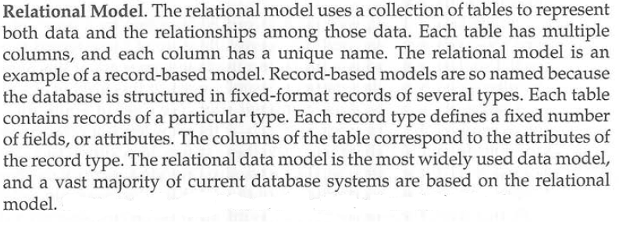
Relational Model

Slide 21
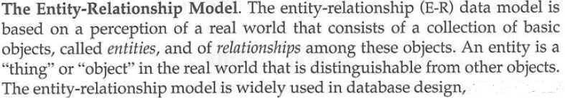
The Entity-Relationship Model

Slide 22
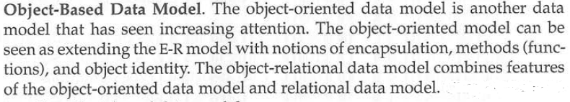
Object-Based Data Model
In object-oriented programming (OOP), objects are the things you think about first in designing a program and they are also the units of code that are eventually derived from the process. In between, each object is made into a generic class of object and even more generic classes are defined so that objects can share models and reuse the class definitions in their code. Each object is an instance of a particular class or subclass with the class's own methods or procedures and data variables. An object is what actually runs in the computer.
Like the ER Model, the object-oriented model is based on a collection of Objects. An object contains values stored in instance variables within the objects. An object also contains bodies of code that operate on the object. These bodies of code are called methods.
Objects that contains the same types of values and the same methods are grouped together into classes. A class may be viewed as a type definition for objects.

Slide 23
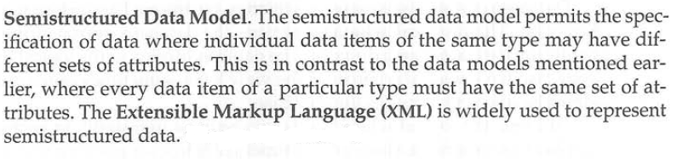
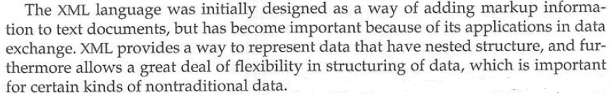
Semi-structured Data Model

Slide 24
Database Users
There are four different types of database system users:
Naive Users.
Application Programmers.
Sophisticated Users.
Specialized Users.

Slide 25
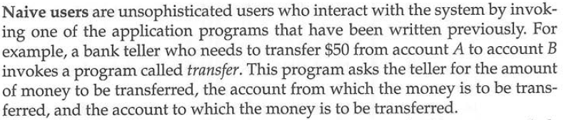
Naïve Users

Slide 26
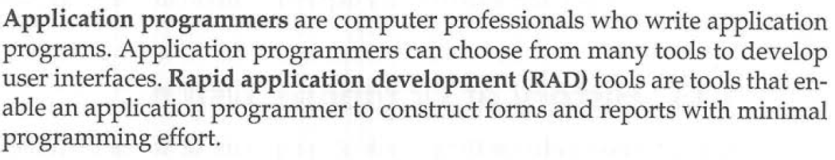
Application Programmers

Slide 27
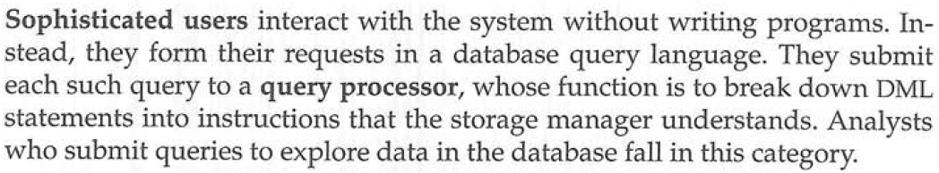
Sophisticated Users

Slide 28
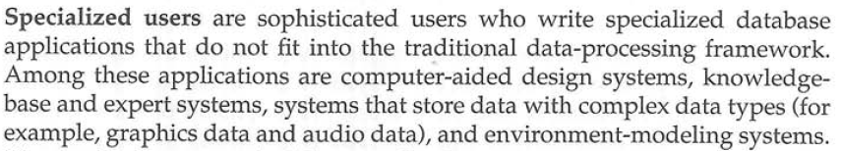
Specialized Users

Slide 29
DBA (DataBase Administrator)
One of the main reasons for using DBMSs is to have central control of both the data and the programs that access those data.
The person who has such central control over the system is called the database administrator (DBA).
The functions of the DBA include the following:

Slide 30
Functions Of DBA
Schema Definition.
Storage and Access-Methods definition.
Schema and Physical-organization modification.
Granting of authorization for Data Access.
Integrity-Constraint Specification.
Routine Maintenance.

Slide 31
Schema Definition.
The DBA creates the original database schema by writing a set of definitions that is translated by the DDL compiler to a set of tables that is stored permanently in the data dictionary.

Slide 32
Storage and Access-Methods definition
The DBA creates appropriate storage structures and access methods by writing a set of definitions, which is translated by the data-storage and data-definition-language compiler.

Slide 33
Schema and Physical-organization modification
Programmers accomplish the relatively rare modifications either to the database schema or to the description of the physical storage organization by writing a set of definitions that is used by either the DDL compiler or the data-storage and data-definition-language compiler to generate modifications to the appropriate internal system tables.

Slide 34
Granting of authorization for Data Access
The granting of different types of authorization allows the database administrator to regulate which parts of the database various users can access.
The authorization information informed is kept in a special system structure that is consulted by the database system whenever access to the data is attempted in the system.

Slide 35
Integrity-Constraint Specification
The data value stored in the database must satisfy certain consistency constraints.
For e.g., the number of hours an employee may work in a week may not exceed a specified limit (say, 80 hours).
Such a constraint must be specified by the database administrator. The integrity constraints are kept in a special system structure that is consulted by the database system whenever an update takes place in the system

Slide 36
Routine Maintenance
Examples of the database administrator’s routine maintenance activities are:
Periodically backing up the database, either onto discs/tapes or onto remote servers, to prevent loss of data in case of disasters.
Ensuring that enough free disk space is available for normal operations, and upgrading disk space as required.
Monitoring jobs running on the database and ensuring that performance in not degraded by very expensive tasks submitted by some users.

Slide 37
DBMS Architecture (DBMS System Structure)
A database system is partitioned into modules that deal with each of the responsibilities of the overall system.
The functional components of a database system can be broadly divided into Query Processor component and Storage Manager component.

Slide 38
Query Processor Components Include
DML Compiler: Which translates DML statements in a query language into low-level instructions that the query evaluation engine understands.
DDL Interpreter: Which interprets DDL statements and records them in a set of tables containing metadata.
Query Evaluation Engine: Which executes low-level instructions generated by the DML compiler.

Slide 39
Storage manager components
It provides interface between the low-level data stored in the database and the application programs and queries submitted to the system. This Component includes:
Transaction Manager.
Buffer Manager.
File Manager.

Slide 40
The storage manager components include.
Authorization and integrity manager: Which tests for the satisfaction of integrity constraints and checks the authority of users to access data.
Transaction manager: Which ensures that the database remains in a consistent (correct) state despite system failures and that concurrent transaction executions proceed without conflicting.
File manager: Which manages the allocation of space on disk storage and the data structures used to represent information stored on disk.
Buffer manager: Which is responsible for fetching data from disk storage into main memory, and deciding what data to cache in memory.

Slide 41
In addition, several data structures are required as part of the physical system implementation
Data Files: Which store the database itself.
Data Dictionary: Which stores metadata about the structure of the database.
Indices: Which provide fast access to data items that hold particular values.
Statistical Data: Which stores statistical information about the data in the database. This information is used by the query processor to select efficient ways to execute a query.

Slide 42
