Slide 1
ENTITY RELATIONSHIP(ER) MODEL

Slide 2
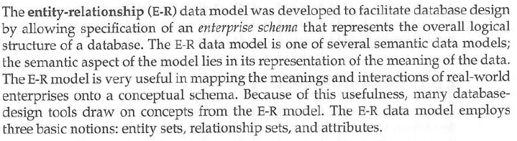
Introduction

Slide 3
Definitions
ENTITY: An entity is a thing or an object in the real world that is distinguishable from other objects. Anything physical is called an entity. For e.g. a student, a table, a chair or a computer is an entity.
ENTITY SET: An entity set may be defined as a collection of different entities. An entity set is a set of entities of the same type that share same properties or attributes. For e.g. set of students who are studying in a particular class can be defined by an entity set called STUDENT.

Slide 4
Definitions
ATTRIBUTES: Attributes are the properties of an entity. An entity is always represented by a set of attributes. For e.g. attributes of an entity STUDENT may be: Roll_No, Name, Class, DOB, Marks, Hobbies etc.
ATTRIBUTE SET: A set of attributes of a given entity is called an attribute set.
DOMAIN: Domain is called a range. A domain is a set of possible values of a given attribute of an entity. For e.g. The Roll_No of a student lies in the domain 1001 to 1050.

Slide 5
Types Of Attributes
SIMPLE ATTRIBUTES.
COMPOSITE ATTRIBUTE.
SINGLE VALUED ATTRIBUTES.
MULTI VALUED ATTRIBUTES.
DERIVED ATTRIBUTES

Slide 6
SIMPLE ATTRIBUTES
Simple attributes are those which can not be further sub-divided into parts.
For e.g., if we are storing the registration no. of a student then this attribute is called simple attribute.

Slide 7
COMPOSITE ATTRIBUTES
Composite attributes are those which can be further sub divided.
For e.g. the name of the student can be further sub divided in to first name, middle name and last name. These are called composite attributes.

Slide 8
SINGLE VALUED ATTRIBUTES
If the attribute is having a single value for a particular entity then that attribute is said to be single valued attribute.
For e.g. the loan_number attribute for a specific loan entity refers to only one loan number.

Slide 9
MULTI VALUED ATTRIBUTES
There may be instances where an attribute has a set of values for a specific entity. This type of attribute is said to be multivalued.
For e.g. consider an employee entity set with the attribute phone_number. An employee may have zero, one, or several phone numbers and different employees may have different numbers of phones.

Slide 10
DERIVED ATTRIBUTES
The value for this type of attribute can be derived from the value of other attributes or entities.
For e.g. suppose that the customer entity set has an attribute are that indicates the customer’s are. If the customer entity set also has an attribute date-of-birth, we can calculate age from date-of-birth and the current date. Thus, age is a derived attribute

Slide 11
Definitions
RELATIONSHIP: A relationship is an association among several entities. A relationship is used in data modeling to represent an association between entities For e.g. we can define a relationship that associates customer Rahul with Loan L-15. This relationship specifies that Rahul is a customer with Loan number L-15.
RELATIONSHIP SET: A relationship set is a set of relationships of the same type. The relationship set is used in data modeling to represent an association between entity sets.

Slide 12
Types of Relationship / Mapping/ Constraints/ Mapping Cardinalities
Mapping cardinalities, cardinality ratios, express the number of entities to which another entity can be associated via a relationship set. The mapping between entities is of following types:
One-To-One Relationship.
One-To-Many Relationship.
Many-To-One Relationship.
Many-To-Many Relationship.

Slide 13
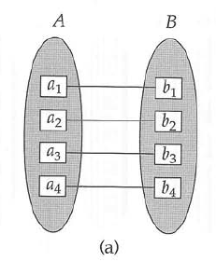
One-To-One Relationship.
Let us assume A and B are given two entity sets. A relationship is said to be one-to-one if an entity in A is associated with only one entity in B and an entity in B is associated with only one entity in A.
For e.g. Let us assume we are given two entity sets, Student and Roll_No. So every student has a unique roll no and corresponding to every roll no there is only one student. So this is one-to-one relationship. Diagrammatically.

Slide 14
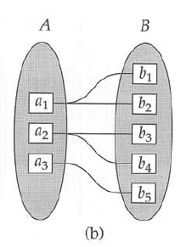
One-To-Many Relationship
The relationship is said to be one-to-many if an entity in A is associated with any number of entities in B and an entity in B can be associated with maximum one entity in A.
For e.g. The relationship between the entities customer and loan is one-to-many like one customer can have loan of several items while corresponding to one loan there is only one customer. Diagrammatically.

Slide 15
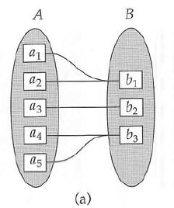
Many-To-One Relationship
The relationship is said to be many-to-one if an entity in A is associated with at most one entity in B and an entity in B can be associated with any number of entities in A.
For e.g. if loan and customers are two entities and if a loan can be shared among several customers, then the relationship is said to be many-to-one. Diagrammatically.

Slide 16
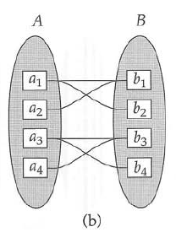
Many-To-Many
The relationship is said to be many-to-many if an entity in A is associated with any number of entities in B and an entity in B is associated with any number of entities in A.
For e.g. An item can be purchased from various suppliers and one supplier can supply various other items also. Diagrammatically

Slide 17
ENTITY RELATIONSHIP DIAGRAM
An E-R diagram can express the overall logical structure of a database graphically. E-R diagrams are simple and clear- qualities that may well account in large part for the widespread use of the E-R model. Such a diagram consist of the following major components:

Slide 18
Components
Rectangles, Which represent entity sets.
Ellipses, Which represent attributes.
Diamond, Which represent relationship sets.
Lines, Which link attributes to entity sets and entity sets to relationship sets.
Double ellipse, which represent multivalued attributes.
Dashed ellipse, which denote derived attributes.
Double lines, which indicate total participation on an entity in a relationship set.
Double rectangle, which represent weak entity sets.

Slide 19
Symbols
Rectangle
Ellipse
Diamond
Lines _____
Double ellipse
Dashed ellipse
Double Line
Double Rectangle

Slide 20
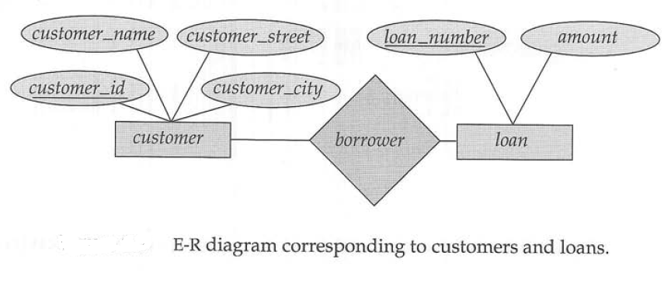
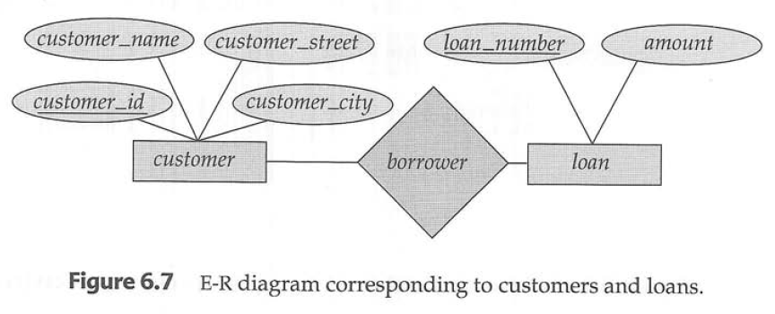
Examples

Slide 21
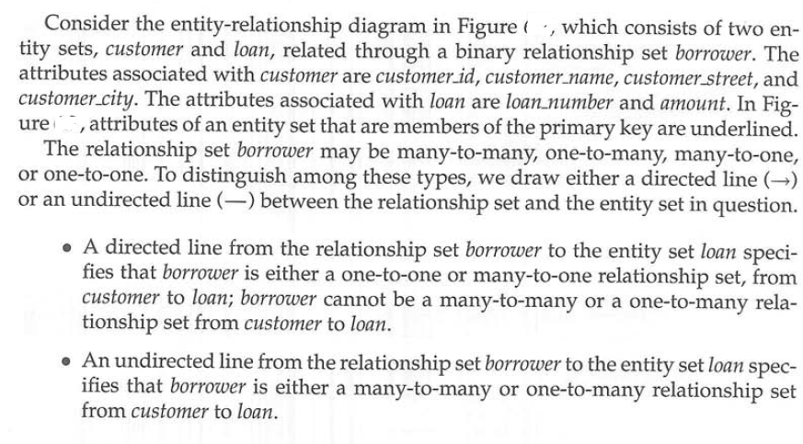
Explanation

Slide 22
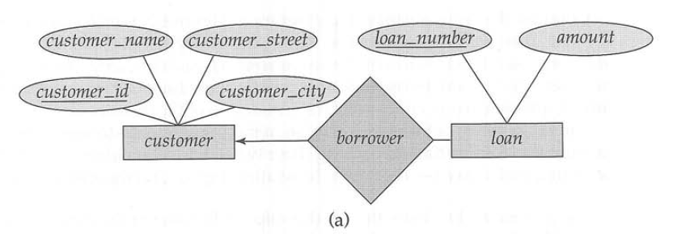
One-To-Many relationship

Slide 23
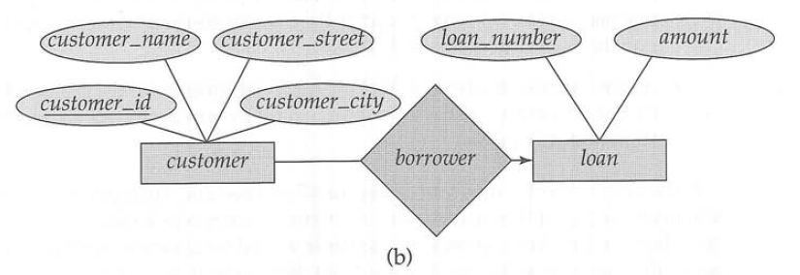
Many-To-One relationship

Slide 24
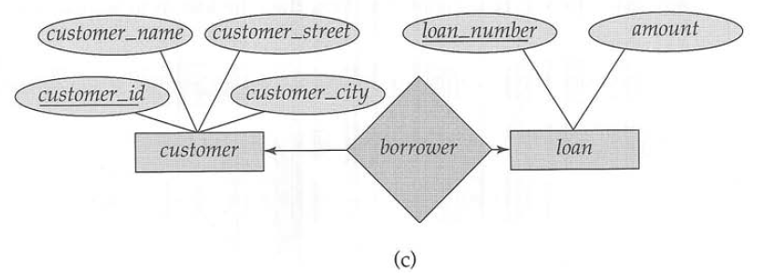
One-To-One relationship

Slide 25
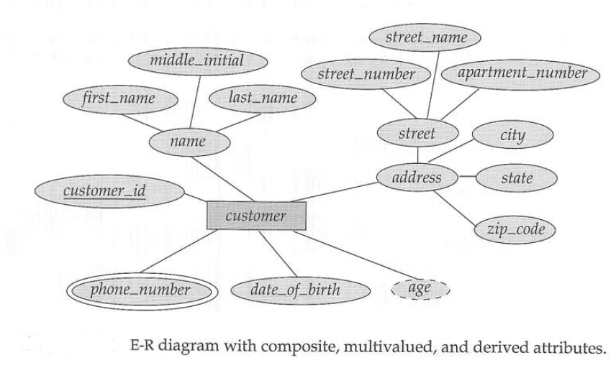
The following figure illustrate a multivalued attribute phone_number, depicted by a double ellipse, and a derived attribute age, depicted by a dashed ellipse. We indicate roles in E-R diagrams by labeling the lines that connect diamonds to rectangle.

Slide 26
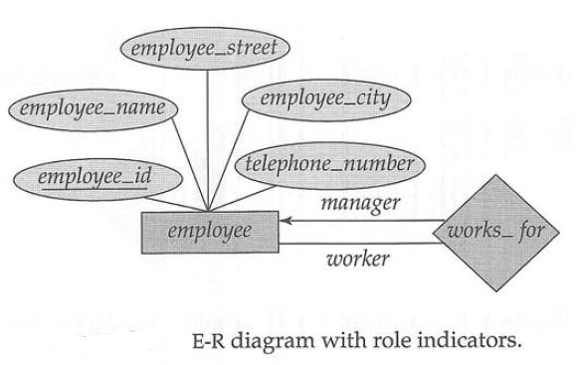
The following diagram shows the role indicators manager and worker between the employee entity set and the works_for relationship set.

Slide 27
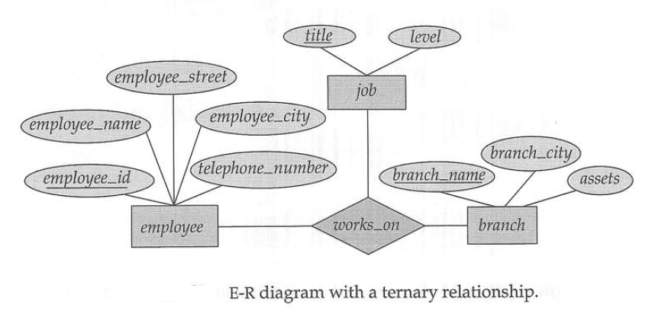
The following Diagram consists of the three entity sets employee, job and branch, related through the relationship set works_on. We can specify some types of many-to-one relationships in nonbinary relationship sets

Slide 28
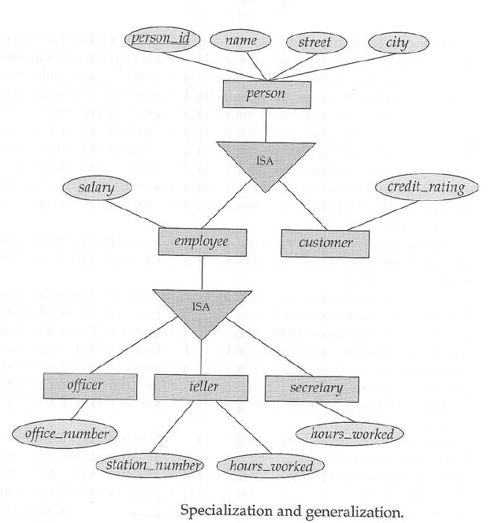
Extended Features of ER Diagrams (Specialization and Generalization)

Slide 29
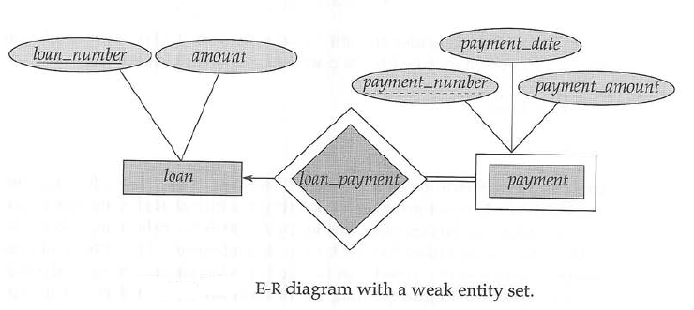
In the following figure, the weak entity set payment depends on the strong entity set loan via the relationship set loan_payment. The figure also illustrate the use of double lines to indicate total participation – The participation of the weak entity set payment in the relationship loan_payment is total, meaning that every payment must be related via loan_payment to some loan. Finally, the arrow from loan_payment to loan indicates that each payment is for a single loan.
The discriminator of a weak entity set also is underlined, but with a dashed, rather than a solid, line.

Slide 30
