Slide 1

Embedded Multi-Core Systems for Mixed Criticality Applications in dynamic and changeable Real-time Environments
WP2/4 – Co-operation Meeting
Dec. 9, 2014

Slide 2
Who we are…
25 partners
19 companies, 6 universities
25 different ideas and interests
+ ideas and expectations from other technical WPs and LL
Common goal:
Providing a hardware platform for other WPs
Delivering ideas (guidelines) how to design a multicore for mixed criticality environments

Slide 3
WP Organisational Overview
6 tasks
Requirements and specification
Advanced processor concepts and architecture definition
Core and chip interconnect, peripheral devices
Increased availability and dynamic reconfiguration
Processor qualification approach and verification
Virtual platforms and prototypes
Many (20) deliverables
4 prototypes
16 reports

Slide 4
WP Technical Overview I
WP4 focuses on hardware
Architectural challenges of mixed criticality applications
Cores, interconnect, memory hierarchy & access, virtualisation
Communication (mainly wireless and TTEthernet)
Reconfigurable architectures, accelerators
Reliability and availability
Prototyping challenges
Virtual prototypes, simulators
Prototypes on Zynq platforms (multiples)
Development of FPGA platforms with possibility of whatever I/O

Slide 5
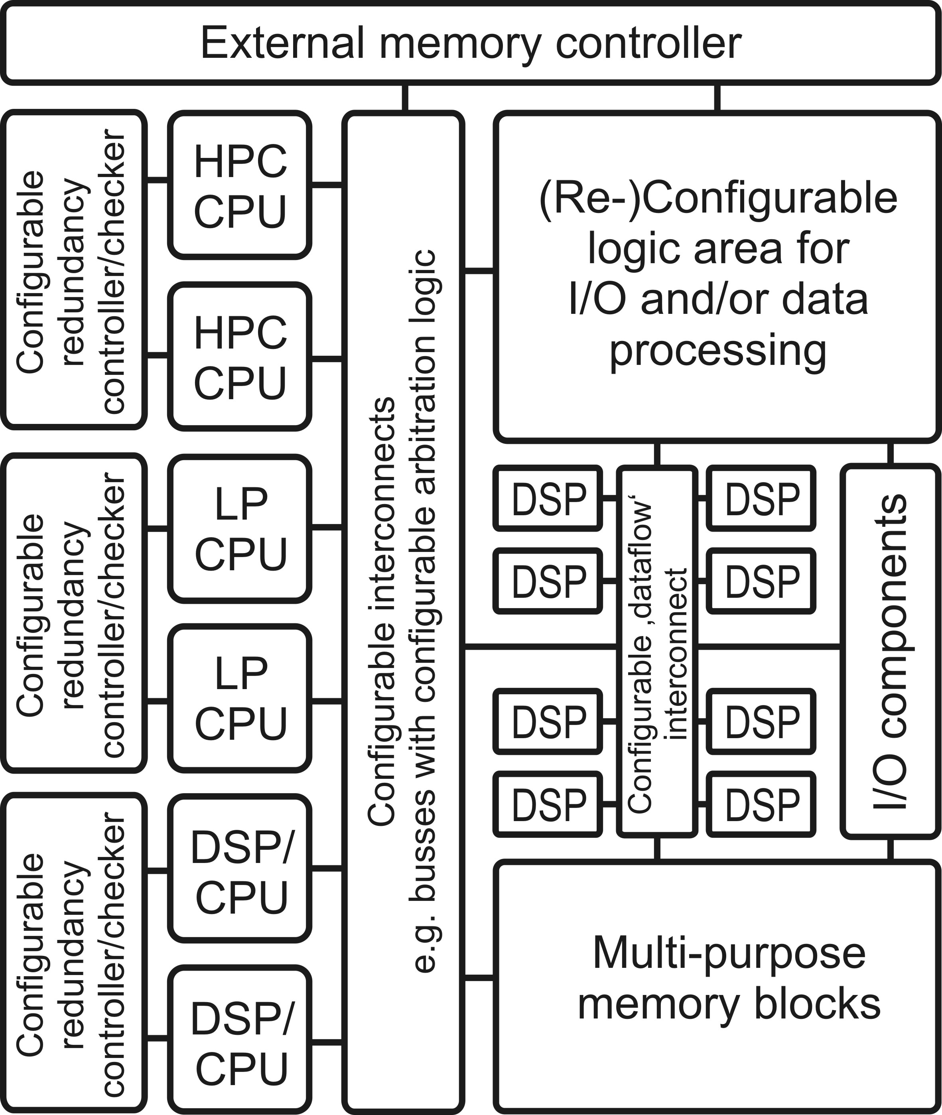
WP Technical Overview II Architectural topics
T4.4
T4.2
T4.3

Slide 6
WP Technical Overview III
T4.5 – Qualification & Verification
More general task
Verification methods, techniques and processes for multi-core mixed-criticality systems and software/hardware interfaces
Verification tools and processes for multi-core mixed-criticality systems and software/hardware interfaces
Processor qualification approach and evaluation of verification for multi-core mixed-criticality systems
Multi-core embedded software real-time debugging and verification approach

Slide 7
WP Technical Overview IV
T4.6 - Demonstrators
Virtual prototype platform
Comprehensive functionality based on T4.2, T4.3, T4.4
Targets many LL/use cases, based on simulations
SystemC-based
Fast development
Many open source components available
Physical FPGA prototype
Subset of functionality
Higher development effort
Targets selected LL/use cases
Performance not suitable for all LL/use cases

Slide 8
Planned Prototypes
EMC2 SoCRocket
Asymmetric multiprocessing on Zynq
Dependable and high accuracy time transfer for distributed control applications
Automotive domain: network technologies and connection to testbed (based on UC7.3)
Multi-processor system-on-chip architecture for cross-domain applications
Automotive time-of-flight demonstrator
Fine grain partially reconfigurable array of processors on Zynq with Linux reprogramming support
DVI-in video processing to DVI-out controlled by Ethernet port

Slide 9
TUDO Involvement
Main contribution in core design and memory hierarchy
Synchronization, coherence
Isolation (time and space)
Maybe virtualisation/interconnect of peripheral devices
…
⇒ Techniques should be implemented in the TUBS SystemC environment

Slide 10
Cooperation with WP2 (TUDO pov)
How will parallel execution expressed in MBD?
Can we provide synchronization techniques specialized for WP2 approaches?
Is our coherence approach useful for WP2 approach?
General:
Suitability of TUDO techniques for WP2 approaches
What can we improve, what needs to be provided?

Slide 11
Backups…

Slide 12
T4.2 - Processor (core) concepts and general architecture
ST1 Core-based support for
mixed-criticality applications
ST2 Multi-core local and distributed memory
hierarchy, interfaces, modules and
(memory/code) compression techniques
ST3 Fixed and reconfigurable hardware
accelerators and co-processors
ST4 Multi-core power management components
ST5 Virtualization of cores and resources for
the Virtual Hard Real-time Machine
ST6 Design and implementation of
System Control for m-c microcontrollers
T4.2

Slide 13
T4.3 - Core and chip interconnect, peripherals
ST1 On-chip interconnect for mixed
criticality systems
ST2 Inter chip- and system-interconnect
ST3 Peripheral components for mixed
criticality systems
T4.3

Slide 14
T4.4 - Increased availability and dynamic reconfiguration
ST1 AMSPS concepts and power
management components
ST2 Redundancy support for hardware
accelerators
ST3 Reconfigurable microcontroller
architecture
ST4 Increased availability by means of
embedded health monitoring
T4.4

Slide 15
T4.2, T4.3, T4.4 – Concepts concern complete chip!
T4.4
T4.2
T4.3

Slide 16
T4.5 – Qualification & Verification
More general tasks, not directly related to gEMC² architecture but more fundamental research
Verification methods, techniques and processes for multi-core mixed-criticality systems and software/hardware interfaces
Verification tools and processes for multi-core mixed-criticality systems and software/hardware interfaces
Processor qualification approach and evaluation of verification for multi-core mixed-criticality systems
Multi-core embedded software real-time debugging and verification approach

Slide 17
T4.6 - Demonstrator
Virtual prototype platform
Comprehensive functionality based on T4.2, T4.3, T4.4
Targets many LL/use cases, based on simulations
SystemC-based
Fast development
Many open source components available
Physical FPGA prototype
Subset of functionality
Higher development effort
Targets selected LL/use cases
Performance not suitable for all LL/use cases

