Slide 1
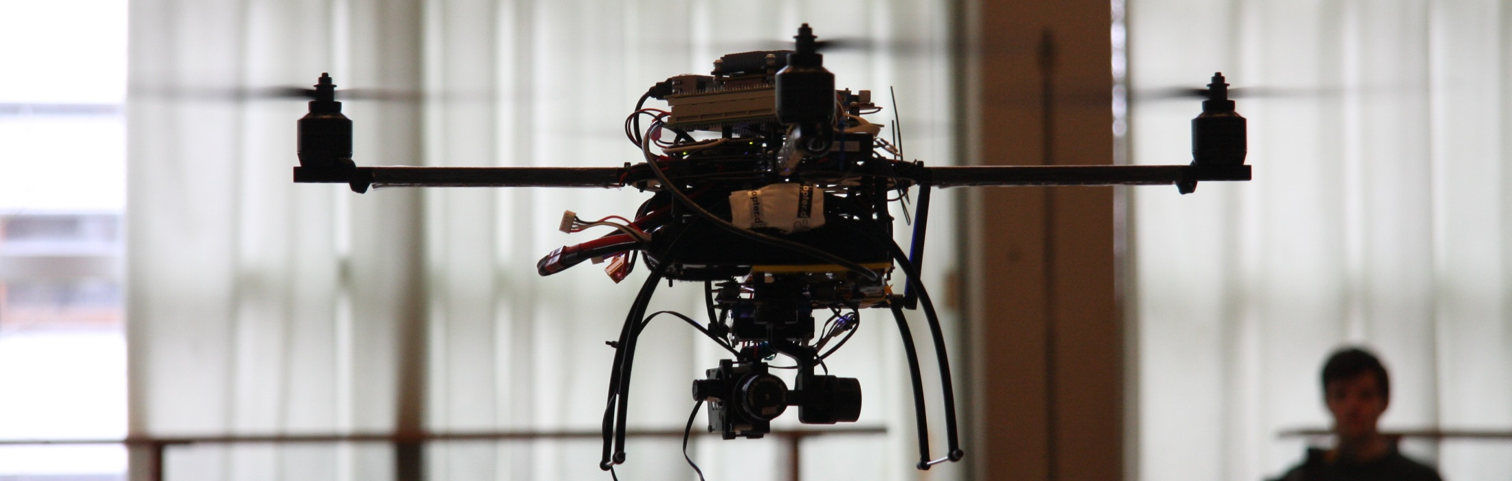
Single-Chip Safety Concept
Demonstrated on Multi-Rotor Systems

Slide 2
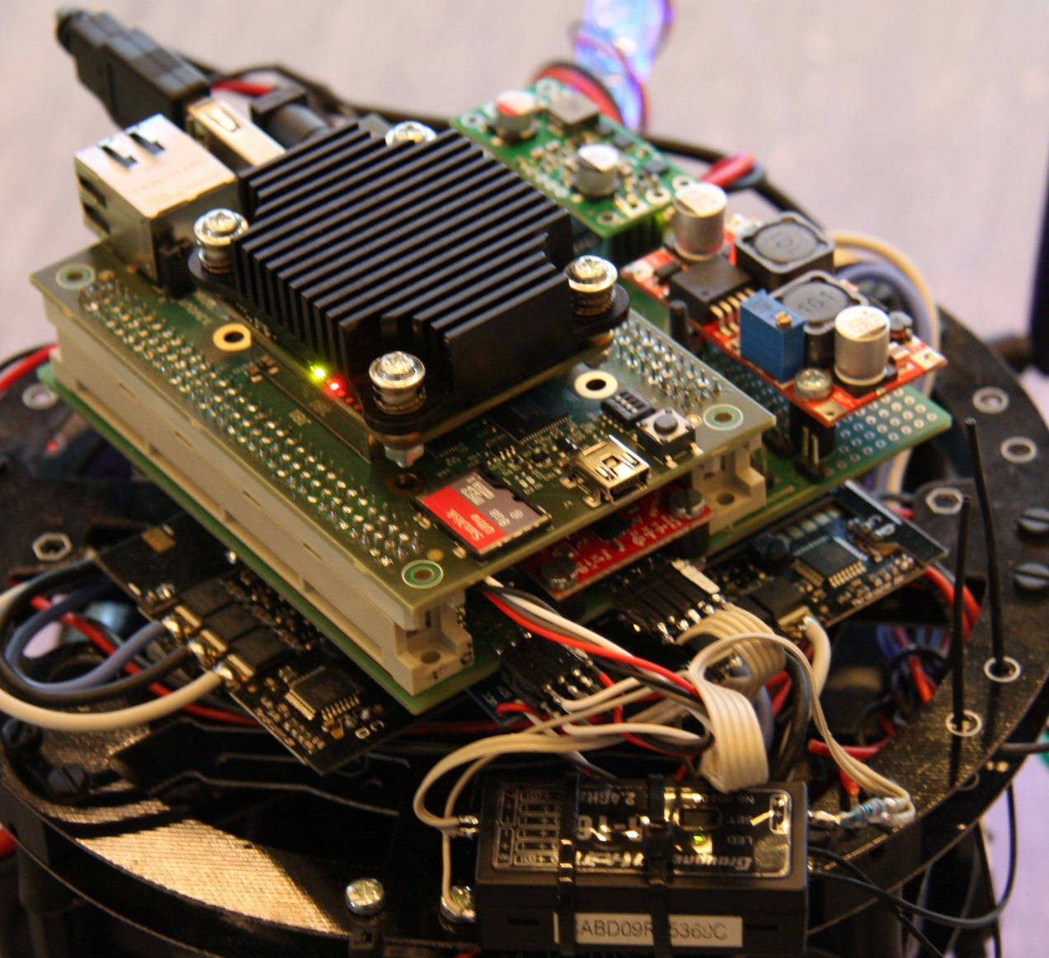
Present State
Avionics

Slide 3
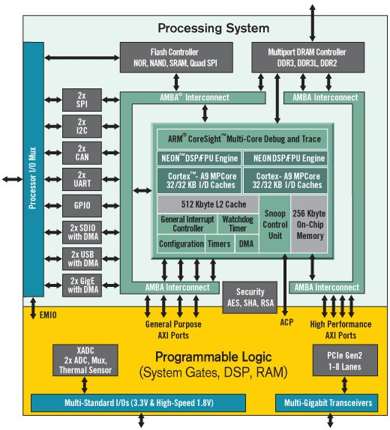
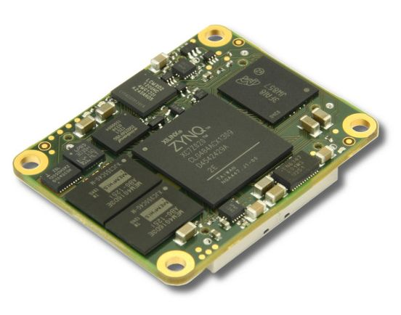
Present State
Used MPSoC – Xilinx Zynq 7020
Dual ARM Cortex-A9 Core
Programmable Logic (FPGA-Part) for own IP-cores
Interfaces
Soft-Cores
DSPs
etc.

Slide 4
Present State
HW-Architecture
Video Processing, Object Detection and Gimbal Adjusment
Mission-Critical Part
ARM9 MP Cortex
Camera
Gimbal
Wi-Fi
SD-Card
DDR-RAM
A9 Core 0
A9 Core 1
L1 Cache
L1 Cache
USB
SDIO
DDR
L2 Cache
Debug Pins
GPIO
AMBA Interconnect
Safety-Critical Part
Debug Pins
Programming Logic
GPIO
GPIO
UART IP
DPRAM 1
RC Receiver
GPIO
PPM IP
MPU9150
I2C IP
AXI Bus
DPRAM 0
AXI Bus
GPIO
BMP085
PPM decoding IP core
MicroBlaze 0
Data Mining
MicroBlaze 1
Flight Control
I2C IP
GPIO
I2C IP
Battery Guards
GPIO
SPI IP
I/D RAM
I/D RAM
GPIO
Motor Drivers
Flight Algorithms

Slide 5
Present State
Safety-Critical Part simplified
To ARM Processing System
Programming Logic
RC Receiver
DPRAM 1
MPU9150
MicroBlaze 0
Data Mining
MicroBlaze 1
Flight Control
DPRAM 0
Motor Drivers
MPL3115A2
Battery Guards
I/D RAM
PPM decoding IP core
I/D RAM
One MicroBlaze has enough performance to process both tasks

Slide 6
Future State
Safety-Critical Part simplified
MPU9150 Nr. 1
Camera
Gimbal
Wi-Fi
ARM9 MP Cortex
SD-Card
DDR-RAM
A9 Core 0
A9 Core 1
MPL3115A2 Nr. 1
AMBA Interconnect
Battery Guards
Programming Logic
SPI
Decoder
Interrupt to request
high priority for
flight algorithms
DPRAM
RC Receiver
PPM
Decoder
Watchdog
MPU9150 Nr. 2
MPL3115A2 Nr. 2
MicroBlaze System
Voter
Motor
communicator
Motor Drivers
DPRAM
MPU9150 Nr. 3
I/D RAM
MPL3115A2 Nr. 3
Leon 3 System
DPRAM
Battery Low Warning
UART to display info
on remote control
I/D RAM

