Slide 1

Study of voice bots in Software development
Sivasurya Santhanam

Slide 2
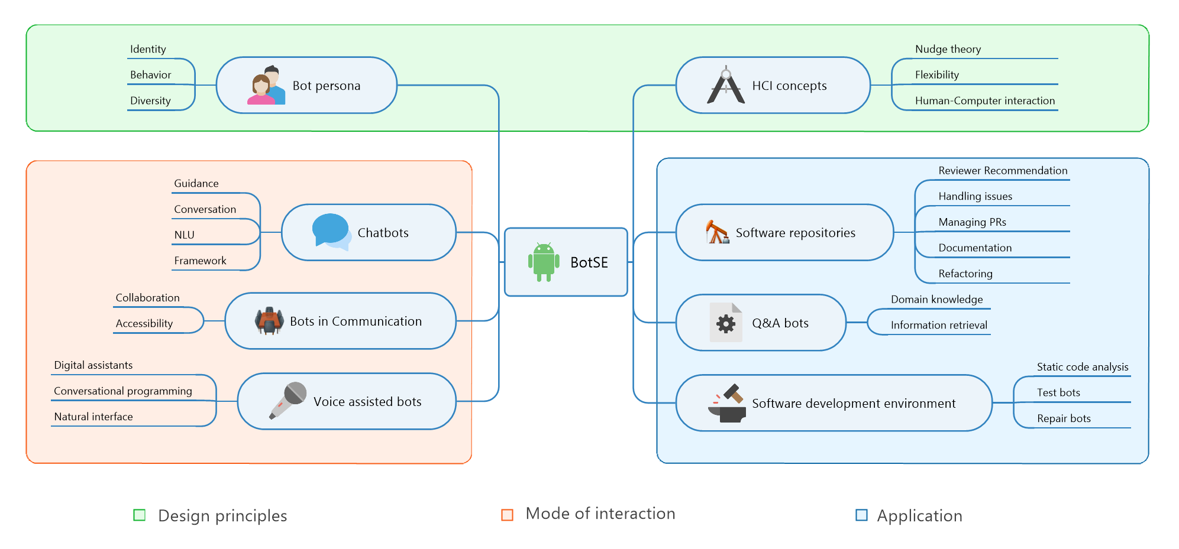
Bots in SE- A systematic mapping study

Slide 3
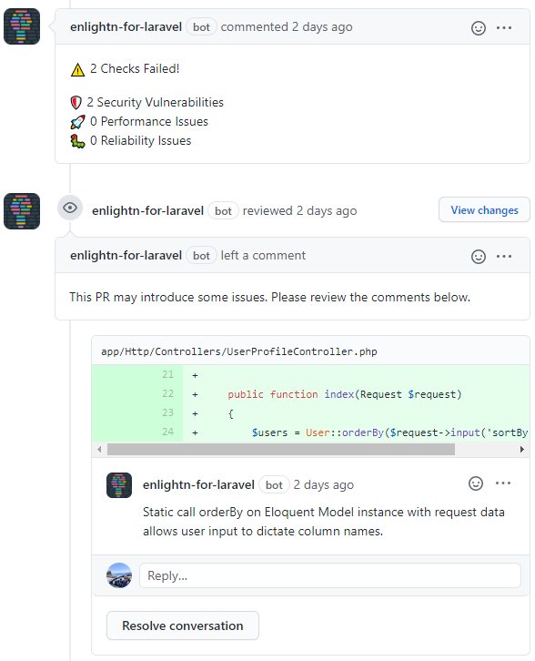
Types of bots
Chatbots
Github bots

Slide 4
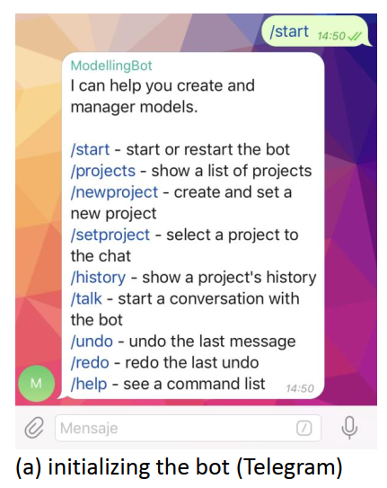
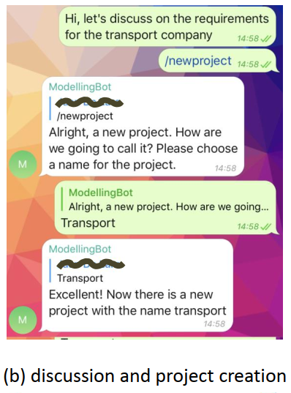
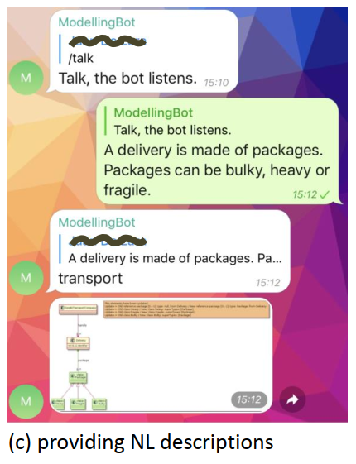
Types of bots
Modelling bot

Slide 5
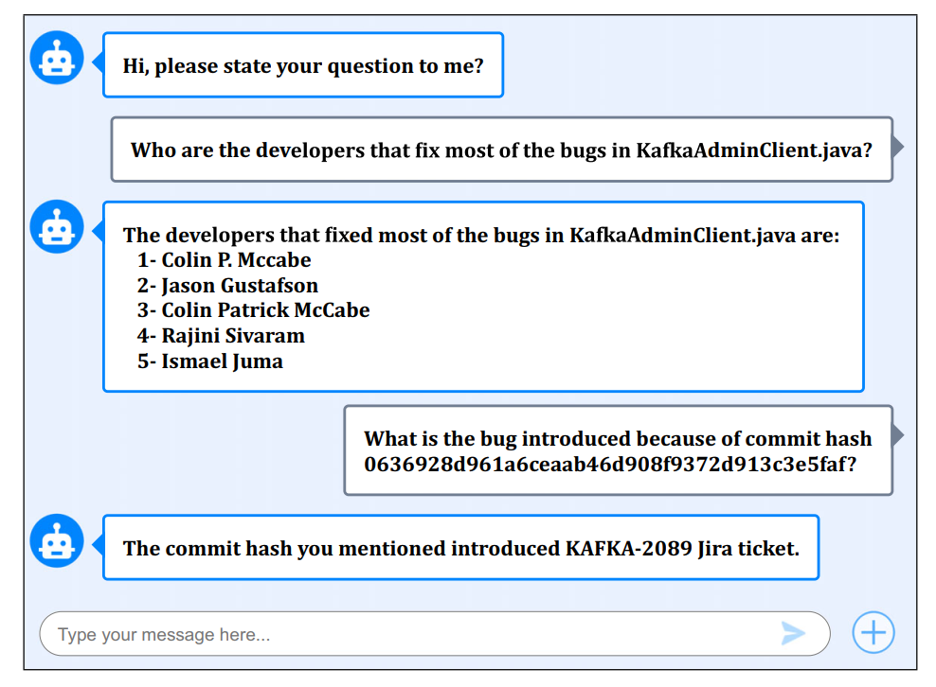
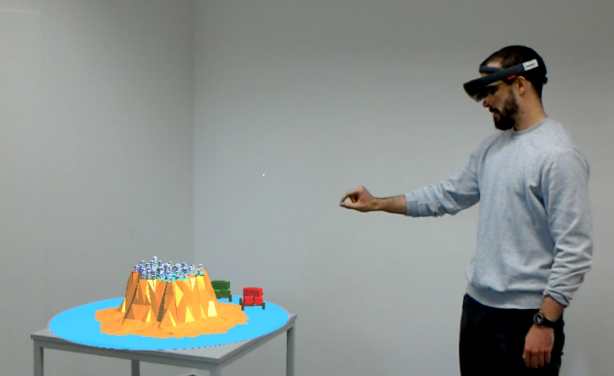
Types of bots
Q/A bots
Voice bots

Slide 6
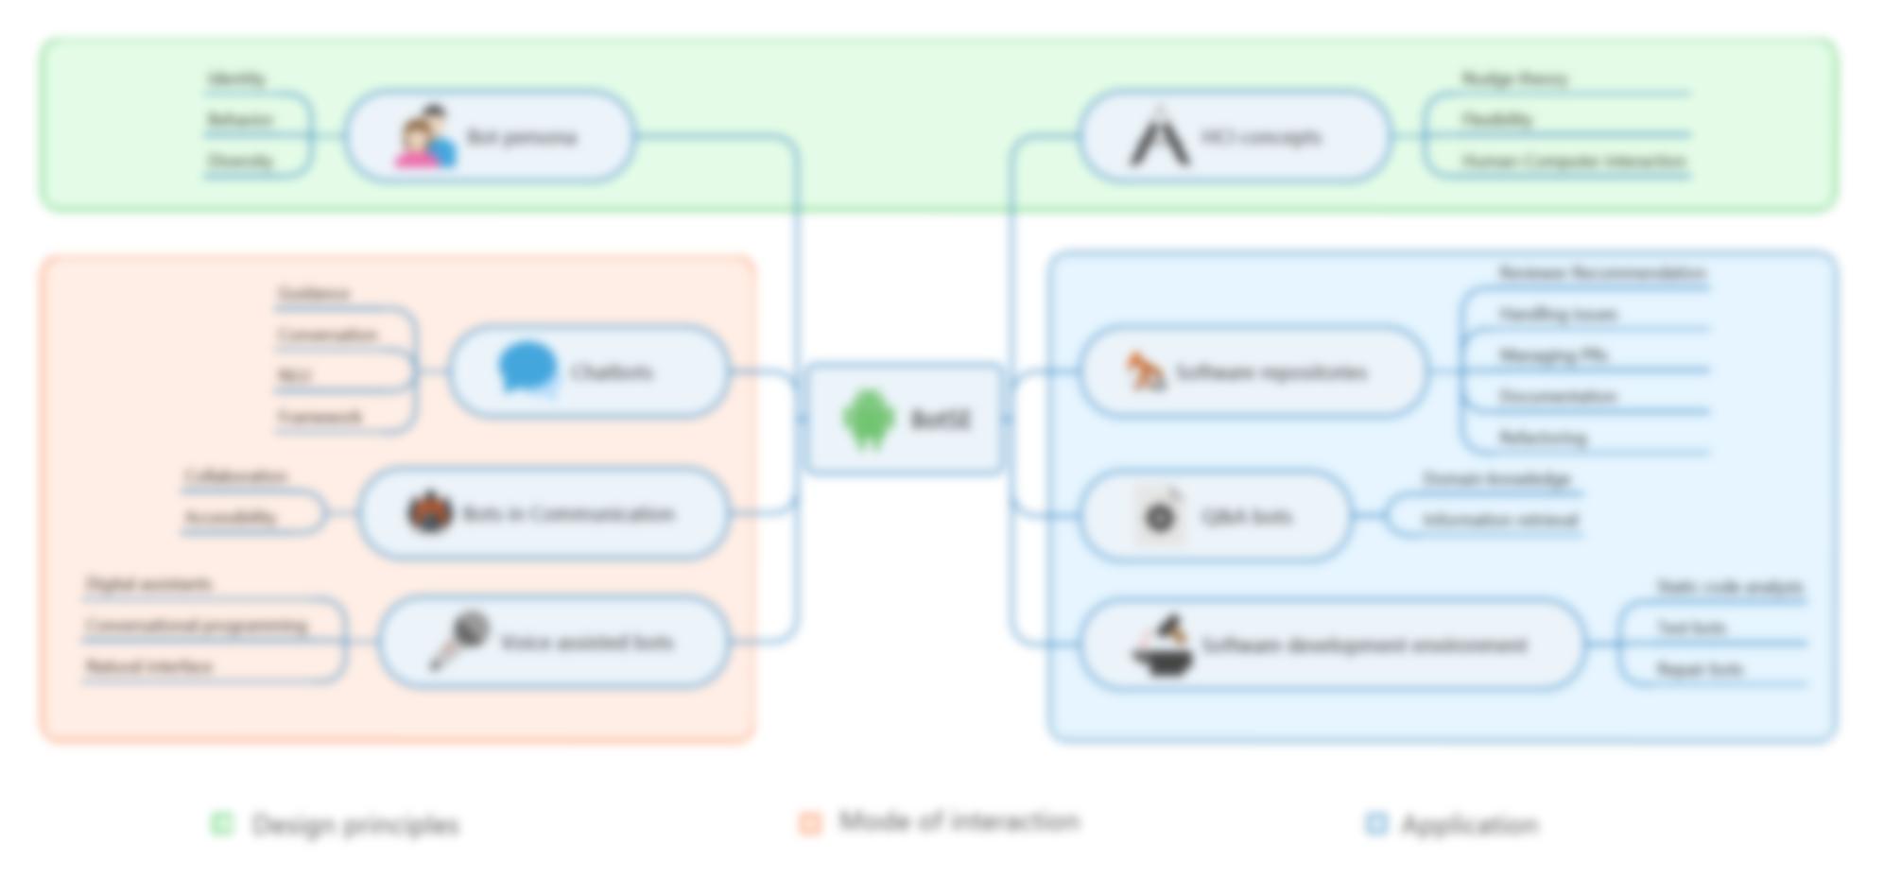
Bots in SE- A systematic mapping study

Slide 7




Voice bots
Speech command
Text transcript
Action commands
Automatic speech recognition system
Executable actions
Natural language understanding module

Slide 8
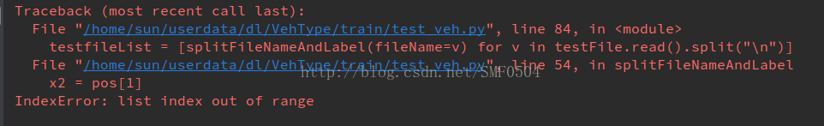

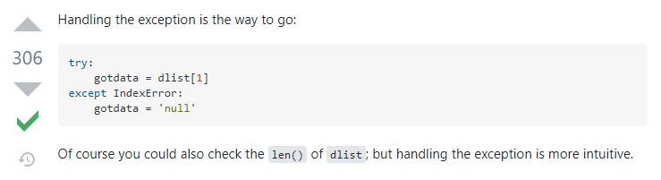
Voice-bot in Software development
hello. how may I help you?
Hi. How to resolve this issue?
Sure. Here’s something that might solve this issue.

Slide 9
Thank you!

