Slide 1

Study of voice bots in Software development
Sivasurya Santhanam

Slide 2
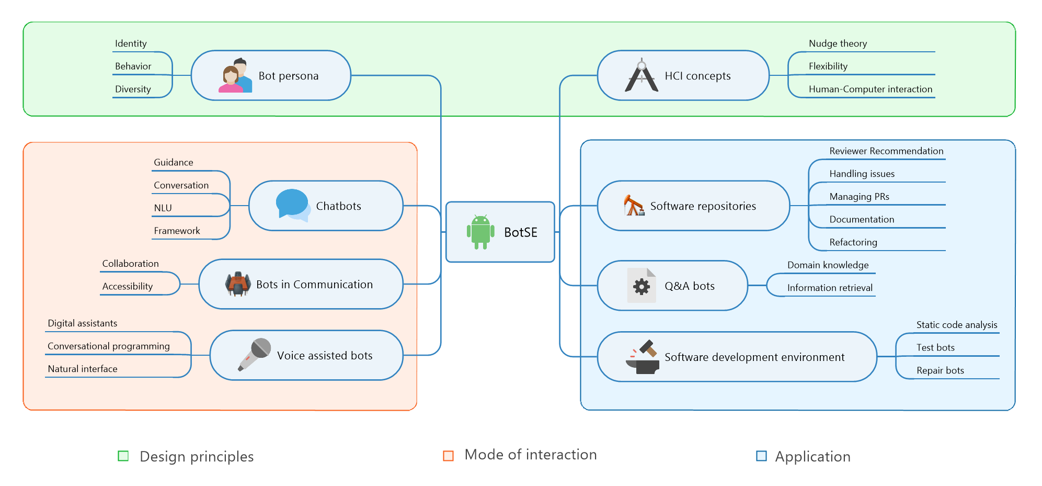
Bots in SE- A systematic mapping study

Slide 3
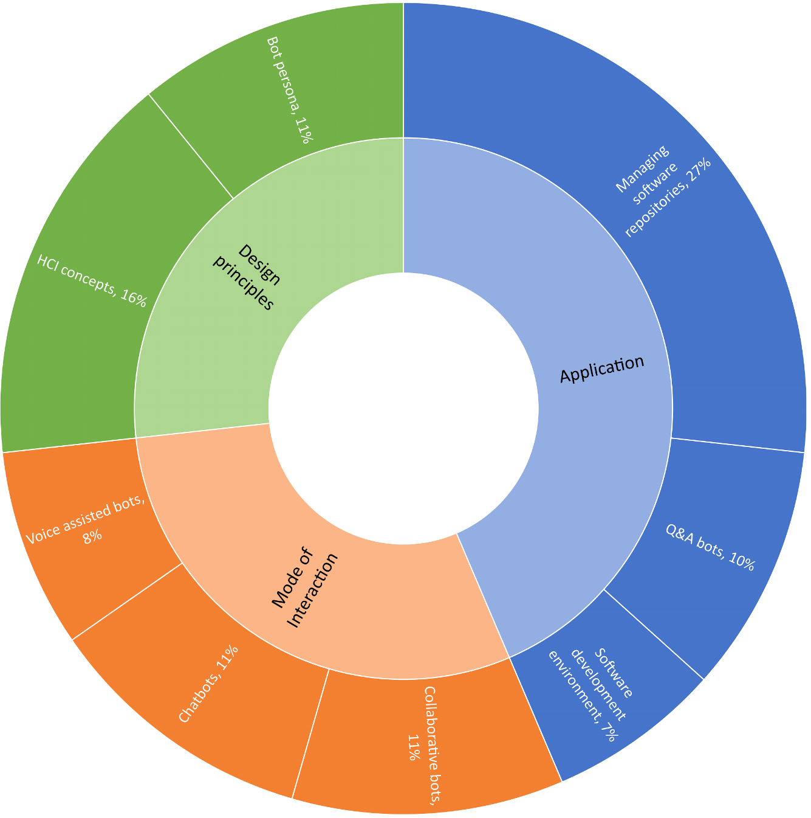
Bots in SE- A systematic mapping study

Slide 4
Interview structure (planned)
15 participants (software developers) with atleast 2yrs exp. In software development.
Background info: (Role, Company, Programming languages, Tools used, Years of experience)
Type: Online video call
Estimated time duration: 1 hour
RQ1. Does multitasking puts cognitive load on developers, affecting their productivity
RQ2. Do software developers believe voice bots reduce such cognitive load

Slide 5
Interview Questions?
Opinions and expectations
1. What do you think about an AI assistant that assist you in workplace to improve productivity?
2. On what type of tasks would you use this bot for?
3. What would you expect from the bot, functional scope and level of autonomy?
4. Would you expect the bot to understand a command entirely in natural language or are you willing to learn keyword targeted commands?

Slide 6
Interview Questions?
Implementation
5. How should the bot be deployed? IDE plugin, Background process, Standalone application, Webservice
6. Would you rather chat(text) with the assistant to execute your actions or do you like to speak(voice) to this assistant?
7. Why would you prefer the choice? What are the hurdles you might imagine for voice assisted bots?

Slide 7
Interview Questions?
Ethical viewpoint
8. Would you trust this assistant. Why?. What are the measures that needs to be taken to gain the trust in the community?
9. Would you be comfortable to share your data to train the model given that the data will not be shared with anyone?. This would help the bot to learn from multiple users and provides better performance.

Slide 8
Thank you!

